Slide 1




GEMOC Studio Tutorial
ICSA Conference, April, 2017
Barais, Combemale, Vojtisek, Wortmann
Inria & Univ. Rennes 1
http://diverse.irisa.fr/

Slide 2
Overview
Practical approach for developing and integrating DSLs
Support abstraction and separation of concerns
Leverage tooling provided by the GEMOC studio
Extend a DSL: syntax and semantics, graphical animation
Lectures and hands-on sessions using FSM and XMontiArc
Combine both DSLs
Materials are available from https://github.com/gemoc/ICSA2017Tutorial

Slide 3
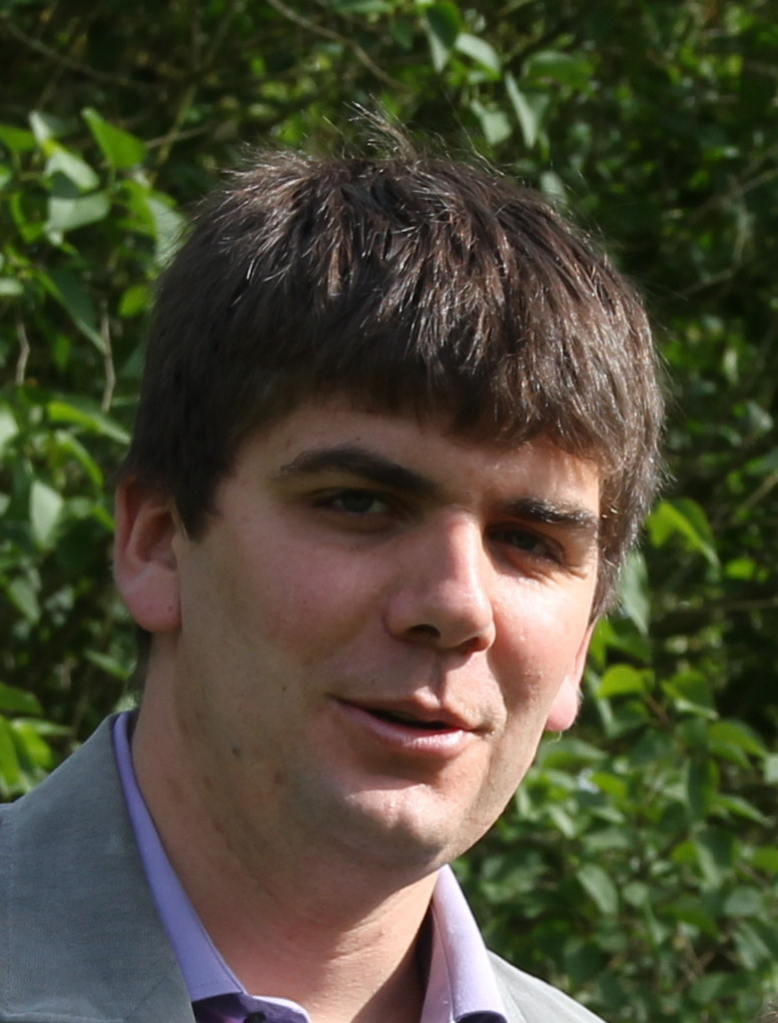



People
Olivier Barais Inria & Univ. Rennes 1 | Benoit Combemale Inria & Univ. Rennes 1 | Didier Vojtisek Inria | Andreas Wortmann Inria & Univ. Rennes 1 RWTH Aachen

Slide 4
Preparation
Please download
GEMOC Studio http://gemoc.org/download.html
Java 8 JDK https://goo.gl/lX8FxD

Slide 5
Program
14:00 - 14:15 Welcome session: Scope and aim of the tutorial
14:15 - 14:45 Presentations: GEMOC Initiative, GEMOC Studio, and MontiArc
14:30 - 15:30 Hands on part I: Steps 2.1 - 2.4
15:30 - 16:00 Coffee Break
16:00 - 17:00 Hands on part II: Steps 2.5 - 2.6
17:00 - 17:30 Conclusion: Discussion and wrap up

Slide 6
Thank you
The end

