Slide 1




MontiArc Overview
Andreas Wortmann (Inria & Univ. Rennes 1)
http://www.andreaswortmann.de
andreas.wortmann@irisa.fr
@andwor

Slide 2
MontiArc¹ Executive Summary
Extensible component & connector ADL
Based on Focus semantics for distributed systems²
semantics domain are stream-processing functions
Minimal design featuring
component types and instance, component inheritance
atomic and hierarchically composed components
component interfaces of typed, directed ports
1st version: textual with MontiCore³ language workbench
Haber, A. (2016). MontiArc - Architectural Modeling and Simulation of Interactive Distributed Systems
Ringert, J. O., & Rumpe, B. (2011). A Little Synopsis on Streams, Stream Processing Functions, and State-Based Stream Processing.
Krahn, H., Rumpe, B., Völkel, S. (2008). MontiCore: Modular Development of Textual Domain Specific Languages

Slide 3
MontiArc Extensions
Δ-MontiArc¹ is a DSL for expressing deltas on MontiArc component definitions, for bottom-up product lining.
MontiArcHV² allows specifying component variability fully integrated within the component hierarchy located at variation points in component definitions.
clArc³ is a variant for modeling self-replicating cloud services.
MontiArcAutomaton⁴ extends MontiArc with behavior language embedding and robotics-related modeling elements.
Haber, A., Rendel, H., Rumpe, B., Schaefer, I. (2012). Evolving Delta-oriented Software Product Line Architectures.
Haber, A., Rendel, H., Rumpe, B., Schaefer, I., van der Linden, F. (2012). Hierarchical Variability Modeling for Software Architectures.
Navarro Perez, A., Rumpe, B. (2013). Modeling Cloud Architectures as Interactive Systems.
Wortmann, A. (2016). An Extensible Component & Connector Architecture Description Infrastructure for Multi-Platform Modeling.

Slide 4
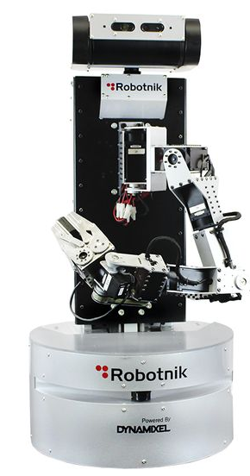
MontiArc Example
CD
Garbages
Pose
ArmPose
composed
component
generic data type parameter
CD data types
subcomponent injection
CleaningRobot
MA
Garbage Detector
Garbages
ActionController<T>
ctrl
Pose
Navigation nav
Arm(Planner p)
Planner p
ArmPose
ArmCtrl
Container Checker
Int
Gripper
gr
s
T
cs
Bool
unidirectional connector between ports s and cs of generic type T
atomic component with embedded port automaton model
subcomponent gr of type Gripper

Slide 5
XMontiArc¹
MontiArc variant for operational execution
Built on top of GEMOC Studio
Ecore metamodel
OCL static semantics
Xtend/K3 execution semantics
Sirius graphical representation
Uses fixed data types (boolean, number, string)
Does not support parametrization, generics, or injection (yet)
Includes FSM language for behavior modeling
https://github.com/awortmann/xmontiarc

Slide 6
XMontiArc Example
composed
component
CleaningRobot
XMA
Garbage Detector
Number
ActionController ctrl
Number
Navigation nav
Number
Number
Arm
Planner p
Number
ArmCtrl
Number
Container Checker
Number
Gripper
gr
Boolean
Boolean
s
cs
unidirectional connector between ports s and cs of generic type Boolean
atomic component with
embedded FSM model
subcomponent gr of type Gripper

Slide 7
XMontiArc Final Project Structure
static metamodels
≪ecore≫
MontiArc Model
≪ecore≫
FSM Model
≪K3≫
XMontiArc K3DSA
executable DSML through weaving
≪K3≫
XSFSM K3DSA
≪melange≫
XMontiArc XDSML
≪melange≫
XSFSM XDSML
aspects defining dynamic semantics
≪melange≫
XMontiArcWithAutomaton XDSML
XMontiArc XMontiArc
XSFSM XSFSM
generated language implementation
XMontiArcWithAutomaton XMontiArc
XMontiArcWithAutomaton XMontiArcWithAutomaton
XMontiArcWithAutomaton XSFSM

Slide 8
Thank you
The end

