Slide 1




GEMOC Studio Tutorial
ICSA Conference, April, 2017
Barais, Combemale, Vojtisek, Wortmann
Inria & Univ. Rennes 1
http://diverse.irisa.fr/

Slide 2
Overview
Practical approach for developing and integrating DSLs
Support abstraction and separation of concerns
Leverage tooling provided by the GEMOC studio
Extend a DSL: syntax and semantics, graphical animation
Lectures and hands-on sessions using FSM and XMontiArc
Combine both DSLs
Materials are available from https://github.com/gemoc/ICSA2017Tutorial

Slide 3
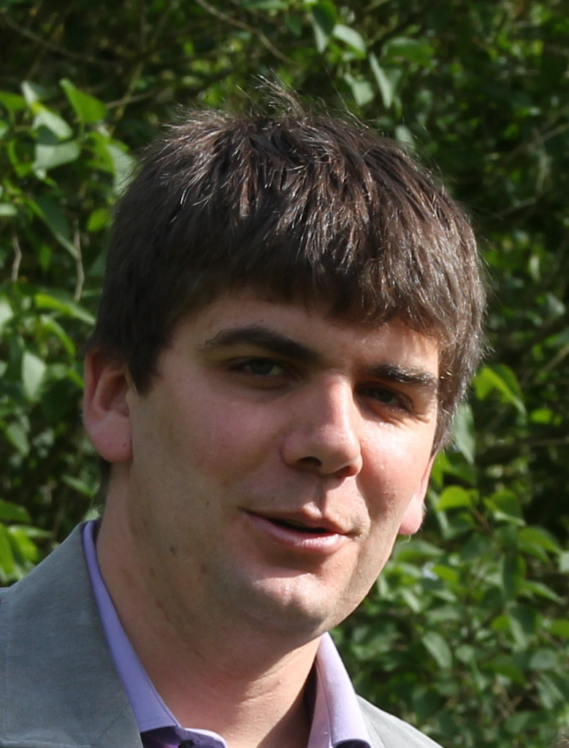



People
Olivier Barais Inria & Univ. Rennes 1 | Benoit Combemale Inria & Univ. Rennes 1 | Didier Vojtisek Inria | Andreas Wortmann Inria & Univ. Rennes 1 RWTH Aachen

Slide 4
Preparation
Please download
GEMOC Studio http://gemoc.org/download.html
Java 8 JDK https://goo.gl/lX8FxD

Slide 5
Program
14:00 Presentation: Opening
14:15 Presentation: GEMOC Initiative and Studio
14:45 Presentation: Model Execution
15:00 Hands-On: Setup and Model Execution
15:10 Presentation: Metamodeling
15:30 Coffee Break
16:00 Presentation: Concrete Syntax
16:15 Hands-On: Create Graphical Representation and Actions
16:35 Presentation: MontiArc and Language Composition
16:50 Hands-On: Composing FSM and MontiArc
17:15 Summary, Discussion

Slide 6
Thank you
The end

