Slide 1
Case: Data Scientist
Company: Twigeo
Presenter: Faezeh Pousaneh

Slide 2
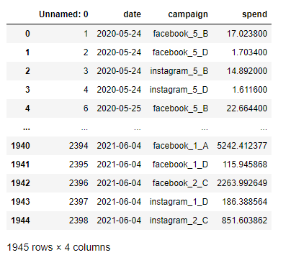
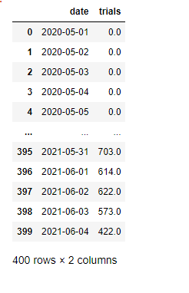
Description of the case:
A client wants to know how to invest money to get the best result on their app trial traffics: The main factors which have impact on the number of trials?
Which campaigns give more trials while being cost efficient?
What we are given:
Table1: Spend
Table2: Trials

Slide 3
Data exploration by history:
Total money the client has spent in whole peiod of time is: 1,635,002 $.
The total number of tials they got is: 598437.
From plot 1, it seems that the client has increased the spending over last couple of months, however, the number of trials remained almost constant. It means their recent strategy of allocating money was not good.
The client mostly invested on facebook_1_A in whole period. However, they had the higher trial on facebook_2_C.
The most occurred trials are about 0-200 (plot2).
The most occurred amount of spent money on campaigns are around 0-500 (plot3).
Plot 4 indicates that for high spending money the number of trials tend to increase, which is natural.

Slide 4
What information the data provide?
Data history is from 2020-05-01 to 2021-06-04, about 13 months.
For the first few days we do not have spending informations, so we must inner-join
data.
Client invests every day on few champains. The invested money is given for individual
champaign per day, however, only the ‘total’ number of trials are given per day.
There are 3 networks:
Instagram
Facebook
Apple
There are 5 targeting types:
1
2
3
4
5

Slide 5
There are 4 different audiences.
A
B
C
D
The number of champaigns per day is not fixed.
In total, there are 14 champaigns.

Slide 6
First intuition about different networks, types and audience:
Plot5: Between target_types, it seems target_type 1 and 5 spend less money for high trials. So they are more efficient:
Type 1
Type 5
Plot6: Between target_audiance groups D and A show less spending money for high trials. So, they are more efficient:
D
A
Between networks, we do not see clear indication of which network is more cost-efficient, because we see that all 3 networks are present in the small spending regions. However, probably Instagram is better.

Slide 7
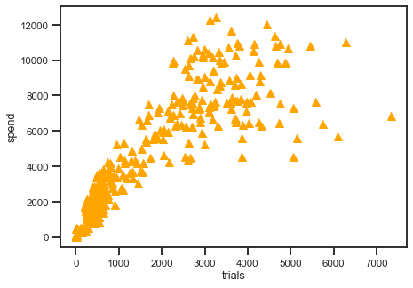
First intuition about the 14 different campaigns:
There are 14 campaings.
From plot 8, 9, 10, 11, it can be seen that colors related to
Instagram_1_D
Facebook_1_D
Facebook_5_A
are have higher trials respectively, while spending less money, therefore, more efficient compared to others.
The following plot indicates that spending more money does not necessarily means having more trials.
most-efficient

Slide 8
First intuition on best week-days to invest
Mondays Tuesdays Wedsday Thursdays Fridays Saturdays Sundays
Mondays Tuesdays Wedsday Thursdays Fridays Saturdays Sundays
?
From plot 13, it seems that people downloaded the trials more often on Mondays and Sundays. Mondays is because they are back after weekend on work and feel less to work so they go to internet and spend some time on surfing. Sundays is also natural because they are back from Saturday family time and spend time at home not working.
Moreover, from plot 13 it seems the client has spent almost the same on all days, which was not a good strategy.
So, it is better the client spends on these days:
1. Mondays, Sundays, Tuesdays
In addition, we find out the less downloaded day is Fridays, that is also natural, because they spend time with friends, out, drinking.

Slide 9
Finding best campaign by calculation:
In this part, we put all 14 campaigns into columns and want to find the efficient one (more trials with less money). So, we assign fix 100 $ to each and find their trials. From obtained data, we find that
Instagram_1_D
Facebook_1_D
Facebook_5_A
Apple_5_A
are the most efficient, respectively. That is exactly same answer we had from data analysis.
Finding best week-days by calculation:
Similarly, we assign fix 100 $ to each day and find their trials. We find that
Mondays
Sundays
are the most efficient, respectively. That is exactly same answer we had from data analysis.
As we concluded from data analysis, here also we obtain that Fridays are worse day to invest.

Slide 10
Conclution
So, finally we conclude that the client should spend the 42000$ :
Instagram target 1 and audience D on Mondays and Sundays.
Some advices:
Get more features on data if possible, age, sex, income, living area, studetnss non-students, person’s number of connections, their intrest in similar app or activity related to clients app, most used hours during day, etc.
Try to invest not only on the first outcome, instagram_1_D, but better on first two. Since there is not much difference between their trials. This make our investement more safe. If anything unexpected happens to the first netwrok.
Check in advance for any events (e.g. football maches) or weather condition (e.g. sunny) which might make people away from net. Avoid those days to invest.
If the conclution is for instance to invest on group ‘students’, avoid to invest on exam periods.
Avoid to invest on holidays priods if possible.

