Slide 1
Analysis of Uber / Lyft prices
Final project

Slide 2
Context
Uber and Lyft's ride prices are not constant
Time
Service Type
Weather
Collected real-time data using Uber & Lyft api queries

Slide 3
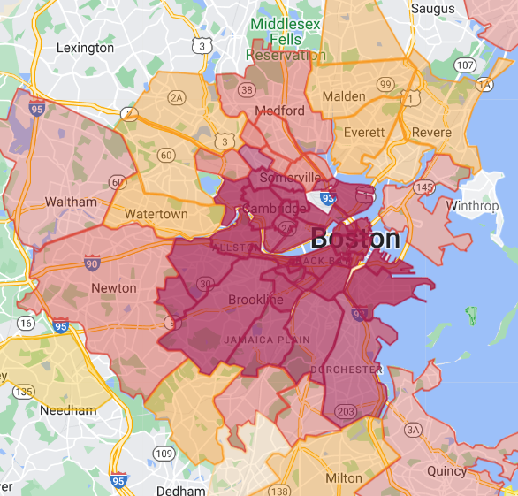
Where / When
Nov 2018

Slide 4
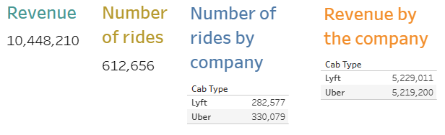
Overview
Over 600,000 rides in a week

Slide 5
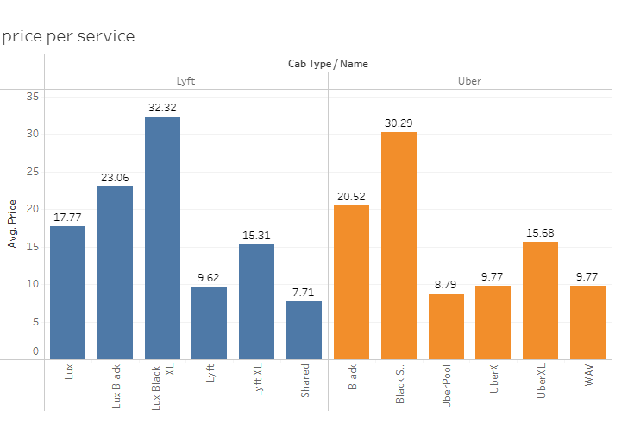
Which One Is Cheaper?

Slide 6
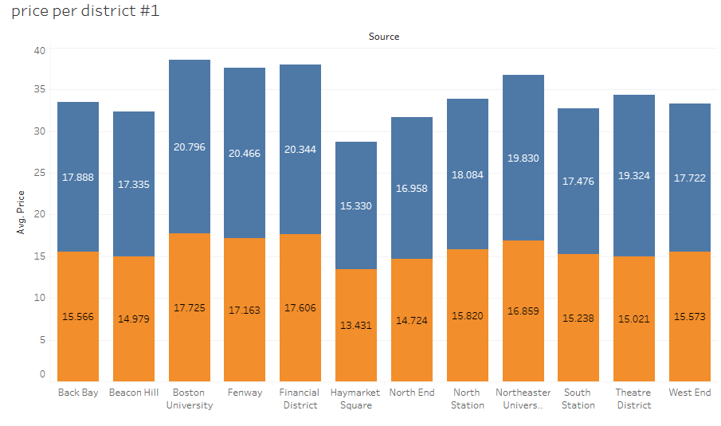
Neighborhood Traffic
If I would be a cab driver, I could earn more rides if

Slide 7
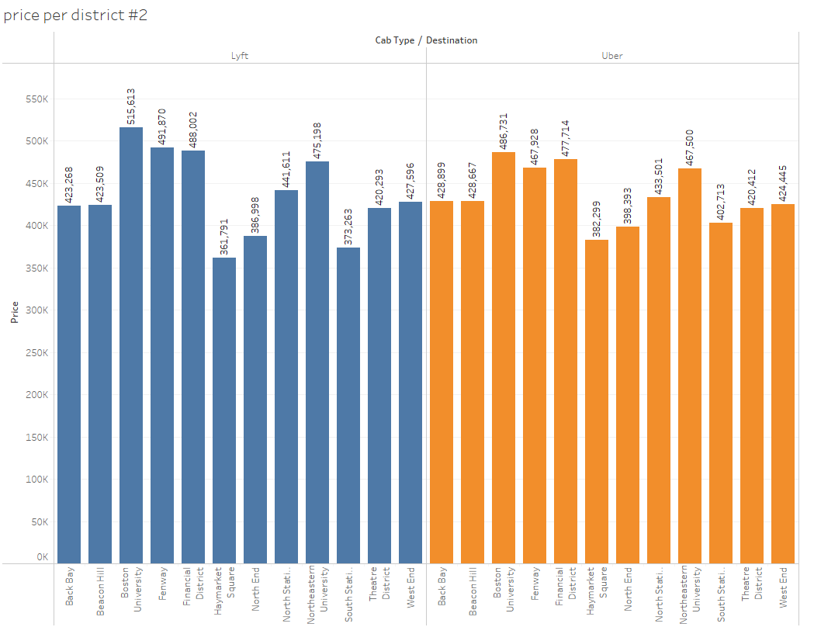
Destination Traffic
Approving rides to which location will make more profit?

Slide 8
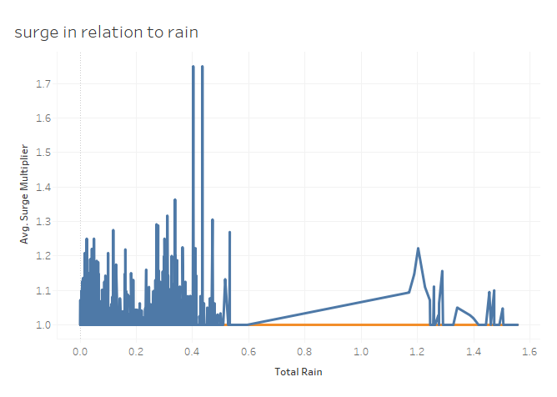
Rain in surge

Slide 9
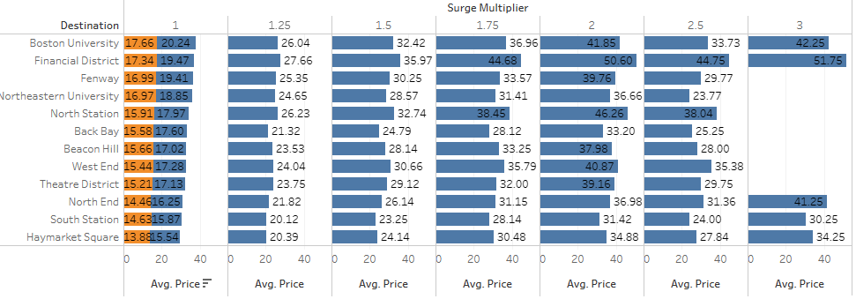
Surge in Source
Which neighborhood are more likely to have surge multiplier?
Uber’s surge is always 1 🤔

Slide 10
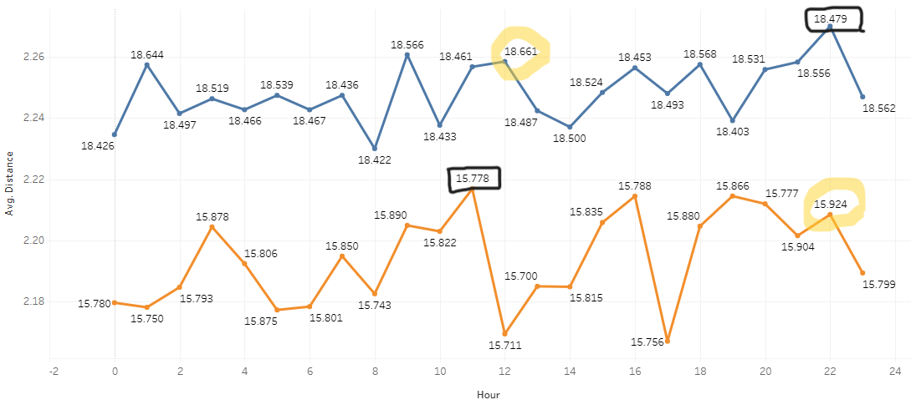
How Far
How far residents of neighborhood would like to travel?

Slide 11
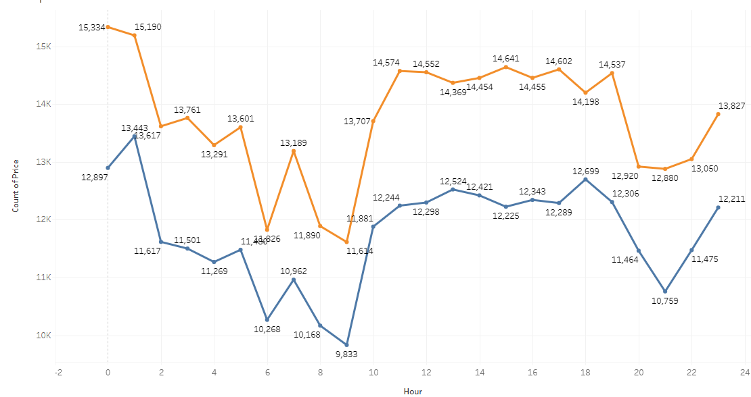
How Many
When can drivers rest?

Slide 12
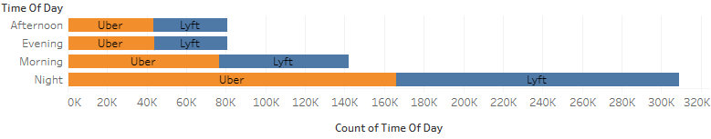
How Many
Shall I choose cab driver as my second job?

Slide 13
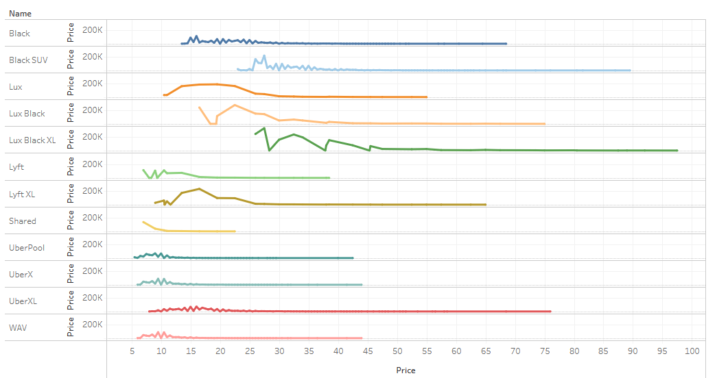
Price Distribution
As a passenger which service is cheaper?

Slide 14
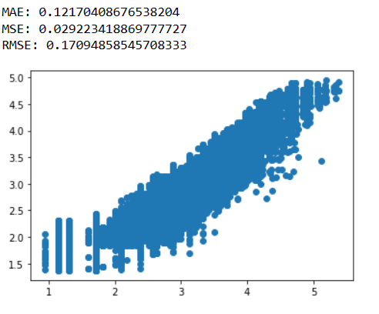
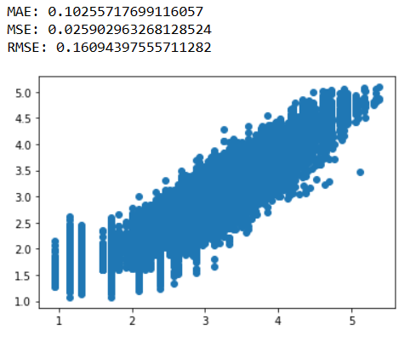
Prediction Models
Linear regression
Random Forest Regressor
Score: 94%
Score: 95%

Slide 15
Thanks for your attentions!
Any Qusetion?

