Slide 1


IDENTITY & PRODUCT GUIDELINES
Mengalirkan kembali nilai elektronik.
A warm operating system for electronics collection,
traceable handoffs, and recovery.
VERSION 1.0 / OCTOBER 2026
Notes:
Original Jejak Balik vector identity and GPT Image Kendali character. Supporting line is approved product copy.

Slide 2


Purpose & audience
Make each return understandable, from a household request to a recorded outcome.
→
→
Households
Coordination
Recovery
Arrange a pickup and see
what happens next.
Review requests, capacity,
routes, and exceptions.
Record custody, inspection,
and the recovery pathway.
A useful next step is always visible. Operator decisions remain explicit.
JEJAK BALIK / BRAND & PRODUCT SYSTEM
02
Notes:
Source: approved Jejak Balik prompt pack and original assets authored for this project. App screenshots are captures of the delivered frontend. Generated mascots are illustrations.

Slide 3
Brand character
Warmth supports the work. Clarity earns trust.
Warm
“Penjemputan terjadwal, tanpa biaya.”
Capable
“Tinjau penanganan baterai.”
Clear
“Permintaan siap ditinjau.”
Circular
“Kehidupan kedua dimulai di sini.”
JEJAK BALIK / BRAND & PRODUCT SYSTEM
03
Notes:
Source: approved Jejak Balik prompt pack and original assets authored for this project. App screenshots are captures of the delivered frontend. Generated mascots are illustrations.

Slide 4

The return-path mark
An open loop with a visible point of origin.
Return
The left-facing turn signals a journey back
into use, rather than a one-way disposal.
Trace
The separate clay node identifies a starting
point. A continuous line carries it forward.
Rounded geometry connects the identity to the miniature world.
JEJAK BALIK / BRAND & PRODUCT SYSTEM
04
Notes:
Source: approved Jejak Balik prompt pack and original assets authored for this project. App screenshots are captures of the delivered frontend. Generated mascots are illustrations.

Slide 5

Lockups & approved variants
Choose the lockup that preserves the wordmark’s legibility.
Primary horizontal
Stacked
Reverse on forest
JEJAK BALIK / BRAND & PRODUCT SYSTEM
05
Notes:
Source: approved Jejak Balik prompt pack and original assets authored for this project. App screenshots are captures of the delivered frontend. Generated mascots are illustrations.

Slide 6
Clear space & minimum size
Keep one stroke width of breathing room around the mark.
8u
Horizontal lockup: 128 CSS px minimum
20 px minimum
64u mark · 8u clear space
Use the supplied favicon for 16 px contexts.
JEJAK BALIK / BRAND & PRODUCT SYSTEM
06
Notes:
Source: approved Jejak Balik prompt pack and original assets authored for this project. App screenshots are captures of the delivered frontend. Generated mascots are illustrations.

Slide 7
Palette
Warm surfaces, forest actions, and restrained semantic color.
Canvas
Surface
Forest
Clay
Text
Border
#F6F3EB
#FFFEFA
#2D6753
#A95135
#25352D
#DDDCD2
White text on forest actions
Dark status text on pale backgrounds
JEJAK BALIK / BRAND & PRODUCT SYSTEM
07
Notes:
Source: approved Jejak Balik prompt pack and original assets authored for this project. App screenshots are captures of the delivered frontend. Generated mascots are illustrations.

Slide 8
Typography
Plus Jakarta Sans — one family for a coherent product.
Aa
Heading / 700
Every item has a next step.
Body / 400
0123456789
A pickup becomes useful when the request, route,
and handoff stay connected.
Tabular numerals
for comparable metrics
UI scale: 12–13 labels · 14–16 body · 18–22 compact headings · 28–36 page titles
JEJAK BALIK / BRAND & PRODUCT SYSTEM
08
Notes:
Source: approved Jejak Balik prompt pack and original assets authored for this project. App screenshots are captures of the delivered frontend. Generated mascots are illustrations.

Slide 9
Layout & spacing
A 4 px rhythm keeps dense information calm.
4
8
12
16
24
32
48
64
Desktop
Mobile
40 px controls
12–16 px card radii
Clear left-to-right hierarchy
44 px touch targets
Full-width sheets and actions
One primary task per view
JEJAK BALIK / BRAND & PRODUCT SYSTEM
09
Notes:
Source: approved Jejak Balik prompt pack and original assets authored for this project. App screenshots are captures of the delivered frontend. Generated mascots are illustrations.

Slide 10
Components
Shared behavior matters as much as shared appearance.
Review request
View details
Collected
Needs review
Button
Inspector
One clear primary action.
Visible keyboard focus.
Identity, status, related data,
next action, and a clear close path.
Tables align values; dialogs state consequences; empty states offer a next step.
JEJAK BALIK / BRAND & PRODUCT SYSTEM
10
Notes:
Source: approved Jejak Balik prompt pack and original assets authored for this project. App screenshots are captures of the delivered frontend. Generated mascots are illustrations.

Slide 11



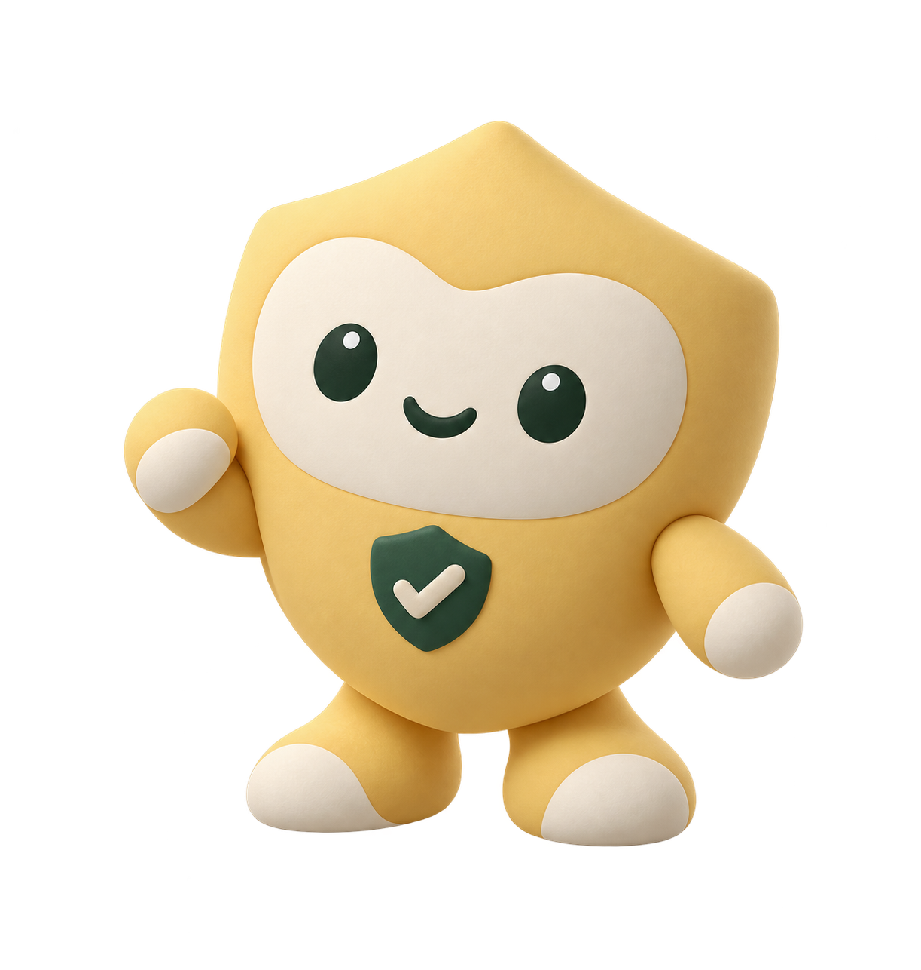
The operating team
Seven original characters, each with a distinct responsibility.
Scout
Rute
Mitra
Pilah
Dampak
Jaga
Kendali
Pickup
intelligence
Route
planning
Partner
coordination
Device
triage
Outcome
reporting
Safety &
exceptions
Operations
coordination
Artwork establishes identity; the interface communicates live task state.
JEJAK BALIK / BRAND & PRODUCT SYSTEM
11
Notes:
Source: approved Jejak Balik prompt pack and original assets authored for this project. App screenshots are captures of the delivered frontend. Generated mascots are illustrations.

Slide 12
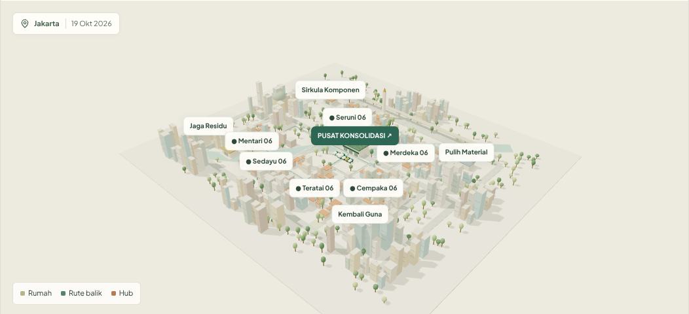
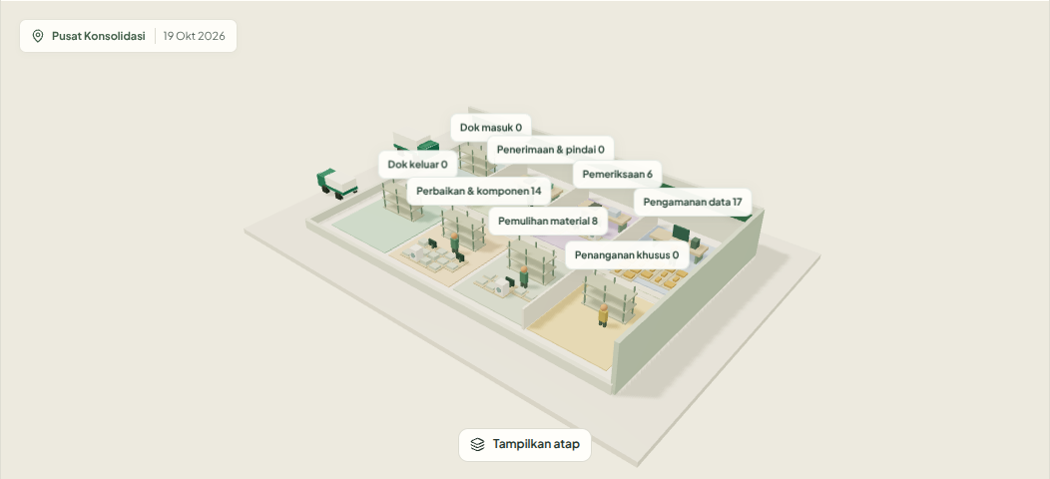
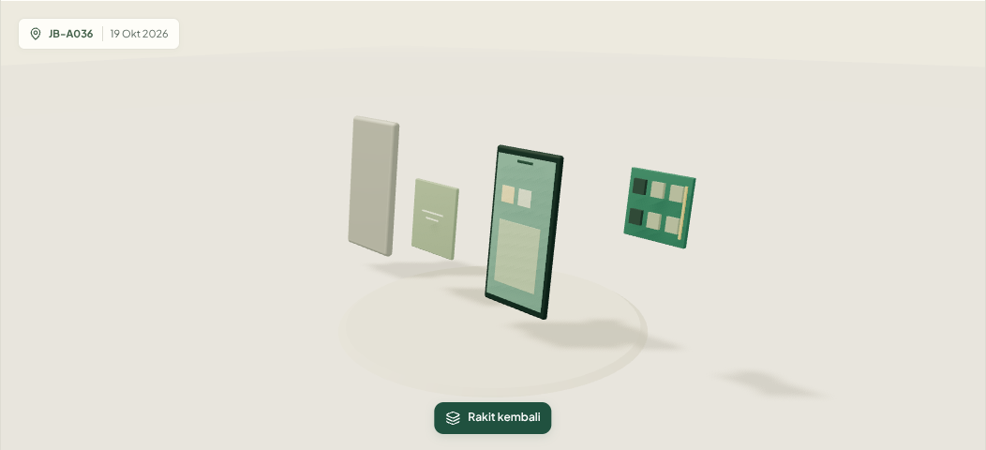
World language
A cared-for place makes collection and recovery legible.
City overview
Hub zones
Device inspection
Soft light, quiet ground,
clear routes and selection.
Work areas connect each
item to its next pathway.
Separated components
make inspection concrete.
3D application views · one palette and spatial hierarchy across three scales.
JEJAK BALIK / BRAND & PRODUCT SYSTEM
12
Notes:
Source: approved Jejak Balik prompt pack and original assets authored for this project. App screenshots are captures of the delivered frontend. Generated mascots are illustrations.

Slide 13
Motion & interaction
Animate meaningful changes; preserve orientation.
140 ms
240 ms
800 ms
1000 ms
Feedback
Panel
Scene focus
Scene transition
Button, chip, and focus response.
Inspectors and sheets enter calmly.
Move toward the selected entity.
Change city and hub viewpoints.
Reduced motion
Use immediate state changes and static highlights.
Never hide status or progress behind animation.
JEJAK BALIK / BRAND & PRODUCT SYSTEM
13
Notes:
Source: approved Jejak Balik prompt pack and original assets authored for this project. App screenshots are captures of the delivered frontend. Generated mascots are illustrations.

Slide 14
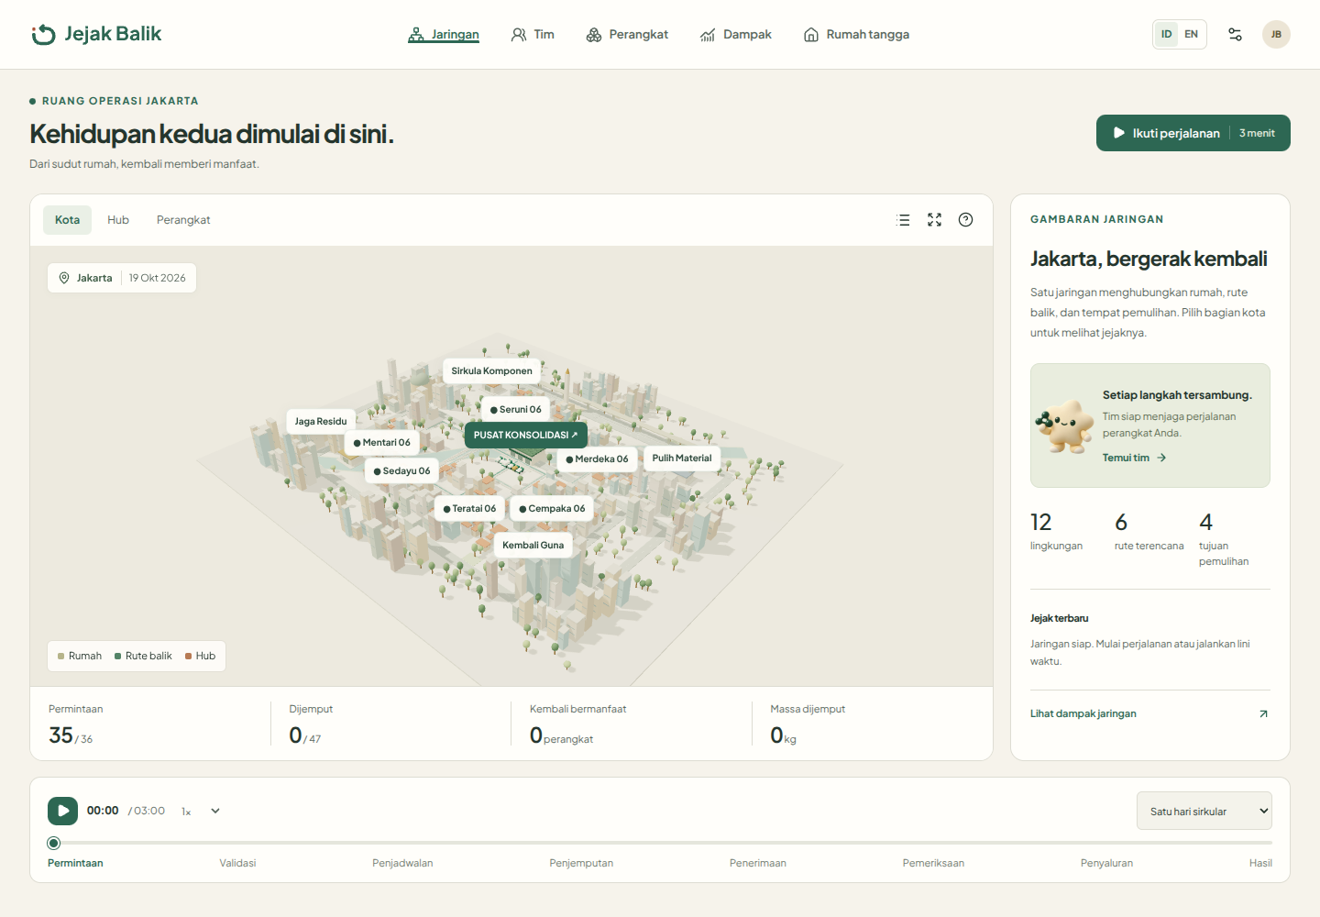
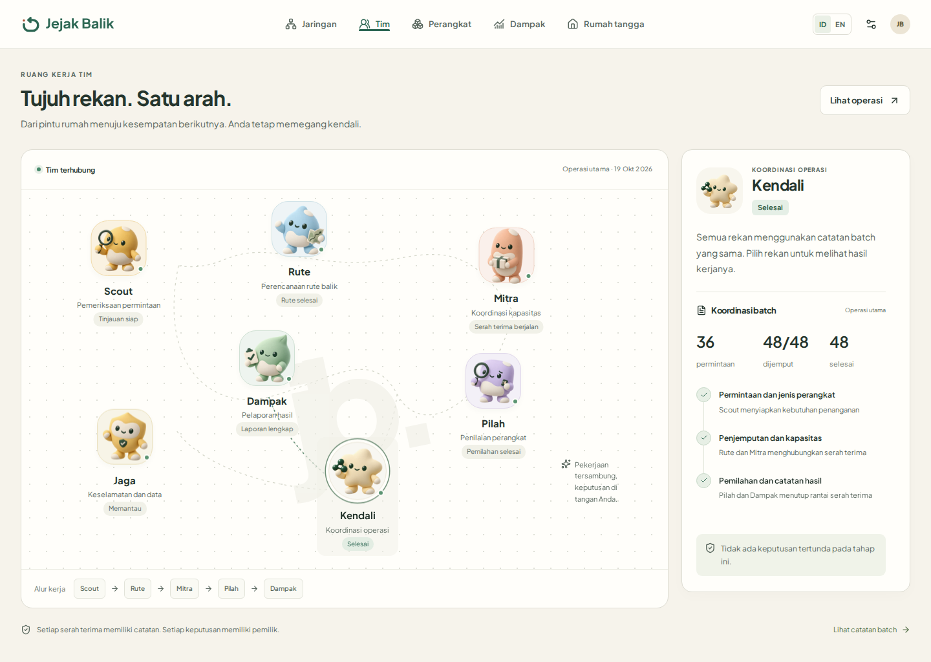
Desktop application
The network and team, captured at different moments in the journey.
Twin Studio
The operating team
Selected entities connect the world, inspector, metrics, and operator actions.
JEJAK BALIK / BRAND & PRODUCT SYSTEM
14
Notes:
Source: approved Jejak Balik prompt pack and original assets authored for this project. App screenshots are captures of the delivered frontend. Generated mascots are illustrations.

Slide 15
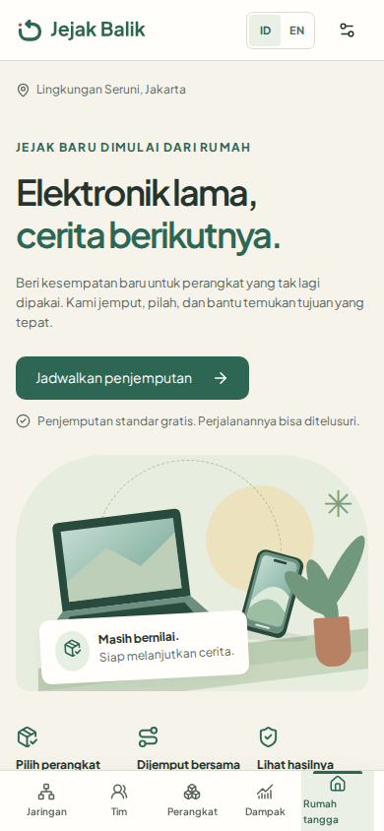
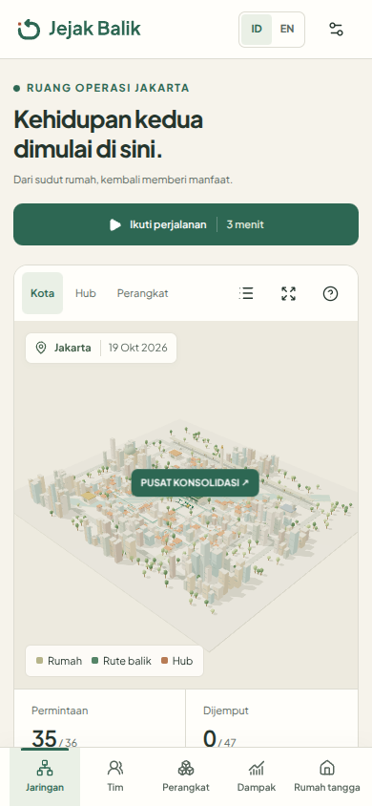
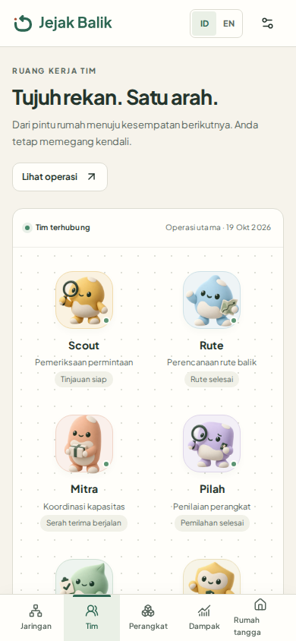
Mobile application
The same journey, arranged for touch.
Responsive principles
Keep actions reachable.
Stack detail before
shrinking text.
Use sheets for focused
decisions.
JEJAK BALIK / BRAND & PRODUCT SYSTEM
15
Notes:
Source: approved Jejak Balik prompt pack and original assets authored for this project. App screenshots are captures of the delivered frontend. Generated mascots are illustrations.

Slide 16
Voice, assets & everyday use
Specific, brief, and honest about what happens next.
Say
Use
“Penjemputan terjadwal, tanpa biaya.”
“Permintaan siap ditinjau.”
“Tinjau penanganan baterai.”
SVG for interface logos
PNG for documents
WebP for character display
Local fonts + included licenses
Tokens for consistent components
Use: clear contrast and an intact return path.
Avoid: stretched marks or color-only status.
JEJAK BALIK / BRAND & PRODUCT SYSTEM
16
Notes:
Source: approved Jejak Balik prompt pack and original assets authored for this project. App screenshots are captures of the delivered frontend. Generated mascots are illustrations.

