Slide 1
Station Intelligence
Brand guidelines
2026
Notes:
Lintara is an independent B2B platform for station planning and operating decisions. This guide presents the selected original identity and its application.

Slide 2
Brand purpose
A station plan connects
movement and space
Movement
People arrive, pass through
and stop to visit.
Space
Lintara helps operators and tenants see how a location, timetable or service change affects people and commercial activity.
Routes and storefronts
shape each decision.
Decision
Compare a change
before committing to it.
02
Notes:
Lintara identity system. Original symbol and brand artwork. Product language follows the supplied product brief. The brand is independent and implies no operator endorsement.

Slide 3
Personality and voice
Clear language helps people understand a choice and its result.
Clear
Name the action
Place a shop
Tempatkan toko
Capable
Name the measure
Average wait
Rata-rata antre
Approachable
Confirm the result
Plan saved
Rencana tersimpan
03
Notes:
Lintara identity system. Original symbol and brand artwork. Product language follows the supplied product brief. The brand is independent and implies no operator endorsement.
English and Indonesian examples use product copy for placement, wait metrics and scenario saves.

Slide 4
Primary logo
The horizontal signature is the default for the application header, reports and brand communication.
04
Notes:
Lintara identity system. Original symbol and brand artwork. Product language follows the supplied product brief. The brand is independent and implies no operator endorsement.

Slide 5
Logo rationale
An L with an open corridor
The navy path anchors the initial. The orange corner marks an opening, while the gap keeps the shape readable at small sizes.
Simple silhouette
Two solid colours. No gradients or extra detail.
05
Notes:
Lintara identity system. Original symbol and brand artwork. Product language follows the supplied product brief. The brand is independent and implies no operator endorsement.
Three internal directions were compared: offset corridor, intersecting route, square courtyard. Offset corridor preserves the clearest L silhouette in monochrome and at favicon scale. The rationale explains visible geometry and does not claim business outcomes.

Slide 6
Logo variants
Horizontal
Stacked
Symbol
Monochrome
White reverse
06
Notes:
Lintara identity system. Original symbol and brand artwork. Product language follows the supplied product brief. The brand is independent and implies no operator endorsement.

Slide 7
Clear space and minimum size
x is 14 units on the 104-unit symbol canvas. Keep at least x of empty space around every signature.
min. x
min. x
Clear-space boundary
128 px horizontal
24 px symbol
Print: horizontal 28 mm minimum. Browser favicons are supplied at 16 and 32 px.
07
Notes:
Lintara identity system. Original symbol and brand artwork. Product language follows the supplied product brief. The brand is independent and implies no operator endorsement.
Minimum sizes were inspected using actual transparent exported PNGs. Display examples are native image placement at the stated CSS size. The logo remains outline vector in the master; print minimum is a recommendation, not a tested printer specification.

Slide 8
Background usage
Choose a version that preserves the symbol and wordmark.
Light background
Navy background
Navy on orange
08
Notes:
Lintara identity system. Original symbol and brand artwork. Product language follows the supplied product brief. The brand is independent and implies no operator endorsement.
The orange field uses mono navy because the orange component of the primary symbol would disappear. Use a clear, solid light field over imagery. Logos are exempt from ordinary text contrast requirements, but supporting copy still needs accessible contrast.

Slide 9
Incorrect usage
The supplied master keeps the geometry and colour consistent.
01 Stretching
02 Recolouring
03 Low contrast
Monthly station report
04 Added effects
05 Crowded space
06 Missing pieces
09
Notes:
Lintara identity system. Original symbol and brand artwork. Product language follows the supplied product brief. The brand is independent and implies no operator endorsement.
The visual examples intentionally violate the master artwork. Preserve aspect ratio, colours, clear space and complete geometry. Avoid effects and low-contrast fields.

Slide 10
Colour palette
HEX
RGB
ROLE
Navy
#243B75
36, 59, 117
Brand and navigation
Orange
#F47B20
244, 123, 32
Selected actions
Background
#F5F7FB
245, 247, 251
Page canvas
Ink
#17233D
23, 35, 61
Primary text
Muted
#667085
102, 112, 133
Secondary text
Positive
#21866B
33, 134, 107
Positive markers
White on navy 10.73:1. Ink on orange 5.73:1. Use orange for accents and ink for text on white.
10
Notes:
Lintara identity system. Original symbol and brand artwork. Product language follows the supplied product brief. The brand is independent and implies no operator endorsement.
RGB values derive directly from hexadecimal tokens. WCAG contrast calculation uses sRGB relative luminance. Muted on white: 4.97:1. Positive on white: 4.48:1, so use dark text with green markers. Orange on white: 2.73:1, so it fails normal-text contrast. CMYK values are intentionally omitted because no print profile is specified.

Slide 11
Typography
Arial
0123456789
Arial is the system sans-serif. Use Nimbus Sans or the platform sans-serif when Arial is unavailable.
15 px body
12 px supporting labels
24-32 px page titles
Regular 400
Medium 600
Bold 700
Tabular numerals for metrics
Keep the wordmark as supplied vector artwork. Its outlined letters are separate from interface type.
11
Notes:
Lintara identity system. Original symbol and brand artwork. Product language follows the supplied product brief. The brand is independent and implies no operator endorsement.
UI font-family is Arial, sans-serif. No external font downloads or font binaries are required. Editable guide text uses installed Nimbus Sans. Arial resolves through system fallback where absent. Fixed logo wordmark paths derive from DejaVu Sans Bold with custom tracking. Included font attribution documents that artwork source.

Slide 12
Icons and information graphics
Station
Tenants
Overview
Average wait
24 px grid. 2 px stroke. Labels carry the meaning.
People present
Plan saved
Pair status colours with text. Keep time and units visible near every chart.
Illustrative design sample
12
Notes:
Lintara identity system. Original symbol and brand artwork. Product language follows the supplied product brief. The brand is independent and implies no operator endorsement.
Icons use the same open source Lucide assets used by the app, under ISC license. Native chart values are an explicitly illustrative design example and do not report station results. Chart data and labels remain editable.

Slide 13
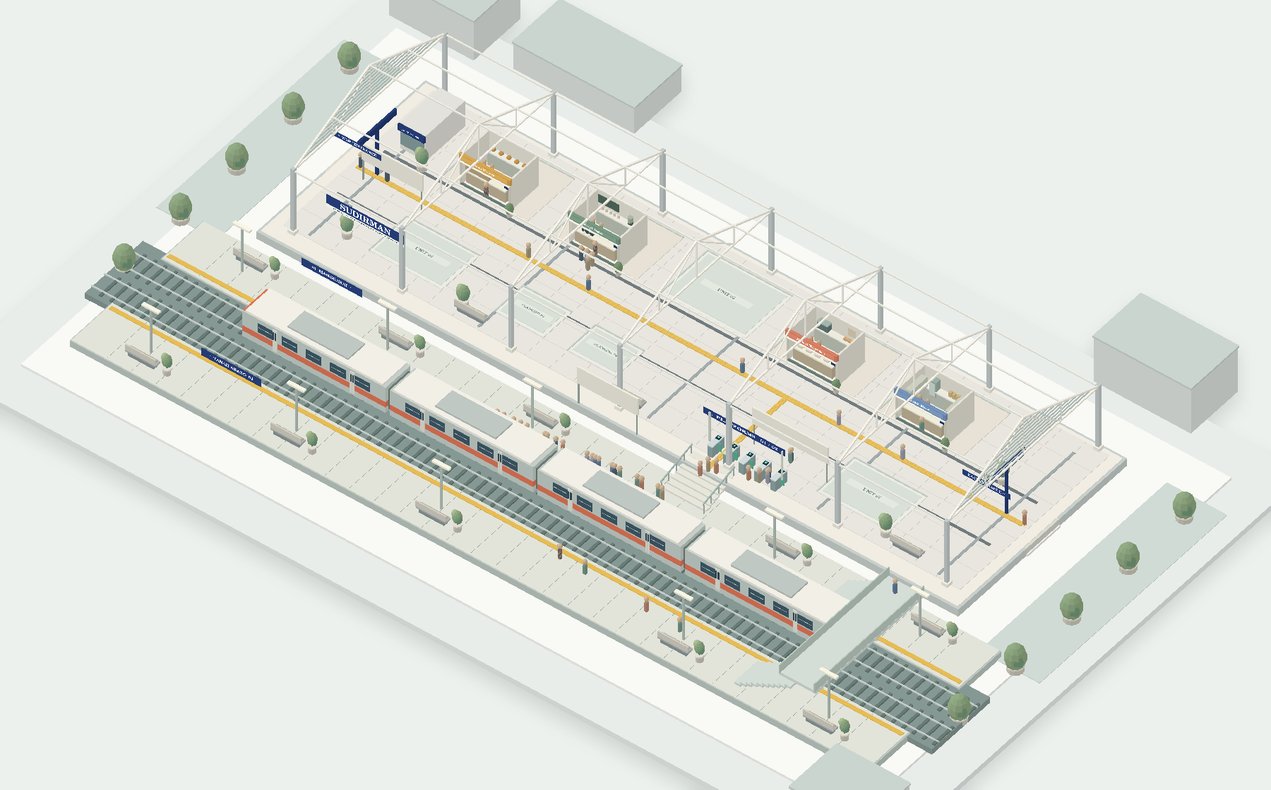
3D world style
Readable architecture
Pale roof trusses and a cream hall keep routes visible.
Simple characters
A rounded head and compact body show movement with restrained detail.
Station geometry example
13
Notes:
Lintara identity system. Original symbol and brand artwork. Product language follows the supplied product brief. The brand is independent and implies no operator endorsement.
Original station geometry example rendered from the scene source. This is a scene illustration, not an application screenshot.
Application specifications derive from the implemented station scene. Hall y=1 and rail/platform y=0. Orthographic camera, directional and hemisphere light, high material roughness, capsule-body and sphere-head instancing, event-clock movement and reduced-motion support come from the actual source. These are authored demonstration geometry and simulation representations.

Slide 14
Desktop application
Application specifications
Station, role and language
Station scene
Contextual
inspector
Navigation
View and selection controls
Header signature
Primary content
Selected details
Horizontal logo
Scene or analysis view
Orange selection cue
14
Notes:
Lintara identity system. Original symbol and brand artwork. Product language follows the supplied product brief. The brand is independent and implies no operator endorsement.
Editable desktop layout specification, derived from the top bar, navigation rail, station scene and contextual inspector components. This diagram is a specification rather than a browser screenshot. Roles and navigation change the main content while the top bar retains the brand.

Slide 15
Tenant and mobile
Application specifications
My business
Visits and contribution describe the business. Busy periods and service settings guide a staffing comparison.
Station preview
Visits, wait and sales
Flow trend
Choose a location
Desktop walkthrough
Compare up to three spaces using the same concept, model window and demand seed.
Phone layout specification
15
Notes:
Lintara identity system. Original symbol and brand artwork. Product language follows the supplied product brief. The brand is independent and implies no operator endorsement.
Specifications derive from the implemented BusinessPage, LocationPage and Mobile components. The business view exposes own operating metrics and settings, the location view compares up to three feasible units, and mobile shows a station preview, headline metrics, trend and desktop walkthrough action. The diagram makes no claim that the full 3D editor runs on a phone.

Slide 16
Implementation reference
One identity source keeps the interface, exports and guide aligned.
Asset or rule | Use
brand-tokens.json | Approved colours and system font stack
Horizontal SVG | Header, reports and desktop identity
Symbol SVG and favicon | Compact navigation and browser tab
PNG transparent exports | Office files and raster workflows
White reverse SVG | Identity on a navy field
8 px spacing rhythm
Generous content margins
Lintara is an independent brand. Station context does not imply operator endorsement.
16
Notes:
Lintara identity system. Original symbol and brand artwork. Product language follows the supplied product brief. The brand is independent and implies no operator endorsement.
Sources of truth: public/brand/brand-tokens.json and path-only SVG masters. UI CSS uses approved tokens, system Arial sans fallback and tabular metric figures. Original symbol source remains editable in tools/brand-assets.py. Art and applications derive from this implementation, with font/icon licenses supplied in the identity pack.

