Slide 1
Fold From Loops 2.0
A technical presentation
currently @ castor:/scratch/lpdi/bin/Rosetta/devel/nubinitio/main/
jaume.bonet@LPDI

Slide 2
What is FFL2
How to work with FFL2RS

Slide 3
What is FFL2

Slide 4
How to work with FFL2RS
(assumes working knowledge of RosettaScripts)
FoldFromLoops * RosettaScripts => NubInitioMover

Slide 5
How to work with FFL2RS
(assumes working knowledge of RosettaScripts)
preface1: ParseTime vs RunTime / MainLine vs DataMap

Slide 6
<ROSETTASCRIPTS>
<SCOREFXNS>
<... />
</SCOREFXNS>
<RESIDUE_SELECTORS>
<... />
</RESIDUE_SELECTORS>
<TASKOPERATIONS>
<... />
</TASKOPERATIONS>
<FILTERS>
<... />
</FILTERS>
<MOVERS>
<... />
</MOVERS>
<APPLY_TO_POSE>
<... />
</APPLY_TO_POSE>
<PROTOCOLS>
<... />
</PROTOCOLS>
</ROSETTASCRIPTS>
ParseTime: applied on the provided data
RunTime: applied on the pose status

Slide 7
DataMap
-in:file:s *.pdb
<ROSETTASCRIPTS>
<SCOREFXNS>
<... />
</SCOREFXNS>
<RESIDUE_SELECTORS>
<... />
</RESIDUE_SELECTORS>
<TASKOPERATIONS>
<... />
</TASKOPERATIONS>
<FILTERS>
<... />
</FILTERS>
<MOVERS>
<... />
</MOVERS>
<APPLY_TO_POSE>
<... />
</APPLY_TO_POSE>
<PROTOCOLS>
<... />
</PROTOCOLS>
</ROSETTASCRIPTS>
(id)
(id)
(id)
(id)
(id)
(id)
(id)

Slide 8
How to work with FFL2RS
(assumes working knowledge of RosettaScripts)
preface2: working with ResidueLabels

Slide 9
ResidueLabels
IO
Select
*
<LabelPoseFromResidueSelectorMover
name=“(&string;)”
property=“(&string;)”
reverse=“(0 &bool;)”
residue_selector=“(&string;)”
/>
<ResiduePDBInfoHasLabel
name=“(&string;)”
property=“(&string;)”
/>
property: (REQUIRED) New label to add to the residues.
reverse: Remove the label (if any) instead of adding it
residue_selector: (REQUIRED) Selector specifying residues to be labeled.
property: (REQUIRED) Label to search the residues.
*
NEW from FFL2

Slide 10
ResidueLabels
why should I care?
template data
target data
<NubInitioMover
...
/>
<ResiduePDBInfoHasLabel
name=“(&string;)”
property=“(&string;)”
/>
size change
chain ID change
guide relax/design process

Slide 11
ResidueLabels
why should I care?
template data
target data
<NubInitioMover
...
/>
*
<MoveMapFactory>
...
</ MoveMapFactory >
RS guided MoveMap
*
Very New -> Undocumented as of now.

Slide 12
ResidueLabels
why should I care?
template data
target data
<NubInitioMover
...
/>
<OperateOnResidueSubset
name=“(&string;)”
selector=“(&string;)”>
<(ResLvlTaskOperation)/>
</OperateOnResidueSubset>
RS guided TaskOperators
https://www.rosettacommons.org/docs/latest/search?q=xsd%2Frlto_

Slide 13
ResidueLabels
why should I care?
template data
target data
<NubInitioMover
...
/>
*
< ResidueLabelsToPymolSelectionMover
name=“(&string;)”
pdb_count=“(0 &bool;)”
/>
print selection command for PyMol!
*
NEW from FFL2

Slide 14
How to work with FFL2RS
(assumes working knowledge of RosettaScripts)
preface3: working with MoveMapFactory
Notes:
Move

Slide 15
MoveMapFactory
Runtime defined MoveMaps!
<MoveMapFactory
name=“(&string;)”
bb=“(0 &bool;)” chi=“(0 &bool;)” nu=“(0 &bool;)”
branches=“(0 &bool;)” jumps=“(0 &bool;)”
>
</MoveMapFactory>

Slide 16
MoveMapFactory
Runtime defined MoveMaps!
<MoveMapFactory
name=“(&string;)”
bb=“(0 &bool;)” chi=“(0 &bool;)” nu=“(0 &bool;)”
branches=“(0 &bool;)” jumps=“(0 &bool;)”
>
<Backbone enable=“(1 &bool;)” residue_selector=“(&string;)”/>
<Chi enable=“(1 &bool;)” residue_selector=“(&string;)”/>
<Nu enable=“(1 &bool;)” residue_selector=“(&string;)”/>
<Branches enable=“(1 &bool;)” residue_selector=“(&string;)”/>
<Jumps enable=“(1 &bool;)” residue_selector=“(&string;)”/>
</MoveMapFactory>

Slide 17
How to work with FFL2RS
(assumes working knowledge of RosettaScripts)
step1.1: preparing your data: Fragments
Notes:
.1

Slide 18
NubInitio
FRAGMENTS
-in:file:s
template data
make_fragments.pl
target data
1 SINGLE CHAIN
CONTINUOUS
W/OUT HETATM
template fragments data
<NubInitioMover
...
/>

Slide 19
NubInitio
FRAGMENTS
-in:file:s
template data
target data
*
1 SINGLE CHAIN
CONTINUOUS
W/OUT HETATM
<StructFragmentMover
...
/>
template fragments data
<NubInitioMover
...
/>
*
NEW from FFL2 – by Andreas Scheck

Slide 20
NubInitio
FRAGMENTS
<StructFragmentMover
name=“(&string;)”
prefix=“(&string;)”
vall_file=“(&string;)”
output_frag_files=“(0 &bool;)”
small_frag_file=“(&string;)” large_frag_file=“(&string;)”
/>
</StructFragmentMover>
https://www.rosettacommons.org/docs/latest/scripting_documentation/RosettaScripts/xsd/mover_StructFragmentMover_type

Slide 21
NubInitio
FRAGMENTS
<StructFragmentMover
name=“(&string;)”
prefix=“(&string;)”
vall_file=“(&string;)”
output_frag_files=“(0 &bool;)”
small_frag_file=“(&string;)” large_frag_file=“(&string;)”
/>
</StructFragmentMover>
DataMap
https://www.rosettacommons.org/docs/latest/scripting_documentation/RosettaScripts/xsd/mover_StructFragmentMover_type

Slide 22
How to work with FFL2RS
(assumes working knowledge of RosettaScripts)
step1.2: preparing your data: Constraints
Notes:
.1

Slide 23
NubInitio
CONSTRAINTGENERATORS
-in:file:s
template data
target data
<StructFragmentMover/>
fragments data
<AddConstraints
...
/>
<NubInitioMover
...
/>

Slide 24
NubInitio
CONSTRAINTGENERATORS
*
<SegmentedAtomPairConstraintGenerator
name=“(&string;)" native=“(0 &bool;)" residue_selector=“(&string;)”
>
<Inner
sd=“(&real;)” weight=“(&real;)” ca_only=“(&bool;)”
use_harmonic=“(0 &bool;)” unweighted=“(false &bool;)” min_seq_sep=“(&non_negative_integer;)”
/>
<Outer
sd=“(&real;)” weight=“(&real;)” ca_only=“(&bool;)”
use_harmonic=“(0 &bool;)” unweighted=“(false &bool;)” max_distance=“(&real;)”
/>
</SegmentedAtomPairConstraintGenerator>
*
NEW from FFL2

Slide 25
NubInitio
CONSTRAINTGENERATORS
<AtomPairConstraintGenerator
name=“(&string;)” sd=“(&real;)” ca_only=“(0 &bool;)”
use_harmonic=“(0 &bool;)” unweighted=“(0 &bool;)”
min_seq_step=“(&int;)” max_distance=“(&int;)”
residue_selector=“(&string;)”
/>
</StructFragmentMover>
To mimic FFL1:
<AtomPairConstraintGenerator
name=“atompairCST” sd=“3.0” ca_only=“true”
use_harmonic=“1” unweighted=“1”
min_seq_step=“6” max_distance=“40”
residue_selector=“template_chain_selector”
/>
</StructFragmentMover>
https://www.rosettacommons.org/docs/latest/search?q=xsd%2Fconstraint_generator_

Slide 26
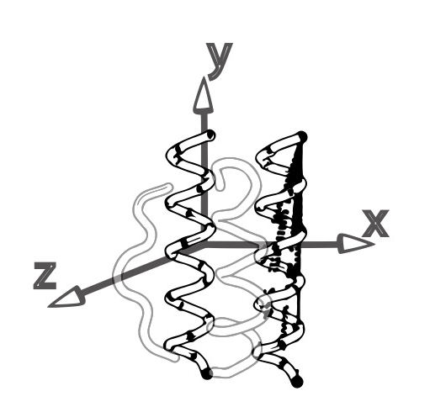
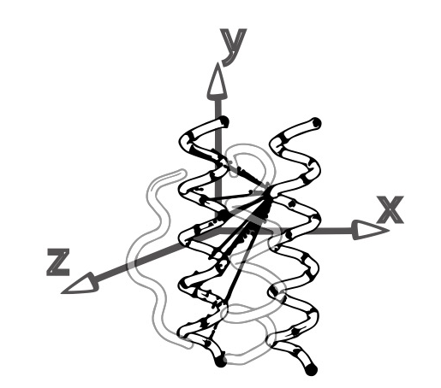
NubInitio
CONSTRAINTGENERATORS
<RESIDUE_SELECTORS>
<SecondaryStructureSelector name=”sse" ss="HE" use_dssp="1" />
</RESIDUE_SELECTORS>
<MOVERS>
<AddConstraints name="add_csts" >
<SegmentedAtomPairConstraintGenerator name="gen_my_csts" residue_selector=”see">
<Inner min_seq_sep="2" />
<Outer use_harmonic="true" unweighted="true" />
</SegmentedAtomPairConstraintGenerator>
</AddConstraints>
<RemoveConstraints name="rm_csts" constraint_generators="gen_my_csts" />
</MOVERS>
<PROTOCOLS>
<Add mover="add_csts" />
<!-- do things with constraints -->
<Add mover="rm_csts" />
</PROTOCOLS>

Slide 27
How to work with FFL2RS
(assumes working knowledge of RosettaScripts)
step2.1: global configuration: Template Insertion Region(s)
step2.2: global configuration: Fragments
step2.3: global configuration: Constraints
step2.4: global configuration: PostProces->Disulfides
step2.5: global configuration: Evaluation->RMSD
step2.6: defining the motif: Global Parameters
step2.7: defining the motif: Individual Segments
Notes:
7

Slide 28
How to work with FFL2RS
(assumes working knowledge of RosettaScripts)
step2.1: global configuration: Template Insertion Region(s)

Slide 29
Template
<NubInitioMover
name=“(&string;)”
template_motif_selector=“(&string;)”
/>
https://www.rosettacommons.org/docs/latest/search?q=xsd%2Frs_

Slide 30
How to work with FFL2RS
(assumes working knowledge of RosettaScripts)
step2.2: global configuration: Fragments

Slide 31
Fragments
<NubInitioMover
name=“(&string;)”
fragments_id=“(&string;)”
/>

Slide 32
Fragments
<StructFragmentMover
name=“(&string;)”
prefix=“(&string;)”
/>
</StructFragmentMover>
<NubInitioMover
name=“(&string;)”
fragments_id=“(&string;)”
/>

Slide 33
How to work with FFL2RS
(assumes working knowledge of RosettaScripts)
step2.3: global configuration: Constraints

Slide 34
Constraints
<NubInitioMover
name=“(&string;)”
use_cst=“(1 &bool;)”
clear_motif_cst=“(1 &bool;)”
angle_weight=“(0 &float;)”
dihedral_weight=“(0 &float;)”
binder_weight=“(0 &float;)”
/>

Slide 35
Constraints Weights Benchmark
*

Slide 36
Constraints Weights Benchmark
*

Slide 37
Constraints Scores
true
false
ni_cst
true
false
ni_motif_cst

Slide 38
How to work with FFL2RS
(assumes working knowledge of RosettaScripts)
step2.4: global configuration: PostProces->Disulfides

Slide 39
Disulfides
<NubInitioMover
name=“(&string;)”
disulfides_side=“(0 &int;)”
repack_disulfides=“(1 &bool;)”
fullatom_scorefxn=“(&string;)”
/>

Slide 40
Disulfides
*
<NubInitioMover
name=“(&string;)”
disulfides_side=“(0 &int;)”
repack_disulfides=“(1 &bool;)”
fullatom_scorefxn=“(&string;)”
/>
-. MonteCarlo .-
dslfc_cen_dst, 5.0
dslfc_cb_dst, 3.5
dslfc_ang, 2.0
dslfc_cb_dih, 0.5
dslfc_bb_dih, 0.5
*
As applied in the AbInito App. Does not modify any provided score.

Slide 41
Disulfides Scores
ni_disulfides_side

Slide 42
How to work with FFL2RS
(assumes working knowledge of RosettaScripts)
step2.5: global configuration: Evaluation->RMSD

Slide 43
RMSD Filtering Options
<NubInitioMover
name=“(&string;)”
rmsd_threshold=“(5.0 &real;)”
rmsd_include_motif=“(0 &bool;)”
rmsd_include_unconstrained=“(1 &bool;)”
max_trials=“(10 &int;)”
/>
-RMSD defines how far from the template we can deviate-

Slide 44
RMSD Filtering Scores
be aware of your surroundings!
ni_rmsd
ni_rmsd_threshold
*
full
no_motif (default)
no_constrained
no_motif_no_constrained
motif regions are excluded from evaluation
ni_rmsd_type
ni_trials
*
Relevant when the insertion motif and the insertion region are of different size

Slide 45
RMSD Filtering Scores
be aware of your surroundings!
ni_rmsd
ni_rmsd_threshold
full
no_motif
no_constrained
no_motif_no_constrained
*
regions without constraints are ignored
ni_rmsd_type
ni_trials
*
Relevant when expecting some particular region to move (for example to better fit the binder).

Slide 46
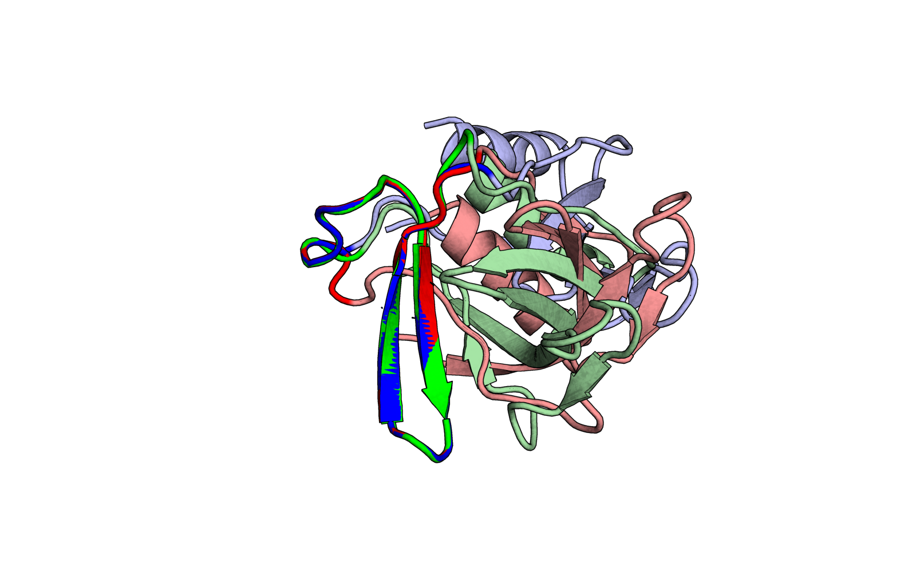
RMSD Filtering Options
be aware of your surroundings!
*
Example provided by Andreas Scheck
ni_rmsd_type
full
vs
no_motif
RMSD: 0.772
the “single segment motif” dilemma
RMSD: 0.718

Slide 47
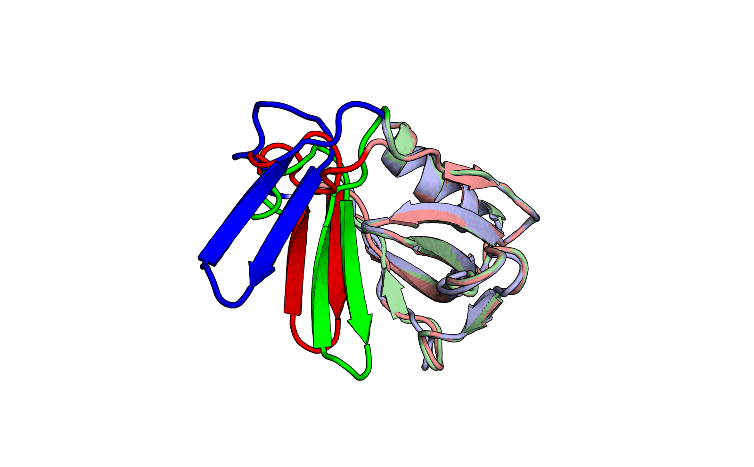
RMSD Filtering Options
be aware of your surroundings!
*
Example provided by Andreas Scheck
ni_rmsd_type
full
vs
no_motif
RMSD: 0.772
the “single segment motif” dilemma
RMSD: 0.718

Slide 48
How to work with FFL2RS
(assumes working knowledge of RosettaScripts)
step2.6: defining the motif: Global Parameters

Slide 49
Defining the Motif: Input File
<NubInitioMover name=“(&string;)” >
<Nub pdb_file=“(&string;)” >
</Nub>
</NubInitioMover>

Slide 50
Defining the Motif: Input File
<SavePoseMover
name=“(&string;)”
reference_pose=“(&string;)”
pdb_file=“(&string;)”
/>
<NubInitioMover name=“(&string;)” >
<Nub reference_name=“(&string;)” >
</Nub>
</NubInitioMover>

Slide 51
Defining the Motif: Selecting Regions
<NubInitioMover name=“(&string;)” >
<Nub residue_selector=“(&string;)”
binder_selector=“(&string;)” >
</Nub>
</NubInitioMover>

Slide 52
How to work with FFL2RS
(assumes working knowledge of RosettaScripts)
step2.7: defining the motif: Individual Segments

Slide 53
Defining the Segments
Do not miscount them!
<NubInitioMover name=“(&string;)” >
<Nub>
<Segment order=“(&int;)” />
</Nub>
</NubInitioMover>
-Segment definition is optional, but if done, it has to be done for all segments-

Slide 54
Defining the Segments
Do not miscount them!
<Index name="motif1" resnums="54A-58A" />
<Index name="motif2" resnums="62A-68A" />
<Index name="motif3" resnums="112A-115A" />
<Index name="motif4" resnums="123A-126A" />
<Or name="insertion" selectors="motif1,motif2,motif3,motif4" />
<NubInitioMover name=“(&string;)” >
<Nub>
<Segment order=“1” />
<Segment order=“2” />
<Segment order=“3” />
<Segment order=“4” />
</Nub>
</NubInitioMover>
<NubInitioMover name=“(&string;)” >
<Nub>
<Segment order=“4” />
<Segment order=“2” />
<Segment order=“1” />
<Segment order=“3” />
</Nub>
</NubInitioMover>
-order is mandatory and defines the sequence order of insertion in the template-

Slide 55
Defining the Segments
Do not miscount them!
<NubInitioMover name=“(&string;)” >
<Nub>
<Segment order=“(&int;)”
n_term_flex=“(&int;)”
c_term_flex=“(&int;)”
editable=“(&comma_separated_int_list;)”
/>
</Nub>
</NubInitioMover>

Slide 56
How to work with FFL2RS
(assumes working knowledge of RosettaScripts)
step3.1: post-processing: Design Labels

Slide 57
THE FFL LABELS
*
NEW from FFL2
*
<DisplayPoseLabelsMover/>
SEQUENCE APTVTVPLALTVVGTGSAMTIGCLPPVGLGLALAALIVYWEMGAKNIIQFVHGGGALLVGHSSTAGAAALLLAGLSLGAAALGITAVLLGAAGVYRCMISTGGAAYKRITVLVAA
STRUCTURE LLLLELLLLLLLEELLLLLLEEEELLLLLLLLLLLLEEEEELLLLLLEEEELLEELLLLLLLHHHLLEEELHHHHHHLLEEEEELLLLHHHLEEEEEEEELLLEEEEEEEELEEL
CONTEXT
DISULFIDIZE * *
FLEXIBLE ** **
COLDSPOT *
HOTSPOT ***** **** ** **** ****
MOTIF ***** ******* **** ****
TEMPLATE ************************************ *** ******************************************* ******* ******
CONSTRAINTS ************************************·····***·······*******************************************····*******····******
MVMP_BB ************************************ ******* ******************************************* ******* ******
MVMP_CHI ************************************ *** ******************************************* ******* ******
-the output is the unedited FA folded pose with the nub (not ready as a final output)-
-chain ID of the design and binders are kept, but not the numbering-

Slide 58
THE FFL LABELS
SEQUENCE APTVTVPLALTVVGTGSAMTIGCLPPVGLGLALAALIVYWEMGAKNIIQFVHGGGALLVGHSSTAGAAALLLAGLSLGAAALGITAVLLGAAGVYRCMISTGGAAYKRITVLVAA
STRUCTURE LLLLELLLLLLLEELLLLLLEEEELLLLLLLLLLLLEEEEELLLLLLEEEELLEELLLLLLLHHHLLEEELHHHHHHLLEEEEELLLLHHHLEEEEEEEELLLEEEEEEEELEEL
CONTEXT
DISULFIDIZE * *
FLEXIBLE ** **
COLDSPOT *
HOTSPOT ***** **** ** **** ****
MOTIF ***** ******* **** ****
TEMPLATE ************************************ *** ******************************************* ******* ******
CONSTRAINTS ************************************·····***·······*******************************************····*******····******
MVMP_BB ************************************ ******* ******************************************* ******* ******
MVMP_CHI ************************************ *** ******************************************* ******* ******
*
<ScoreFunction name=“(&string;)” >
<Reweight scoretype=“chainbreak” weight=“1.0”/>
<Reweight scoretype=“linear_chainbreak” weight=“1.0”/>
<Reweight scoretype=“overlap_chainbreak” weight=“1.0”/>
</ ScoreFunction >
<ResiduePDBInfoHasLabel
name=“(&string;)”
property=“(&string;)”
/>
<MoveMapFactory>
...
</ MoveMapFactory >
<OperateOnResidueSubset
name=“(&string;)”
selector=“(&string;)”>
<(ResLvlTaskOperation)/>
</OperateOnResidueSubset>
<FastDesign/>
<FastRelax/>
*
For Multi-segment Motifs.

Slide 59
THE FFL LABELS
SEQUENCE APTVTVPLALTVVGTGSAMTIGCLPPVGLGLALAALIVYWEMGAKNIIQFVHGGGALLVGHSSTAGAAALLLAGLSLGAAALGITAVLLGAAGVYRCMISTGGAAYKRITVLVAA
STRUCTURE LLLLELLLLLLLEELLLLLLEEEELLLLLLLLLLLLEEEEELLLLLLEEEELLEELLLLLLLHHHLLEEELHHHHHHLLEEEEELLLLHHHLEEEEEEEELLLEEEEEEEELEEL
CONTEXT
DISULFIDIZE * *
FLEXIBLE ** **
COLDSPOT *
HOTSPOT ***** **** ** **** ****
MOTIF ***** ******* **** ****
TEMPLATE ************************************ *** ******************************************* ******* ******
CONSTRAINTS ************************************·····***·······*******************************************····*******····******
MVMP_BB ************************************ ******* ******************************************* ******* ******
MVMP_CHI ************************************ *** ******************************************* ******* ******
<ResiduePDBInfoHasLabel
name=“(&string;)”
property=“(&string;)”
/>
<MoveMapFactory>
...
</ MoveMapFactory >
<OperateOnResidueSubset
name=“(&string;)”
selector=“(&string;)”>
<(ResLvlTaskOperation)/>
</OperateOnResidueSubset>
*
<MoveMapFactoryToNamedMovemap/>
*
NEW from FFL2

Slide 60
THE FFL LABELS
SEQUENCE APTVTVPLALTVVGTGSAMTIGCLPPVGLGLALAALIVYWEMGAKNIIQFVHGGGALLVGHSSTAGAAALLLAGLSLGAAALGITAVLLGAAGVYRCMISTGGAAYKRITVLVAA
STRUCTURE LLLLELLLLLLLEELLLLLLEEEELLLLLLLLLLLLEEEEELLLLLLEEEELLEELLLLLLLHHHLLEEELHHHHHHLLEEEEELLLLHHHLEEEEEEEELLLEEEEEEEELEEL
CONTEXT
DISULFIDIZE * *
FLEXIBLE ** **
COLDSPOT *
HOTSPOT ***** **** ** **** ****
MOTIF ***** ******* **** ****
TEMPLATE ************************************ *** ******************************************* ******* ******
CONSTRAINTS ************************************·····***·······*******************************************····*******····******
MVMP_BB ************************************ ******* ******************************************* ******* ******
MVMP_CHI ************************************ *** ******************************************* ******* ******
<LabelPoseFromResidueSelectorMover reverse=“true” property=“HOTSPOT” />
<Layer select_core=“true” />
<LabelPoseFromResidueSelectorMover property=“COLDPOT” />
<ResiduePDBInfoHasLabel
name=“(&string;)”
property=“(&string;)”
/>
<MoveMapFactory>
...
</ MoveMapFactory >
<OperateOnResidueSubset
name=“(&string;)”
selector=“(&string;)”>
<(ResLvlTaskOperation)/>
</OperateOnResidueSubset>
<MoveMapFactoryToNamedMovemap/>

Slide 61
How to work with FFL2RS
(assumes working knowledge of RosettaScripts)
step3.2: global configuration: PostProces->ChainBreak

Slide 62
ChainBreak
*
<NubInitioLoopClosureMover
name=“(&string;)”
break_side=“(3 &int;)”
break_side_ramp=“(0 &bool;)”
scorefxn=“(&string;)”
trials=“(10 &int;)”
/>
*
*
*
NEW from FFL2
centroid-level scorefxn.

Slide 63
ChainBreak Scores
niccd_break_side
niccd_trials

Slide 64
How to work with FFL2RS
(assumes working knowledge of RosettaScripts)
step3.3: post-processing: Evaluate Design
Notes:
.1

Slide 65
EVALUATION
-in:file:s
template data
target data
<StructFragmentMover/>
fragments data
<AddConstraints/>
<NubInitioMover/>
< ResiduePDBInfoHasLabel />
< MoveMapFactory/>
<FastDesign/>
< OperateOnResidueSubset />
<NubInitioLoopClosureMover/>
?

Slide 66
EVALUATION
-in:file:s
template data
target data
<StructFragmentMover/>
fragments data
<AddConstraints/>
<NubInitioMover/>
< ResiduePDBInfoHasLabel />
< MoveMapFactory/>
<FastDesign/>
< OperateOnResidueSubset />
<NubInitioLoopClosureMover/>
<ddG
name=“(&string;)”
...
/>

Slide 67
EVALUATION
-in:file:s
template data
target data
<StructFragmentMover/>
fragments data
<AddConstraints/>
<SavePoseMover/>
<NubInitioMover/>
< ResiduePDBInfoHasLabel />
< MoveMapFactory/>
<FastDesign/>
< OperateOnResidueSubset />
<NubInitioLoopClosureMover/>
*
<RmsdFromResidueSelectorFilter
name=“(&string;)”
reference_name=“(&string;)”
reference_selector=“(&string;)”
query_selector=“(&string;)”
/>
*
NEW from FFL2

Slide 68
EVALUATION
-in:file:s
template data
target data
<StructFragmentMover/>
fragments data
<AddConstraints/>
<NubInitioMover/>
<Chain/>
< ResiduePDBInfoHasLabel />
< MoveMapFactory/>
<FastDesign/>
< OperateOnResidueSubset />
<NubInitioLoopClosureMover/>
*
<ScorePoseSegmentFromResidueSelectorFilter
name=“(&string;)”
residue_selector=“(&string;)”
/>
*
NEW from FFL2

Slide 69
EVALUATION
-in:file:s
template data
target data
<StructFragmentMover/>
fragments data
<AddConstraints/>
<NubInitioMover/>
< ResiduePDBInfoHasLabel />
< MoveMapFactory/>
<FastDesign/>
< OperateOnResidueSubset />
<NubInitioLoopClosureMover/>
<ConstraintFulfilmentFilter name=“unf_atompair” distance=“1” angle=“0” dihedral=“0” />
<ConstraintFulfilmentFilter name=“unf_angle” distance=“0” angle=“1” dihedral=“0” />
<ConstraintFulfilmentFilter name=“unf_dihedral” distance=“0” angle=“0” dihedral=“1” />

Slide 70
EVALUATION
-in:file:s
template data
target data
<StructFragmentMover/>
fragments data
<AddConstraints/>
<NubInitioMover/>
< ResiduePDBInfoHasLabel />
< MoveMapFactory/>
<FastDesign/>
< OperateOnResidueSubset />
<NubInitioLoopClosureMover/>
*
<ConstraintFulfilmentFilter
name=“(&string;)”
distance=“(1 &bool;)”
angle=“(1 &bool;)”
dihedral=“(1 &bool;)”
/>
*
NEW from FFL2

Slide 71
The Standard FFL as a RS
Go To >> Examples
Notes:
.1

Slide 72
Further Down…
-in:file:s
template data
target data
<StructFragmentMover prefix=“fragschA” />
<AddConstraints/>
fragments data
<NubInitioMover fragment_id=“fragschA” />
<StructFragmentMover prefix=“fragschB” />
<AddConstraints/>
fragments data
<NubInitioMover fragment_id=“fragschB” />
< ResiduePDBInfoHasLabel />
< MoveMapFactory/>
<FastDesign/>
< OperateOnResidueSubset />
<NubInitioLoopClosureMover/>
Notes:
.1

