Slide 1

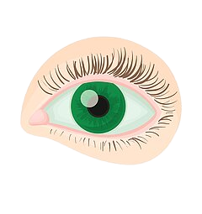
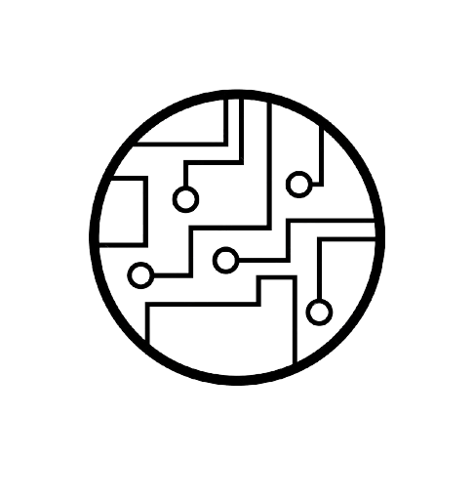
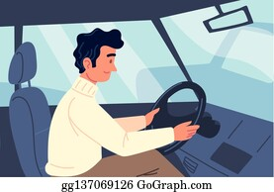

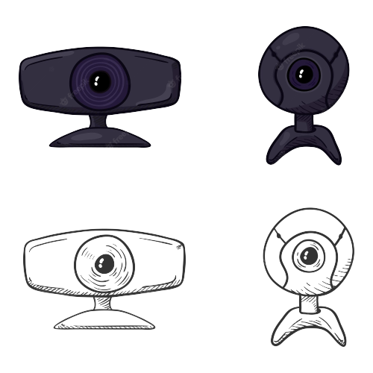
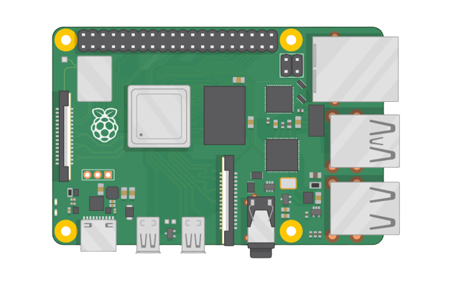


Team 26
Determine ROI
Wake-o-Matic
Sound Warning
Filtering
1 in 8 fall asleep
Blinking Frequency Evaluation
Closed Eye Detection
250,000+ deaths a year
Brake - The Road Safety Charity (2023). Available at: https://www.brake.org.uk/

