Slide 1
E-R Model to Relational Model
Entity Translation
  Attributes in Entity-Attributes in Relational Model
  Primary Key in Entiry-Primary Key in Relational Model
  Domain in Entity-Domain in Relational Model
Example of “Sailors Reserve Boats”

Slide 2
Example
Sailors(sid: integer, sname: string, rating: integer, age: real)
Boats(bid: integer, bname: string, color: string)
Reserves(sid: integer, bid: integer, day: date)

Slide 3
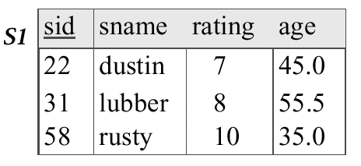
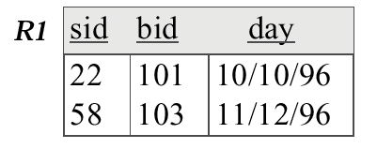
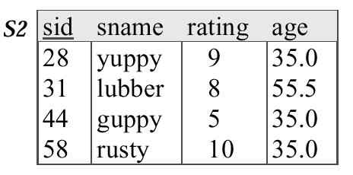
Example
Boats
Bid bname color
Interlake blue
Interlake red
Clipper green
Marine red

Slide 4
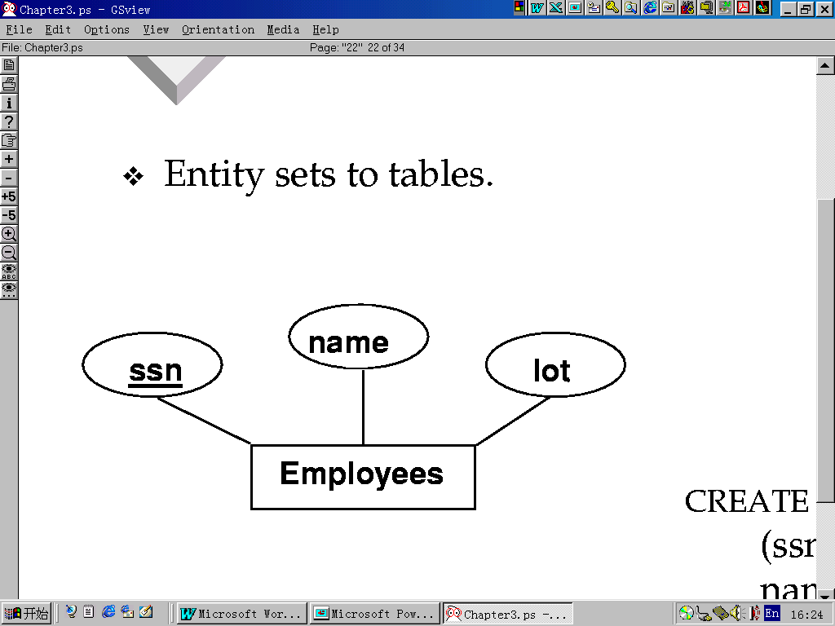
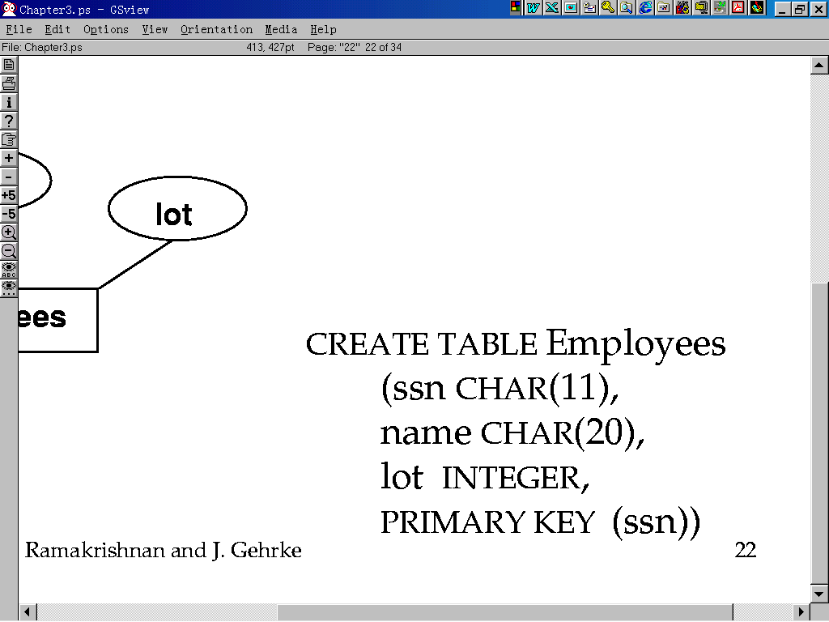
E-R Model to SQL

Slide 5
Many-Many Relation Translation
Many-Many relation is mapped to a table, including attributes：
  Primay Key of each related entity-Foreign Key
  All foreign Keys-Primary Key
  Attributes of Relation-Common Attributes

Slide 6
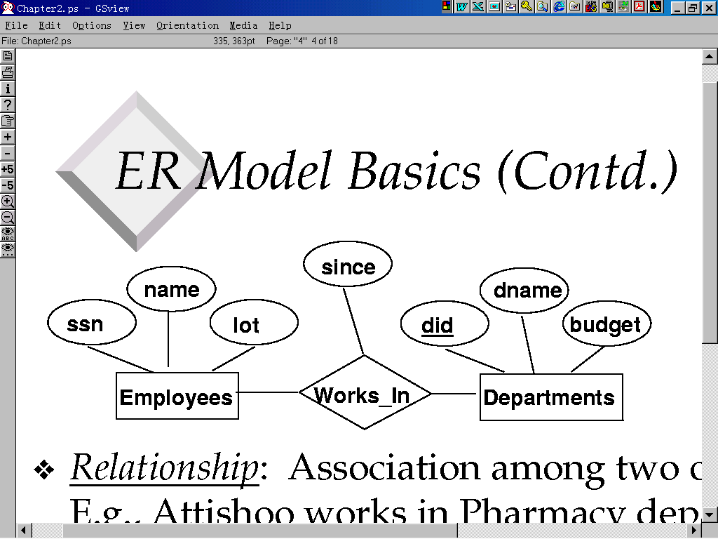
Example
m
n

Slide 7
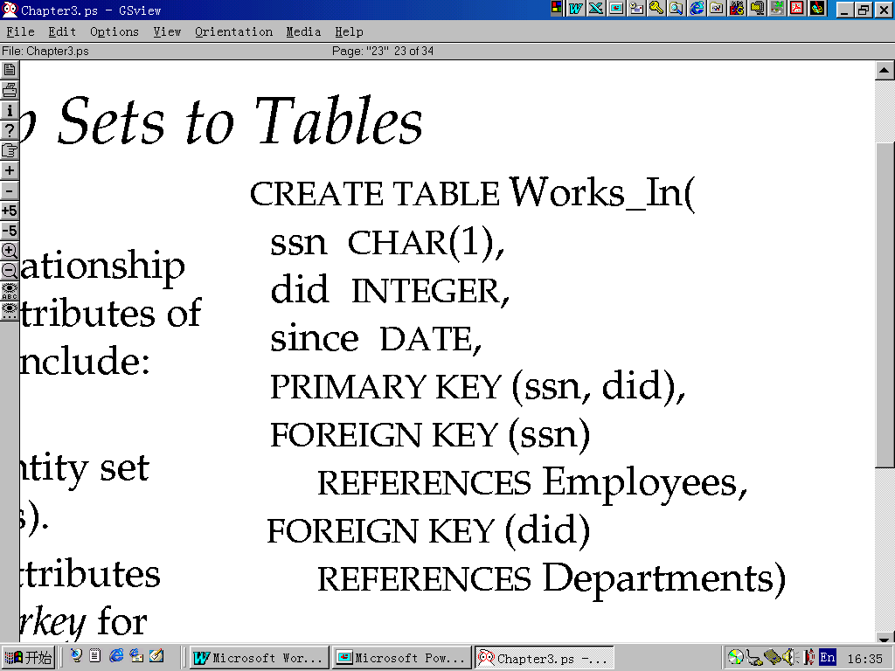
Example

Slide 8
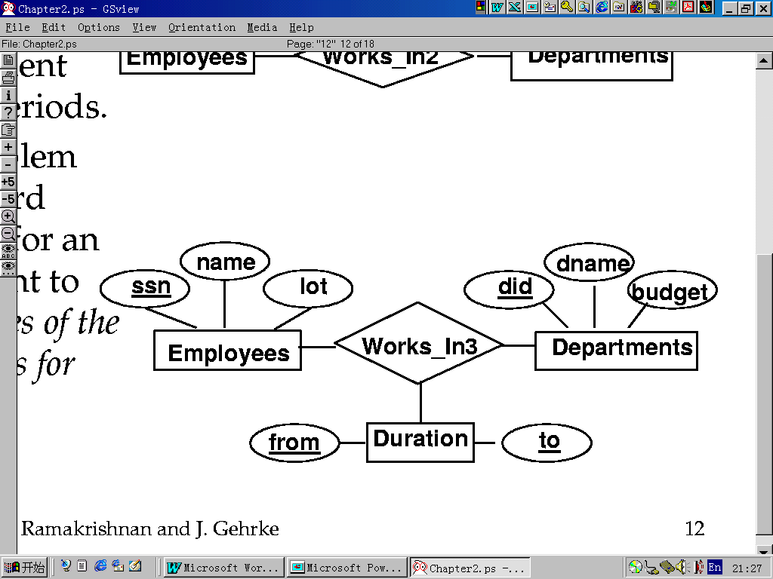
Example
m
n
p

Slide 9
Example
CREATE TABLE Work3-In(
  ssn CHAR(11), did integer,
  from date, to date,
  PRIMARY KEY(ssn, did, from, to)
  FOREIG KEY (ssn) REFERENCES Employees,
  ON DELETE NO ACTION,
  FOREIG KEY (did) REFERENCES Departments,
  FOREIGN KEY (from) REFERENCE DURATION,
  FOREIGN KEY (to) REFERENCE DURATION)

Slide 10
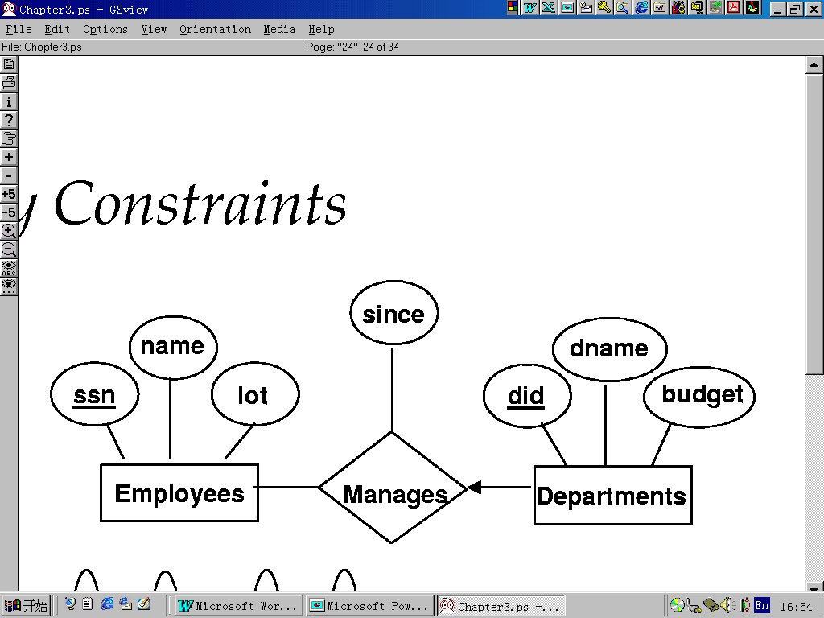
One-Many Relation Translation
1
n

Slide 11
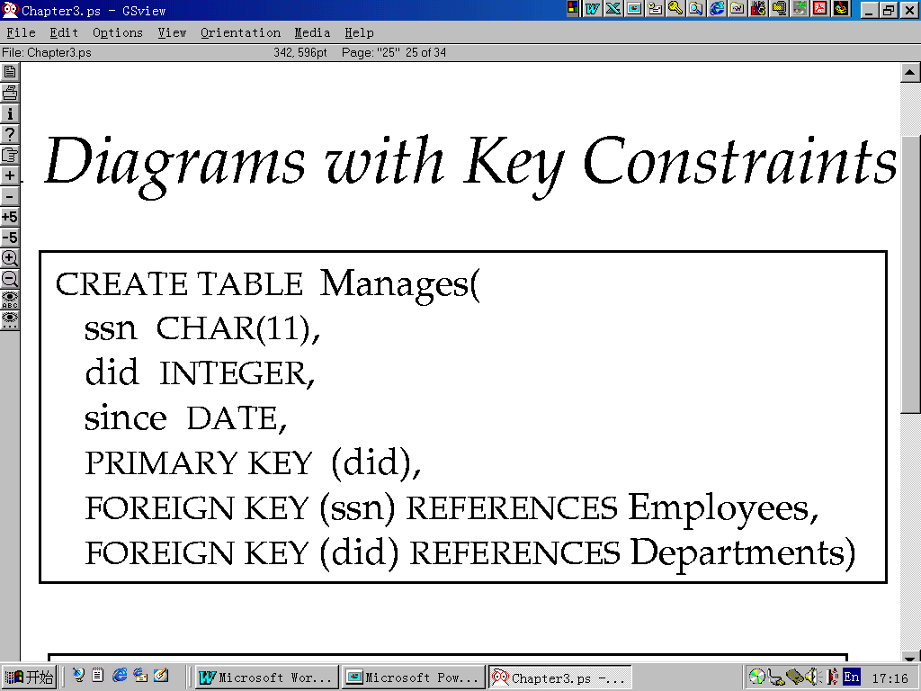
Option 1
One-Many translates into one table

Slide 12
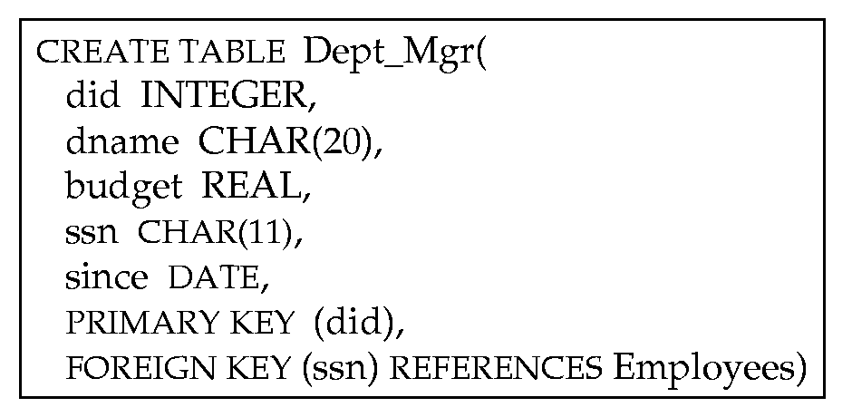
Option 2
Merge Manages and Departments into One Table

Slide 13
Question?
One-Many Relation，Why merge Manages and Departments?
Pros and Cons of the two options
Many-Many Relation, Why translation into one independent Table?
How to translate One-One?

Slide 14
Answer
Option1 vs. Option2
  More tables are created by Option1
  For some queries，Option1 looks into two tables，Option2 looks into one table
  Option2 waste spaces，if there is any department without manager

Slide 15
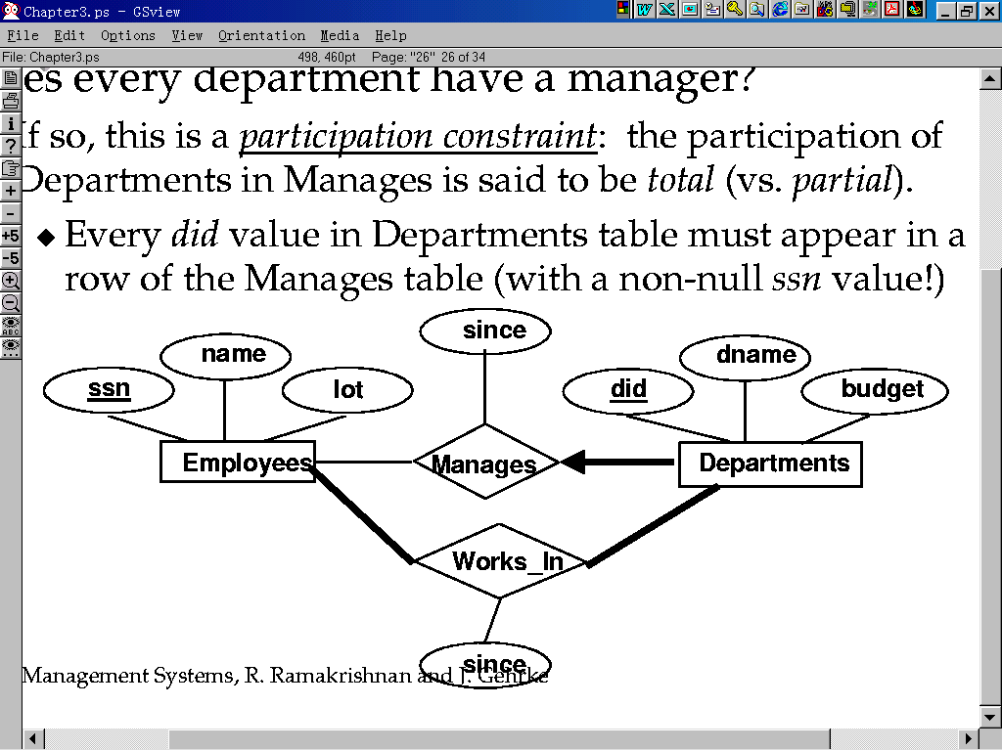
Relation with Constrains Translation
1
n
m
n

Slide 16
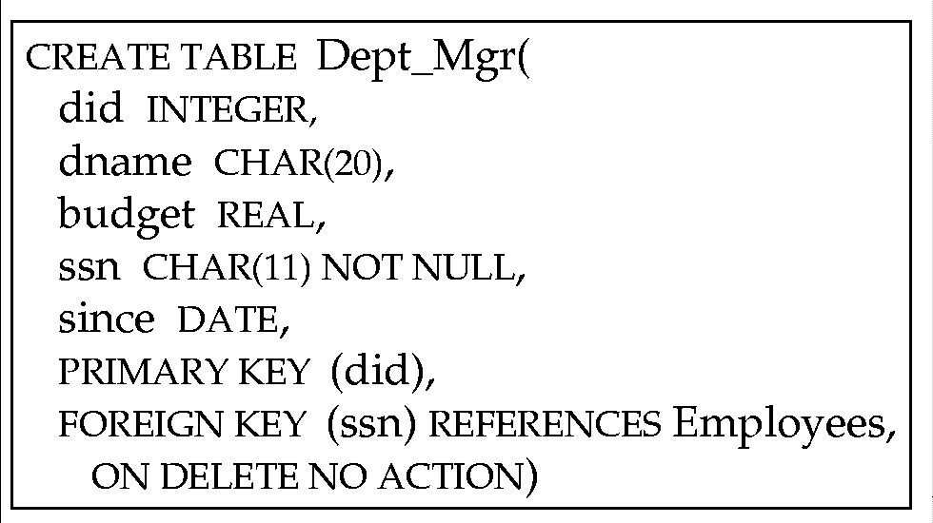
Constraints: 1:n(1:1)

Slide 17
Relation with Constrains Translation
ssn is NOT NULL --Constraints
Option 1 can represent Manages and Departments，but Option2 is better. WHY?
Option 2 won’t waste any space.

Slide 18
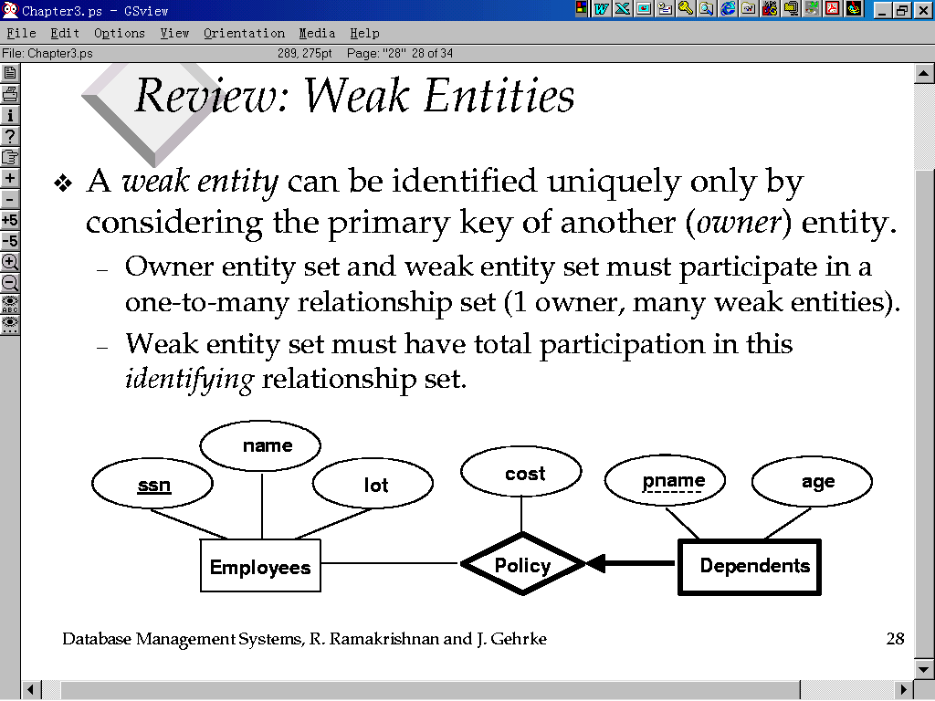
Weak Entity Translation
All weak entities paticipate in binary relation(?)
All paticipation
1
m

Slide 19
Weak Entity Translation
Option 2 for One-Many Relation translation （Why?）, but must consider the rest conditions
  Weak entity has a partial key
  Once delete the Owner entity, delete the related weak entity.

Slide 20
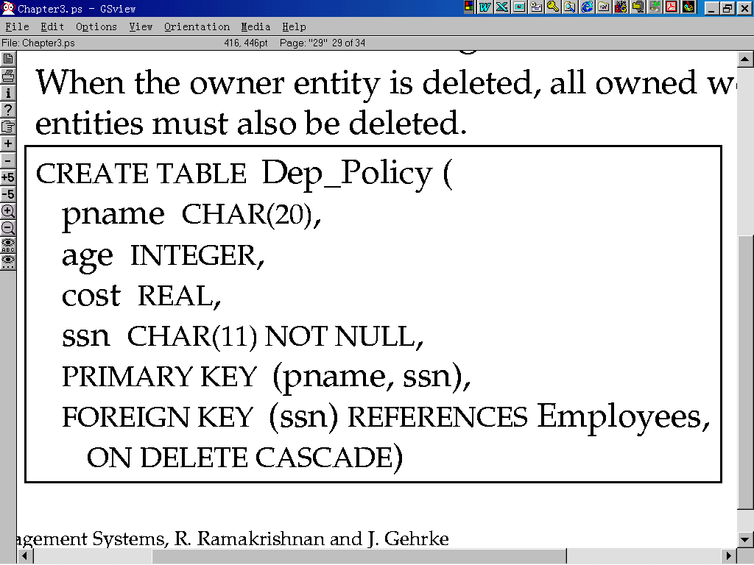
Example

Slide 21
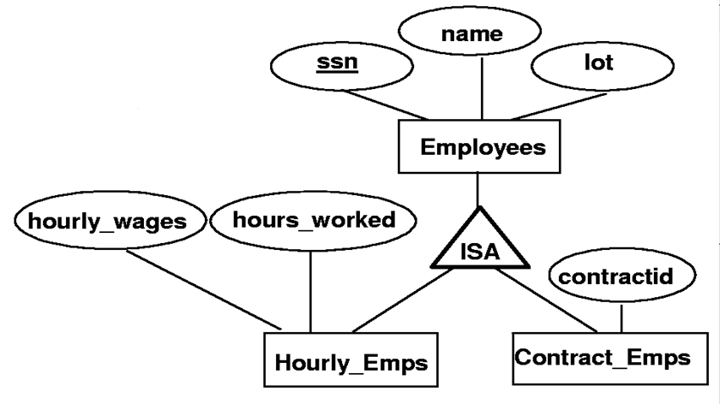
ISA Translation

Slide 22
Option1
Three Entities – Three Tables
  Employees Table
  Relation Hourly_Emps includes Attributes:ssn, hourly_wages, hours_worked,; ssn is both Primary Key Foreign Key; When delete the Super entity, delete the Child entity.
  Contract_Emps Table
  Question：Why Hourly_Emps does not include name and lot? Inheritage?

Slide 23
Option1
CREATE TABLE Hourly_Emps ( ssn CHAR(20),
  hourly_wages REAL,
  hours_worked INTEGER,
  PRIMARY KEY(ssn),
  FOREIG KEY (ssn) REFERENCES Employees,
  ON DELETE CASCADE )

Slide 24
Option 2
Three Entities – Two Tables
  Hourly_Emps and Contract_Emps. They all contains the attributes of the super entity Employees, no constraint is needed, unless the primary key constraints.
  Overlap Constraints are both needed by Option1 and Option2

Slide 25
Option1 vs. Option2
Option 1:当查询涉及到Employees的属性和其它一些细节属性时需要连接操作;当查询仅涉及到Employees的属性时则在Employees关系上进行即可;另一个优点是可以存储非Hourly_Emps和Contract_Emps的实体
方法二:主要确定无法存储非Hourly_Emps和Contract_Emps的实体,且name和lot出现了两次;优点是仅涉及到Hourly_Emps或Contract_Emps的查询仅在一个关系上进行即可,不需要额外的连接操作,但涉及到所有雇员的查询则需要在两个关系上进行;

