Slide 1
Chapter 14
Normalization
Pearson Education © 2009

Slide 2
Chapter 14 - Objectives
The purpose of normalization.
How normalization can be used when designing a relational database.
The potential problems associated with redundant data in base relations.
The concept of functional dependency, which describes the relationship between attributes.
The characteristics of functional dependencies used in normalization.
Pearson Education © 2009

Slide 3
Chapter 14 - Objectives
How to identify functional dependencies for a given relation.
How functional dependencies identify the primary key for a relation.
How to undertake the process of normalization.
How normalization uses functional dependencies to group attributes into relations that are in a known normal form.
Pearson Education © 2009

Slide 4
Chapter 14 - Objectives
How to identify the most commonly used normal forms, namely First Normal Form (1NF), Second Normal Form (2NF), and Third Normal Form (3NF).
The problems associated with relations that break the rules of 1NF, 2NF, or 3NF.
How to represent attributes shown on a form as 3NF relations using normalization.
Pearson Education © 2009

Slide 5
Purpose of Normalization
Normalization is a technique for producing a set of suitable relations that support the data requirements of an enterprise.
Pearson Education © 2009

Slide 6
Purpose of Normalization
Characteristics of a suitable set of relations include:
the minimal number of attributes necessary to support the data requirements of the enterprise;
attributes with a close logical relationship are found in the same relation;
minimal redundancy with each attribute represented only once with the important exception of attributes that form all or part of foreign keys.
Pearson Education © 2009

Slide 7
Purpose of Normalization
The benefits of using a database that has a suitable set of relations is that the database will be:
easier for the user to access and maintain the data;
take up minimal storage space on the computer.
Pearson Education © 2009

Slide 8
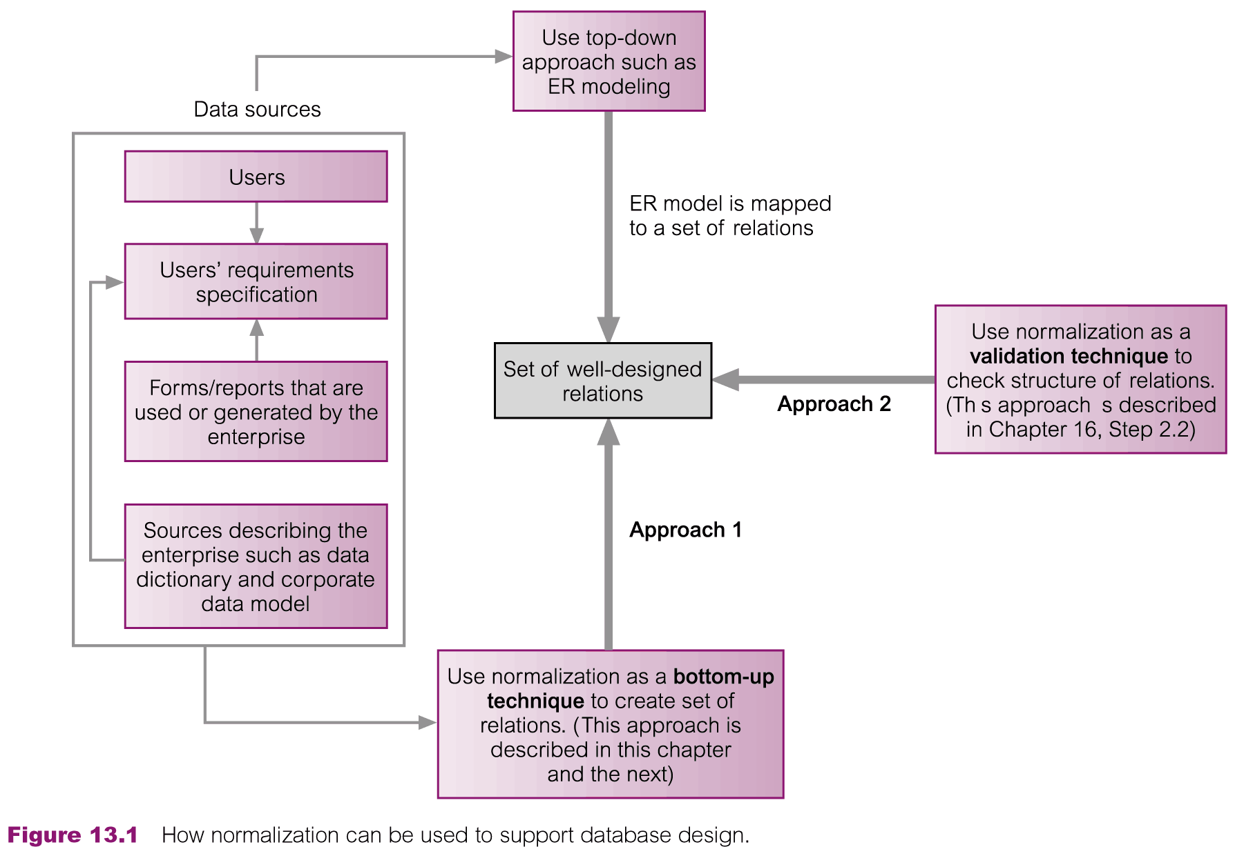
How Normalization Supports Database Design
Pearson Education © 2009

Slide 9
Data Redundancy and Update Anomalies
Major aim of relational database design is to group attributes into relations to minimize data redundancy.
Pearson Education © 2009

Slide 10
Data Redundancy and Update Anomalies
Potential benefits for implemented database include:
Updates to the data stored in the database are achieved with a minimal number of operations thus reducing the opportunities for data inconsistencies.
Reduction in the file storage space required by the base relations thus minimizing costs.
Pearson Education © 2009

Slide 11
Data Redundancy and Update Anomalies
Problems associated with data redundancy are illustrated by comparing the Staff and Branch relations with the StaffBranch relation.
Pearson Education © 2009

Slide 12
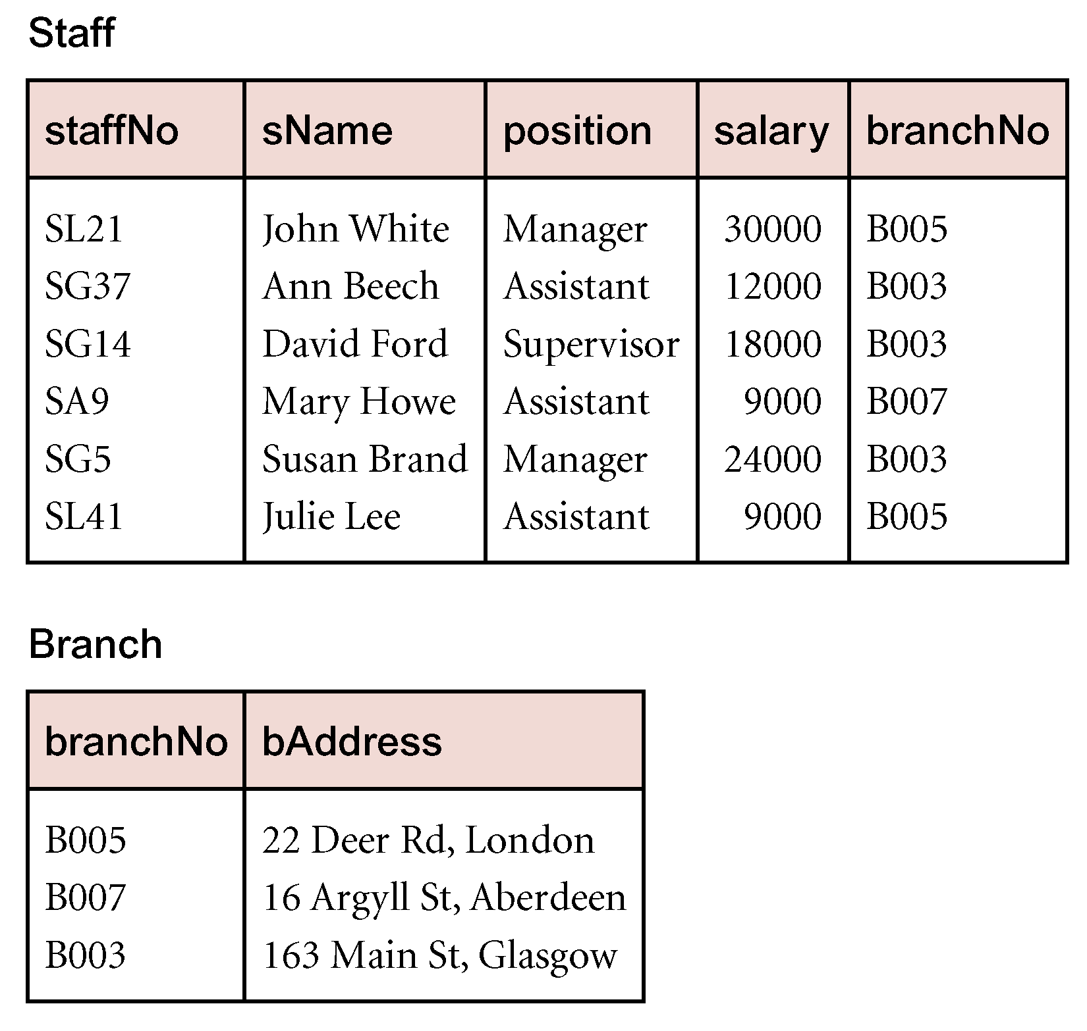
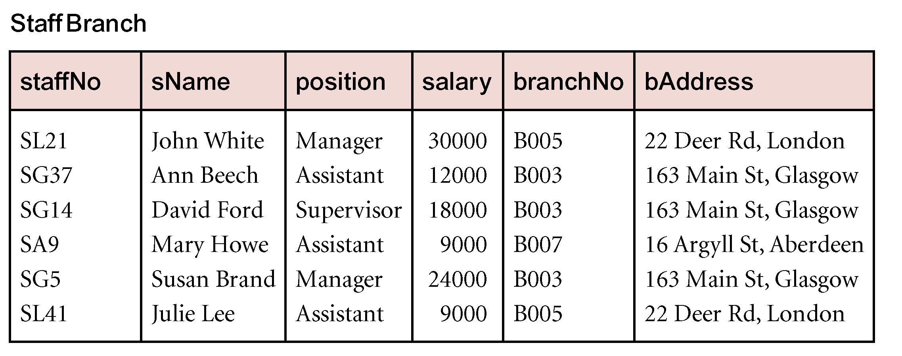
Data Redundancy and Update Anomalies
Pearson Education © 2009

Slide 13
Data Redundancy and Update Anomalies
StaffBranch relation has redundant data; the details of a branch are repeated for every member of staff.
In contrast, the branch information appears only once for each branch in the Branch relation and only the branch number (branchNo) is repeated in the Staff relation, to represent where each member of staff is located.
Pearson Education © 2009

Slide 14
Data Redundancy and Update Anomalies
Relations that contain redundant information may potentially suffer from update anomalies.
Types of update anomalies include
Insertion
Deletion
Modification
Pearson Education © 2009

Slide 15
Lossless-join and Dependency Preservation Properties
Two important properties of decomposition.
Lossless-join property enables us to find any instance of the original relation from corresponding instances in the smaller relations.
Dependency preservation property enables us to enforce a constraint on the original relation by enforcing some constraint on each of the smaller relations.
Pearson Education © 2009

Slide 16
Functional Dependencies
Important concept associated with normalization.
Functional dependency describes relationship between attributes.
For example, if A and B are attributes of relation R, B is functionally dependent on A (denoted A → B), if each value of A in R is associated with exactly one value of B in R.
Pearson Education © 2009

Slide 17
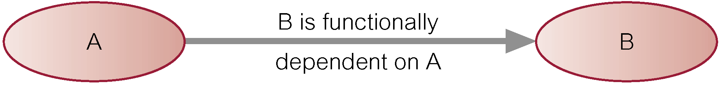
Characteristics of Functional Dependencies
Property of the meaning or semantics of the attributes in a relation.
Diagrammatic representation.
The determinant of a functional dependency refers to the attribute or group of attributes on the left-hand side of the arrow.
Pearson Education © 2009

Slide 18
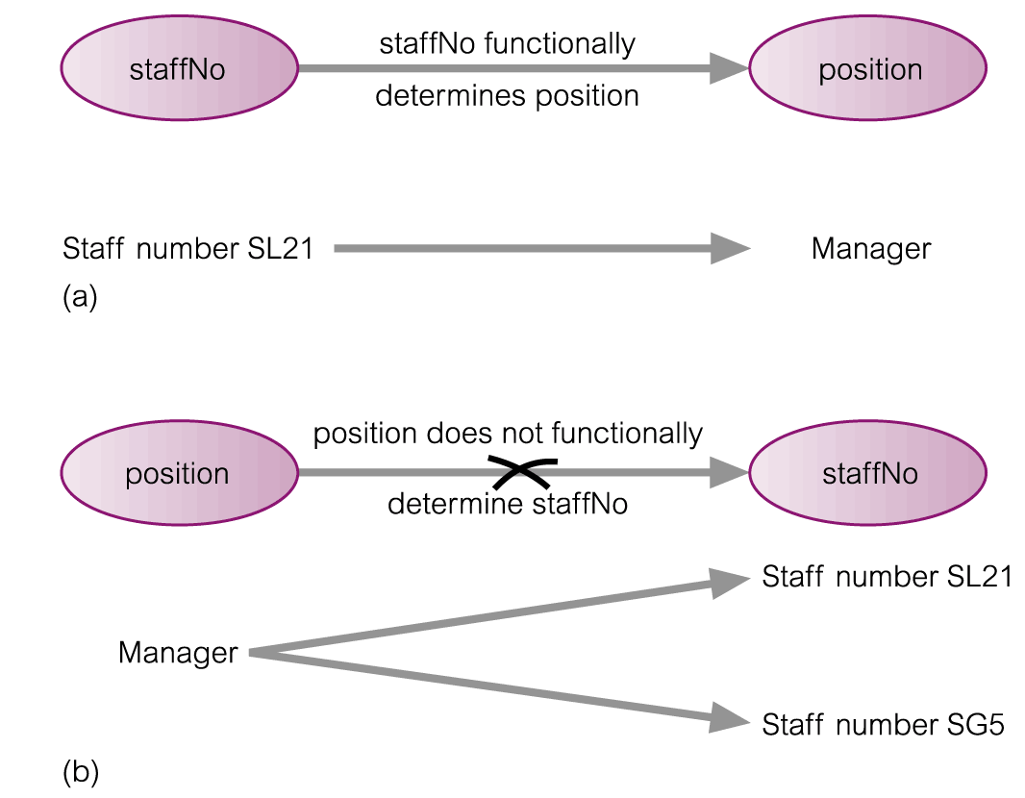
An Example Functional Dependency
Pearson Education © 2009

Slide 19
Example Functional Dependency that holds for all Time
Consider the values shown in staffNo and sName attributes of the Staff relation (see Slide 12).
Based on sample data, the following functional dependencies appear to hold.
staffNo → sName
sName → staffNo
Pearson Education © 2009

Slide 20
Example Functional Dependency that holds for all Time
However, the only functional dependency that remains true for all possible values for the staffNo and sName attributes of the Staff relation is:
staffNo → sName
Pearson Education © 2009

Slide 21
Characteristics of Functional Dependencies
Determinants should have the minimal number of attributes necessary to maintain the functional dependency with the attribute(s) on the right hand-side.
This requirement is called full functional dependency.
Pearson Education © 2009

Slide 22
Characteristics of Functional Dependencies
Full functional dependency indicates that if A and B are attributes of a relation, B is fully functionally dependent on A, if B is functionally dependent on A, but not on any proper subset of A.
Pearson Education © 2009

Slide 23
Example Full Functional Dependency
Example in the Staff relation (see Slide 12).
staffNo, sName → branchNo
True - each value of (staffNo, sName) is associated with a single value of branchNo.
However, branchNo is also functionally dependent on a subset of (staffNo, sName), namely staffNo. Example above is a partial dependency.
Pearson Education © 2009

Slide 24
Slide 12 again: Data Redundancy and Update Anomalies
Pearson Education © 2009

Slide 25
Characteristics of Functional Dependencies
Main characteristics of functional dependencies used in normalization:
There is a one-to-one relationship between the attribute(s) on the left-hand side (determinant) and those on the right-hand side of a functional dependency.
Holds for all time.
The determinant has the minimal number of attributes necessary to maintain the dependency with the attribute(s) on the right hand-side.
Pearson Education © 2009

Slide 26
Transitive Dependencies
Important to recognize a transitive dependency because its existence in a relation can potentially cause update anomalies.
Transitive dependency describes a condition where A, B, and C are attributes of a relation such that if A → B and B → C, then C is transitively dependent on A via B (provided that A is not functionally dependent on B or C).
Pearson Education © 2009

Slide 27
Example Transitive Dependency
Consider functional dependencies in the StaffBranch relation (see Slide 12).
staffNo → sName, position, salary, branchNo, bAddress
branchNo → bAddress
Transitive dependency, branchNo → bAddress exists on staffNo via branchNo.
Pearson Education © 2009

Slide 28
Slide 12 again: Data Redundancy and Update Anomalies
Pearson Education © 2009

Slide 29
The Process of Normalization
Formal technique for analyzing a relation based on its primary key and the functional dependencies between the attributes of that relation.
Often executed as a series of steps. Each step corresponds to a specific normal form, which has known properties.
Pearson Education © 2009

Slide 30
Identifying Functional Dependencies
Identifying all functional dependencies between a set of attributes is relatively simple if the meaning of each attribute and the relationships between the attributes are well understood.
This information should be provided by the enterprise in the form of discussions with users and/or documentation such as the users’ requirements specification.
Pearson Education © 2009

Slide 31
Identifying Functional Dependencies
However, if the users are unavailable for consultation and/or the documentation is incomplete then depending on the database application it may be necessary for the database designer to use their common sense and/or experience to provide the missing information.
Pearson Education © 2009

Slide 32
Example - Identifying a set of functional dependencies for the StaffBranch relation
Examine semantics of attributes in StaffBranch relation (see Slide 12). Assume that position held and branch determine a member of staff’s salary.
Pearson Education © 2009

Slide 33
Slide 12 again:
Pearson Education © 2009

Slide 34
Example - Identifying a set of functional dependencies for the StaffBranch relation
With sufficient information available, identify the functional dependencies for the StaffBranch relation as:
staffNo → sName, position, salary, branchNo, bAddress
branchNo → bAddress
bAddress → branchNo
branchNo, position → salary
bAddress, position → salary
Pearson Education © 2009

Slide 35
Example - Using sample data to identify functional dependencies.
Consider the data for attributes denoted A, B, C, D, and E in the Sample relation (see next slide).
Important to establish that sample data values shown in relation are representative of all possible values that can be held by attributes A, B, C, D, and E. Assume true despite the relatively small amount of data shown in this relation.
Pearson Education © 2009

Slide 36
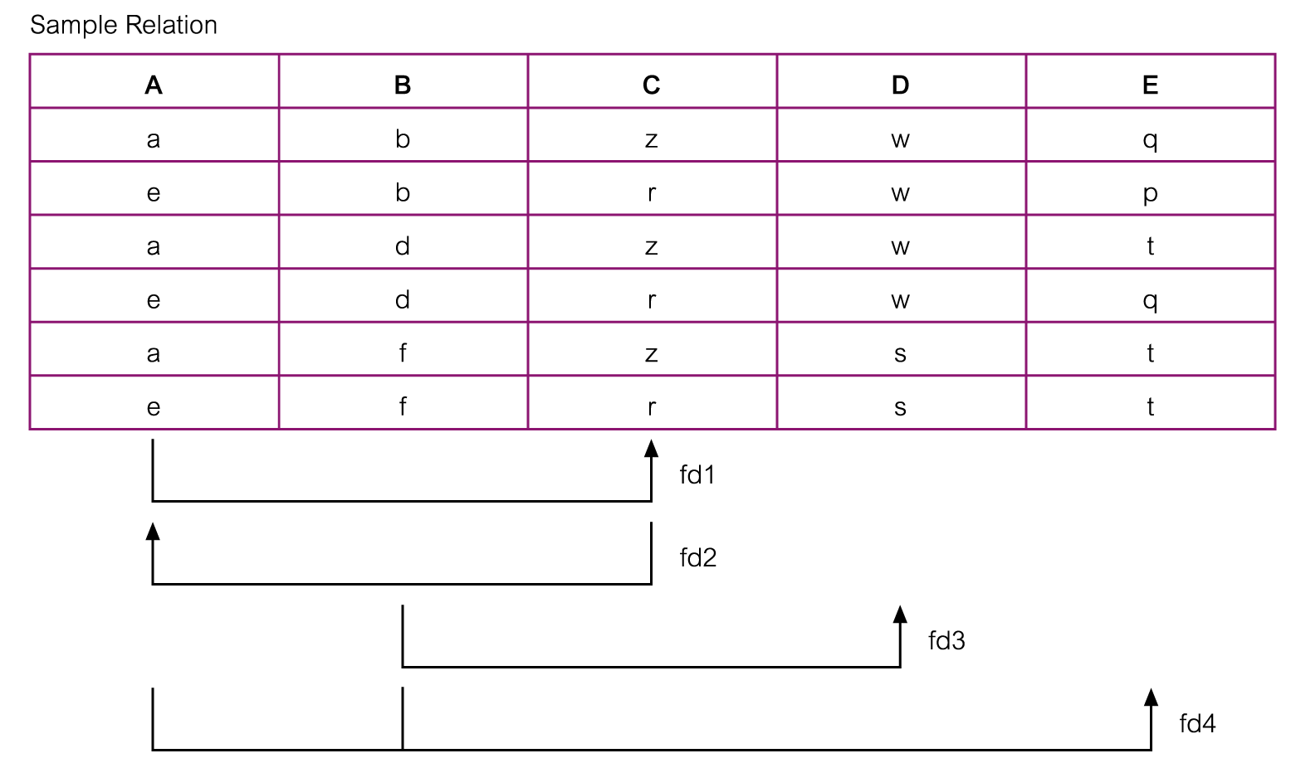
Example - Using sample data to identify functional dependencies.
Pearson Education © 2009

Slide 37
Example - Using sample data to identify functional dependencies.
Functional dependencies between attributes A to E in the Sample relation.
A → C (fd1)
C → A (fd2)
B → D (fd3)
A, B → E (fd4)
Pearson Education © 2009

Slide 38
Identifying the Primary Key for a Relation using Functional Dependencies
Main purpose of identifying a set of functional dependencies for a relation is to specify the set of integrity constraints that must hold on a relation.
An important integrity constraint to consider first is the identification of candidate keys, one of which is selected to be the primary key for the relation.
Pearson Education © 2009

Slide 39
Example - Identify Primary Key for StaffBranch Relation
StaffBranch relation has five functional dependencies (see Slide 34).
The determinants are staffNo, branchNo, bAddress, (branchNo, position), and (bAddress, position).
To identify all candidate key(s), identify the attribute (or group of attributes) that uniquely identifies each tuple in this relation.
Pearson Education © 2009

Slide 40
Slide 34 again: a set of functional dependencies for the StaffBranch relation
With sufficient information available, identify the functional dependencies for the StaffBranch relation as:
staffNo → sName, position, salary, branchNo, bAddress
branchNo → bAddress
bAddress → branchNo
branchNo, position → salary
bAddress, position → salary
Pearson Education © 2009

Slide 41
Example - Identifying Primary Key for StaffBranch Relation
All attributes that are not part of a candidate key should be functionally dependent on the key.
The only candidate key and therefore primary key for StaffBranch relation, is staffNo, as all other attributes of the relation are functionally dependent on staffNo.
Pearson Education © 2009

Slide 42
Example - Identifying Primary Key for Sample Relation
Sample relation has four functional dependencies (see Slide 37).
The determinants in the Sample relation are A, B, C, and (A, B). However, the only determinant that functionally determines all the other attributes of the relation is (A, B).
(A, B) is identified as the primary key for this relation.
Pearson Education © 2009

Slide 43
Example - Using sample data to identify functional dependencies.
Function dependencies between attributes A to E in the Sample relation.
A → C (fd1)
C → A (fd2)
B → D (fd3)
A, B → E (fd4)
Pearson Education © 2009

Slide 44
The Process of Normalization
As normalization proceeds, the relations become progressively more restricted (stronger) in format and also less vulnerable to update anomalies.
Pearson Education © 2009

Slide 45
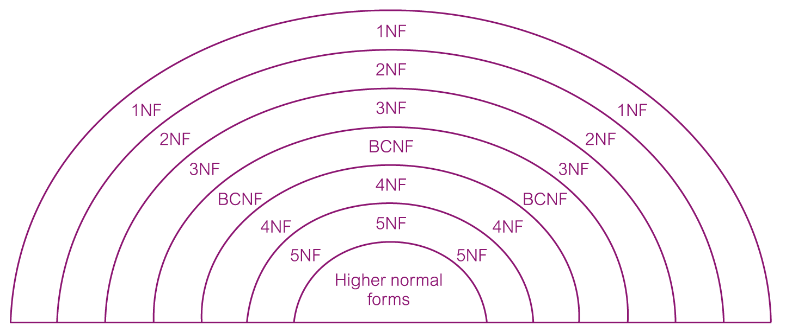
The Process of Normalization
Pearson Education © 2009

Slide 46
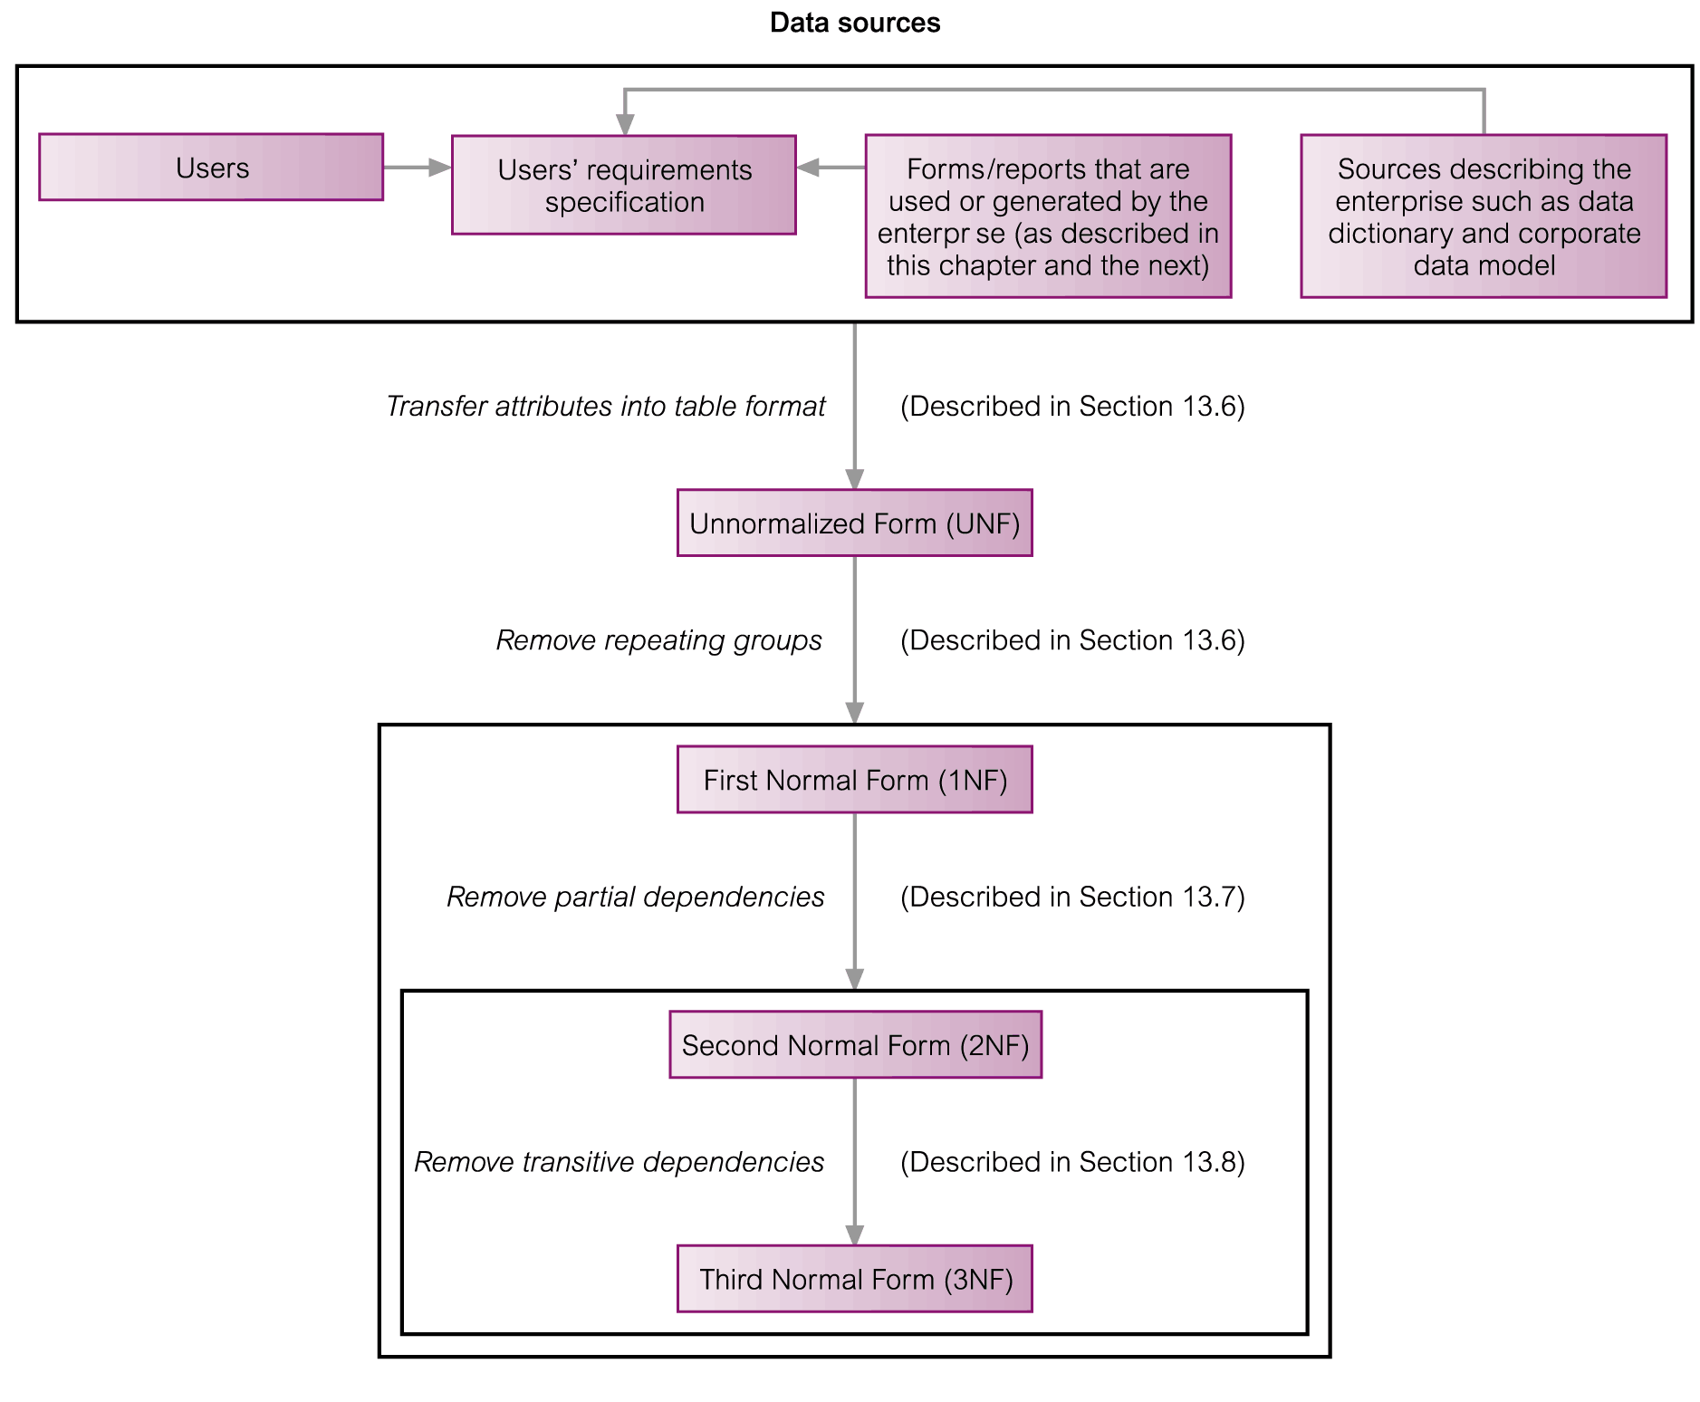
The Process of Normalization
Pearson Education © 2009

Slide 47
Unnormalized Form (UNF)
A table that contains one or more repeating groups.
To create an unnormalized table
Transform the data from the information source (e.g. form) into table format with columns and rows.
Pearson Education © 2009

Slide 48
First Normal Form (1NF)
A relation in which the intersection of each row and column contains one and only one value.
Pearson Education © 2009

Slide 49
UNF to 1NF
Nominate an attribute or group of attributes to act as the key for the unnormalized table.
Identify the repeating group(s) in the unnormalized table which repeats for the key attribute(s).
Pearson Education © 2009

Slide 50
UNF to 1NF
Remove the repeating group by
Entering appropriate data into the empty columns of rows containing the repeating data (‘flattening’ the table).
Or by
Placing the repeating data along with a copy of the original key attribute(s) into a separate relation.
Pearson Education © 2009

Slide 51
Second Normal Form (2NF)
Based on the concept of full functional dependency.
Full functional dependency indicates that if
A and B are attributes of a relation,
B is fully dependent on A if B is functionally dependent on A but not on any proper subset of A.
Pearson Education © 2009

Slide 52
Second Normal Form (2NF)
A relation that is in 1NF and every non-primary-key attribute is fully functionally dependent on the primary key.
Pearson Education © 2009

Slide 53
1NF to 2NF
Identify the primary key for the 1NF relation.
Identify the functional dependencies in the relation.
If partial dependencies exist on the primary key remove them by placing then in a new relation along with a copy of their determinant.
Pearson Education © 2009

Slide 54
1NF to 2NF
E.g. R = (A,B,C,D,E)
AB → C,D,E
B → D
Decompose relation to
R₁ = (A,B,C,E)
R₂ = (B,D)

Slide 55
Third Normal Form (3NF)
Based on the concept of transitive dependency.
Transitive Dependency is a condition where
A, B and C are attributes of a relation such that if A → B and B → C,
then C is transitively dependent on A through B. (Provided that A is not functionally dependent on B or C).
Pearson Education © 2009

Slide 56
Third Normal Form (3NF)
A relation that is in 1NF and 2NF and in which no non-primary-key attribute is transitively dependent on the primary key.
Pearson Education © 2009

Slide 57
2NF to 3NF
Identify the primary key in the 2NF relation.
Identify functional dependencies in the relation.
If transitive dependencies exist on the primary key remove them by placing them in a new relation along with a copy of their dominant.
Pearson Education © 2009

Slide 58
2NF to 3NF
E.g. R = (A,B,C,D,E)
A → B,C
C → D,E
So by transitivity, A → B,C,D,E, and is a key
Decompose relation to
R₁ = (A,B,C)
R₂ = (C,D,E)

Slide 59
General Definitions of 2NF and 3NF
Second normal form (2NF)
A relation that is in first normal form and every non-primary-key attribute is fully functionally dependent on any candidate key.
Third normal form (3NF)
A relation that is in first and second normal form and in which no non-primary-key attribute is transitively dependent on any candidate key.
Pearson Education © 2009

