Slide 1
Chapter 3
Database Architectures
and the Web
Dr. Huan Huo
University of Shanghai for Science and Technology

Slide 2
Chapter 3 - Objectives
The meaning of the client–server architecture and the advantages of this type of architecture for a DBMS
The difference between two-tier, three-tier and n-tier client–server architectures
The function of an application server
The meaning of middleware and the different types of middleware that exist
The function and uses of Transaction Processing (TP) Monitors

Slide 3
Chapter 3 - Objectives
The purpose of a Web service and the technological standards used
The meaning of service-oriented architecture (SOA)
The difference between distributed DBMSs, and distributed processing
The architecture of a data warehouse
The software components of a DBMS
About Oracle’s logical and physical structure

Slide 4
Multi-user DBMS Architectures
Teleprocessing
Traditional architecture for multi-user systems
One computer with a single central processing unit (CPU) and a number of terminals
Put a huge burden on the central computer
Downsizing
Replacing expensive mainframe computers with more cost-effective networks of personal computers

Slide 5
Multi-user DBMS Architectures
File-server architecture
Processing is distributed about the network
Three main disadvantages
Large amount of network traffic
Full copy of DBMS required on each workstation
Concurrency, recovery, and integrity control are complex
Multiple DBMSs can access the same files

Slide 6
Multi-user DBMS Architectures
Traditional two-tier client–server architecture
Client process requires some resource
Server provides the resource
Basic separation of four main components of business application (database, transaction logic, business logic & user interface)
Typical interaction between client and server

Slide 7
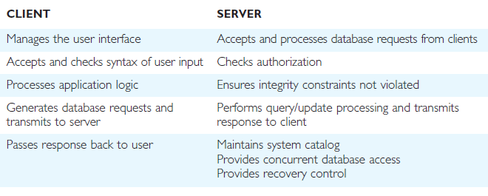
Summary of client–server functions

Slide 8
Multi-user DBMS Architectures
Three-tier client–server architecture
User interface layer
Business logic and data processing layer
DBMS
Many advantages over traditional two-tier or single-tier designs

Slide 9
Multi-user DBMS Architectures
N-tier architectures
Three-tier architecture can be expanded to n tiers
Application servers
Hosts an application programming interface (API) to expose business logic and business processes for use by other applications

Slide 10
Multi-user DBMS Architectures
Middleware
Software that mediates with other software
Communication among disparate applications
Six main types
Asynchronous Remote Procedure Call (RPC)
Synchronous RPC
Publish/Subscribe
Message-Oriented middleware (MOM)
Object-request broker (ORB)
SQL-oriented data access

Slide 11
Multi-user DBMS Architectures
Transaction processing monitor
Controls data transfer between clients/servers
Provides a consistent environment, particularly for online transaction processing (OLTP)
Significant advantages
Transaction routing
Managing distributed transactions
Load balancing
Funneling
Increased reliability

Slide 12
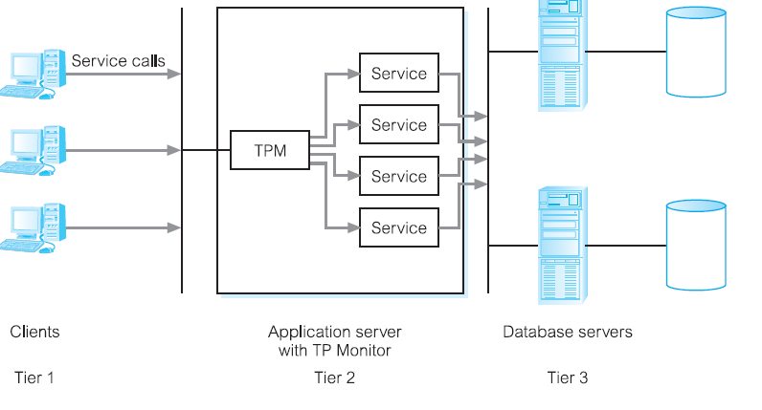
Multi-user DBMS Architectures
Transaction processing monitor

Slide 13
Distributed DBMSs
Characteristics of DDBMS
Collection of logically related shared data
Data split into fragments
Fragments may be replicated
Fragments/replicas are allocated to sites
Sites are linked by a communications network
Data at each site is controlled by DBMS
DMBS handles local apps autonomously
Each DBMS in one or more global application

Slide 14
Distributed DBMSs
Distributed processing
Centralized database that can be accessed over a computer network
System consists of data that is physically distributed across a number of sites in the network

Slide 15
Data Warehousing
Data warehouse
Consolidated/integrated view of corporate data
Drawn from disparate operational data sources
Range of end-user access tools capable of supporting simple to highly complex queries to support decision making
Subject-oriented, integrated, time-variant, and nonvolatile

Slide 16
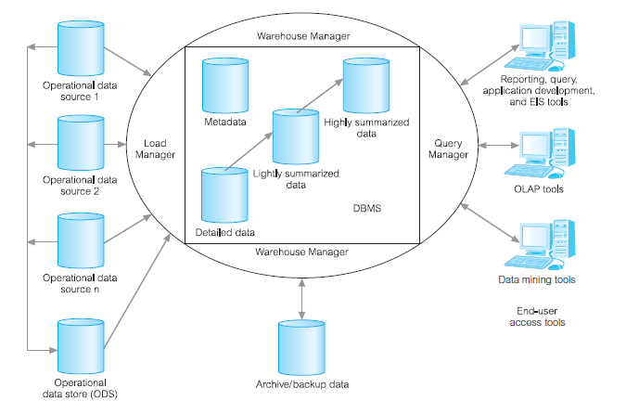
Typical Architecture of a Data Warehouse

Slide 17
Components of a DBMS
Major components of a DBMS:
Query processor
Database manager (DM)
File manager
DML preprocessor
DDL compiler
Catalog manager

Slide 18
Components of a DBMS
Major software components for database manager
Authorization control
Command processor
Integrity checker
Query optimizer
Transaction manager
Scheduler
Recovery manager
Buffer manager

Slide 19
Oracle Architecture
Oracle’s logical database structure
Tablespaces
Schemas
Data blocks
Extents/segments

Slide 20
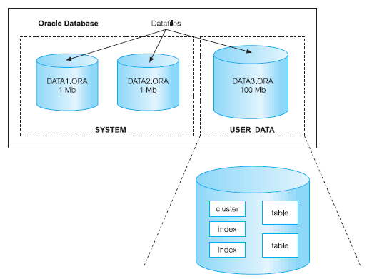
Relationship between an Oracle Database, Tablespaces, and Datafiles

Slide 21
Oracle Architecture
Oracle’s physical database structure
Datafiles
Redo log files
Control files
The Oracle instance
Oracle processes and shared memory required to access information in the database

