Slide 1
1D-CNN for time series
Mei Todaka 10/13/2018@Big Mtn Data

Slide 2











Thanks to our Sponsors!
Partners
Premier
Logo:

Slide 3
About me
Mei Todaka
Principal Industrial / Data Science Engineer at IM Flash
Math / Operations Research background
Recent interest
Deep learning (CNN, RNN, GAN, Deep Auto Encoder, new stuff for semi-supervised learning)
Natural Language Processing (Topic modeling, HMM, attention)
Half R / Half Python, SQL every day.
Native Japanese speaker

Slide 4
Questions
How many of you implemented CNN?
45 mins talk, 15 mins for question and discussion (or socialization).
Code demo. You can download and play with it later.
Notes:
5 mins

Slide 5
Vibration Analysis
Traditional vibration analysis – does not scale
Raw accelerometer data -> Fast Fourie Transformation
Manual diagnosis using domain knowledge
Using knowledge of specific type of components
Known parameter of the components (bearing diameter, shaft speed etc)
Only applicable for limited type of components (bearing, pumps etc)
An alternative – deep learning
I’m reproducing a model proposed by the following paper:
Wei Zhang,Gaoliang Peng, Chuanhao Li, Yuanhang Chen and Zhujin Zhang, “A New Deep Learning Model forFault Diagnosis with Good Anti-Noise and Domain Adaption Ability on RawVibration Signals”, MDPI Sensors, 2017.

Slide 6
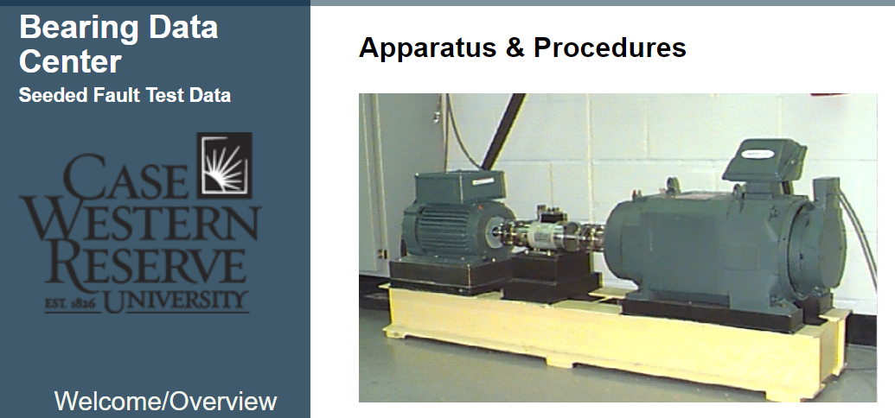
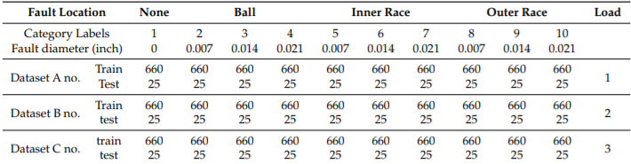
Bearing Fault Classification ~ data
Vibration data with 10 types of faults
1 of them is normal
3 types of running mode by motor load (HP)
Data is transformed to create 2048 data points samples
750 test samples
no overlap
17,800 training samples
overlapped (data augmentation)
2,000 validation samples
overlapped (data augmentation)

Slide 7
Data prep https://github.com/meitetsu3/1DCNN
data_prep.upynb
visualization.ipynb
Notes:
15 min

Slide 8
Demo on 1D-CNN
1DCNN_demo.jpynb
Notes:
10 min, total 25 min

Slide 9
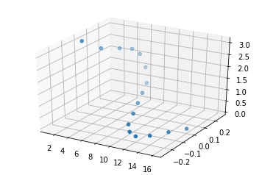
Explanation of 1D-CNN, why it works
1DConv.xlsx – 1 channel tab, 2 channel tab
It is like recognizing the shape of string.
Increasing the number of sensor is not too bad in terms of # of variables to optimize.
Notes:
10 minutes, 35 mins

Slide 10
Quiz
How many parameters?
Output shape?

Slide 11
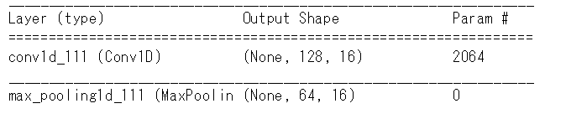
Quiz
How many parameters?
16 kernels, each 64 size, 2 channels
16x64x2=2048
+16 (each kernel has a bias)
2048+16 = 2064
Output shape
Each kernel with 64 length go through 2048 with 16 strides, with padding = ‘same’
2048/16 = 128
There are 16 kernels
(None, 128, 16)
Notes:
45 minutes

Slide 12
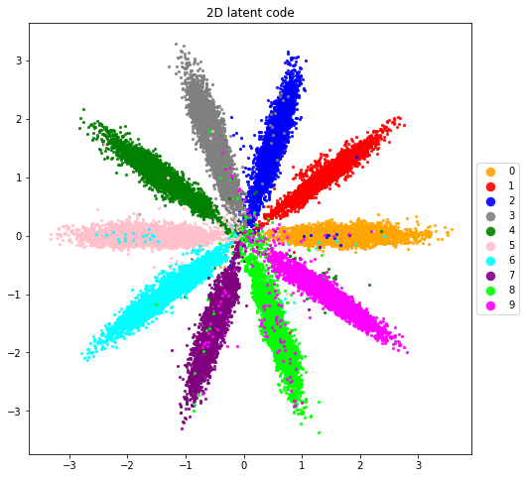
Questions / Discussions?
RNN
Takes wat longer to train. Accuracy?
Semi-supervised learning
Adversarial Auto Encoder
Imbalanced Deep Learning by Minority Class Incremental Rectification

