Slide 1
Wireless Charging: Unplugging the Future
A Guide to How it Works and Where It's Going
Presented by:
Name: Md Fahim
ID: IT21039
Year: 4th
Semester: 2nd
Supervised by:
Dr. Nazrul Islam
Associate Professor
Dept. of ICT, MBSTU

Slide 2
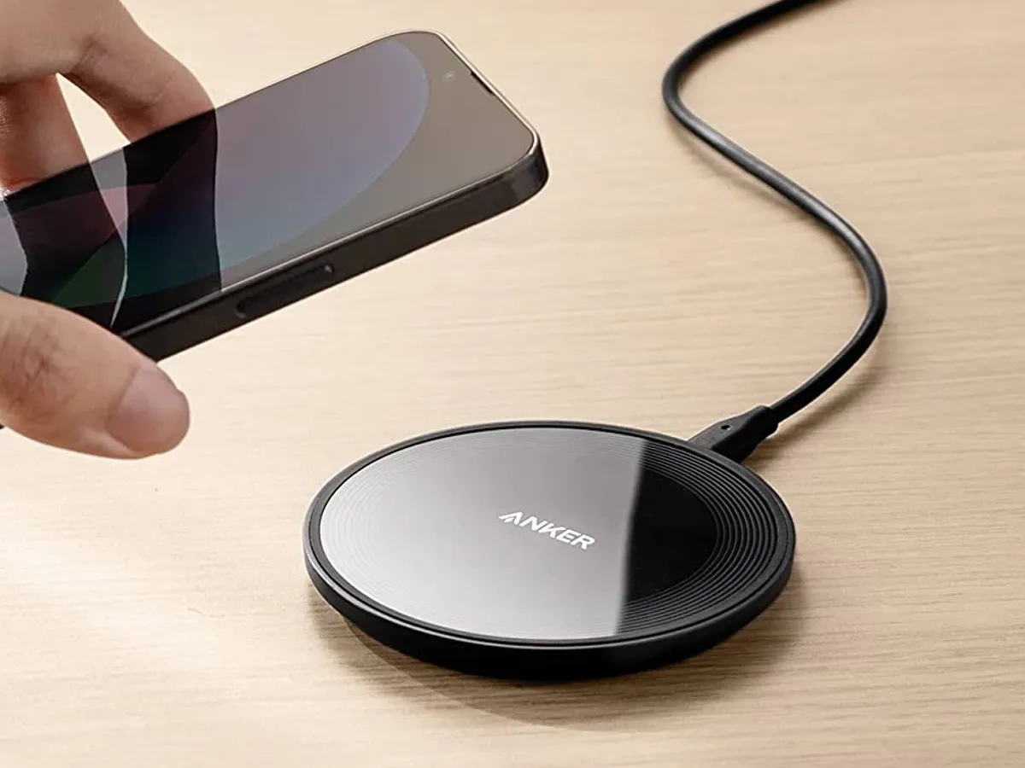
What is Wireless Charging?
Wireless charging is a technology that allows a device to be charged without a physical cable.
It's formally known as inductive power transfer (IPT).
It uses an electromagnetic field to transfer energy from a charging base (the "transmitter") to a compatible device (the "receiver").
You see it most often in smartphones, smartwatches, and wireless earbuds.

Slide 3
How it Works: The Magic of Induction
This technology is based on a 19th-century principle called electromagnetic induction.
1. Transmitter Coil: The charging pad (plugged into the wall) contains a coil of wire. When turned on, an alternating current flows through it, creating an oscillating magnetic field.
2. Receiver Coil: Your phone contains a similar (but smaller) coil.
3. Induction: When you place the phone's coil inside the pad's magnetic field, the field "induces" an electric current in the phone's coil.
4. Charging: This new current is converted into Direct Current (DC) and used to charge the device's battery.

Slide 4
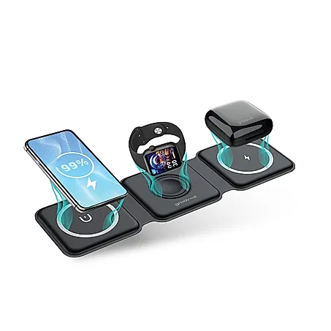
The Process: Step-by-Step
Plug In: The charging pad is plugged into a wall outlet, receiving AC power.
Create Field: The pad's internal components convert the power and send it to the transmitter coil, which generates a steady magnetic field.
Handshake: When you place your device on the pad, the receiver coil senses the field. The two coils "communicate" to confirm compatibility and determine the right amount of power to send.
Transfer Power: The pad begins to oscillate its magnetic field, which induces a current in the device's receiver coil.
Charge Battery: The device's internal circuits convert this new current and safely charge the battery.

Slide 5

The Standard: What is "Qi"?
You will see the "Qi" (pronounced "Chee") logo on almost all wireless charging products.
Qi is the dominant, open, universal standard for wireless charging, developed by the Wireless Power Consortium (WPC).
Why it matters: Qi ensures interoperability. Any Qi-certified device (like an iPhone, Google Pixel, or Samsung Galaxy) will work with any Qi-certified charger, regardless of the brand.
This standard is why you don't need a specific "iPhone charger" or "Samsung charger."

Slide 6
Advantages: Why Go Wireless?
Convenience: The #1 benefit. Simply drop your device on the pad and go. No fumbling with cables or finding the right plug.
Durability: It saves wear and tear on your device's charging port and on the cable itself. No more frayed cables or broken connectors.
Safety: A sealed, "no-contact" system means no exposed electrical connectors. This is safer in environments where water might be present (e.g., kitchen counters).
Clutter-Free: Creates a cleaner, more minimal aesthetic on your desk, nightstand, or in your car.

Slide 7
Disadvantages & Limitations
Efficiency: Wireless charging is less efficient than wired charging. Some energy (typically 15-30%) is lost as heat during the transfer.
Speed: While it's getting faster (Qi2 is closing the gap), it is often slower than the fastest wired "fast-charging" options.
Alignment: You must place the device on the "sweet spot" of the pad. Misalignment can stop the charge or make it very slow. (Note: MagSafe and the new Qi2 standard solve this with magnets).
Immobility: You can't comfortably pick up and use your phone while it's charging on a pad, unlike with a cable.

Slide 8
Applications Beyond the Phone
Wireless charging has been in use for longer than you might think!
Consumer Electronics: Electric toothbrushes (one of the first common uses), smartwatches, and wireless earbud cases.
Automotive: Many new cars have built-in Qi charging pads in the center console or dashboard.
Medical: Charging implanted medical devices like pacemakers or nerve stimulators, avoiding the need for invasive surgery to replace batteries.
Industrial: Powering tools, autonomous robots, and sensors in factory settings where cables are impractical or dangerous.

Slide 9
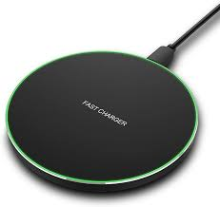
The Future of Wireless Power
The technology is rapidly evolving beyond just pads.
Resonant Charging: This allows charging "at a distance" (from a few inches to several feet) without a pad.
"True" Wireless Charging: The ultimate goal. Imagine walking into a room and your phone, laptop, and watch all start charging in your pocket or on your desk, powered by a transmitter hidden in the wall or ceiling.
Smarter Pads: Multi-device charging mats that can power your phone, watch, and buds all at once, no matter where you place them.
Higher Wattage: Powering larger devices, such as laptops, kitchen appliances, and even electric vehicles as they park over a charging mat.

Slide 10
Conclusion
Today: Wireless charging is a convenient and reliable technology, standardized by Qi, that has moved from a luxury to a common feature.
Tomorrow: It's the first step toward a truly cordless world, promising a future where power is delivered as seamlessly as Wi-Fi.

Slide 11
Q&A
Feel free to ask any question regarding the presentation.
Thank you.

