Slide 1
Setting up Jenkins with AWS

Slide 2
Create an AWS Account
Sign Up: Go to the AWS website and click on "Create an AWS Account".
Enter Details: Provide your email, password, and account name.
Billing Information: Enter your billing information (credit card details).
Choose Support Plan: Select a support plan that suits your needs (Basic, Developer, Business, Enterprise).
Identity Verification: Verify your identity through a phone call or SMS.

Slide 3
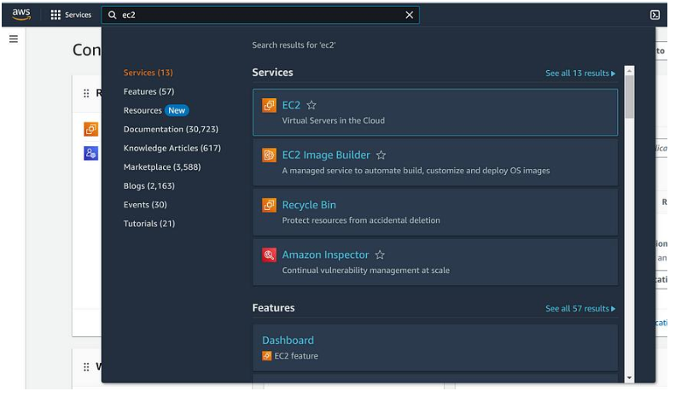
Create an EC2 Instance
Search and select ‘EC2’ on the AWS console.

Slide 4
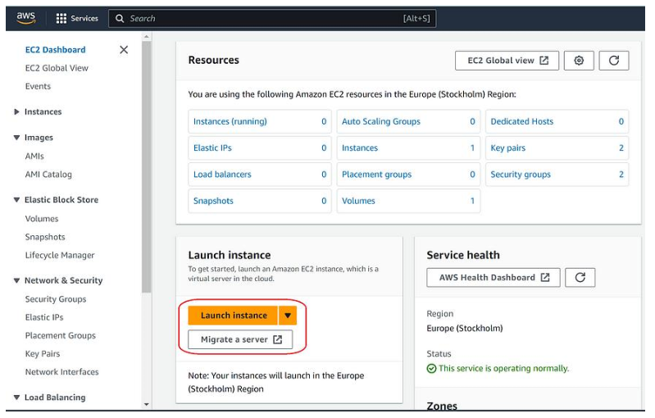
Create an EC2 Instance
On EC2 dashboard, click on Launch Instance.

Slide 5
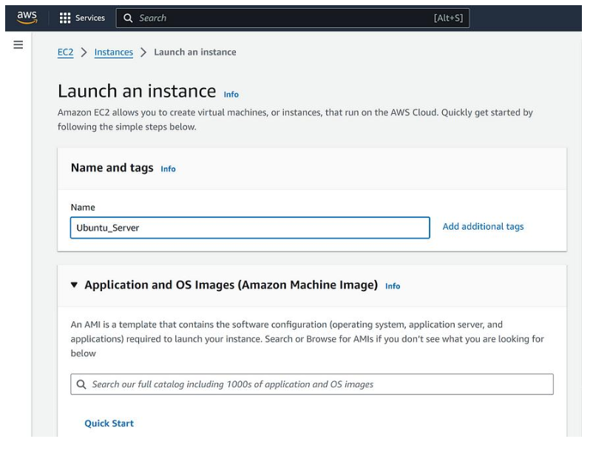
Create an EC2 Instance
Name your server anything you want, but it should be meaningful.

Slide 6
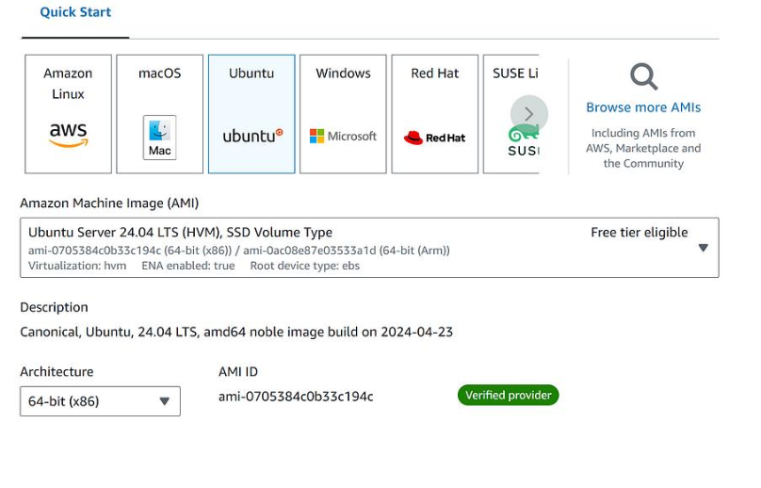
Create an EC2 Instance
Scroll down and from the OS options, select Ubuntu.

Slide 7
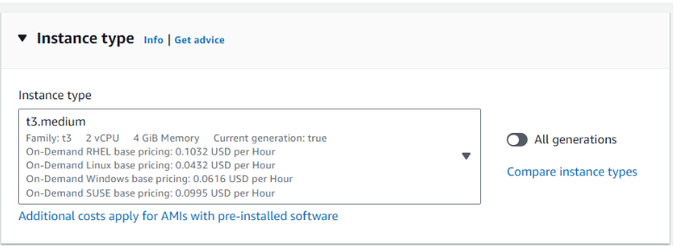
Create an EC2 Instance
Select instance Type

Slide 8
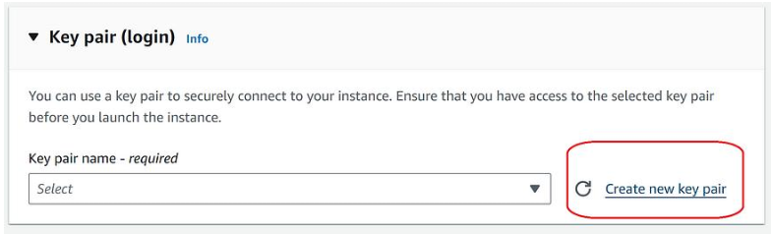
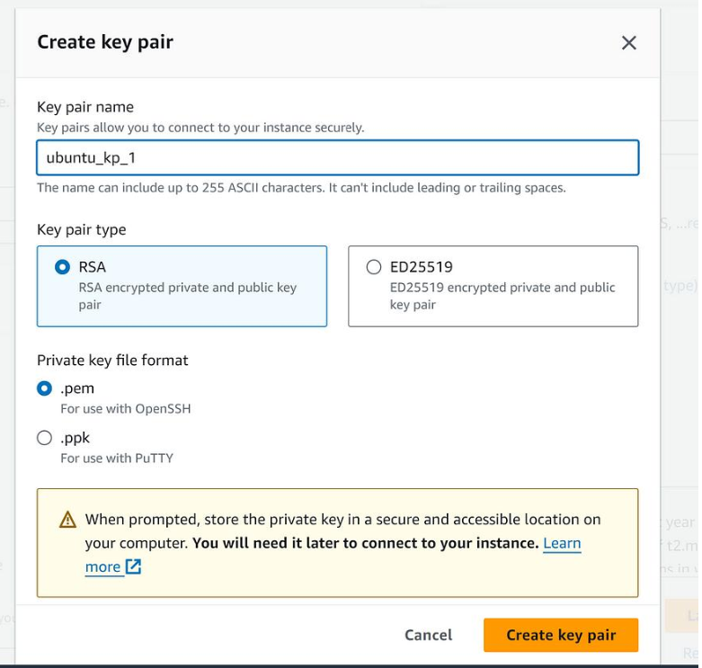
Create an EC2 Instance
Scroll down and click on ‘create new key pair’. In the pop up page, name
the key and then click ‘create key pair’.

Slide 9
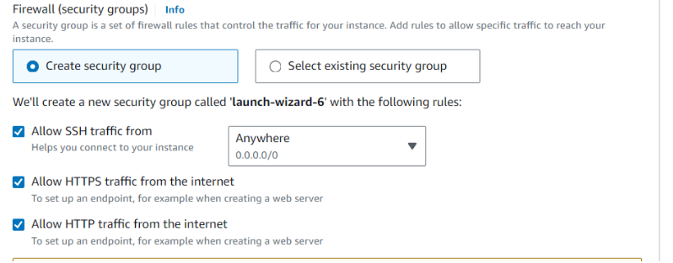
Create an EC2 Instance
Create a Security Group

Slide 10
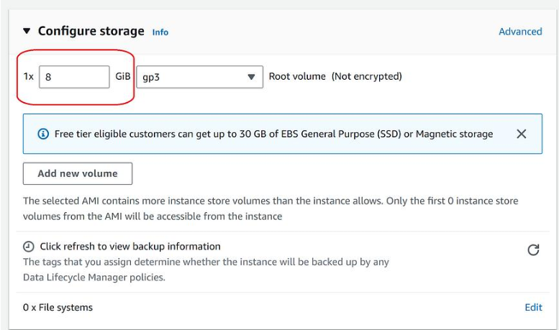
Create an EC2 Instance
Scroll down and select RAM

Slide 11
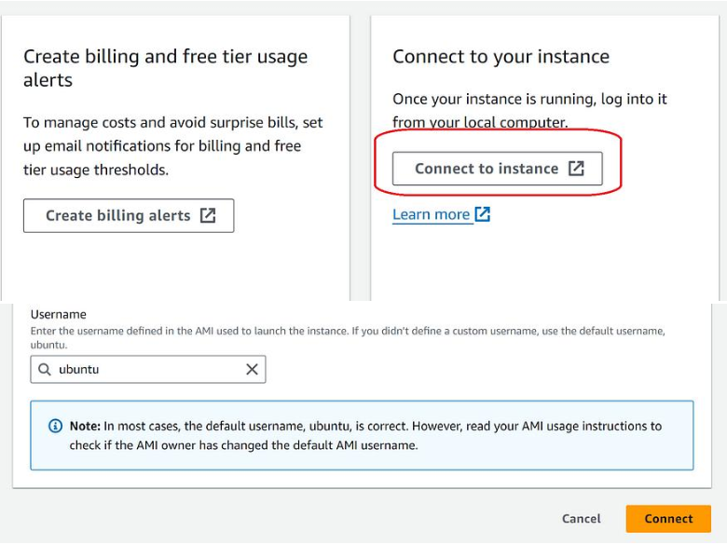
Create an EC2 Instance
Once the server is successfully created, click “Connect Instance”. On the next
page, simply click on ‘connect’ and it will take you to your server.

Slide 12
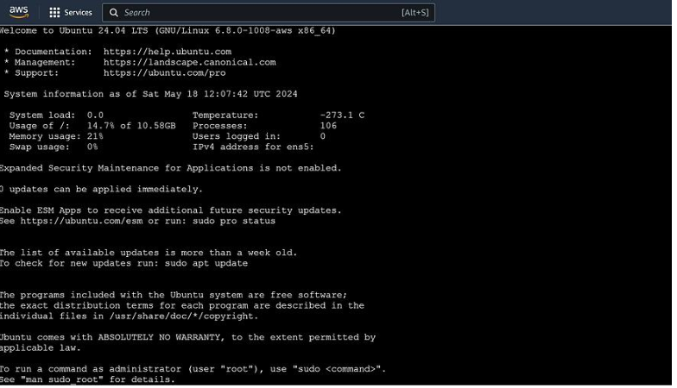
Install Jenkins on an Ubuntu server in AWS EC2 Instance.
You should now have an Ubuntu terminal open in your preferred Browser.

Slide 13
Install Jenkins on an Ubuntu server in AWS EC2 Instance.
Update the System and
Install java
sudo apt update
sudo apt install openjdk-21-jdk –y

Slide 14
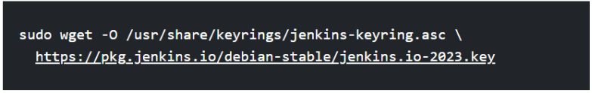
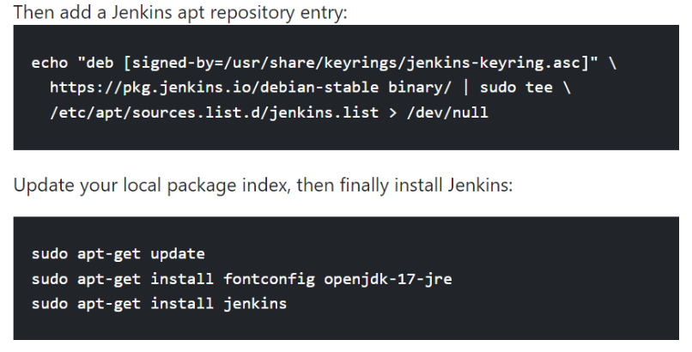
Install Jenkins on an Ubuntu server in AWS EC2 Instance.
Add the key and repository for Jenkins:
You can use the following commands when desired
sudo systemctl start jenkins
sudo systemcrl enable jenkins
sudo systemctl status jenkins

Slide 15
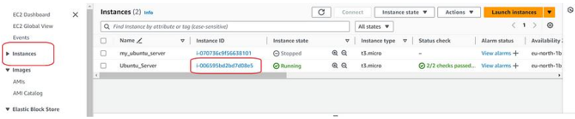
Install Jenkins on an Ubuntu server in AWS EC2 Instance.
If the above commands run successfully, Jenkins will be installed. Since
Jenkins runs on port 8080, we will allow this port on our server’s IP.
Go to EC2 instances and click on ‘Instance id’ of the server that you are
currently working on.

Slide 16
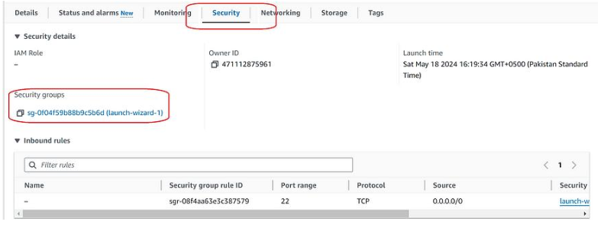
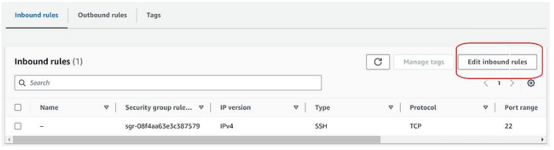
Install Jenkins on an Ubuntu server in AWS EC2 Instance.
On the page that opens, scroll down and select security and then click on a
security group.
Now, click on ‘Edit Inbound rules’

Slide 17
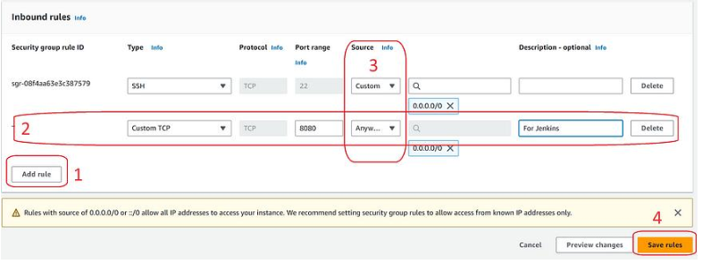
Install Jenkins on an Ubuntu server in AWS EC2 Instance.
Click on ‘Add rule’, then complete the new row as:
Type => Custom TCP
Port => 8080
Source => Anywhere IPV-4
At the end, click on ‘Save rules’.

Slide 18
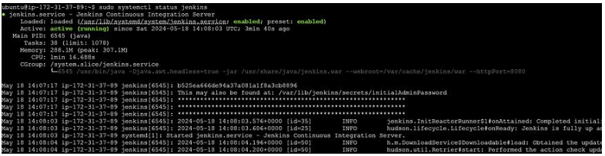
Install Jenkins on an Ubuntu server in AWS EC2 Instance.
Now, We will go back to our terminal
Run the following commands now:
1: sudo systemctl enable jenkins
2: sudo systemctl start jenkins
Optionally, you can check if Jenkins is running using the following
command:
sudo systemctl status jenkins

Slide 19
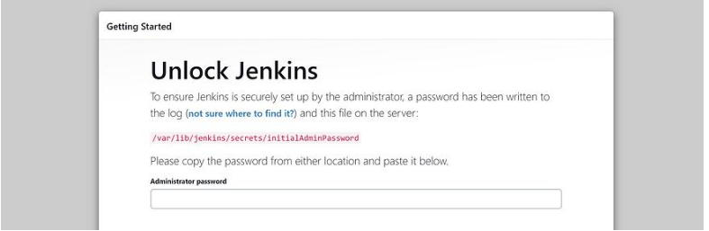
Install Jenkins on an Ubuntu server in AWS EC2 Instance.
write the following command to get the Jenkins initial password.
sudo cat /var/lib/jenkins/secrets/initialAdminPassword
Copy the password (Note the cntrl C would not work, select password, right
click and then copy)
Now, from your EC2 instance, click on the Ubuntu instance that is running
and copy the IPv4 public address. Paste the copied address in a new tab and
add ‘:8080’ in front of it like: 50.29.10.140:8080

Slide 20
Jenkins Configuration and Triggering the Job
First, install plugins for webhook
In Jenkins Dashboard:
Manage Jenkins => plugins => search Multibranch scan Webhook Trigger
Installed the plugins and then backed to Dashboard.
Create Jenkinsfile and push it to the repo.

Slide 21
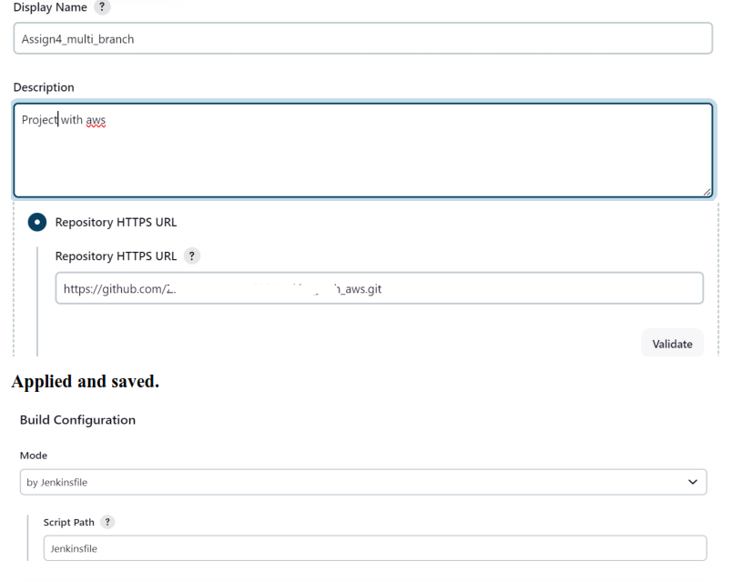
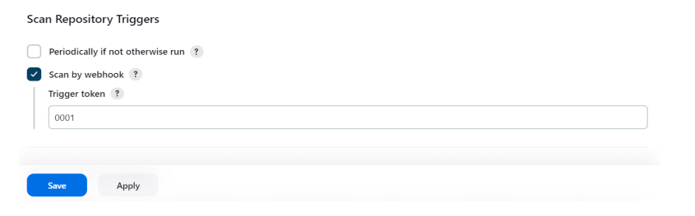
Jenkins Configuration and Triggering the Job
On Jenkins Dashboard, Create a new multibranch pipeline job.

Slide 22
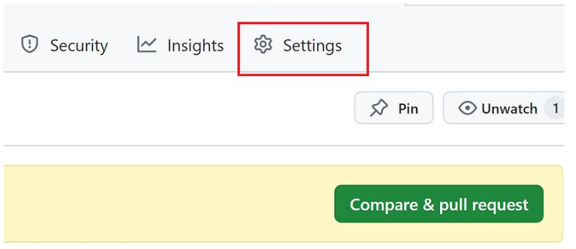
Jenkins Configuration and Triggering the Job
update settings for Webhook on GitHub
Go to Settings of the current Github repository.

Slide 23
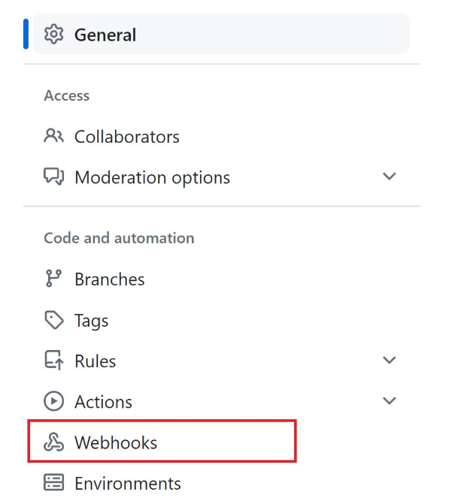
Jenkins Configuration and Triggering the Job
Under General tab select Webhooks

Slide 24
Create another instance in EC2 and install Apache Server on it
Connect to the instance as we did previously.
Update the system.
sudo apt update
Install Apache Server
sudo apt install apache2 -y
sudo systemctl enable apache2
sudo systemctl start apache2
Automation

Slide 25
Automation
Create a Directory for Deployment
Let’s say our website is going to /var/www/html/app
sudo mkdir -p /var/www/html/myapp
Set ownershio
sudo chown -R ubuntu:ubuntu /var/www/html/myapp
Enable SSH Access for Jenkins
Make sure sshd is running (sudo systemctl status sshd)
Get the public IP or DNS of this instance

Slide 26
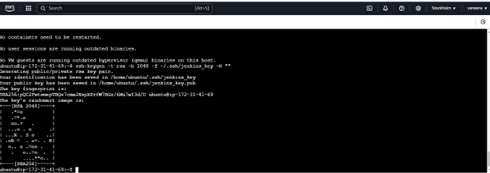
Automation
Create or authorize Jenkins's public key:
On Jenkins EC2: cat ~/.ssh/id_rsa.pub
sh-keygen -t rsa -b 2048 -f ~/.ssh/jenkins_key -N "“
On Apache EC2: Add that key to ~/.ssh/authorized_keys
echo "<JENKINS_PUBLIC_KEY>" >> ~/.ssh/authorized_keys
chmod 600 ~/.ssh/authorized_keys
sudo systemctl restart apache2

Slide 27
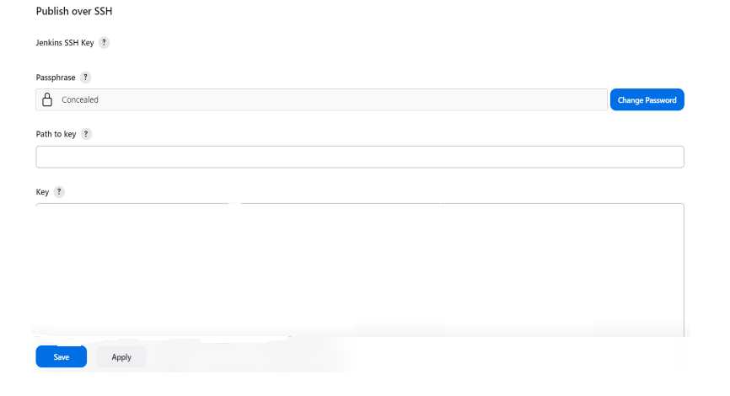
Automation
Then on Jenkins Dashboard => Manage Jenkins => System

Slide 28
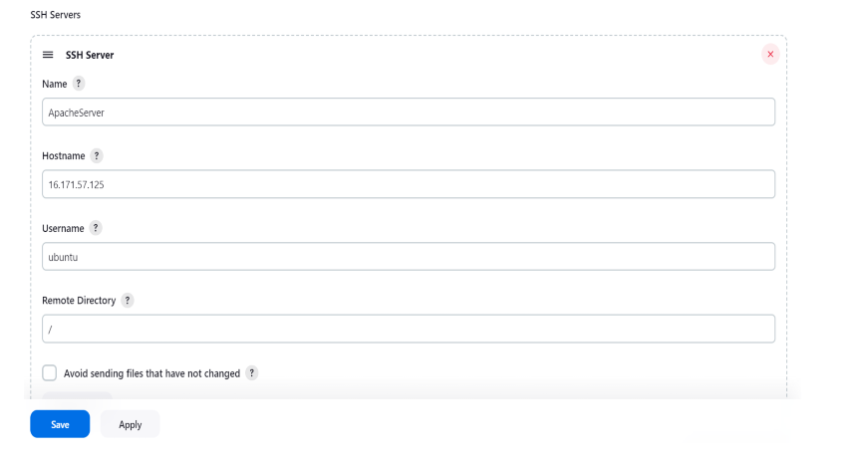
Automation
Then, fill ssh server form and save

Slide 29
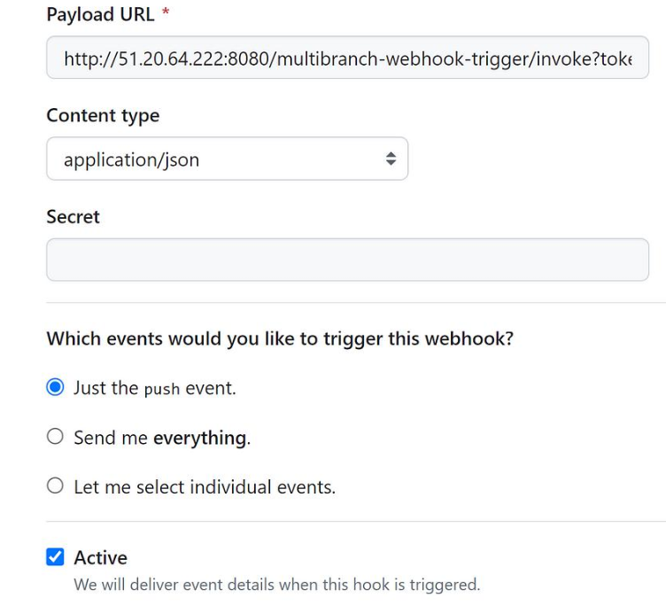
Jenkins Configuration and Triggering the Job
Click on add webhook and fill the desired fields

