Slide 1

Chapter 5 – Support Vector Machine
Prepared by: Shier Nee, SAW

Slide 2
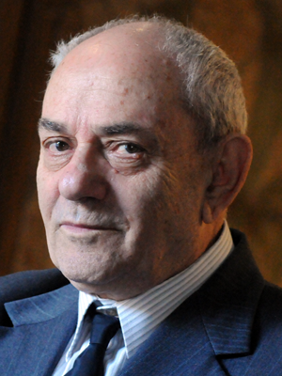
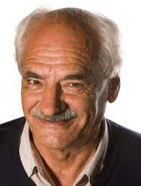
Support Vector Machine
Supervised learning models with associated learning algorithms that analyze data for classification and regression analysis.
The original SVM algorithm was invented by Vladimir N. Vapnik and Alexey Ya. Chervonenkis in 1963

Slide 3
Support Vector Machine
Robust algorithm for classification problems
Medical problems
Text and hypertext categorization
Image classification
Advantages:
SVM depends on convex optimization
Easy to use
Excellent performance on different type of datasets

Slide 4

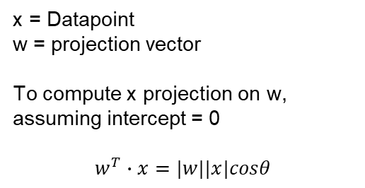




Projection Concept Recap
x = Datapoint
w = projection vector
To compute x projection on w, assuming intercept = 0
$$w^{T}∙x=|w||x|cosθ$$
x
w
$$θ$$
If $cosθ >0$ → Same side as w
x’
$$w^{′T}∙x=|w||x|cosθ$$
If $cosθ<0$ → Opposite side as w
If $w^{T}∙x$is +ve, same side as w
If $w^{T}∙x$is –ve, opposite side as w

Slide 5
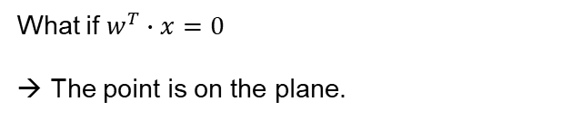
Projection Concept Recap
w
x = Datapoint
w = normal projection vector from the plane
We can determine which side of the x by computing projection of x onto w
x
If $w^{T}∙x$is +ve, same side as w
If $w^{T}∙x$is –ve, opposite side as w
x’
What if $w^{T}∙x=0$
→ The point is on the plane.

Slide 6
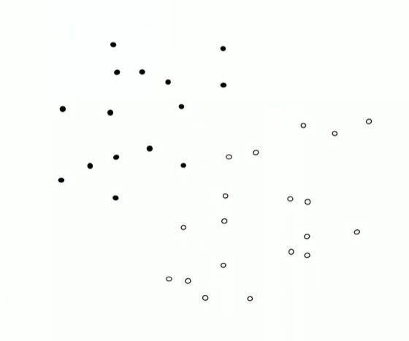

Linear Classifier
Assuming we have these point, we want to classify into black and white points.
We need a hyperplane, which is defined by the
normal vector to the plane, w
Intercept, b
w
We want to have a classifier with a function of w and b.
x
f (w,b)
y
We defined x as the point, y as {-1, 1}
Black point = -1 ; white point = 1
$$y=f\left(x;w, b\right)=\operatorname{sgn}\left(w^{T}∙x+b\right)$$

Slide 7
Linear Classifier
Questions:
We can have different hyperplane.
How do we choose the w and b so that we have an optimum classifier?
What we need is a evaluation metrics to determine the a good classifier.
In SVM, we evaluate the margin in which we want to maximize the margin between the points and the hyperplane.

Slide 8
Linear Classifier
Tight margin
Maximize margin
To find which margin is the best, we need to measure the margin → distance between point that touch the margin and the plane

Slide 9




Compute the margin
$$\left\{x:<w,x\right\}+b=−1\}$$
We first define our decision boundary function
$$y=f\left(x;w, b\right)=sgn(w^{T}∙x+b)$$
$$\left\{x:<w,x\right\}+b=+1\}$$
What we know is
+ve value → points are same as as w
-ve value → points are opposite as as w
Zero value → points are on the hyperplane
w
$$\left\{x:<w,x\right\}+b=0\}$$

Slide 10



Compute the margin
We need to compute the distance between x to the hyperplane.
So we need a projection of x to hyperplane → x’
Projection (x-x’) onto w = $\frac{w^{T}(x−x^{′})}{|w|}∙\frac{w}{\left|w\right|};$ $w^{T}x−w^{T}x^{′}$
x
x'
We know $w^{T}\left(x^{′}\right)+b=0$ → $−b= w^{T}\left(x^{′}\right)$
w
Projection (x-x’) onto w = $\frac{w^{T}x+b}{|w|}∙\frac{w}{|w|}$
Distance between x to x’ is $\frac{w^{T}x+b}{|w|}$

Slide 11




Compute the margin
|x¹-x’| = $\frac{w^{T}x1+b}{|w|}$ = $\frac{1}{|w|}$
|x²-x’| = $\frac{w^{T}x2+b}{|w|}$ = $\frac{1}{|w|}$
|x¹-x²| = $\frac{2}{|w|}$
We want to maximize this
w
Equivalent to minimizing the inverse, $\frac{|w|}{2}$
Or even better to minimizing the convex form, $\frac{|w|2}{2}$

Slide 12
Objective function
Or even better to minimizing the convex form, $\frac{|w|2}{2}$
Next thing to take note is to ensure the points sit on the correct side.
Add a constraint to the objective function

Slide 13






Objective function
3 scenarios:
Correct side but inside the margin
Correct side and outside the margin
Wrong side
$$\left\{x:<\left\langle w,x\right\rangle \right\}+b=−1\}$$
$$−1<\left(\left\langle w,x_{i}\right\rangle +b\right)<1$$
$$\left\{x:<\left\langle w,x\right\rangle \right\}+b=+1\}$$
w
For $yi=−1, \left(\left\langle w,x_{i}\right\rangle +b\right)<−1$
For $yi=+1, \left(\left\langle w,x_{i}\right\rangle +b\right)>+1$
For $yi=−1, \left(\left\langle w,x_{i}\right\rangle +b\right)>0$
For $yi=1, \left(\left\langle w,x_{i}\right\rangle +b\right)<0$
$$\left\{x:<\left\langle w,x\right\rangle \right\}+b=0\}$$

Slide 14

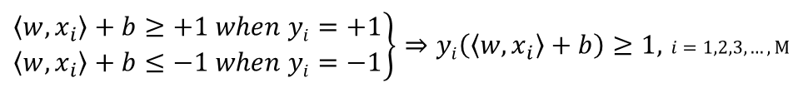
To solve the constrained optimization – Primal Form
Finding the optimal hyperplane is an optimizing problem
$$min\frac{|w|2}{2}$$
$\left.\begin{matrix}\left\langle w,x_{i}\right\rangle +b≥+1 when yi=+1 \\ \left\langle w,x_{i}\right\rangle +b≤−1 when yi=−1\end{matrix}\right\}⇒yi\left(\left\langle w,x_{i}\right\rangle +b\right)≥1,$ $i=1,2,3,…, M$
N+1 parameters (N: dimension of data)
M constraints (M; number of datapoints)
Primal problem

Slide 15
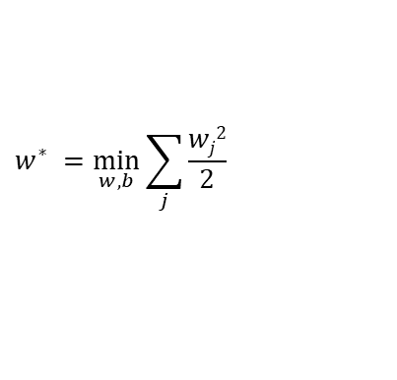

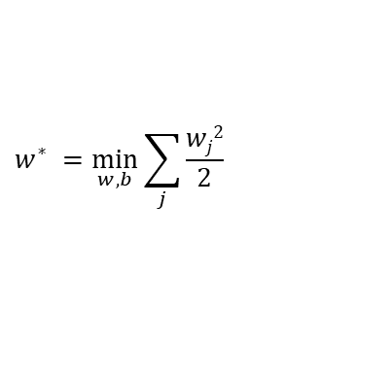

To solve the constrained optimization – Dual Form
We want to minimize the following with constrains.
$$w^{∗} =\min_{w,b}{\sum_{j}{\frac{wj2}{2}}}$$
s.t
$$yi\left(\left\langle w,x_{i}\right\rangle +b\right)≥+1$$
Such problem is not trivial, we can use Lagrangian optimization
Rewrite the equation so that it is not positive inequality.
$$w^{∗} =\min_{w,b}{\sum_{j}{\frac{wj2}{2}}}$$
s.t
$$1−yi\left(\left\langle w,x_{i}\right\rangle +b\right)≤0$$

Slide 16


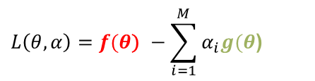




To solve the constrained optimization – Dual Form
$$w^{∗} =\min_{w,b}{\sum_{j}{\frac{wj2}{2}}}$$
s.t
$$1−yi\left(\left\langle w,xi\right\rangle +b\right)≤0$$
$f(θ$)
$g(θ$)
Introduce M Lagrange multipliers, $α$
$$L\left(θ, α\right)=f(θ\text{)} −\sum_{i=1}^{M}{α_{i}g(θ\text{) }}$$
$$Minimize$$
$$Maximize$$
$$L=\max_{α}{(\min_{θ}{L(θ, α}))}$$
Lagrange Dual Form

Slide 17
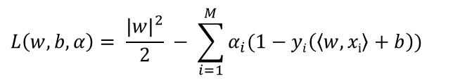

To solve the constrained optimization
We use M Lagrange multipliers, $α$, with $α_{i}≥0$
$$L\left(w, b, α\right)= \frac{{|w|}^{2}}{2} − \sum_{i=1}^{M}{α_{i}(1−yi\left(\left\langle w,xi\right\rangle +b\right))}$$
Maximize the margin
Ensure point at the correct side
To minimize $L\left(w, b, α\right)$, we need to find a stationary point that satisfies
$$<w^{∗},b^{∗},α^{∗}>=\max_{α}{(\min_{w,b}{L(w, b, α}))}$$

Slide 18
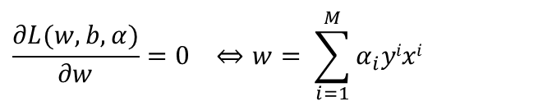
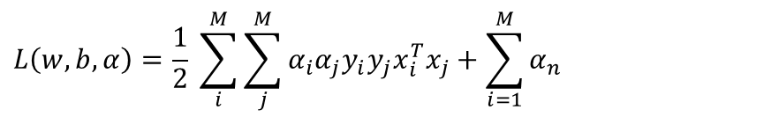
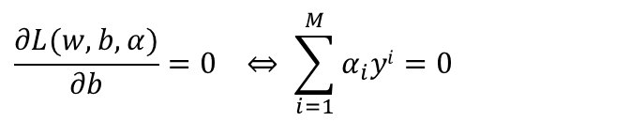
To solve the constrained optimization
We find partial derivative of
$$\frac{∂L(w,b,α)}{∂w}=0 ⇔w= \sum_{i=1}^{M}{α_{i}yixi}$$
$$\frac{∂L(w,b,α)}{∂b}=0 ⇔ \sum_{i=1}^{M}{α_{i}yi}=0$$
Plugging these into the Lagrangian yields the following:
$$L\left(w,b, α\right)=\frac{1}{2} \sum_{i}^{M}{\sum_{j}^{M}{α_{i}α_{j}y_{i}y_{j}x_{i}^{T}x_{j}}}+\sum_{i=1}^{M}{α_{n}}$$
This will normally solve using Sequential Minimal Optimization algorithm (SMO)

Slide 19
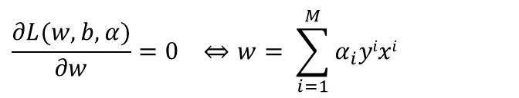

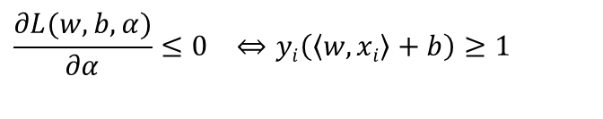
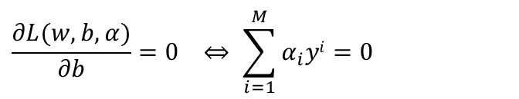
Inequalities to solved
$$\frac{∂L(w,b,α)}{∂w}=0 ⇔w= \sum_{i=1}^{M}{α_{i}yixi}$$
Dual feasibility
$$\frac{∂L(w,b,α)}{∂b}=0 ⇔ \sum_{i=1}^{M}{α_{i}yi}=0$$
Dual feasibility
$$\frac{∂L(w,b,α)}{∂α}≤0 ⇔yi\left(\left\langle w,xi\right\rangle +b\right)≥1$$
Primal feasibility
Combine all → Karush-Kuhn-Tucker(KKT) conditions
$$α_{i}\left(1−yi\left(\left\langle w,xi\right\rangle +b\right)\right)=0, ∀ i=1,…, M$$
$$α_{i}≥0,∀ i=1,…, M$$

Slide 20

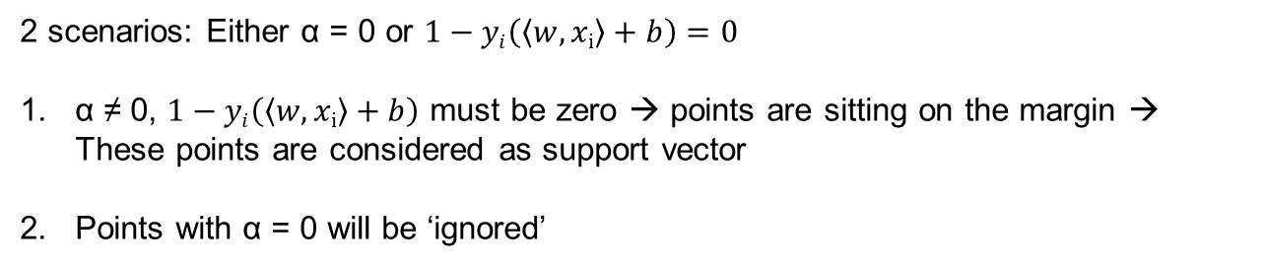
Inequalities to solved
Must satisfies Karush-Kuhn-Tucker(KKT) conditions
$$α_{i}\left(1−yi\left(\left\langle w,xi\right\rangle +b\right)\right)=0, ∀ i=1,…, M$$
$$α_{i}≥0,∀ i=1,…, M$$
2 scenarios: Either α = 0 or $1−yi\left(\left\langle w,xi\right\rangle +b\right)=0$
α ≠ 0, $1−yi\left(\left\langle w,xi\right\rangle +b\right)$ must be zero → points are sitting on the margin → These points are considered as support vector
Points with α = 0 will be ‘ignored’

Slide 21
Geometrical Interpretation
Points with α = 0, will NOT considered in defining hyperplane
Points with α ≠ 0, will considered in defining hyperplane
Points with α = 0, will NOT considered in defining hyperplane

Slide 22

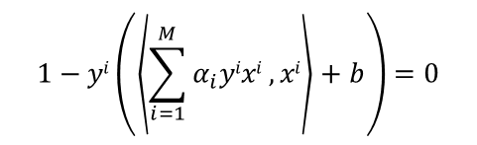
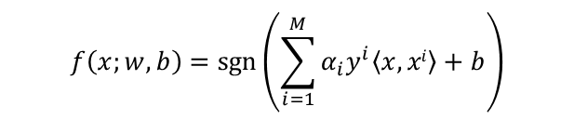

Decision Function
Decision Function
$$y=f\left(x;w, b\right)=\operatorname{sgn}\left(w^{T}∙x+b\right)$$
We know
$$w= \sum_{i=1}^{M}{α_{i}yixi}$$
Prediction of y can be obtained via the following by substituting w to decision function
$$f\left(x;w, b\right)=\operatorname{sgn}\left(\sum_{i=1}^{M}{α_{i}y^{i}\left\langle x,xi\right\rangle }+b\right)$$
Solve the following to get b
$$1−yi\left(\left\langle \sum_{i=1}^{M}{α_{i}yixi},xi\right\rangle +b\right)=0$$

Slide 23

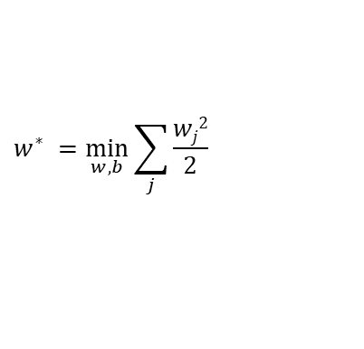

SVM Theory :
Maximizing margin to best classifying the two classes.
Maximize margin
$$<w^{∗},b^{∗},α^{∗}>=\max_{α}{(\min_{w,b}{L(w, b, α}))}$$
No data point are allow to be in the wrong side → Hard margin
$$w^{∗} =\min_{w,b}{\sum_{j}{\frac{wj2}{2}}}$$
s.t
$$yi\left(\left\langle w,x_{i}\right\rangle +b\right)≥1$$

Slide 24


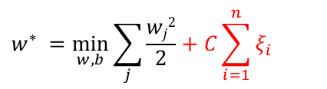


Non separable cases
Soft Margin → Give some slack, allow some error
$$ξ_{i}$$
$$w^{∗} =\min_{w,b}{\sum_{j}{\frac{wj2}{2}}}+C\sum_{i=1}^{n}{ξ_{i}}$$
s.t
$$yi\left(\left\langle w,x_{i}\right\rangle +b\right)≥1−ξ_{i},$$
$$ξ≥0$$
Allow some slack over here.
Constraint the number of data that is wrong.
$$ξ_{i}$$
Notes:
xi

Slide 25

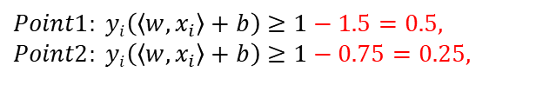




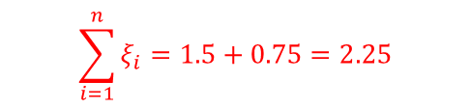
Non separable cases
$$w.x+b=−1$$
Soft Margin → Give some slack, allow some error
$$w^{∗} =\min_{w,b}{\sum_{j}{\frac{wj2}{2}}}+C\sum_{i=1}^{n}{ξ_{i}}$$
s.t
$$yi\left(\left\langle w,x_{i}\right\rangle +b\right)≥1−ξ_{i},$$
$$ξ_{i}=1.5$$
$$ξ≥0$$
The error
$$Point1: yi\left(\left\langle w,x_{i}\right\rangle +b\right)≥1−1.5=0.5,$$
$$Point2: yi\left(\left\langle w,x_{i}\right\rangle +b\right)≥1−0.75=0.25,$$
$$ξ_{i}=0.75$$
$$\sum_{i=1}^{n}{ξ_{i}}=1.5+0.75=2.25$$
$$w.x+b=0$$
$$w.x+b=+1$$

Slide 26

Non separable cases
$$w.x+b=−1$$
Soft Margin → Give some slack, allow some error
$$w^{∗} =\min_{w,b}{\sum_{j}{\frac{wj2}{2}}}+C\sum_{i=1}^{n}{ξ_{i}}$$
s.t
$$yi\left(\left\langle w,xi\right\rangle +b\right)≥1−ξ_{i},$$
$$ξ_{i}=1.5$$
$$ξ≥0$$
The error
$$ξ_{i}=0.75$$
Small C → soft margin → allow more error
Big C → hard margin → allow NO error
$$w.x+b=0$$
$$w.x+b=+1$$

Slide 27
Example
C= 10
All points satisfy the constraint
3 support vectors

Slide 28
Example
C = 3
C = 2
Some points violates the constraint
4 support vectors
More points violate the constraint
10 support vectors

Slide 29

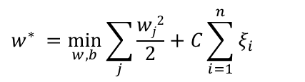
Example
C = 0.01
$$w^{∗} =\min_{w,b}{\sum_{j}{\frac{wj2}{2}}}+C\sum_{i=1}^{n}{ξ_{i}}$$
s.t
$$yi\left(\left\langle w,xi\right\rangle +b\right)≥1−ξ_{i},$$
$$ξ≥0$$
Small C → soft margin → allow more error
Big C → hard margin → allow NO error
All points violates the constraint
N support vectors

Slide 30
Which C to use?
C | Training error | Testing error | # support vectors
0.01 | 42.1 | 30.1 | 2341
0.1 | 31.3 | 16.5 | 1756
1 | 22.1 | 16.2 | 1230
10 | 15.2 | 17.2 | 1000
100 | 10.2 | 17.9 | 987
1000 | 1.2 | 17.8 | 854
Cross Validation

Slide 31
Which C to use?
Validation error
Choose the C with lowest validation error
C

Slide 32
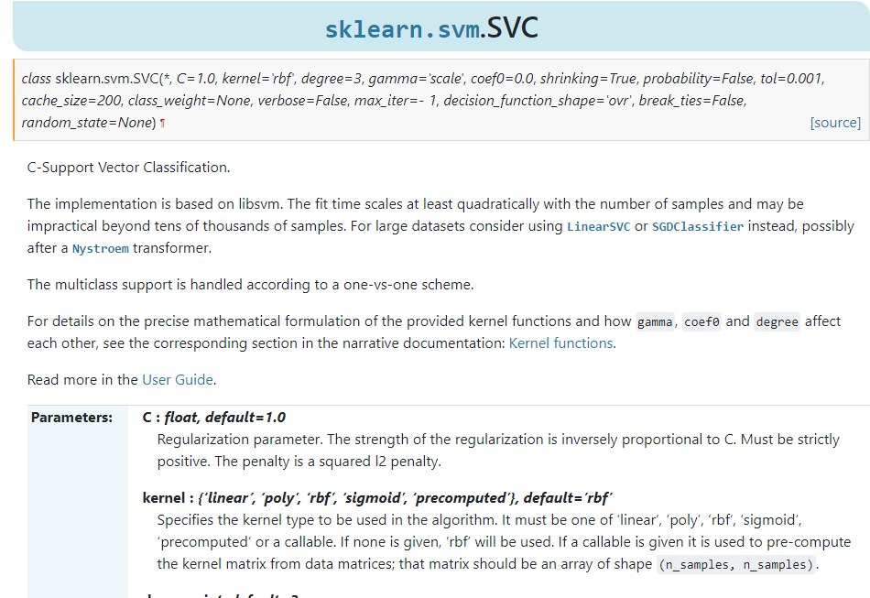
SKLEARN - SVM

Slide 33






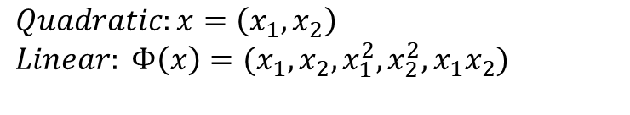
Kernel
$$x_{2}$$
Actual Boundary Decision Function:
$$x_{1}+x_{2}^{2}=5$$
$$x_{1}=x_{2}^{2}+5$$
We can rewrite it in linear form, by transforming it to using basis expansion
$$Quadratic:x=\left(x_{1}, x_{2}\right)$$
$$Linear: Φ\left(x\right)=(x_{1}, x_{2}, x_{1}^{2}, x_{2}^{2},x_{1}x_{2})$$
$$x_{1}$$
$$x_{1}−x_{2}^{2}−5=0 →Quadratic$$
$$w ∙Φ\left(x\right)+b =0 →Linear$$

Slide 34


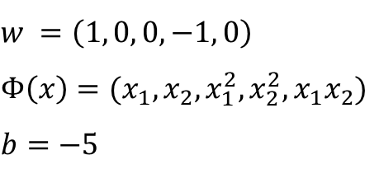

Kernel
$$x_{2}$$
$$Linear: Φ\left(x\right)=(x_{1}, x_{2}, x_{1}^{2}, x_{2}^{2},x_{1}x_{2})$$
$$x_{1}+x_{2}^{2}=5$$
$$x_{1}−x_{2}^{2}−5=0 →Quadratic$$
$$w ∙Φ\left(x\right)+b =0 →Linear$$
$$w =\left(1, 0, 0, −1, 0\right)$$
$$Φ\left(x\right)=(x_{1}, x_{2}, x_{1}^{2}, x_{2}^{2},x_{1}x_{2})$$
$$b=−5$$
$$x_{1}$$
We embedded 2 dimensional space into 5 dimensional space.
And in 5D space, it is linear which we can solve the equation

Slide 35

Kernel
What if we have d-dimensional $x$ and deal with quadratic boundary???
$$Features: x=\left(x_{1}, x_{2}, …,x_{d}\right)$$
$$Quadratic boundary:{(x}_{1}, x_{2}, x_{1}^{2}, x_{2}^{2},x_{1}x_{2}, …,x_{d−1}x_{d})$$
$$Linear: Φ\left(x\right)=(x_{1}, x_{2}, x_{1}^{2}, x_{2}^{2},x_{1}x_{2},, …,x_{d−1}x_{d})$$

Slide 36
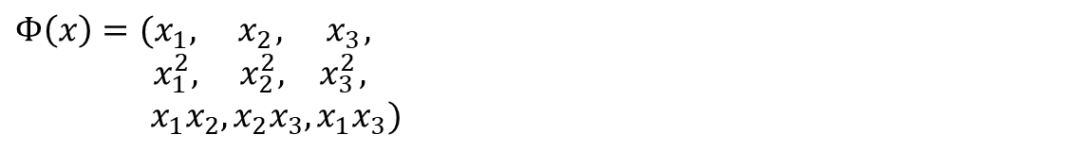
Example
What is the dimension of $Φ\left(x\right)$, if $x=\left(x_{1}, x_{2},x_{3}\right)$
$$Φ\left(x\right)=(x_{1}, { x}_{2}, { x}_{3},$$
$x_{1}^{2}, x_{2}^{2},{ x}_{3}^{2},$
$x_{1}x_{2},x_{2}x_{3},x_{1}x_{3})$
Dimension = 9

Slide 37
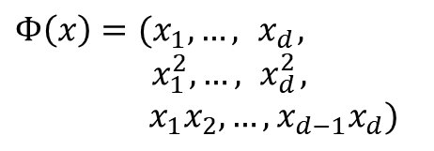
Example
What is the dimension of $Φ\left(x\right)$, if $x=\left(x_{1}, x_{2},…,x_{d}\right)$
$$Φ\left(x\right)=(x_{1}, …, { x}_{d},$$
$x_{1}^{2},…,{ x}_{d}^{2},$
$x_{1}x_{2},…,x_{d−1}x_{d})$
d
d
d Choose 2
Dimension = 2d + d(d-1)/2
~ O(d²)

Slide 38
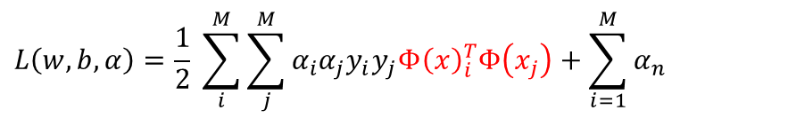
Kernel in SVM
Recall SVM loss function
$$L\left(w,b, α\right)=\frac{1}{2} \sum_{i}^{M}{\sum_{j}^{M}{α_{i}α_{j}y_{i}y_{j}x_{i}^{T}x_{j}}}+\sum_{i=1}^{M}{α_{n}}$$
Replace $x$ with $Φ\left(x\right)$
$$L\left(w,b, α\right)=\frac{1}{2} \sum_{i}^{M}{\sum_{j}^{M}{α_{i}α_{j}y_{i}y_{j}{Φ\left(x\right)}_{i}^{T}Φ\left(x_{j}\right)}}+\sum_{i=1}^{M}{α_{n}}$$

Slide 39
Kernel in SVM

Slide 40
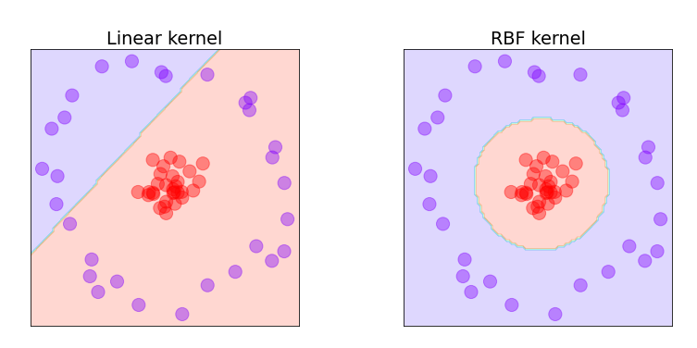
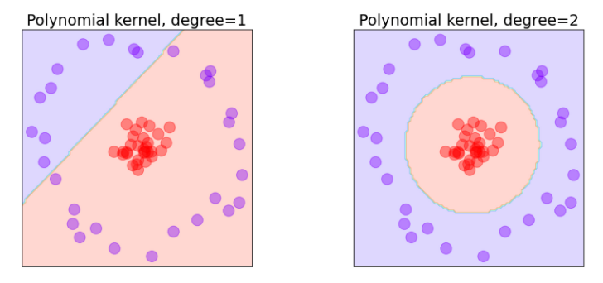
Kernel in SVM

Slide 41
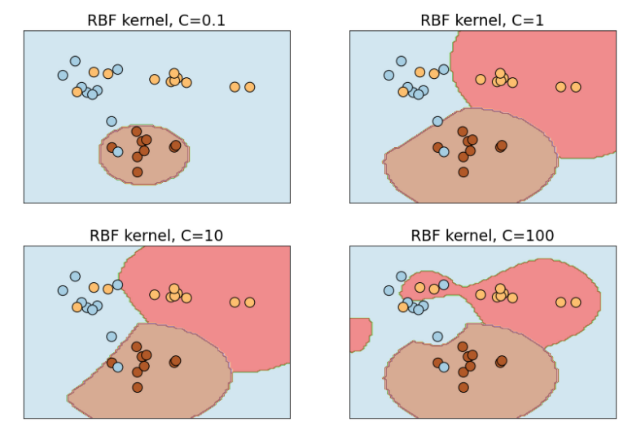
Kernel in SVM

Slide 42
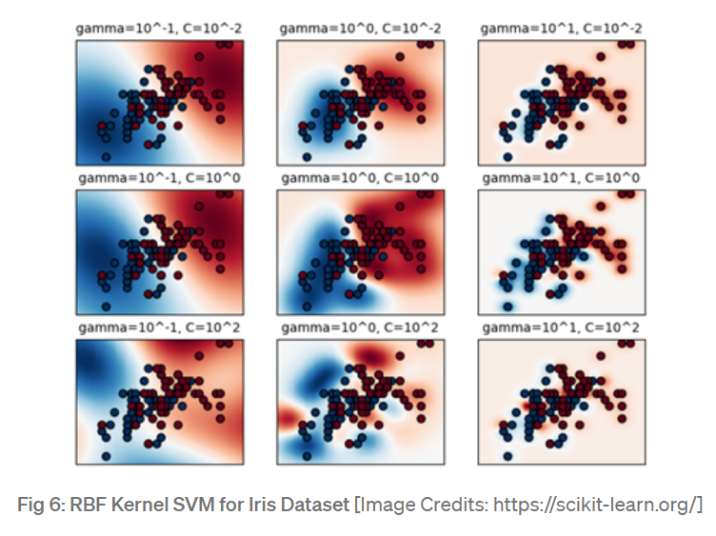
Kernel in SVM

Slide 43
Pros and Cons
Pros | Cons
Good linear classifier because it find the best decision boundary (consider hard margin case) | Not suited for large datasets Computational cost ~ O(d₂)
Easy to transform into non linear model

Slide 44
References:
https://tube.switch.ch/videos/96049a00
https://scikit-learn.org/stable/auto_examples/svm/plot_rbf_parameters.html

