Slide 1

Module: Software Engineering Project: Implement the KNN Classifier
Presented by KNN Quest:
Kashif Hussain –
Fahad Jabbar –
Naila Shaheen –
Guided by: Prof. Dr. Damir Dobric

Slide 2
Methodology
Problem statement
Introduction to KNN classifier
Implementation of Native KNN classifier
Integration of KNN classifier with Neocortex API
Implementation of KNN Classifier with Spatial Pooler generated SDRs
Unit testing
Discussion
Conclusion
References

Slide 3
Problem statement

Slide 4
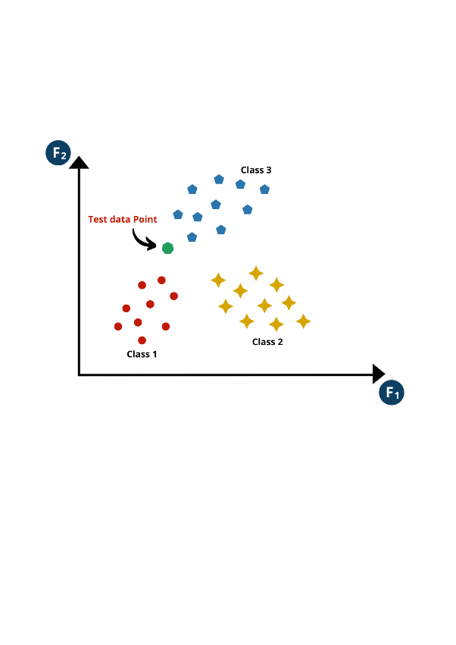
Implementation of Native KNN classifier
A native KNN classifier is designed based on the principle of similarity, where data points with similar characteristics tend to belong to the same class. During training, it stores labeled data points, each representing specific features and corresponding class labels. When predicting, it calculates distances between new and stored points, identifies the k nearest neighbors, and predicts the class label based on a majority vote among them.

Slide 5
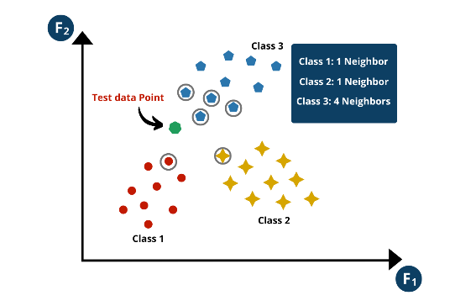
Working of Native KNN Classifier
1. Selecting Value of k
2. Calculating Distance
3. Finding Nearest Neighbor
4. Voting and Prediction

