Slide 1

Module: Software Engineering Project: Implement the KNN Classifier
Presented by KNN Quest:
Kashif Hussain –
Fahad Jabbar –
Naila Shaheen –
Guided by: Prof. Dr. Damir Dobric

Slide 2
Methodology
Problem statement
Introduction to KNN classifier
Implementation of Native KNN classifier
Integration of KNN classifier with Neocortex API
Implementation of KNN Classifier with Spatial Pooler generated SDRs
Unit testing
Discussion
Conclusion
References

Slide 3
Problem statement
KNN Challenges: High Dimensions & Imbalanced Data
KNN: Simple and effective classifier.
Limitations:
High Dimensions: Distances become unreliable, leading to inaccurate classification.
Imbalanced Classes: Biased towards majority class, neglecting minority.
Goal: Improve KNN for these scenarios.

Slide 4
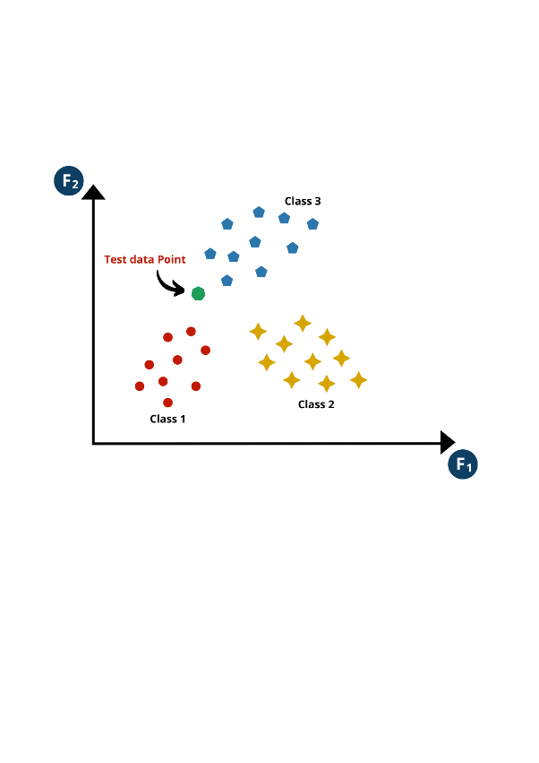
Implementation of Native KNN classifier
A native KNN classifier is designed based on the principle of similarity, where data points with similar characteristics tend to belong to the same class. During training, it stores labeled data points, each representing specific features and corresponding class labels. When predicting, it calculates distances between new and stored points, identifies the k nearest neighbors, and predicts the class label based on a majority vote among them.

Slide 5
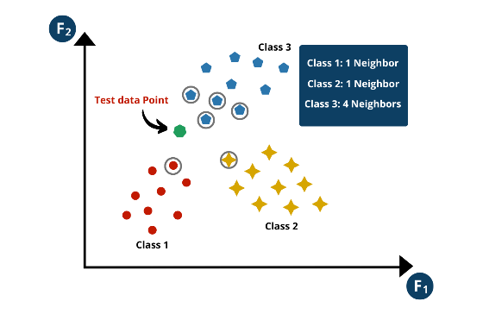
Working of Native KNN Classifier
1. Selecting Value of k
2. Calculating Distance
3. Finding Nearest Neighbor
4. Voting and Prediction

Slide 6
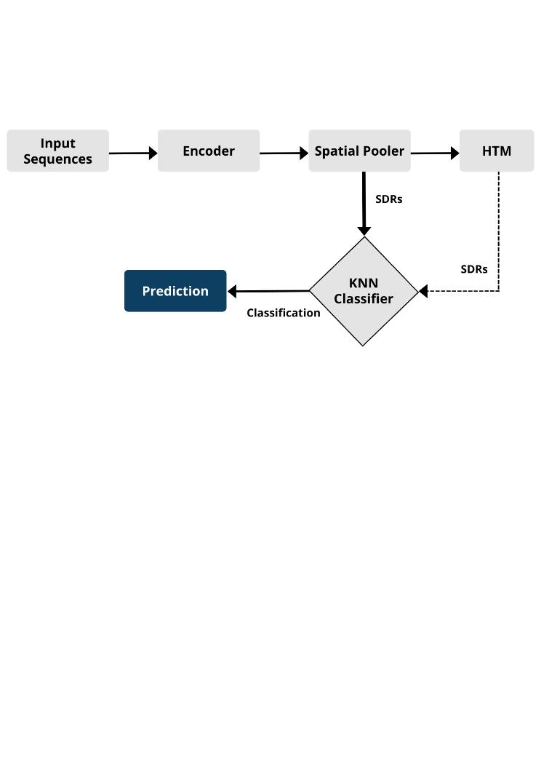
Integration of KNN with Neocortex API
A sequence learning and classification framework integrates an encoder, Spatial Pooler, Temporal Memory, and K-nearest neighbor (KNN) classifier. The encoder preprocesses sequential data, while the Spatial Pooler identifies spatial patterns using Hebbian learning principles. These patterns are utilized by the KNN classifier for label prediction, while the Temporal Memory focuses on learning temporal sequences and enriching classification insights.

Slide 7
Results
When presented with a new sequence, the KNN classifier utilizes both spatial patterns from the Spatial Pooler and temporal context from the Temporal Memory. This integrated approach, drawing on spatial and temporal learning mechanisms inspired by HTM principles, boosts classification accuracy and robustness when dealing with sequential data.

Slide 8
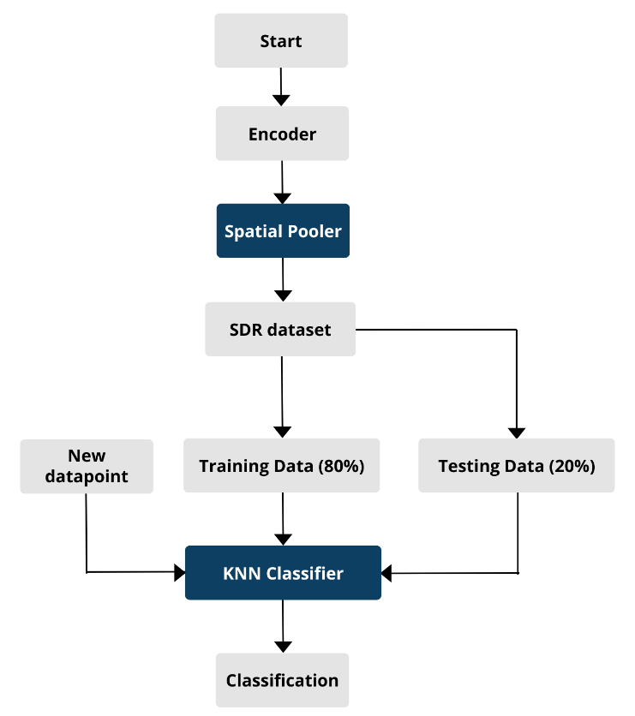
KNN classifier with Spatial Pooler generated SDRs
After obtaining the dataset from the Spatial Pattern Learning experiment, it's stored in a CSV file. The LoadData() method efficiently reads and parses this dataset, creating DataPoint objects for each entry. This dataset, representing SDRs, is then utilized by the KNN classifier to classify sequences based on their similarity to the training data, leveraging the nearest neighbors in the feature space for precise pattern recognition and classification decisions.

Slide 9
Conclusion
The research integrates K-Nearest Neighbors (KNN) classification with the Neocortex API, leveraging spatial pooling and hierarchical temporal memory (HTM) for enhanced sequential data classification. Rigorous testing showcases the model's robustness, achieving a notable 90% accuracy rate across diverse scenarios. These results highlight the promise of neuromorphic-inspired frameworks in advancing sequential data analysis, while future research aims to optimize performance and explore broader applications

