Slide 1

Academic Year 2026–2027 | Review 1
ModelGuard
A Unified Security Toolkit for the ML Model Supply Chain
Mrs. Sneha Thankachan
Asst.prof
Fahad MUT23CC027
Chris Paul MUT23CC026
Adhwaith Krishna MUT23CC005
Nadiq Aman MUT23CC050
24 September 2026
Notes:
The cover follows the supplied MITS template. Team registration numbers and any co-guide details were not supplied and have not been invented.

Slide 2
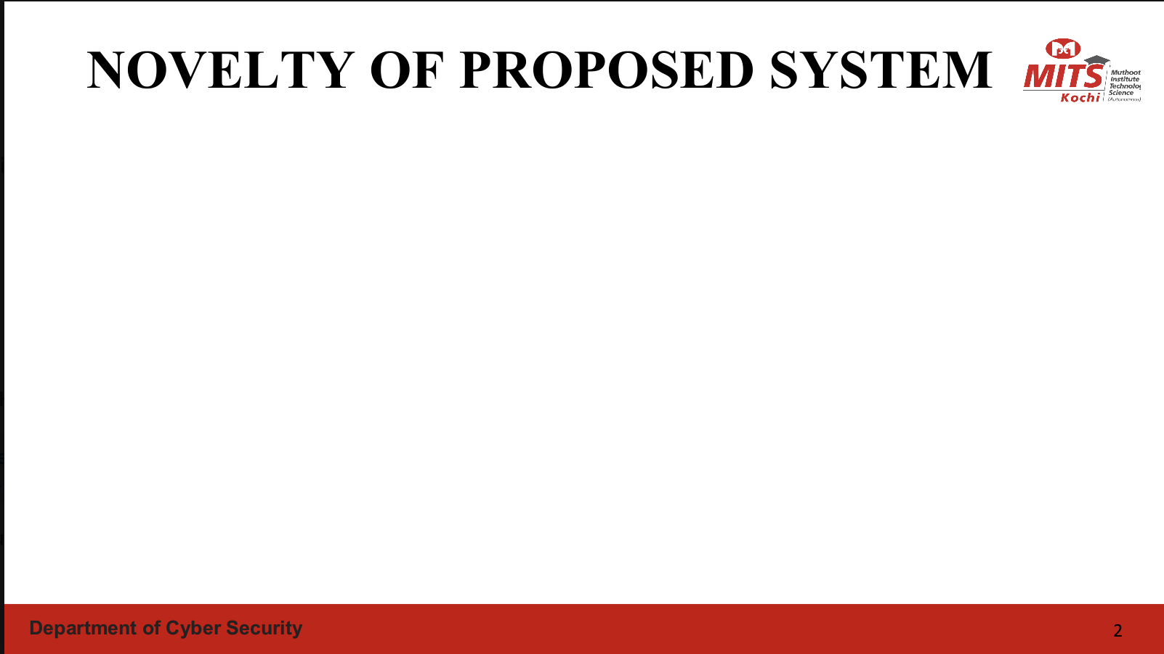
NOVELTY OF PROPOSED SYSTEM
RESEARCH GAP
Existing defenses usually focus on unsafe serialization or one file format; parser robustness and chat-template evidence are still handled as separate checks.
01
02
03
Unified model-package inspection
Dual assurance track
Coverage-aware evidence
One workflow correlates file structure, tensor ranges and embedded chat-template findings across GGUF and safetensors.
Fast static validation screens files before use, while offline AFL++ campaigns test selected GGUF parser builds.
Verdicts preserve rule evidence, locations, target versions and incomplete/error states instead of a blanket safe label.
Notes:
Novelty is framed as a practical systems contribution: a unified evidence workflow plus offline parser testing. This is not a claim that each underlying technique is individually new.

Slide 3

Project Overview
1
Engineering Problem
2
Motivation
3
Project Need
Untrusted model files can expose loading software to malformed structures or unsafe metadata before inference begins.
Safer serialization reduces pickle-style execution risks, but parser robustness and template handling still need checks.
Developers need a repeatable pre-use check with clear evidence, plus a way to test the loaders themselves.
4
Target Users
5
Project Scope
6
Expected Impact
ML developers, MLOps and security teams, model repository operators, and maintainers of GGUF loaders.
Static inspection of GGUF and safetensors, associated chat templates, and an offline fuzzing track for GGUF parsers.
Earlier detection of malformed files and suspicious templates, with reproducible parser failures for maintainers.
Group 3
ModelGuard: Security for the ML Model Supply Chain
3 / 20
Notes:
Project source: Zeroth Review - Group 3.pdf, supplied by the team. First-review implementation details and module allocations are proposed. No completed experiments or measured ModelGuard results are claimed.

Slide 4
Problem Statement
File Structure
Invalid lengths, offsets or tensor dimensions can expose defects in model readers.
Model files can contain malformed structures or unsafe metadata that reaches loading software before inference begins. ModelGuard will inspect GGUF and safetensors without executing model code, analyze chat-template metadata, and test GGUF parsers through offline fuzzing.
Template Metadata
Templates may alter prompts or misuse capabilities exposed by their rendering environment.
Loader Robustness
Static rules alone cannot establish that a parser handles every malformed input safely.
Group 3
ModelGuard: Security for the ML Model Supply Chain
4 / 20
Notes:
Project source: Zeroth Review - Group 3.pdf, supplied by the team. First-review implementation details and module allocations are proposed. No completed experiments or measured ModelGuard results are claimed.

Slide 5
Related Work and Project Gap
Relevant research and tools for model supply-chain security. Reported findings below belong to the cited studies.
Study / Tool | Approach | Finding / Relevance
Kellas et al. (2025), PickleBall [1] | Library-specific loading policies for pickle | 79.8% benign models loaded; all malicious examples blocked in its dataset
Casey et al. (2024) [2] | Study of unsafe serialization on Hugging Face | Documents model supply-chain exposure and detection gaps
Liu et al. (2025) [3] | Analysis of pickle loading paths and scanner bypasses | Shows limitations of existing pickle scanning coverage
ModelScan [4] | Static checks for model serialization attacks | Useful baseline on supported formats, not a GGUF parser fuzzer
GGUF / safetensors docs [5–6] | Format layouts and metadata structures | Define the structures and metadata that ModelGuard will inspect
Key Findings and Project Gap
Pickle defenses address unsafe deserialization but retain security and compatibility trade-offs.
Modern model formats still need separate parser-robustness and template checks.
ModelGuard combines format validation, template evidence and offline parser testing.
Group 3
ModelGuard: Security for the ML Model Supply Chain
5 / 20
Notes:
Project source: Zeroth Review - Group 3.pdf, supplied by the team. First-review implementation details and module allocations are proposed. No completed experiments or measured ModelGuard results are claimed.
Verified sources:
https://arxiv.org/abs/2508.15987
https://arxiv.org/abs/2410.04490
https://arxiv.org/abs/2508.19774
https://github.com/protectai/modelscan
https://github.com/ggml-org/ggml/blob/master/docs/gguf.md
https://github.com/huggingface/safetensors
https://huggingface.co/docs/transformers/en/chat_templating_writing
https://aflplus.plus/docs/fuzzing_in_depth/

Slide 6
System Architecture
Static Inspection Track
Model Package
GGUF / safetensors
and tokenizer files
Bounded Parser
structure and
metadata extraction
Structure Checks
lengths, offsets
and tensor layout
Template Checks
static analysis
and reference diff
Evidence Report
verdict, locations
and coverage
Offline Parser-Testing Track
Seed Corpus
small valid
GGUF files
AFL++
mutations guided
by coverage
Target Parser
isolated build
with sanitizers
Crash Triage
reproduce and
minimize inputs
Regression Cases
reviewed rules
and parser tests
Offline findings feed the scanner only after validation. The production scan never runs a model or renders an untrusted template.
Group 3
ModelGuard: Security for the ML Model Supply Chain
6 / 20
Notes:
Project source: Zeroth Review - Group 3.pdf, supplied by the team. First-review implementation details and module allocations are proposed. No completed experiments or measured ModelGuard results are claimed.
https://aflplus.plus/docs/fuzzing_in_depth/

Slide 7
Methodology: Workflow
1
2
3
4
5
Corpus
Parsing
Analysis
Validation
Integration
Collect valid fixtures, malformed variants and labeled template examples.
Extract metadata with format-specific limits and retain byte locations.
Run structural rules and static template checks without inference.
Measure detection errors and reproduce parser failures.
Combine CLI reports and regression tests for repeatable checks.
Proposed workflow: record file hashes, source revisions and rule versions so that every result can be reproduced.
Group 3
ModelGuard: Security for the ML Model Supply Chain
7 / 20
Notes:
Project source: Zeroth Review - Group 3.pdf, supplied by the team. First-review implementation details and module allocations are proposed. No completed experiments or measured ModelGuard results are claimed.

Slide 8
Methodology: Static Scan Algorithm
Algorithm 1: Proposed ModelGuard Static Scan
Input: model file F, optional tokenizer files, rules R, resource limits L
Output: report containing findings, coverage and verdict
1. Record hash, source revision and file size of F
2. Identify the supported file format from its content
3. If unsupported: return INCOMPLETE with the reason
4. Parse structure and metadata under limits L
5. If parsing fails: return ERROR with available evidence
6. Check header consistency, tensor ranges and layout
7. Extract the chat template if one is available
8. Inspect template syntax and text without rendering it
9. Compare with a trusted, versioned reference when available
10. Combine rule findings and record skipped checks
11. Assign verdict from evidence and scan coverage
12. Export readable and JSON reports
Group 3
ModelGuard: Security for the ML Model Supply Chain
8 / 20
Notes:
Project source: Zeroth Review - Group 3.pdf, supplied by the team. First-review implementation details and module allocations are proposed. No completed experiments or measured ModelGuard results are claimed.

Slide 9
Module Ownership and Individual Contribution
ID | Module / Responsibility | Proposed Owner | Planned Deliverable
M1 / M2 | File parser and structural checks for GGUF / safetensors | Fahad | Bounded parser, rule checks and malformed fixtures
M3 | Chat-template extraction and static analysis | Chris Paul | Template rules and trusted-reference comparison
M4 | AFL++ harness and GGUF parser crash triage | Adhwaith Krishna | Instrumented harness and reproducible test corpus
M5 | Reporting, CLI and integration testing | Nadiq Aman | Readable / JSON reports and integration tests
Each member owns a defined implementation area and must explain the design, code evidence, tests and current limitations during the review.
M1: File Parser and M2: Structure Analyser share a common format schema.
M3: Template Analyser keeps code-risk and prompt-content findings separate.
M4: Fuzzing Harness produces reproducible, minimized test cases.
M5: Reporting Module preserves evidence, confidence and scan coverage.
Group 3
ModelGuard: Security for the ML Model Supply Chain
9 / 20
Notes:
Project source: Zeroth Review - Group 3.pdf, supplied by the team. First-review implementation details and module allocations are proposed. No completed experiments or measured ModelGuard results are claimed.

Slide 10
Progress Since the Zeroth Review
Parameter | Zeroth Review | Current Status
Literature Survey | Initial base papers and project motivation | Recent research plus official format, tool and testing references mapped to the gap
Problem Definition | Broad model-file and loading-code risks | Scoped to GGUF / safetensors structure, chat templates and GGUF parser robustness
Architecture | Static scanner with a parallel fuzzing concept | Module interaction, evidence flow and coverage-aware reporting defined
Algorithms | High-level checking concept | M1/M2 parsing, structural rules and CLI implemented; M3–M5 remain planned.
Hardware | Planning estimates | CPU, RAM and SSD needs stated; no model-inference GPU required
Software | Initial tool list | Python 3.11 package, pytest suite and GitHub Actions CI verified.
Review guidance → action taken: novelty, individual ownership, evidence status, technology justification and a revised timeline were added. Committee-specific minutes were not supplied.
Group 3
ModelGuard: Security for the ML Model Supply Chain
10 / 20
Notes:
Project source: Zeroth Review - Group 3.pdf, supplied by the team. First-review implementation details and module allocations are proposed. No completed experiments or measured ModelGuard results are claimed.

Slide 11
Development Progress and Working Evidence
1
System Design
COMPLETE — parser, analyser and output layers separated in code.
2
Static Scanner
IMPLEMENTED — GGUF v2/v3 and safetensors scans produce findings.
3
Template Analysis
PLANNED — Module 3 is outside this First Review implementation.
4
Fuzzing Harness
PLANNED — AFL++ target and crash triage are future work.
5
Initial Testing
VERIFIED — 50 pytest tests pass; JSON and HTML reports are included.
Evidence now available for Modules 1–2: source code, seven tiny fixtures, 50 passing tests, CLI scans and generated reports. No overall completion percentage is claimed.
Group 3
ModelGuard: Security for the ML Model Supply Chain
11 / 20
Notes:
This slide deliberately avoids inventing implementation progress or preliminary results. Replace each EVIDENCE NEEDED item with the team's actual artifact before submission.

Slide 12
Source code snapshots: Modules 1–2
Committed implementation on main: e0942b9
M1: detect a truncated header
M2: detect data beyond the file
modelguard/parsers/gguf_parser.py, lines 62–68
modelguard/analyzers/structure_analyzer.py, lines 192–193
data = self.stream.read(size)
if len(data) != size:
raise ParserError(
"MG103", "Truncated GGUF header", field,
{"offset": self.position - len(data),
"expected": size, "actual": len(data)},
)
return data
if end > available:
findings.append(_finding(
"GG118", "ERROR", "bounds",
"Tensor data extends beyond the file",
field,
{"end": end, "available": available}
))
A short read produces a controlled error with the expected and actual byte counts.
The analyser records a GG118 finding when the declared tensor range exceeds the available data.
Source excerpts. Long argument lines are wrapped for readability. Full files are included in the source snapshot ZIP.
Group 3
ModelGuard: Security for the ML Model Supply Chain
12 / 20
Notes:
M1: detect a truncated header
https://github.com/Fahad-uz/ModelGuard/blob/e0942b9cd9a0199c576ecd95855d8e3115bdd002/modelguard/parsers/gguf_parser.py#L62-L68
A short read produces a controlled error with the expected and actual byte counts.
M2: detect data beyond the file
https://github.com/Fahad-uz/ModelGuard/blob/e0942b9cd9a0199c576ecd95855d8e3115bdd002/modelguard/analyzers/structure_analyzer.py#L192-L193
The analyser records a GG118 finding when the declared tensor range exceeds the available data.
Source code excerpts preserve the source tokens. Only indentation and line wrapping changed.

Slide 13
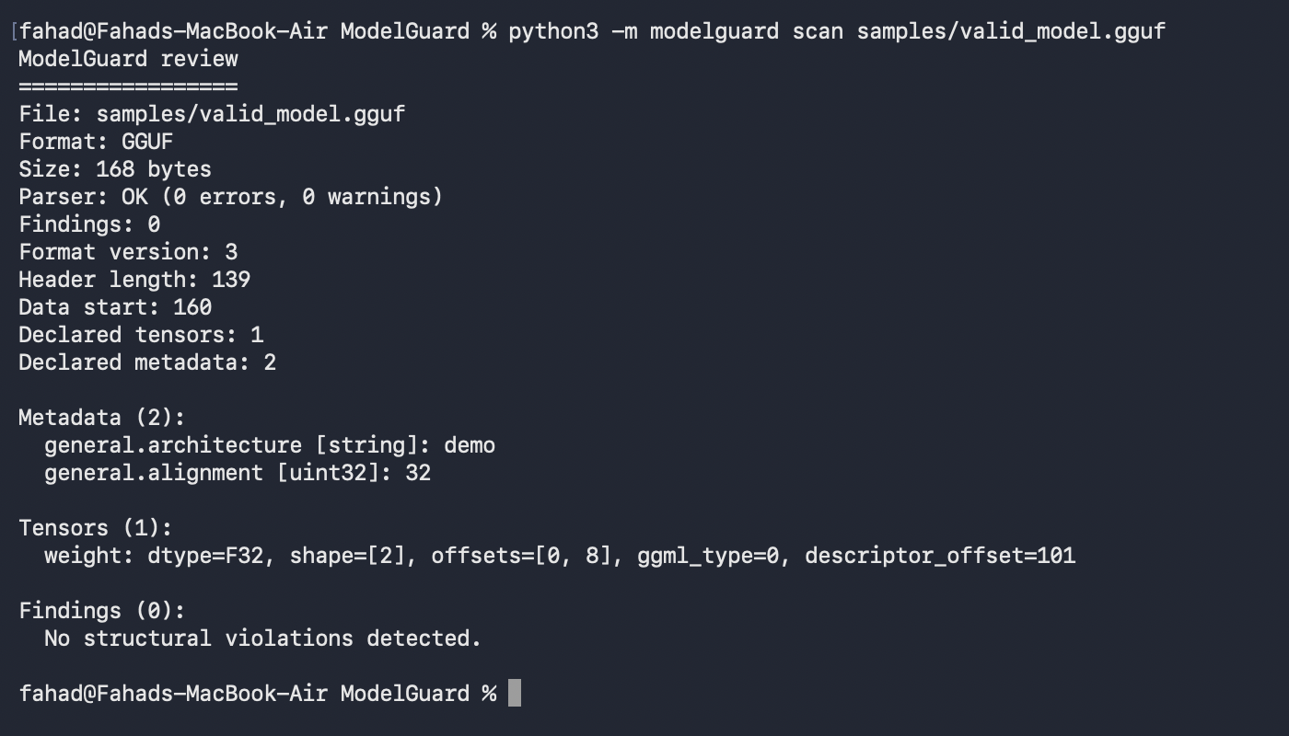
Working scan: GGUF
Synthetic GGUF v3 fixture • metadata and tensor descriptor parsed • 0 findings
Command: python3 -m modelguard scan samples/valid_model.gguf
Group 3
ModelGuard: Security for the ML Model Supply Chain
13 / 20

Slide 14
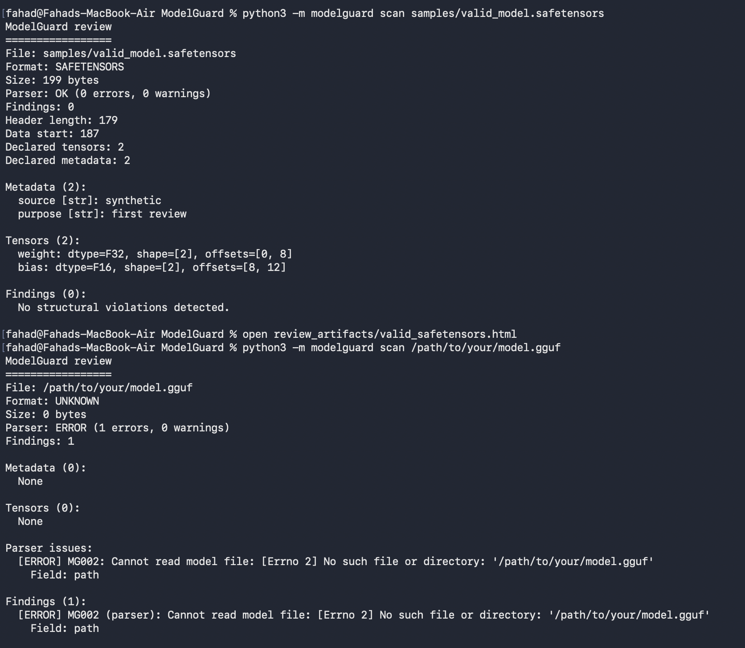
Working scan: safetensors
Synthetic safetensors fixture • two tensors and two metadata fields • 0 findings
Command: python3 -m modelguard scan samples/valid_model.safetensors
Group 3
ModelGuard: Security for the ML Model Supply Chain
14 / 20

Slide 15
Automated test result
The First Review parser and structural analyser tests pass on Python 3.11.
Command: uv run --no-project --with pytest --python 3.11 python -m pytest -q
50 automated tests pass
7 synthetic model fixtures
GGUF and safetensors covered
Tests cover valid headers, truncated inputs, offset/range anomalies and CLI/report behavior.
Group 3
ModelGuard: Security for the ML Model Supply Chain
15 / 20

Slide 16
Technologies and Development Requirements
Software Stack and Why
Hardware and Rationale
Current: Python 3.11+ — bounded static readers and CLI
Current: standard library — no runtime parser dependency
Current: pytest — 50 parser, analyser and CLI tests
Current: GitHub Actions — Python 3.11 and 3.13 tests
Planned: Jinja2 syntax inspection without template rendering
Planned: AFL++ and Clang/LLVM for GGUF parser fuzzing
Planned: sanitizers and pinned targets for crash triage
Planned fuzzing workstation
8+ CPU cores — parallel fuzzing throughput
16–32 GB RAM — corpus, builds and sanitizer overhead
250 GB free SSD — models, queues and crash artifacts
Broadband — controlled download of public fixtures
GPU not required — analysis does not run inference
Reproducibility Controls
Pin dependencies, target commits and build flags.
Separate trusted seeds from generated inputs and crash cases.
Offline CLI scope: no database, cloud platform or network protocol is required. Development IDE remains a team choice.
Group 3
ModelGuard: Security for the ML Model Supply Chain
16 / 20
Notes:
Project source: Zeroth Review - Group 3.pdf, supplied by the team. First-review implementation details and module allocations are proposed. No completed experiments or measured ModelGuard results are claimed.
https://aflplus.plus/docs/fuzzing_in_depth/

Slide 17
Updated Timeline and Work Plan
Activity
Status
W1
W2
W3
W4
W5
W6
W7
W8
Design freeze
Complete
Format parser & structural rules
Complete
Template analysis
Planned
Fuzz harness & seed corpus
Planned
Integration & validation
M1/M2 done
Documentation & Review 2
Planned
M1/M2 implementation and tests are on main. Timeline bars for Modules 3–5 are planned work.
Group 3
ModelGuard: Security for the ML Model Supply Chain
17 / 20
Notes:
Project source: Zeroth Review - Group 3.pdf, supplied by the team. First-review implementation details and module allocations are proposed. No completed experiments or measured ModelGuard results are claimed.

Slide 18
Challenges and Mitigations
1
Format Complexity
2
Template Ambiguity
3
Large Model Files
GGUF versions and tensor encodings vary. Pin the initial scope and expand it through tested adapters.
Custom templates can be legitimate. Use pinned references and retain evidence for human review.
Bound allocations and metadata sizes. Inspect headers and ranges without loading tensor weights for inference.
4
Fuzzing Coverage
5
Crash Interpretation
6
False Confidence
Many mutations fail at the header. Use diverse valid seeds and focus harnesses on reachable parser paths.
A crash may indicate a bug rather than an exploitable vulnerability. Reproduce, minimize and investigate each case.
Rules cannot detect every threat. Preserve unsupported cases and use NO FINDINGS only within completed scan coverage.
Group 3
ModelGuard: Security for the ML Model Supply Chain
18 / 20
Notes:
Project source: Zeroth Review - Group 3.pdf, supplied by the team. First-review implementation details and module allocations are proposed. No completed experiments or measured ModelGuard results are claimed.

Slide 19
Remaining Work
1
Parser Hardening
2
Template Rules
3
Fuzzing Campaign
Extend verified GGML type coverage and test larger real model headers without loading weights.
Build syntax and text checks, define trusted references and evaluate legitimate template variations.
Build target harnesses, prepare seed corpora and record repeatable coverage and crash-triage results.
4
Integration
5
Evaluation
6
Documentation
Connect Modules 3–5 to the existing CLI and preserve stable JSON fields and controlled failures.
Measure detection errors and resource use on a labeled corpus. Compare baselines only where their supported scope overlaps.
Prepare the project report, user guide and reproducibility notes. Document confirmed issues through responsible disclosure.
Group 3
ModelGuard: Security for the ML Model Supply Chain
19 / 20
Notes:
Project source: Zeroth Review - Group 3.pdf, supplied by the team. First-review implementation details and module allocations are proposed. No completed experiments or measured ModelGuard results are claimed.

Slide 20
References
[1] Kellas, A. D., et al. (2025). PickleBall: Secure Deserialization of Pickle-based Machine Learning Models. ACM CCS 2025. arXiv:2508.15987.
[2] Casey, B., Santos, J. C. S., & Mirakhorli, M. (2024). AI/ML Supply Chain Attacks in Hugging Face Models.
arXiv:2410.04490.
[3] Liu, T., et al. (2025). The Art of Hide and Seek: Pickle-Based Model Supply Chain Poisoning. arXiv:2508.19774.
[4] Protect AI. ModelScan repository and documentation.
[5] ggml-org. GGUF format specification.
Group 3
ModelGuard: Security for the ML Model Supply Chain
20 / 20
Notes:
References were limited to sources used for the threat model, formats, template handling, fuzzing, sanitizers and testing.
https://arxiv.org/abs/2508.15987
https://arxiv.org/abs/2410.04490
https://arxiv.org/abs/2508.19774
https://github.com/protectai/modelscan
https://github.com/ggml-org/ggml/blob/master/docs/gguf.md
https://github.com/huggingface/safetensors
https://huggingface.co/docs/transformers/en/chat_templating_writing
https://aflplus.plus/docs/fuzzing_in_depth/
https://jinja.palletsprojects.com/en/stable/sandbox/
https://clang.llvm.org/docs/AddressSanitizer.html
https://clang.llvm.org/docs/UndefinedBehaviorSanitizer.html
https://docs.pytest.org/en/stable/

