Slide 1


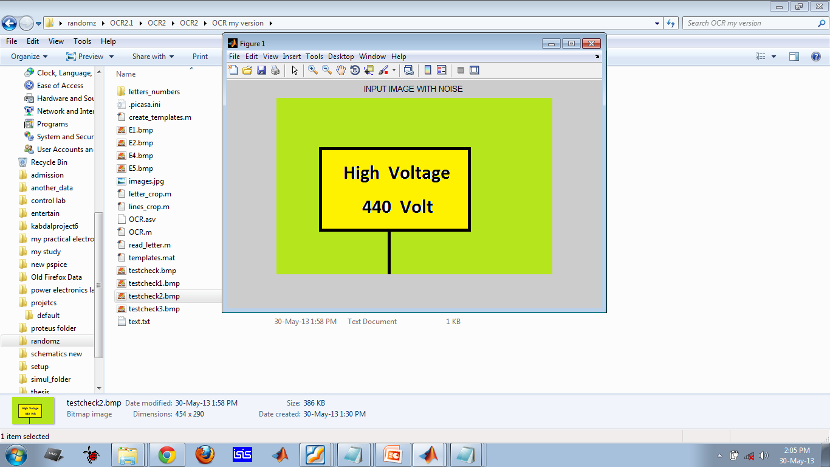
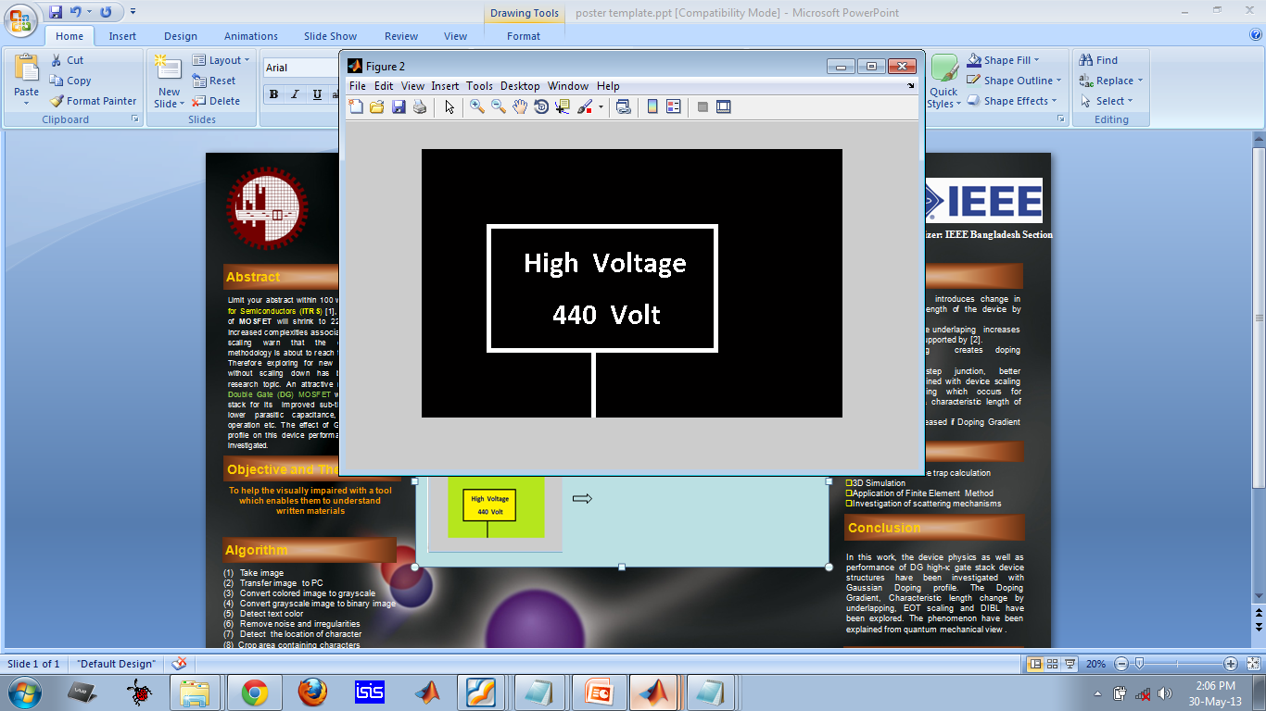
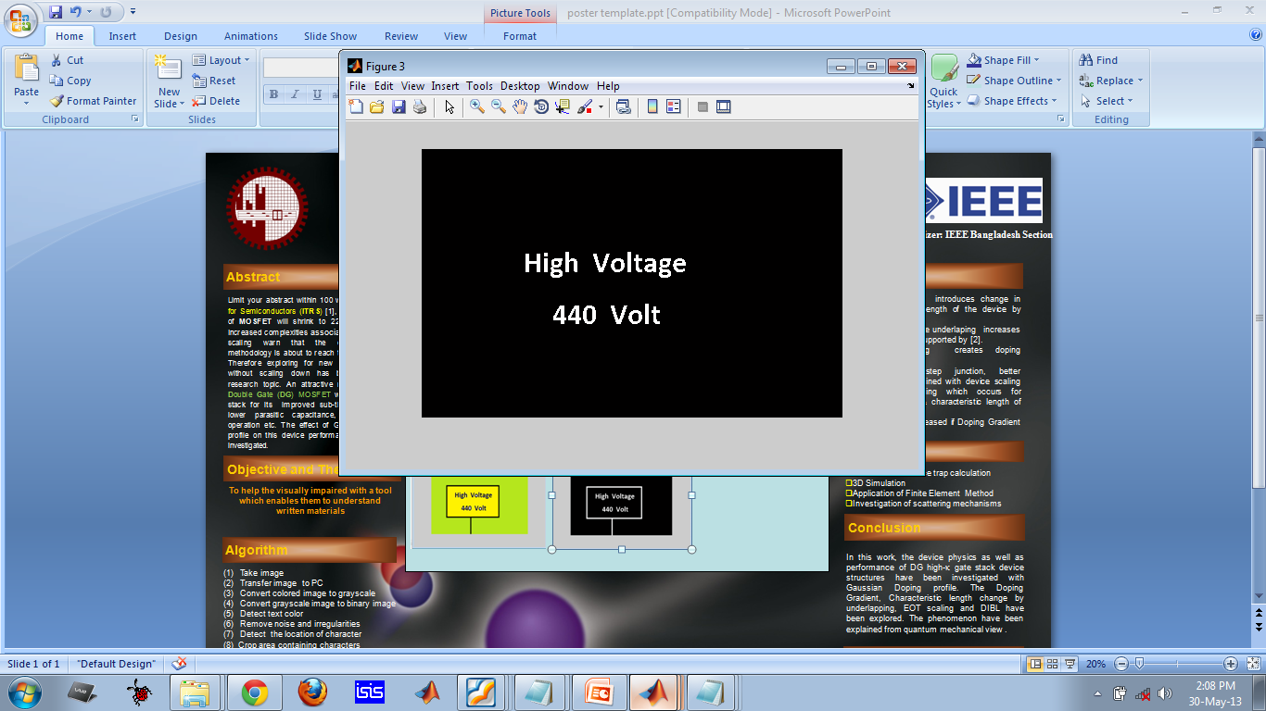
SS12: Asia 13: Code-A-Thon Challenge
ALO : an image to voice converter for visually challenged
Rashed, Khalid, Fahad, Monjurul
Department of Electrical and Electronic Engineering
Bangladesh University of Engineering and Technology (BUET), Dhaka-1000, Bangladesh.
Organizer: IEEE Bangladesh Section
Abstract
Implementation
Merits
This project aims to help the visually impaired people. We believe that Technology can ensure the welfare of humanity. Hence we should employ our technical knowledge to make the lives of many disabled people better. In this project, we have tried to implement an image-to-voice converter application that enables the visually impaired person to take a image of the written content and then listen to what is there.
→This application will help the visually impaired people to get more integrated into society.
→ It will make daily lives of them easier.
→It will also help in their education process.
Input image from mobile phone through wi-fi app
Image Processing GUI
(Optical Character Recognition)
Future Work
→Enrich the library of the application
→Implementation in open source platform
→Release in mobile app
→Improvement of code and algorithm
Theme
To help the visually impaired with a tool which enables them to understand written materials.
Conclusion
Algorithm
In this work, a method to convert the information in am image to voice output has been implemented. This project aims to help visually impaired persons. The process consists of two steps- optical character recognition and text to speech conversion. We hope our effort will enhance the quality of lives of hundreds of people who can’t see and reduce existing discrimination to disabled persons in our society.
(1) Take image
(2) Transfer image to PC
(3) Convert colored image to grayscale
(4) Convert grayscale image to binary image
(5) Detect text color
(6) Remove noise and irregularities
(7) Detect the location of character
(8) Crop area containing characters
(9) Compare the cropped area with database
(10) Detect character
(11) Write the character in a text file
(12) Continue step 7-11until no characters
(13) Read out the text in windows speech API
Image to text
Spell checking
Read the text out loud

