Slide 1
DIGITAL CASH REGISTER

Slide 2

Product Detection
(Sensor)
Price Detection
(Memory)
Accumulation
(1st Counter)
Storage
(2nd Counter)
Work Pyramid
Display
(7 Segment BCD)

Slide 3
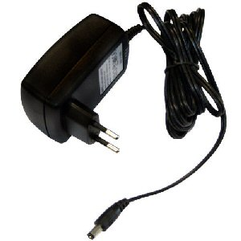
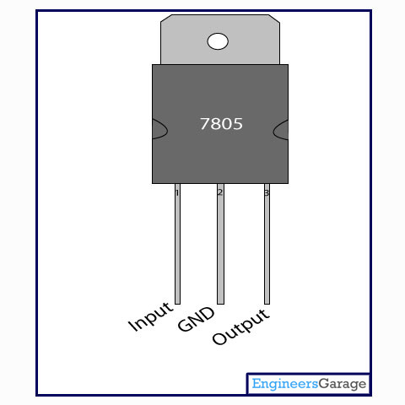
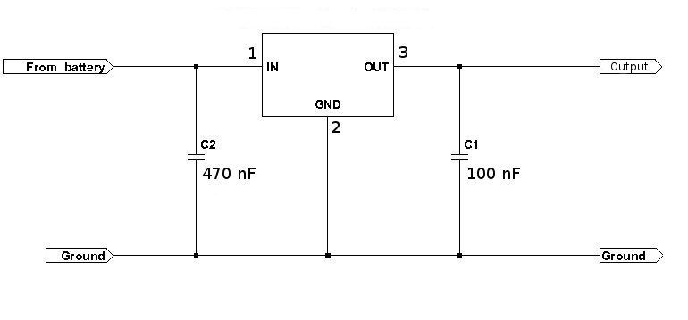
Max Power Consumption=
12 Watts

Slide 4
Sensor

Slide 5
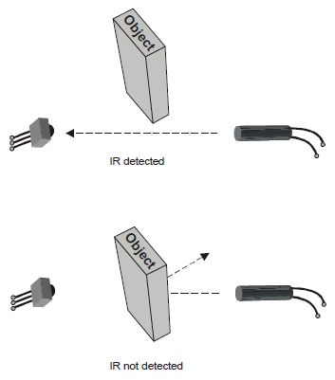
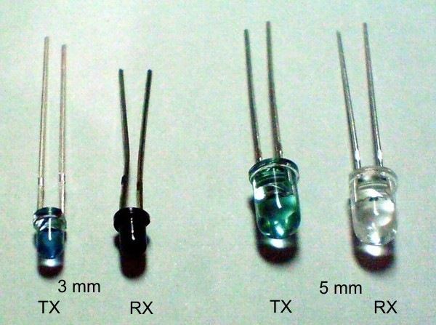
IR RECEIVER
& TRANSMITTER

Slide 6
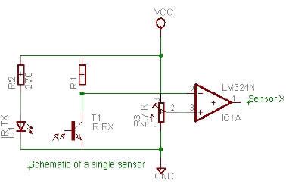
Opening or thin paper
Hard Paper
Card of
specific product
Circuit of
IR receiver and transmitter

Slide 7
Memory

Slide 8
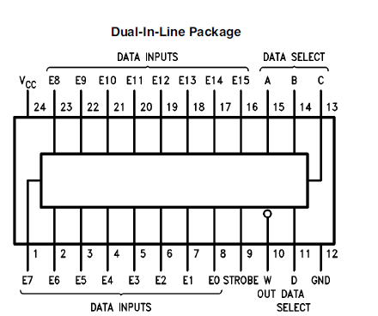
IC 74150

Slide 9
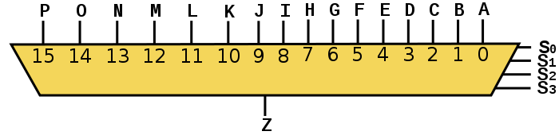
Prices are set as MUX gets supply
Output
from Comparators
LM 324
Bits of Selectors are shorted

Slide 10
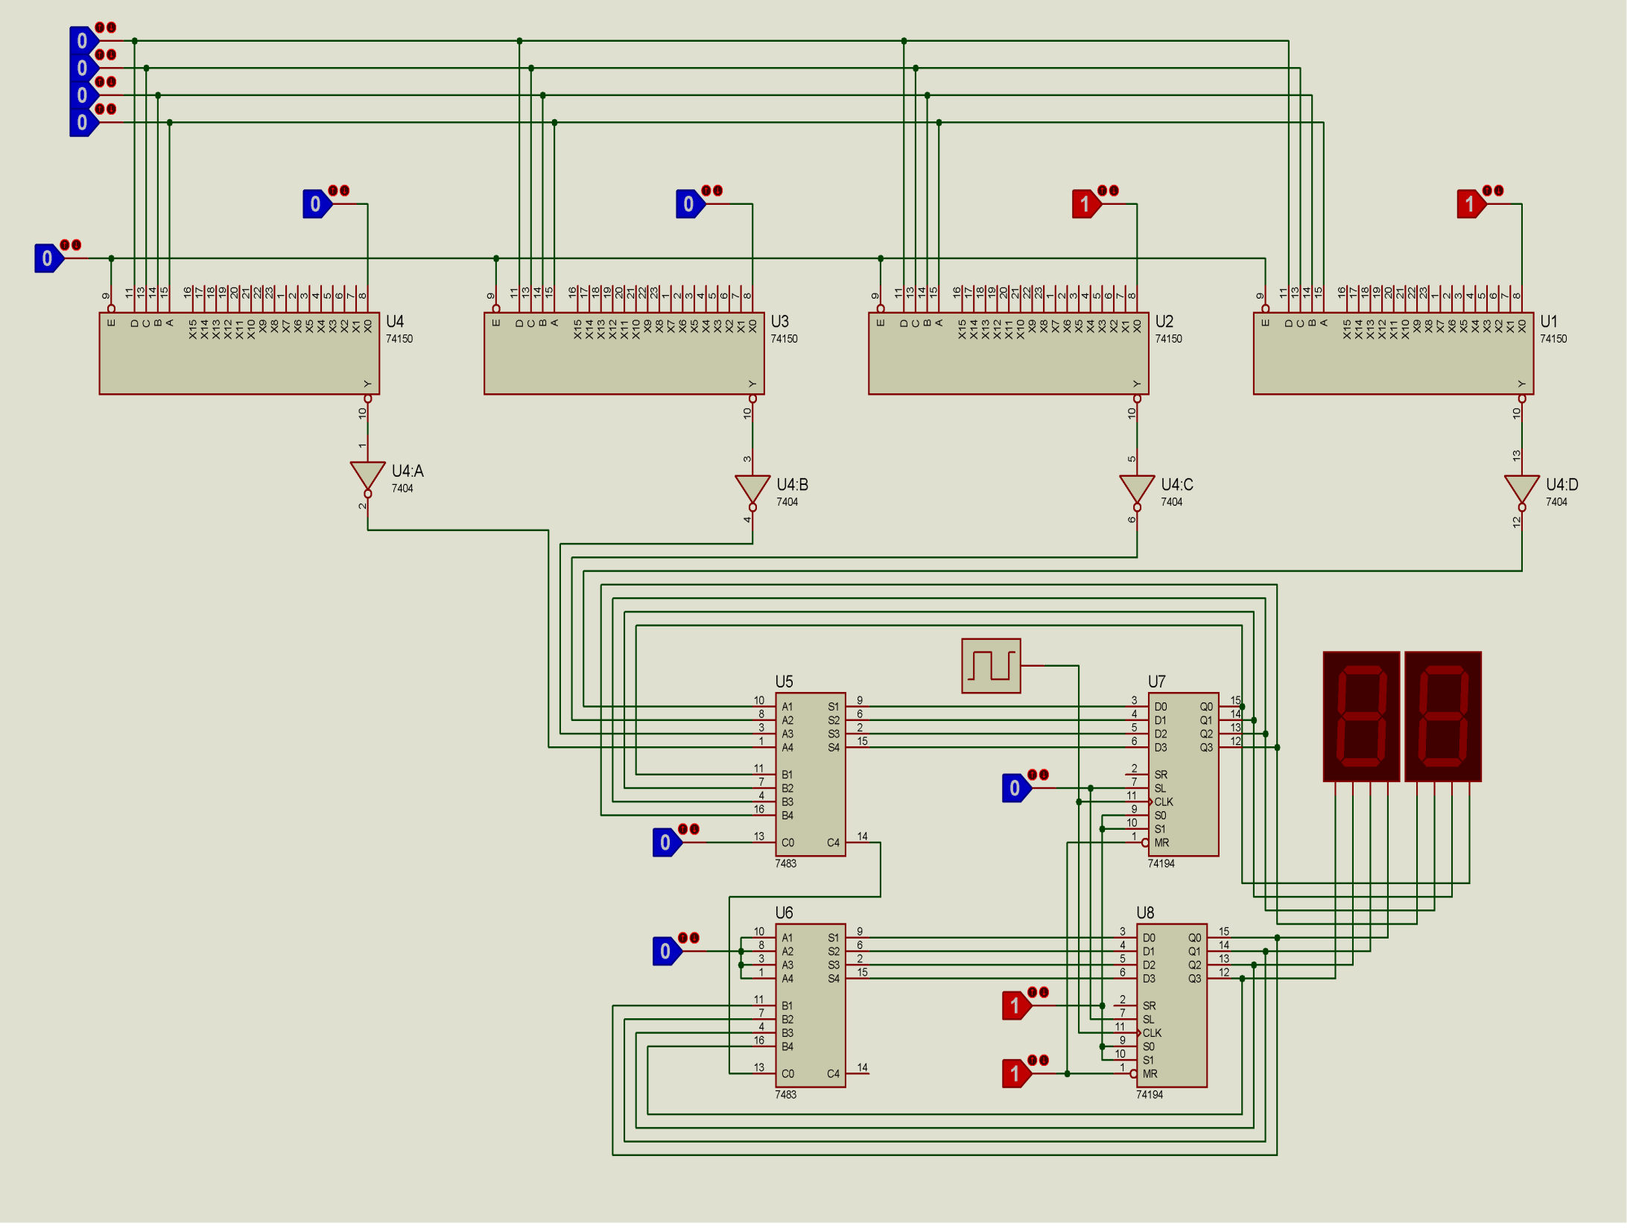
Adder 7483
Binary to decimal conversion seemed Troublesome
Shift-register
74194

Slide 11
Then…..
another Idea crossed our minds………..
A tricky One!!!

Slide 12
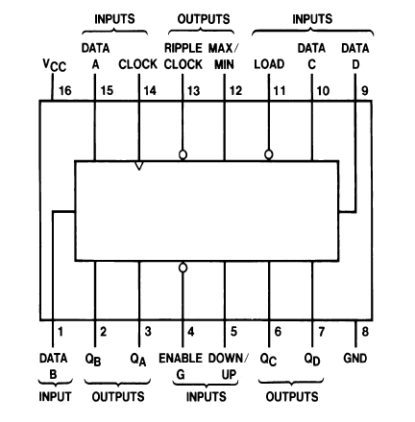
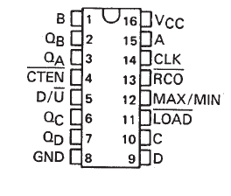
Output of MUX
goes into COUNTER circuit
IC 74190
IC 74191
4-Bit bcd Up/Down Counter
4-Bit binary Up/Down Counter

Slide 13
Price in binary

Slide 14
Reset Cash Register
Price in binary
load/count

Slide 15
Reset Cash Register
load/count

Slide 16
Reset Cash Register
load/count

Slide 17


Slide 18
Cost of circuit component
Component name | Quantity | Cost (BDT)
12V Adapter | 1 | 150
IC 7805 | 1 | 15
Heat sink | 1 | 30
LM324 | 2 | 30
IR emitter | 4 | 10
IR receiver | 4 | 10
IC 74150 | 4 | 320
555 timer IC | 1 | 30
IC 74191 | 1 | 30
IC 74190 | 2 | 60

Slide 19
Component name | Quantity | Cost (BDT)
IC 7432 | 1 | 20
IC 7404 | 1 | 20
Switches | 3 | 30
Resistors | 30 | 10
Potentiometer | 2 | 20
Wire |  | 60
IC 7447 | 2 | 60
7seg display | 2 | 20
Leds | 5 | 15
Breadboard | 5 | 900
Total |  | 1840

Slide 20
For 4 bit price system, Total No. of ICs = 15
99 is the highest we can count
Increasing 2 more, we can have 5 bit price system
Increasing 4 more and 1 display, We can count 999

