Slide 1
Future Energy Systems Using deep RL to optimize energy management systems
Data ^{X}
Students: Nate Tsang, Zilin Yan, Serena Wu, Collin Cao, Niema El Bouri
Mentor: Ashkan Yousefi

Slide 2
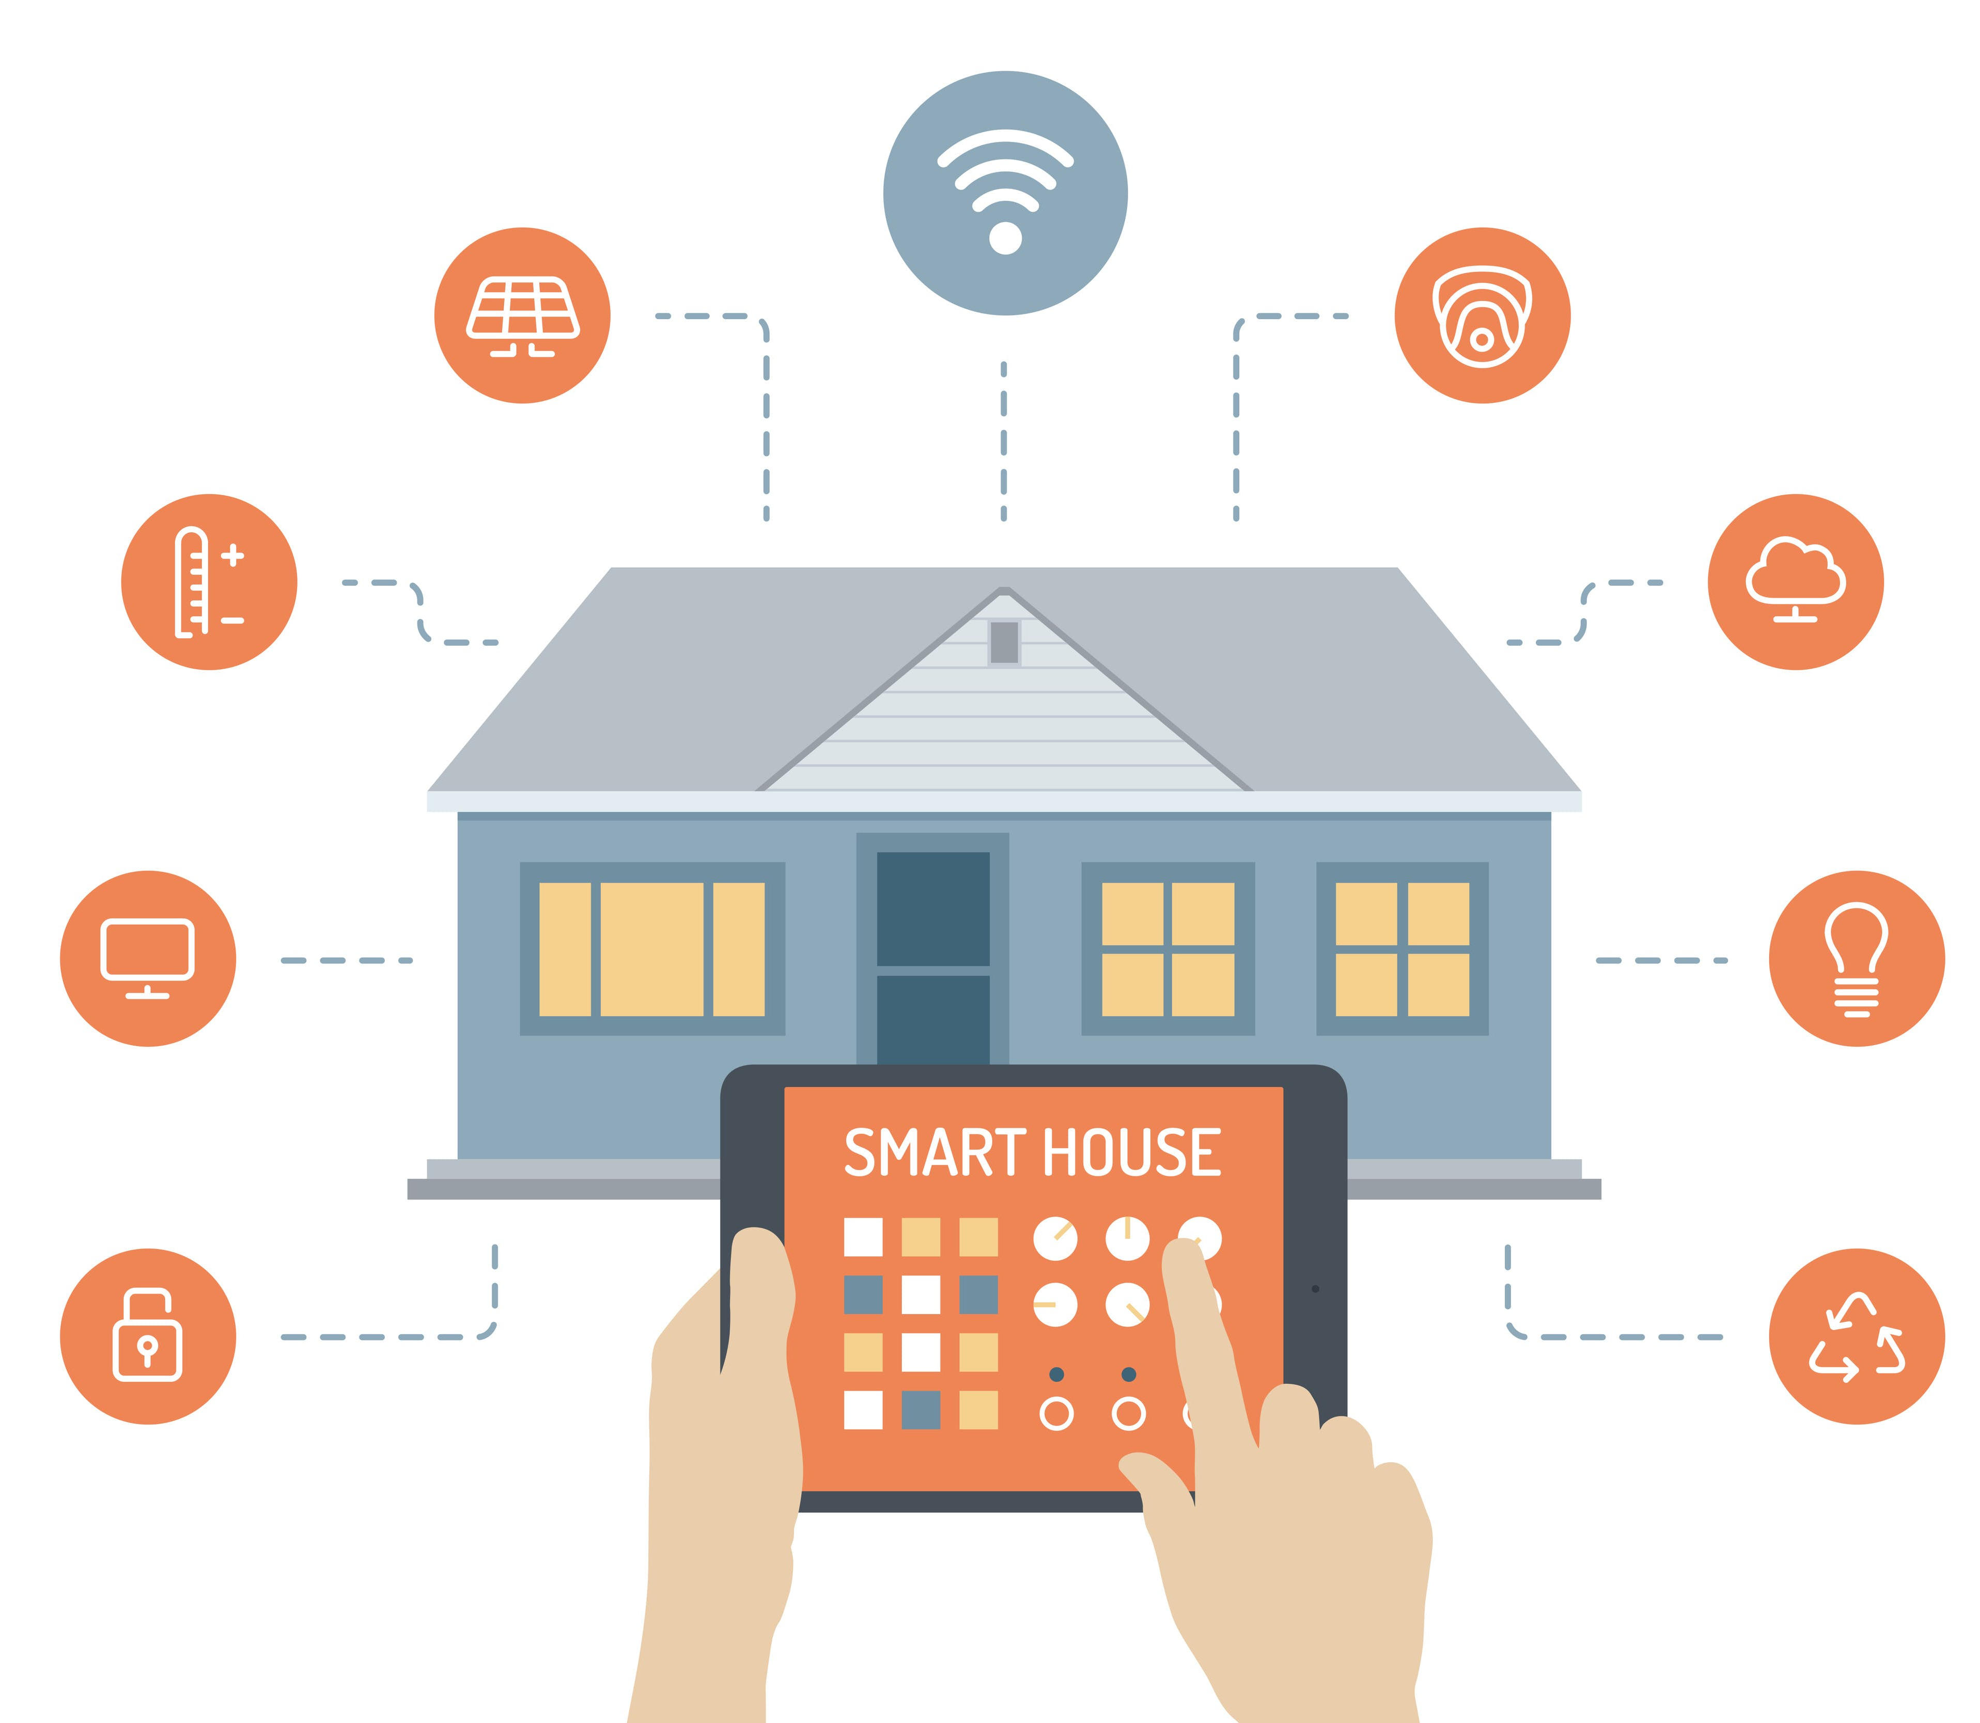
Project Description
With the proliferation of smart meters, large volumes of data are becoming available. This will help customers transition from a passive to an active and dynamic player in the energy market.
Customers need a system that can help them reduce electricity costs while ensure their lifestyle is undisturbed. Such a system would need to optimize:
1) building energy use
2) energy supply from each DER
Goal: using deep RL, provide real-time recommendations to utility customers to better manage their use of electricity with the goal of reducing cost
Image from Archinect News on 8/17/17 by Anastasia Tokmakova
https://archinect.com/news/article/150023205/considering-the-downsides-of-smart-home-technologies

Slide 3
Slide 2: User Perspective. Illustrate UI or Input /Output
Example Intended Screenshot
List Top 3 User Requirements
(your best guess)
Performance..
Presentation..
…

Slide 4
Technical Components of Project
Top Components in order of Importance
UI
Ability to send emails
Use of Neural Network Algorithms
Where will we get the data
..
Color Code Orange or Red: Lines you need to learn to do
Color Code Green: Lines which will be easy to develop

Slide 5
Put Sample Architecture (SA) and /or Data Model (DM) Replace the diagram below with your SA / DM (it is okay to use two slides, one for SA and one for DM)
Possible Inputs Code Blocks
Possible Output Code Blocks
Compute including test, train, split
Web or Poll
Algorithm Options w/ Tables/Matrix
Prediction / Classification
Natural Language, State Space
Feature Extraction
Web
Download
Email
Stream
Social Net
Pandas: Short
Term Storage
Chatbot
…
…
Crawl
Long Term Storage: SQL and File Formats (JSON, CSV, Excel)
Control Decision
Feedback from External System (World)

Slide 6
What will you do next
What is the initial set of tasks (3-5) tasks
Put initials or a name next to each
Week 1
Task 1
Task 2
Week 2
Wait to decide
Week 3..
Wait to decide
Hint: start with the red items on your list of technical components

