Slide 1


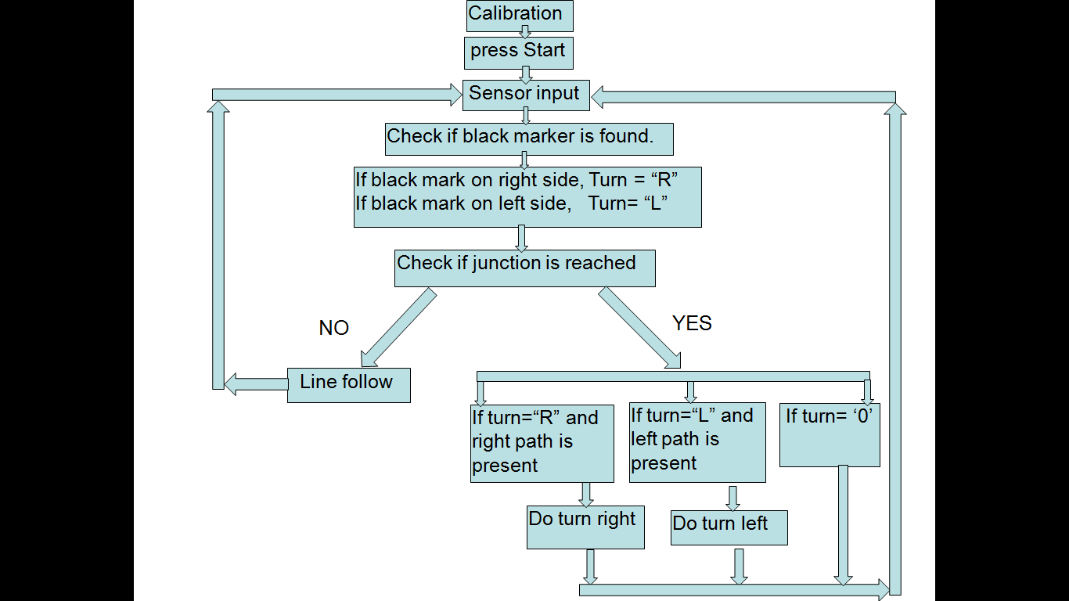
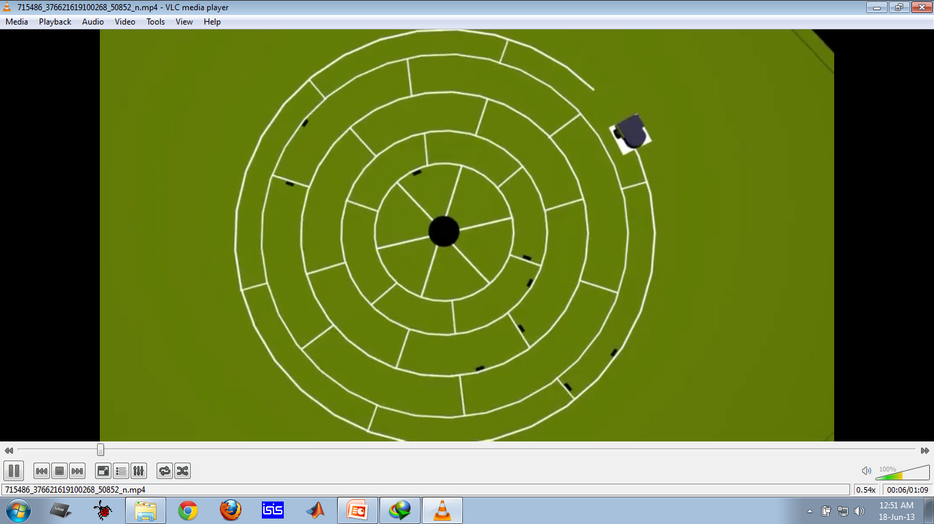
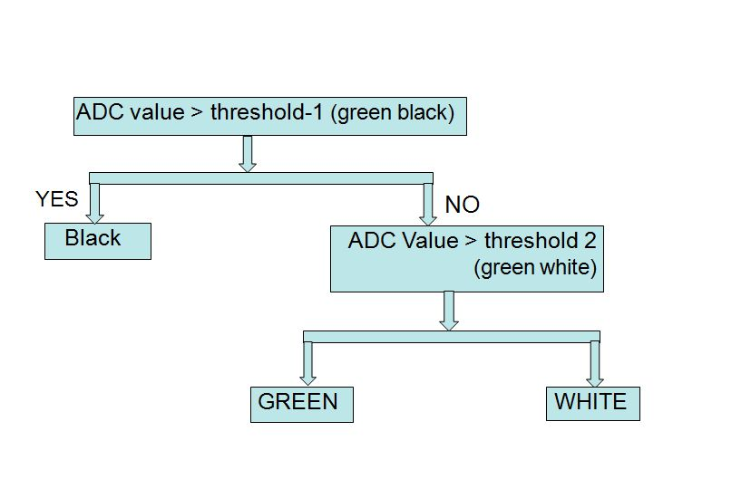
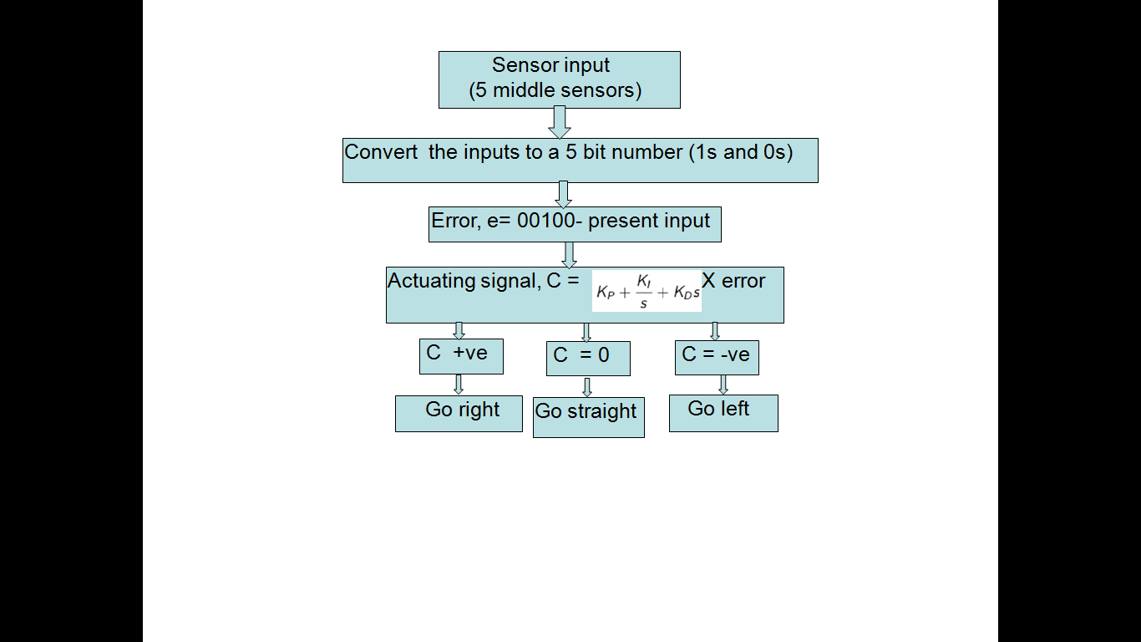
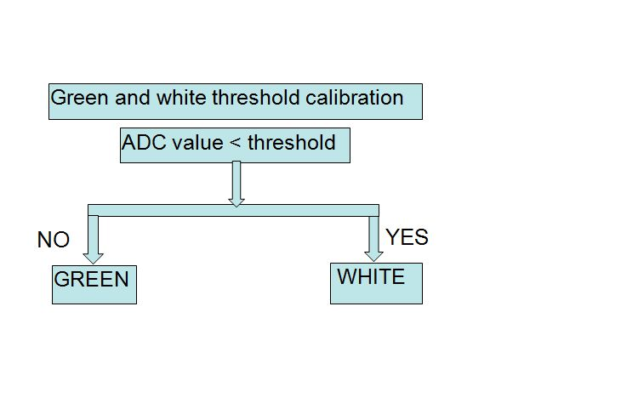
EEE 402 : Control System 1 Lab Project
Maze Solver Robot with PID control Rashed, Khalid, Fahad, Monjurul, Razib, Shaugato
Department of Electrical and Electronic Engineering
Bangladesh University of Engineering and Technology (BUET), Dhaka-1000, Bangladesh.
Organizer: IEEE Bangladesh Section
Abstract
Main Algorithm
Our Achievements
This project aims to develop a maze-solver robot which solves a circular maze . The robot which we have built follows line-both straight and circular. The electronic controller in the robot is implemented with PID algorithm. This controller provides smooth cruise control. The robot also tackles the challenge of detecting three colors on its track- black, white and green.
→By constructing this robot we have gained experience in mechanical construction.
We have gained practical knowledge on PID controller which has wide applications.
We have learnt some valuable ways to solve mazes and incorporate it into intelligent systems.
Future Work
Theme
→Mechanical construction needs improvement.
We can incorporate more complex control algorithms.
To build a robot which can follow line, solve maze upon directional instruction and practical implement ion of the PID controller.
Algorithm for color detection
Algorithm for PID implementation
Conclusion
Track/ Maze
Our maze-solver robot incorporates PID controller which keeps it on track and provides smooth running while solving the maze. We have achieved practical knowledge in robot design-both in electrical and mechanical ways. If we can improve the mechanical design further, our robot can be quiet promising. We hope to explore further the arena of robotics and control theory which EEE 402 course-project has instilled in us. We thank our course instructors for their valuable suggestions and guidance.

