Slide 1

Study of People’s Eat-out Behavior using Natural Language Processing (NLP) on Tweets
Abul H. Fahad (20764979), Syed A. Iqbal (20640625), Mohamed H. Abdalla (20800994)
{ahfahad, saiqbal, mhabdall}@uwaterloo.ca
Group 36, ECE 657A, Winter 2019

Slide 2
Outline
Data Collection
Merging,
Exploratory Data Analysis (EDA) and Preliminary Learnings
Feature and Target Extraction
(Web scraping, NLP)
Machine Learning (Regression, Classification)
Md. Mahabur Rahman, Md Taksir Hasan Majumder, Md Saddam Hossain Mukta, Mohammed Eunus Ali, and Jalal Mahmud. 2016. Can we predict eat-out preference of a person from tweets?. In Proceedings of the 8th ACM Conference on Web Science (WebSci '16). ACM, New York, NY, USA, 350-351. DOI: https://doi.org/10.1145/2908131.2908199

Slide 3
Additional Literature Review
Henriette Cramer , Mattias Rost , Lars Erik Holmquist, Performing a check-in: emerging practices, norms and 'conflicts' in location-sharing using foursquare, Proceedings of the 13th International Conference on Human Computer Interaction with Mobile Devices and Services, August 30-September 02, 2011, Stockholm, Sweden
Jilin Chen , Gary Hsieh , Jalal U. Mahmud , Jeffrey Nichols, Understanding individuals' personal values from social media word use, Proceedings of the 17th ACM conference on Computer supported cooperative work & social computing, February 15-19, 2014, Baltimore, Maryland, USA
Kenneth Joseph , Chun How Tan , Kathleen M. Carley, Beyond "local", "categories" and "friends": clustering foursquare users with latent "topics", Proceedings of the 2012 ACM Conference on Ubiquitous Computing, September 05-08, 2012, Pittsburgh, Pennsylvania

Slide 4
Dataset
Data Collection
Merging,
Exploratory Data Analysis (EDA) and Preliminary Learnings
Feature and Target Extraction
(Web scraping, NLP)
Machine Learning (Regression, Classification)
Dataset consists of 731 *.txt files.
File name is the Twitter handle of that user.
Each file has hundreds of Tweets from that user with a timestamp.

Slide 5
Merging and Exploratory Data Analysis(1)
Data Collection
Merging,
Exploratory Data Analysis (EDA) and Preliminary Learnings
Feature and Target Extraction
(Web scraping, NLP)
Machine Learning (Regression, Classification)

Slide 6
Exploratory Data Analysis(2)

Slide 7
Preliminary Learnings (3)

Slide 8
Some Application of NLP
Data Collection
Merging,
Exploratory Data Analysis (EDA) and Preliminary Learnings
Feature and Target Extraction
(Web scraping, NLP)
Machine Learning (Regression, Classification)
Parsing
Word Net
Named Entity Recognition
Information Retrieval
Sentiment Analysis
Document Clustering
Topic Segmentation
Part of Speech Tagging
Authoring
Machine Translation
Summarization
Information Extraction
Spoken Dialog Systems
Natural Language Generation
Word Sense Disambiguation

Slide 9
URL extraction from Tweets
.txt
file
Get file content
Re.findall() — Regular expression operations
List of URLs for that user
urls = re.findall('http[s]?://(?:[a-zA-Z]|[0-9]|[$-_@.&+]|[!*\(\),]|(?:%[0-9a-fA-F][0-9a-fA-F]))+', fileContent)
cleanUrls = []
for url in urls:
lastChar = url[-1] # get the last character
# if the last character is not (^ - not) an alphabet, or a number, or a '/', then enter IF condition
if (bool(re.match(r'[^a-zA-Z0-9/]', lastChar))):
cleanUrls.append(url[:-1]) # stripping last character, no matter what
else:
cleanUrls.append(url) # else, simply append to new list
#print(cleanUrls)
return cleanUrls

Slide 10
Restaurant Category Extraction from an URL
Function:
Website finder
Is it foursquare link?
Function:
get_4square_url
Place Category finder
website
title
4square
link
Urllib,
beautiful soup,
NLTK
No
URL
Urllib, beautiful soup, NLTK
Place
category
urllib, beautiful soup, NLTK
Price Category finder
Is it a eatery?
Save
result
category
Yes
Urllib, beautiful soup, NLTK
No
Go to Next URL

Slide 11
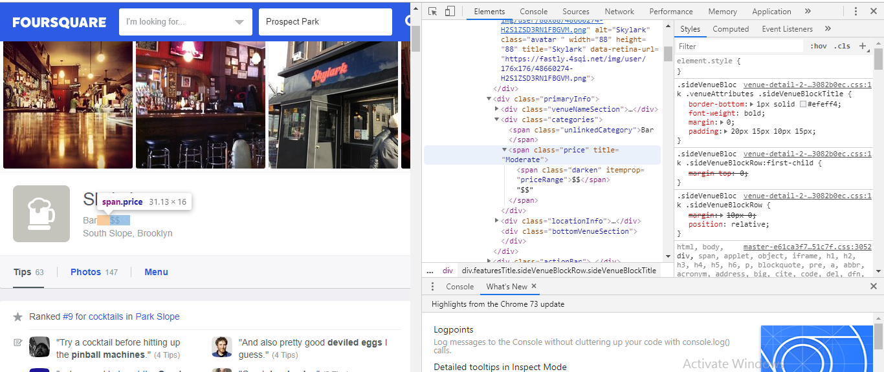

Slide 12
Pitfalls of webscraping
Anti- Scraping Technologies:
If you’re hitting a particular website from the same IP address then there are high chances that target website can block your IP address. Proxy services with rotating IP Addresses help in this regard. Proxy servers help mask IP addresses and can improve crawling speed.
There are several rotating proxy services available on the internet. Scraping frameworks like Scrapy provide easy integration for several rotating proxy services.
Javascript-based dynamic content:
Websites that heavily rely on Javascript & AJAX to render dynamic content makes data extraction difficult. Now, Scrapy and related frameworks/libraries will only work or extract what it finds in the HTML document. Ajax calls or Javascript are executed at runtime so it can’t scrape that. This can be handled by rendering the web page in a headless browser like Headless Chrome which essentially allows running Chrome in a server environment. Other Alternatives include PhantomJS which provides a headless Webkit based environment.
Captchas

Slide 13

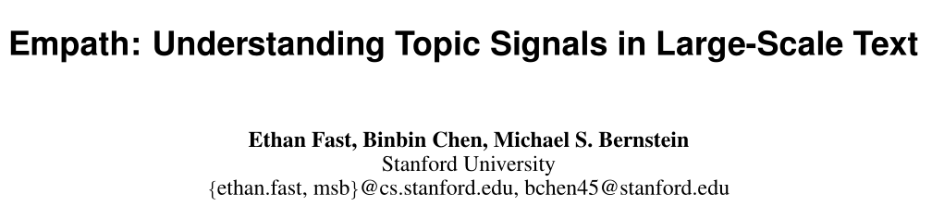
LIWC: linguistic inquiry and word count

Slide 14
Tweet Processing using Empath
file.read()
nltk.tokenize
remove all tokens that are not alphabetic
Lexicon
Analysis
Using
Empath
.txt file
containing
tweets of
each user
open()

Slide 15
LIWC: linguistic inquiry and word count (Pennebaker et. al, 2001)
LIWC uses Dictionaries of Categories to define its search terms.
The Pennebaker Dictionary (2001)
LIWC's default set of psychologically meaningful categories
74 subdictionaries (categories)
{80 in LIWC 2007}
Each subdictionary is comprised of words chosen and assessed by a set of judges who then agreed upon a set of subdictionary scales (93%-100% of the time).
Many of these words are in multiple categories.

Slide 16
Analysis via lexicon
“Attendees scream in rage at the poor quality of the talk.”
2 anger words
2 (anger) /13 (total words) = 0.15
normalized anger count

Slide 17
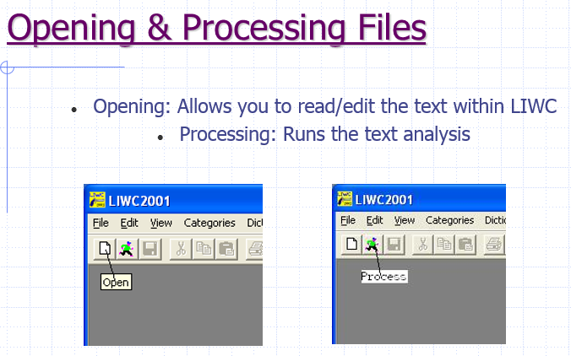
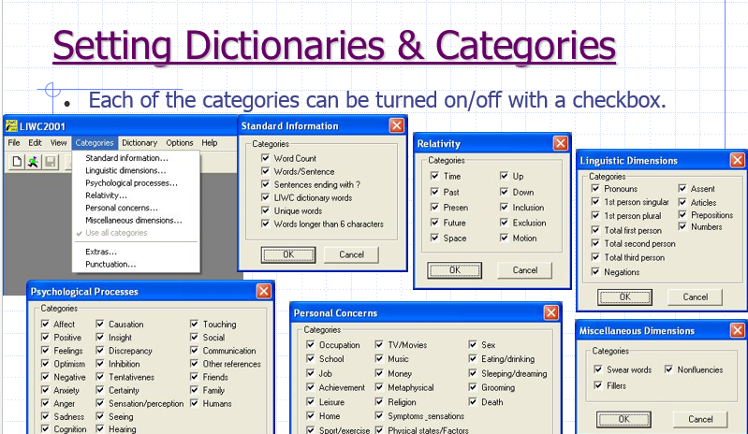
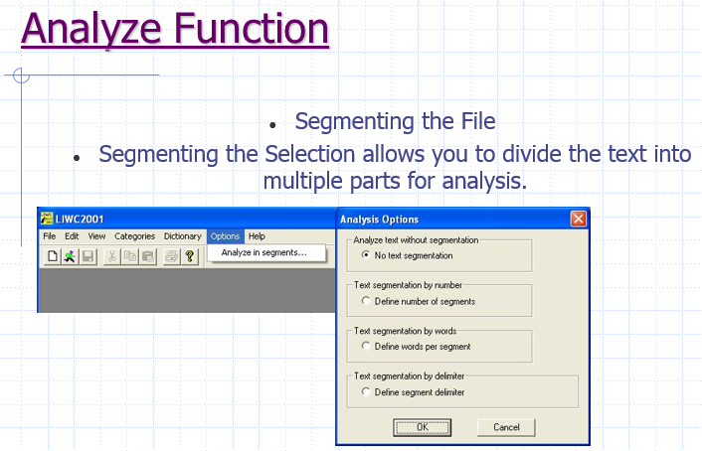
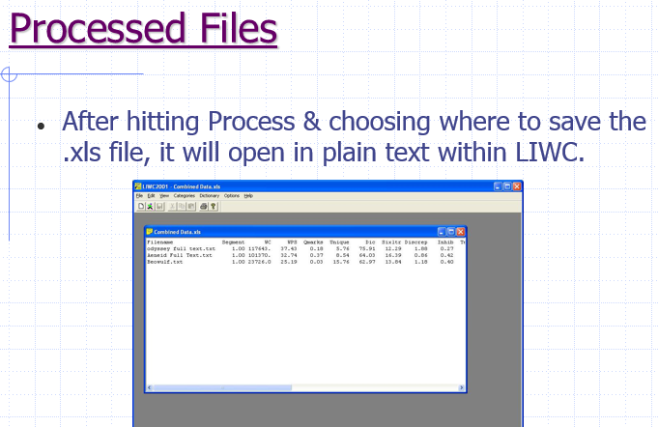
LIWC Analysis

Slide 18
Final Look of Dataset for ML
Features
Categories

Slide 19
Machine Learning (Regression, Classification) Stages of attempting the problem
Data Collection
Merging,
Exploratory Data Analysis (EDA) and Preliminary Learnings
Feature and Target Extraction
(Web scraping, NLP)
Machine Learning (Regression, Classification)
Stage One (No Feature Selection)
Stage Two (Implementing Feature Selection)
Stage Three (Hyper-parameter Tuning)

Slide 20
Stage One (No Feature Selection)-(1)
Attempting the regression problem (R­² Scores)
kNN
 | Cheap | Moderate | Expensive | Very Expensive
Training Score | 32.1% | 24.8% | 30% | 24.7%
Testing Score | -3.4% | -13.4% | -15.8% | -29.2%
SVM
 | Cheap | Moderate | Expensive | Very Expensive
Training Score | 5.1% | 4.5% | 2.9% | -0.7%
Testing Score | -2.1% | 0.6% | 1.7% | -6.3%
LASSO
 | Cheap | Moderate | Expensive | Very Expensive
Training Score | 18.0% | 4.5% | 16.7% | 0%
Testing Score | 9.2% | 1.7% | -0.9% | -0.8%
Random Forest
 | Cheap | Moderate | Expensive | Very Expensive
Training Score | 83.3% | 82.1% | 83.4% | 70.8%
Testing Score | -2.1% | -13.7% | -17.1% | -47.9%
Neural Network
 | Cheap | Moderate | Expensive | Very Expensive
Training Score | 99.9% | 99.9% | 99.9% | 99.9%
Testing Score | -38.9% | -86.5% | -72.7% | -84.8%

Slide 21
Stage One (No Feature Selection)-(2)
Attempting the classification problem
kNN
 | Cheap | Moderate | Expensive | Very Expensive
Accuracy | 57.7% | 52.3% | 55.3% | 61.9%
AUC | 54% | 50% | 55% | 45%
SVM
` | Cheap | Moderate | Expensive | Very Expensive
Accuracy | 60.1% | 55.3% | 66.6% | 73.8%
AUC | 65% | 54% | 65% | 62%
Random Forest
 | Cheap | Moderate | Expensive | Very Expensive
Accuracy | 53.5% | 49.4% | 62.5% | 70.8%
AUC | 60% | 47% | 63% | 46%
Neural Network
 | Cheap | Moderate | Expensive | Very Expensive
Accuracy | 55.3% | 54.1% | 56.5% | 67.2%
AUC | 60% | 54% | 61% | 62%

Slide 22
Stage two- (1) Feature Selection- Feature Ranking (Mutual Information metric)
Frequency of visiting Cheap restaurants:
Frequency of visiting Moderate restaurants:
Frequency of visiting Expensive restaurants:
Frequency of visiting Very Expensive restaurants:
air_travel | achievement | swimming
0.13093052 | 0.0870093 | 0.08630168
office | alcohol | family
0.09203442 | 0.08195523 | 0.08058522
philosophy | toy | occupation
0.0901525 | 0.07765963 | 0.0771492
affection | tool | meeting
0.08395045 | 0.07485812 | 0.07333734
Notes:
In an attempt to improve the regression and classification scores feature selection using feature ranking has been applied
The metric used for feature ranking is Mutual Information instead of Pearson Correlation because clearly our features are highly nonlinear. The top 20 features for each target will be used in building its model.

Slide 23
Stage Two- (2)
Attempting the regression problem using top 20 features for each model (R­² Scores)
kNN
 | Cheap | Moderate | Expensive | Very Expensive
Training Score | 29.7% | 18.6% | 28.2% | 20.5%
Testing Score | 4.6% | -11.6% | -11.3% | -31.1%
SVM
 | Cheap | Moderate | Expensive | Very Expensive
Training Score | 4.8% | 3.1% | 0.8% | -3.1%
Testing Score | -0.6% | -0.2% | 4.0% | -8.1%
LASSO
 | Cheap | Moderate | Expensive | Very Expensive
Training Score | 5.8% | 0.4% | 10.6% | 0%
Testing Score | 5.4% | -0.2% | -0.8% | -0.8%
Random Forest
 | Cheap | Moderate | Expensive | Very Expensive
Training Score | 81.2% | 81.6% | 83.3% | 73.7%
Testing Score | 4.2% | -10.3% | -21.1% | -14.1%
Neural Network
 | Cheap | Moderate | Expensive | Very Expensive
Training Score | 96.8% | 81.7% | 99.7% | 99.4%
Testing Score | -42.2% | -80.1% | -97.6% | -227.7%
Notes:
For most of the regression models the model improved by implementing feature selection

Slide 24
Stage Two- 3
Attempting the classification problem
kNN
 | Cheap | Moderate | Expensive | Very Expensive
Accuracy | 54.1% | 52.3% | 55.3% | 64.8%
AUC | 55% | 53% | 57% | 45%
SVM
 | Cheap | Moderate | Expensive | Very Expensive
Accuracy | 55.9% | 47.0% | 63% | 75.5%
AUC | 64% | 47% | 65% | 51%
Random Forest
 | Cheap | Moderate | Expensive | Very Expensive
Accuracy | 54.1% | 50.5% | 65.4% | 72.6%
AUC | 61% | 52% | 63% | 62%
Neural Network
 | Cheap | Moderate | Expensive | Very Expensive
Accuracy | 57.1% | 48.2% | 58.3% | 61.9%
AUC | 59% | 48% | 60% | 55%
Notes:
however for the classification the result mostly close but better without implementing feature selection.

Slide 25
Stage- 3 (1)
Hyper parameters of each model is tuned using Cross-Validation and GridSearchCV
Hyper parameters to be tuned:
kNN (Number of neighbors, Wight function used in prediction)
SVM (C, gamma)
LASSO (regularization parameter Alpha)
Random Forest (Number of trees , Max depth of the trees, Class Weight)
Neural Network (L2 regularization parameter, Hidden layers structure, Solver, Max number of iteration)
Notes:
Therefore, in this stage the regression models’ hyper parameters are tuned with implementing feature selection; however, in the classification case the models are tuned without features selection implementation.

Slide 26
Obtained Results
Regression Problem (R­² Scores)
Cheap restaurants visiting frequency:
Random Forest [Number of trees=100, Max depth of the trees=10] | Testing Score=10%
Moderate restaurants visiting frequency:
SVM [C=1, gamma=1] | Testing Score=1.7%
Expensive restaurants visiting frequency:
LASSO [Alpha=1] | Testing Score=5%
Very Expensive restaurants visiting frequency:
LASSO [Alpha=1] | Testing Score=0.3%

Slide 27
Obtained Results
Classification Problem
More than an average Cheap restaurant visitor:
SVM [C=2, gamma=0.01] | AUC= 66%
Moderate restaurants visiting frequency:
Random Forest [Number of trees=100, Max depth of the trees=20] | AUC= 64%
Expensive restaurants visiting frequency:
SVM [C=0.5, gamma=0.01] | AUC= 67%
Very Expensive restaurants visiting frequency:
Neural Network [Hidden layers structure= 5000, L2 regularization parameter= 0.0001, Max number of iteration= 50, Solver= Adam] | AUC= 64%
Notes:
Up to 17 percent better than chance models

Slide 28
Future Work
Sentiment Analysis of Users
---
----

