Slide 1
why bjp will win the election
Presented by

Slide 2

Indian Political Parties Comparison
- Overview of BJP and Congress
- Key differences
- Stats on support base

Slide 3

Political Parties

Slide 4

Leadership in Focus
- Narendra Modi and Rahul Gandhi
- Their backgrounds
- Comparison of leadership styles

Slide 5
Leadership Comparison

Slide 6

Public Opinion Analysis
- Perception of Modi and Rahul
- Trends in public support
- Role of social media

Slide 7
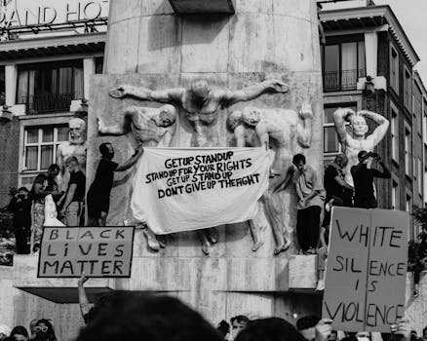
Public Opinion

Slide 8
Credits
Images provided by Pexels: https://www.pexels.com

