Slide 1
UIDAI Hackathon
Team Reference ID : yLlgZN09uA
Team Member Details
Sr No | Name | E Mail ID
1. | Ruksar Mujawar | mujawarruksar43@gmail.com
2. | Fahad Bakshi | fahadbakshi123@gmail.com
3. | Ayodhya Sathe | ayodhyasathe16@gmail.com

Slide 2
About the Problem Statement
Theme : Address Update
Problem Statement:
Address Update Challenge in Urban Areas
In urban cities, Citizens generally change their location due to many unavoidable reason like sift in duties, Transfers and many more but when they change their location the updating the information on Aadhar become a complex and challenging task to overcome this issue we are providing an seamless solution were we develop an web application using which an citizen can update his location just by authenticate the owners details and updating the address of citizen.

Slide 3
Approach
In urban cities, Citizens generally change their location due to many unavoidable reason like sift in duties, Transfers and many more, so we create this web application and we are use the following approach:
Step1: Intially the user/tenant create a login on web portal i.e. registration on web portal, during registration the user is authenticated using OTP.
Step2: User/Tenant will login using registered credentials to update the information of Aadhar.
Step3: For Updating the User/tenant Aadhar information with new location of land owner Aadhar details we add the Aadhar details of land owner.
Step4: Aadhar update request is sent to land for validation and authentication.
Step5: The land owner need to login and accept the request for authenticating and updating address of tenant.

Slide 4
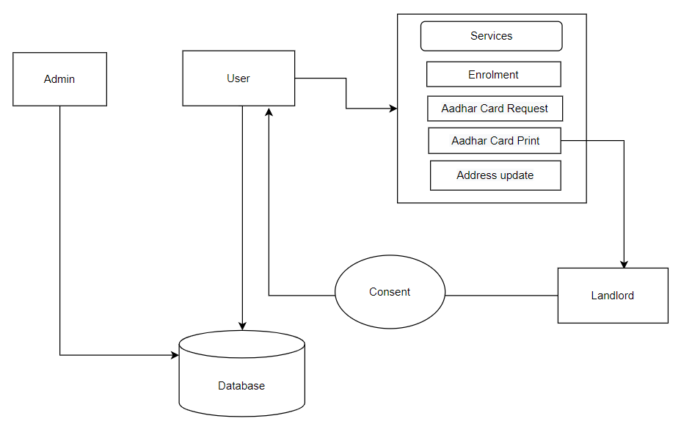
Architectural Diagram

Slide 5
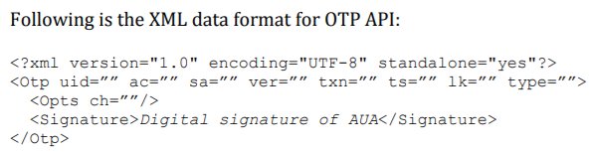
API Usage
Authentication Factors and One Time Pin (OTP) :
Authentication focuses on matching a person’s identity based on the reliability of a credential offered. Various agencies have different requirements for the degree of assurance required while authenticating beneficiaries/customers. When authenticating a resident, multiple factors may be used to strengthen the authenticity of the request.
OTP Request API
The application initiated OTP request API in detail including the flow, communication protocol, and data formats.

Slide 6
Security Considerations
In this Web API we provided security Considerations as:
Validation: Validating a website is the process of ensuring that the pages on the website conform to the norms or standards defined by various organizations
OTP: A one-time password (OTP) is an automatically generated numeric or alphanumeric string of characters that authenticates the user for a single transaction or session.
Biometric Authentication: which allows you to delegate authentication to the device's authenticators, including common mobile authenticators such as fingerprints or face ID.
Password-based authentication: Passwords are the most common methods of authentication. Passwords can be in the form of a string of letters, numbers, or special characters. To protect yourself you need to create strong passwords that include a combination of all possible options.

