Slide 1
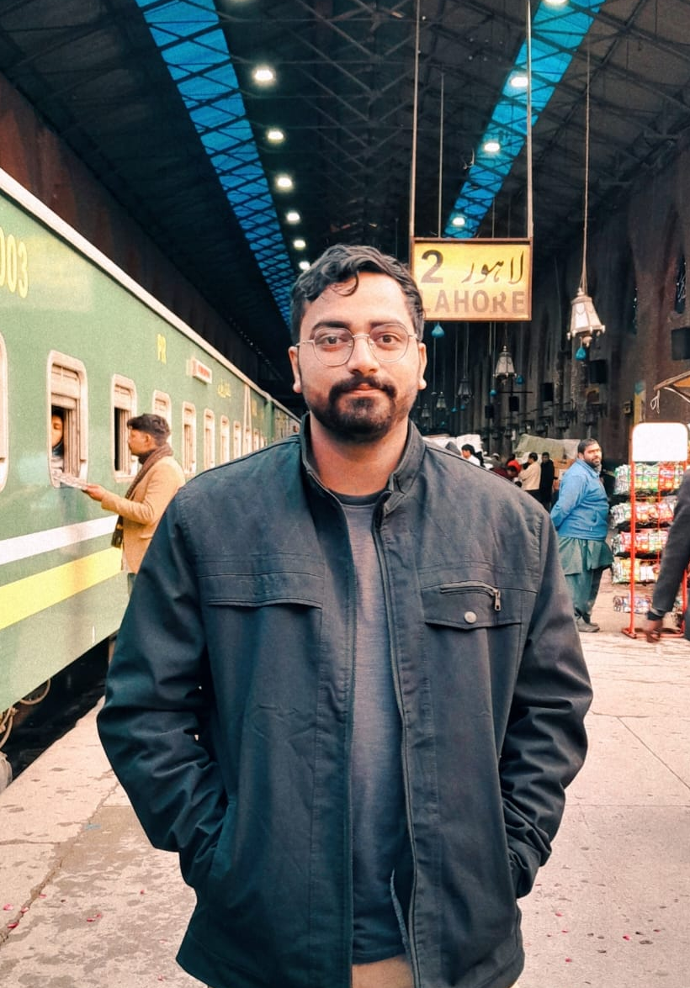
Who are you?
Hello there! I am Fahad Hassan, I’m currently a Data Science undergrad at the Institute of Business Management (CBM) — 6th semester and counting! My academic journey kicked off at Govt. Degree College SRE Majid for Intermediate, after doing my O-Levels at Sadequain Grammar School. But hey, it’s not all books and lectures! I've got real-world experience too — I spent nearly 2 years at Ibex as a Customer Support Representative for Walmart.com, where I mastered the art of patience, communication, and solving problems like a pro. I've also dipped my toes into the freelancing world, picking up projects and sharpening my skills along the way. When I’m not crunching data, you’ll probably find me:
Watching or playing football (team CR7 😎),Deep-diving into the latest manga (don’t tempt me to start a recommendation thread... I’m ready).
Let’s just say I’m a curious mind who loves solving problems — whether it's with data, people, or a football at my feet.

Slide 2
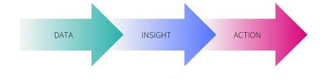
Understanding the Problem
Mission Brief: Conversion rates, repeat orders, operational efficiency.
Key questions to answer:
User behavior (signups, channels, conversion trends).
Growth recommendations.
Orders & revenue metrics (sales, AOV, cancellations).
My approach to this case study is to gain insights from the data that is given and based on this, we will come up with suitable data driven decisions for the problems defined and hopefully crack this case study.

Slide 3



User Behavior Analysis (Part 1) User Acquisition & Conversion Metrics
------------------------------------------------------------------------------------------------------------------------
"How many users signed up through paid channels?"
SELECT COUNT(*) AS paid_channel_signups
FROM dataset1
WHERE acquisition_platform IN ('Google', 'Facebook', 'tiktok');
------------------------------------------------------------------------------------------------------------------------
"% of users with at least one order?"
SELECT
(COUNT(CASE WHEN first_order_date IS NOT NULL AND first_order_date != '' THEN 1 END) * 100.0) / COUNT(*) AS percent_users_with_orders
------------------------------------------------------------------------------------------------------------------------
"Top acquisition channel?” SELECT acquisition_platform, COUNT(*) AS user_count
FROM dataset1
GROUP BY acquisition_platform
ORDER BY user_count DESC
LIMIT 1;

Slide 4
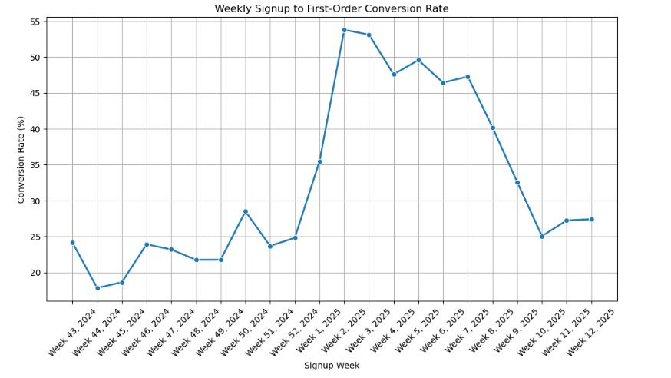
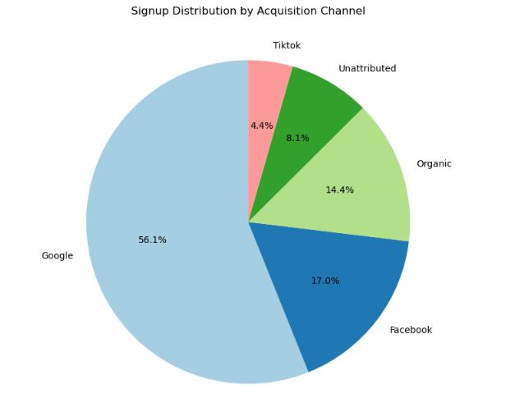
User Behavior Analysis (Part 2) Trends and Viz
------------------------------------------------------------------------------------------------------------------------
Shows the weekly trend of first order conversion
Shows the distribution of signups by channels

Slide 5
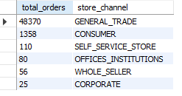


Orders & Revenue Metrics Sales Performance & Cancellations
------------------------------------------------------------------------------------------------------------------------
Total sales by store channel:
select count(*) as total_orders, store_channel
From dataset2
group by store_channel
order by count(ordered_quantity) desc;
Average Order Value (AOV): SELECT AVG(order_total) AS aov
FROM (
SELECT order_number,
SUM((amount_per_unit * ordered_quantity) - item_discount) AS order_total
FROM dataset2
GROUP BY order_number
) AS order_totals;
% canceled orders:
SELECT
(COUNT(DISTINCT CASE WHEN order_status = 'CANCELLED' THEN order_number END) * 100.0)
/ COUNT(DISTINCT order_number) AS percent_orders_cancelled
------------------------------------------------------------------------------------------------------------------------
------------------------------------------------------------------------------------------------------------------------
------------------------------------------------------------------------------------------------------------------------

Slide 6
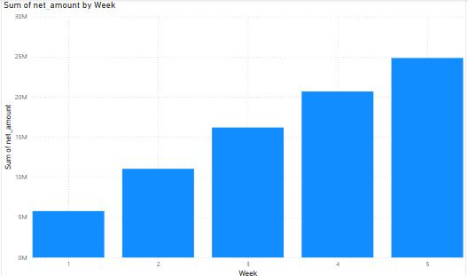
Orders and Revenue Weekly Trend of Sales and Orders
------------------------------------------------------------------------------------------------------------------------
This visualization shows the weekly trend of sales. The original question in the case study emphasized on a “Monthly” trend but unfortunately the data available was for the month of January only (dataset 2) so I came up with a weekly trend instead. A calculated net amount was first taken out in PowerBI as some of the discounts given were more than the amount actually paid for the item. To correct this I simply removed the entire discount where the discount exceeded the cost of item and then a net amount column was calculated.
------------------------------------------------------------------------------------------------------------------------

Slide 7


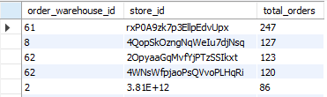
SQL Deep Dive Key SQL Queries & Insights
------------------------------------------------------------------------------------------------------------------------
Total number of orders SELECT COUNT(DISTINCT order_number) AS total_orders
FROM dataset2;
Total sales revenue: SELECT SUM((amount_per_unit * ordered_quantity) - item_discount) AS total_sales_revenue
FROM dataset2;
Distribution of orders by warehouse and store: They can be taken out combined or separately, I have run an sql query combining both: SELECT
order_warehouse_id,
store_id,
COUNT(DISTINCT order_number) AS total_orders
FROM dataset2
GROUP BY order_warehouse_id, store_id
ORDER BY total_orders DESC;
------------------------------------------------------------------------------------------------------------------------
------------------------------------------------------------------------------------------------------------------------
------------------------------------------------------------------------------------------------------------------------

Slide 8

Growth Recommendations: Improving first order conversion rate
First order conversion rate implies the rate for an order to be placed since an account has been created. Coming to the problem, how can we improve the order conversion rate that is currently, 28.25%, well here is the solution that I propose.
1. Optimize Paid Campaigns Based on Conversion Spikes Weeks 1–4 of 2025 saw conversion rates over 50%, much higher than the average. This should align with promotional offers, discount or other marketing methods done in the time period at the start of the year. A thorough research over the practices in this time period could help identify the best methods to improve the first order conversion.

Slide 9

Improving first order conversion rate (2)
2.Boost Conversion in Organic & Facebook Channels Organic (14.4%) and Facebook (17%) have considerable signup volume but have lower conversion rates. Since the company is already paying for these signups ( Not organic ), it is best to optimize them to yield results. Good practices could be welcome email nudges, first-time discounts, and onboarding flows for users from these channels. Customer behavior changes with the acquisition platform, google might show users with the urgency to buy the product since it is searched based, while users signed up from Facebook might need more nurturing, we can educate with testimonials or "how it works" and the benefits they get buying from us.

Slide 10
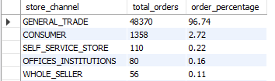
Idea to Improve Repeat Orders
Introduce Product Bundles or Subscriptions: General Trade is the biggest acquisition channel (96.74%). These users may be small shops or households that regularly buy similar SKUs. We can offer pre-made bundles with discounts to incentivize this and make full use of the opportunity; we can target these customers with their order purchase history and offer customized bundles.
Understanding when your customers are most likely to reorder is key. Set up smart, time-based reminders (via WhatsApp, SMS, or email) that nudge customers to reorder just before they typically do. The idea is to catch them at the perfect moment — before they run out or move on.

Slide 11
Thank you!
This case study has been an exciting journey through data and strategy - where numbers met creativity to uncover growth opportunities. I've thoroughly enjoyed playing detective with the given datasets, connecting insights to real business impact. It's been both intellectually rewarding and surprisingly fun to turn raw data into actionable recommendations. I'm energized by the potential these findings hold and would love to explore how we can bring them to life together!

