Slide 1

Chapter 3, Project Organization and Communication

Slide 2
A Communication Example
"Two missile electrical boxes manufactured by different contractors were joined together by a pair of wires.
Box 1
Pair of Wires
Box 2

Slide 3
A Communication Example (continued)
Thanks to a particular thorough preflight check, it was discovered that the wires had been reversed."
Box 1
Box 2

Slide 4
After the Crash...
...
"The postflight analysis revealed that the contractors had indeed corrected the reversed wires as instructed."

Slide 5
“In fact, both of them had.”
Box 1
Box 2

Slide 6
Communication is important
In large system development efforts, you will spend more time communicating than coding
A software engineer needs to learn the so-called soft skills: technical writing, reading documentation, communication, collaboration, management, presentations.
In this course, we ask each of you to (acquire and) demonstrate the following skills:
Management: Run a team meeting
Presentation: Present an major aspect of STARS during its development phase.
Collaboration: Negotiate requirements with the client and with members from your team and other teams.
Technical writing: Write part of the documentation of STARS

Slide 7
Definitions
Communication event
Type of information exchange that has defined objectives and scope
Scheduled: Planned communication (e.g., review, meeting)
Unscheduled:Event-driven communication (e.g., request for change, issue clarification, problem report)
Communication mechanism
Tool or procedure that can be used to transmit information
Synchronous: Sender and receiver are available at the same time
Asynchronous: Sender and Receiver are not communicating at the same time.

Slide 8
Classification of Communication
Communication
is supported by
Communication
Event
*
*
Mechanism
Planned
Unplanned
Synchronous
Asynchronous
Event
Event
Mechanism
Mechanism

Slide 9
Planned Communication Events
Problem Definition
Objective: Present goals, requirements and constraints
Example: Client Presentation
Usually scheduled at the beginning of a project.
Project Review: Focus on system model
Objective: Assess status and review system model, system decomposition, and subsystem interfaces
Examples: Analysis Review, System Design Review
Scheduled around project milestones and deliverables
Client Review: Focus on requirements
Objective: Brief client, agree on requirements changes
Client Review
Usually scheduled after analysis phase

Slide 10
Planned Communication Events (continued)
Walkthrough (Informal)
Objective: Increase quality of subsystem
Example: Developer presents subsystem to team members, informal, peer-to-peer
To be scheduled by each team
Inspection (Formal)
Objective: Compliance with requirements
Example: Client acceptance test (Demonstration of final system to customer)
To be scheduled by project management

Slide 11
Planned Communication Events (continued)
Status Review
Objective: Find deviations from schedule and correct them or identify new issues
Example: Status section in regular weekly team meeting
Scheduled every week
Brainstorming
Objective: Generate and evaluate large number of solutions for a problem
Example: Discussion section in regular weekly team meeting
Scheduled every week

Slide 12
Planned Communication Events (continued)
Release
Objective: Baseline the result of each software development activity
Software Project Management Plan (SPMP)
Requirements Analysis Document (RAD)
System Design Document (SDD)
Object Design Document (ODD)
Test Manual (TM)
User Manual (UM)
Usually scheduled after each phase
Postmortem Review
Objective: Describe Lessons Learned
Scheduled at the end of the project

Slide 13
Unplanned Communication Events
Request for clarification
The bulk of communication among developers, clients and users.
Example: A developer may request a clarification about an ambiguous sentence in the problem statement.
Request for change
A participant reports a problem and proposes a solution
Change requests are often formalized when the project size is substantial.
Example: A participant reports of a problem the air conditioner in the lecture room and suggests a change.
Issue resolution
Selects a single solution to a problem for which several solutions have been proposed.
Uses issue base to collect problems and proposals

Slide 14
Example of Request for Clarification
From: Alice
Newsgroups: cs413.architecture.discuss
Subject: SDD
Date: Thu, 10 Oct 23:12:48 -0400
Message-ID: <325DBB30.4380@andrew.cmu.edu>
MimeVersion: 1.0
Content-Type: text/plain; charset=us-ascii
When exactly would you like the System Design Document? There is some confusion over the actual deadline: the schedule claims it to be October 22, while the template says we have until November 7.
Thanks,
Alice

Slide 15
Example of a Change Request
Report number: 1291
Date: 5/3
Author: Dave
Synopsis: The STARS client crashes when empty forms are submitted.
Subsystem: User interface
Version: 3.4.1
Classification: missing/incorrect functionality, convention violation, bug, documentation error
Severity: severe, moderate, annoying
Description: <<Description of the problem>>
Rationale: <<Why the change should be done>>
Proposed solution: <<Description of desired change>>

Slide 16
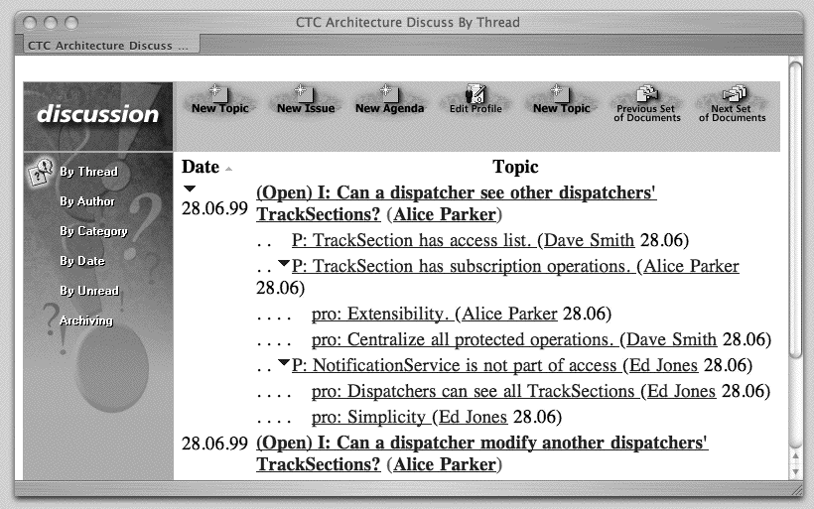
Example of Issue Base

Slide 17
Synchronous Communication Mechanisms
Smoke signals
Supports: ?, Pros: ?, Cons: ?
Hallway conversation (face-to-face)
Supports: Unplanned conversations, Request for clarification, request for change
Pro: Cheap and effective for resolving simple problems
Con: Important information can be lost, misunderstandings can occur when conversation is relayed to others.
Meeting (face-to-face, telephone, video conference)
Supports: Planned conversations, client review, project review, status review, brainstorming, issue resolution
Pro: Effective mechanism for resolution of isssues, and building consensus
Con: High cost (people, resources); difficulty of managing them and getting effective results

Slide 18
Meeting Roles
Primary facilitator
Responsible for organizing the meeting and guiding the execution.
Writes the agenda describing objective and scope of meeting.
Distribute the agenda to the meeting participants
Minute taker
Responsible for recording the meeting.
Identifies action items and issues
Release them to the participants
Time keeper
Responsible for keeping track of time

Slide 19
Structure of a Meeting Agenda

Slide 20
Asynchronous Communication Mechanisms
E-Mail
Supports: Release, change request, brainstorming
Pro: Ideal for planned communication events and announcements.
Con: E-mail taken out of context can be easily misunderstood, sent to the wrong person, lost or not read by the receiver.
Newsgroups
Supports: Release, change request, brainstorming
Pro: Suited for notification and discussion among people who share a common interest; cheap (shareware available)
Con: Primitive access control (often, you are either in or out)
World Wide Web
Supports: Release, change request, inspections
Pro: Provide the user with a hypertext metaphor: Documents contain links to other documents.
Con: Does not easily support rapidly evolving documents

Slide 21
Asynchronous Communication Mechanisms
Lotus Notes
Each user sees the information space as a set of databases, containing documents composed of a set of fields. Users collaborate by crating, sharing and modifying documents
Supports: Release, change request, brainstorming
Pro: Provides excellent access control mechanisms and replication of databases.
Con: Proprietary format, expensive

Slide 22
Example: Document Review with Lotus Notes
Use cases:
Fill out a review form
Attach document to be reviewed
Distribute the review form to reviewers
Wait for comments from reviewers
Review comments
Create action items from selected comments
Revise document and post the revised version
Iterate the review cycle
The following example demonstrates a document review database from JAMES project.

Slide 23
Review of Documents Database

Slide 25
Fill out the Review Form
Select reviewers
Select the document to be reviewed
Add comments to reviewers
Determine deadline

Slide 26
Reviewer Notification
Selected reviewers get e-mail

Slide 28
Reviewers add their Comments

Slide 29
Originator Notification

Slide 30
Final Recipient Notification

Slide 31
Review Tasks
Editor reviews comments
Editor selects reviewed comments
Web Master posts reviewed document and action items
Team members complete their action items
Editor integrates changes
Editor posts changed document on the review database for the next review cycle

Slide 32
Accepted Document w/ Action Items

Slide 33
SPMP Action Items

Slide 34
Summary
Communication Events
Planned (stipulated by the schedule)
Unplanned (driven by unexpected events)
Communication Mechanisms
Asynchronous communication mechanisms
Synchronous communication mechanisms
Important events and mechanisms
Weekly meeting
Project reviews
Online communication (discussion forum, email, web)

