Slide 1
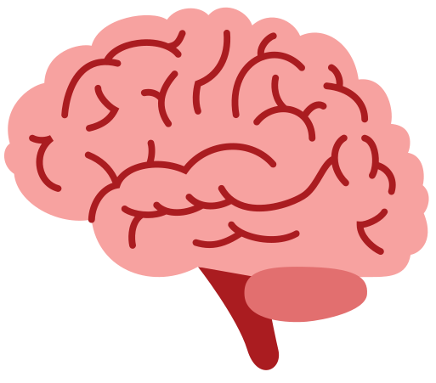
stroke
ALERT

Slide 2

Stroke is the 2nd leading cause of death and a major cause of disability worldwide
Strokes are estimated to cost over $721 billion annually.
Diagnosis and management are often delayed in resource-poor regions.

Slide 3
In an ideal world...
FAST
Diagnosis
Thrombolysis
Symptom Onset
CT Brain
NIHSS
4.5 hours only

Slide 4

In our world...
FAST
Diagnosis
Thrombolysis
Symptom Onset
CT Brain
NIHSS
unawareness of diagnostic tests
unawareness of nearest stroke centers
delayed arrival
delayed/inaccurate reporting
untrained first responder
unavailability of stroke/neurology consultants

Slide 5



strokeALERT App
ACCESSIBLE
FAST
ACCURATE

Slide 6
How does it work?
Takes in text input from FAST Exam to analyse if the patient is having a stroke or not.
Takes in CT scan images and runs them through our advanced CNN model and tells if the patient is having a hemorrhagic stroke or an Ischemic Stroke with 96.8% accuracy.

Slide 7
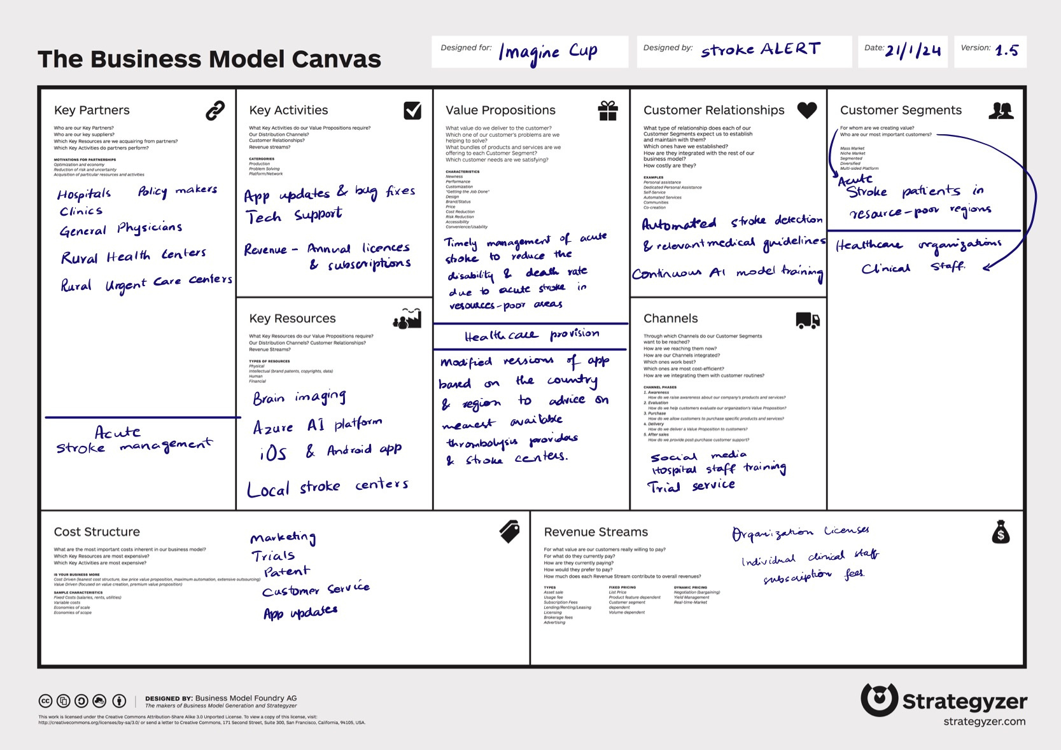

Slide 8
Future work:
Incorporate NIHSS Tests and Guidelines for Ischemic Stroke.
Aware the user of the nearest thrombolysis centres if it hasn’t been 4.5 hrs since the stroke.
Guidance if it has been over 4.5 hrs.
Use XAI to explain the results and create transparency.
Use AI to analyze 3D scans.

Slide 9




The Team
Muhamad Fahad
Sarah Imdad
Urooj Imdad
Ammad Ali
The Computer Scientist
The Biomedical Engineer
The AI/ML Engineer
The Doctor

Slide 10
