Slide 1

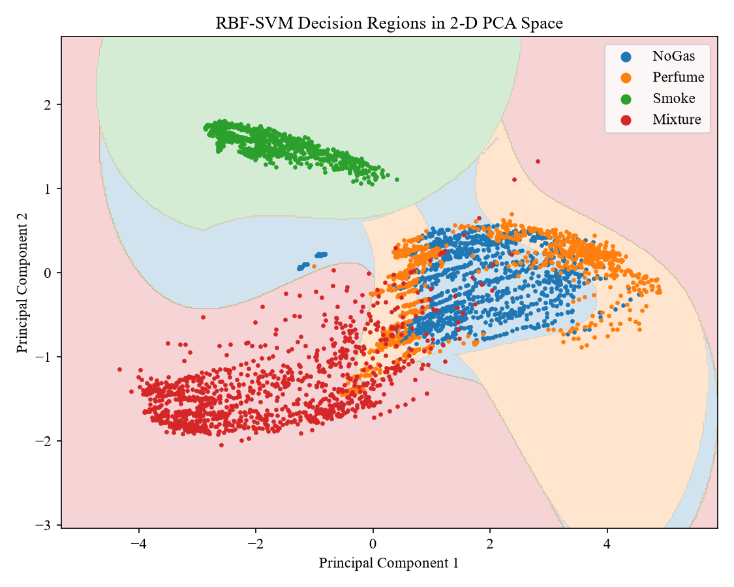
Review: Real-Time Gas Leak Detection in Pipelines, Logistics and Manufacturing Using Support Vector Machines on IoT Sensor Data
UNIVERSITY OF CHITTAGONG
Department of Mathematics | M.S. (Applied Math), AMAT-526
Project defence presentation
RBF-SVM decision regions for NoGas, Perfume, Smoke and Mixture
Presented by: ______________________
ID: ____________ Session: ____________
Supervisor: ______________________
Notes:
Introduce yourself and the supervisor. One sentence: we built and tested a Support Vector Machine that reads seven cheap gas sensors and decides, in about a millisecond, whether the air holds a gas leak and which gas it is.

Slide 2

Why gas leaks need real-time detection
13,238 km
9,926
The gap
of Titas Gas pipelines serve about 2.88 million customers (2021); most lines were built for a 30-year life
spots leaking methane found in just 1,682 km of pipeline surveyed in 2021–22
Gas is odorised, but smell reveals only part of the leaks, and nobody smells a pipe all day.
Factories, depots and warehouses (e.g. BM Depot, Sitakunda 2022) face the same risk.
We need a sensor + model that decides on its own, every few seconds.
34
2023
worshippers killed in 2020 when gas from a leaking line exploded in a Narayanganj mosque
Siddique Bazar explosion, Dhaka: gas leaked from an abandoned pipeline in the basement
Notes:
Context. Bangladesh's gas network is old: Titas found 9,926 leaking spots in only 1,682 km surveyed. Leaks have killed people (Narayanganj 2020, Siddique Bazar 2023). Odorant is not enough, so we need automatic, instrumental detection that runs continuously. Sources are cited in Chapter 1 of the report.

Slide 3




What we did, and what is new
Aim: detect and identify a gas leak from low-cost IoT gas sensors, in real time, with one well-understood model: the Support Vector Machine.
Real sensor data
One model, in depth
Real-time proof
Pipeline and honesty tests
6,400 readings from 7 MQ gas sensors, 4 classes: NoGas, Perfume, Smoke, Mixture (MultimodalGasData).
SVM from the mathematics (margin, dual, kernel, KKT) to tuned code: a linear baseline, then an RBF model.
Measured on a laptop: about 1 ms per decision, while the sensors report only every 2 s.
An acoustic pipeline-leak case study (GPLA-12) and a time-ordered test that exposes sensor drift.
Notes:
These four points are our contribution. Stress that every number in the talk comes from experiments we actually ran; the code runs on a laptop and in Google Colab with identical results.

Slide 4
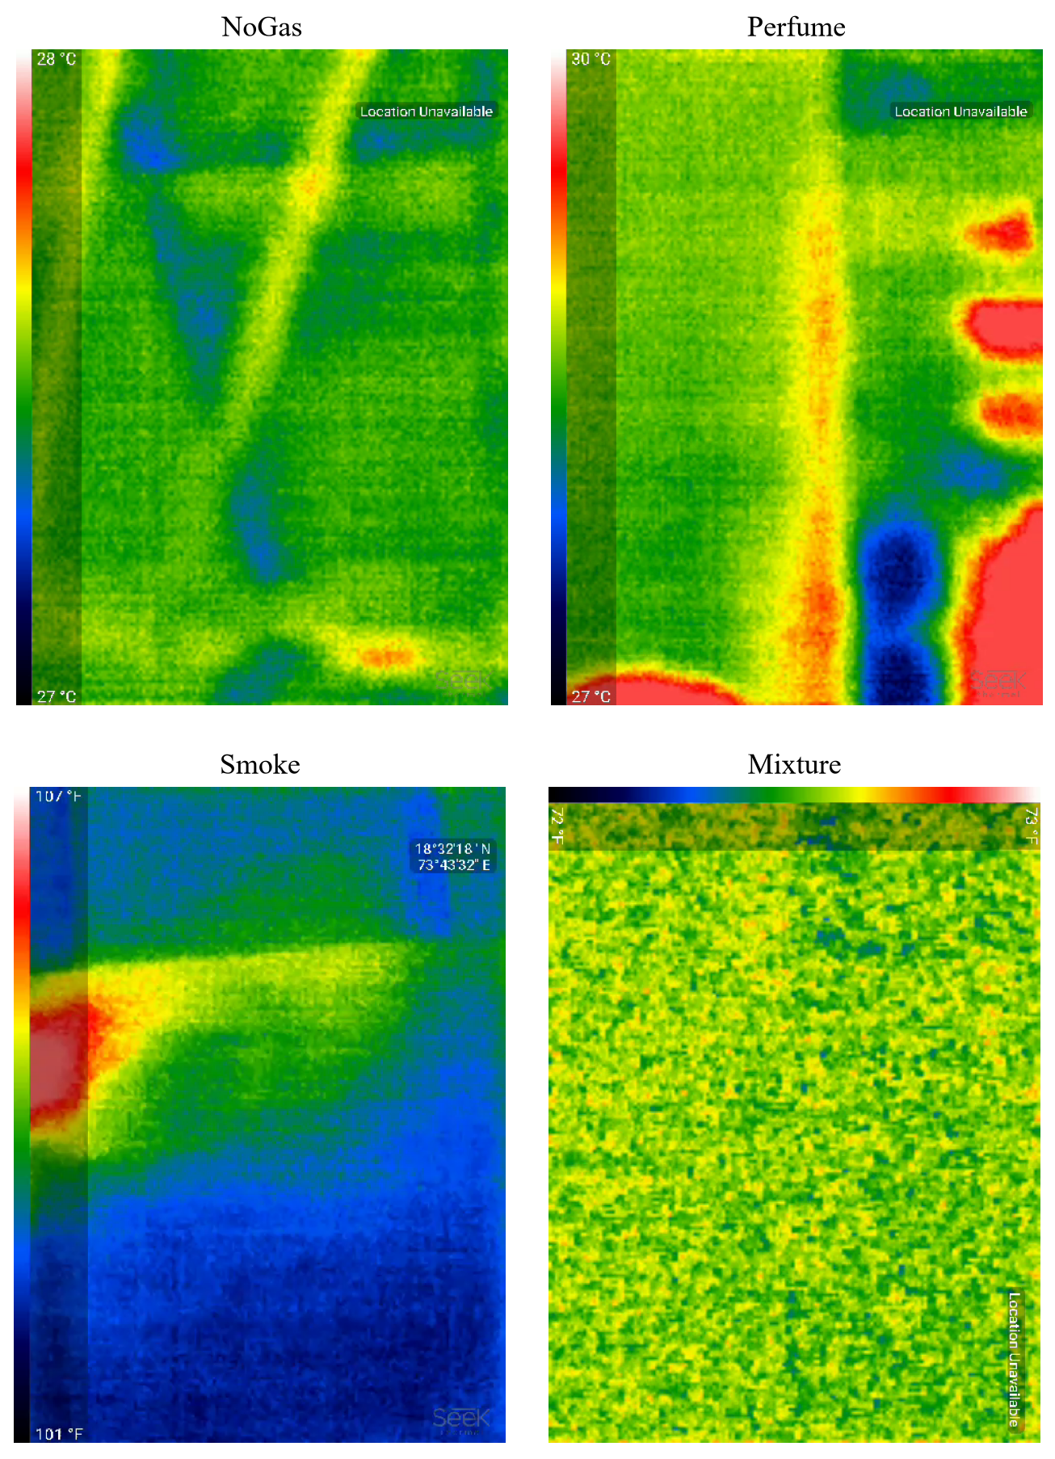
The data: 7 gas sensors, 4 classes
MQ2 LPG, smoke
MQ3 alcohol vapour
MQ5 natural gas, LPG
MQ6 LPG, butane
MQ7 carbon monoxide
MQ8 hydrogen
MQ135 NH₃, benzene, CO₂
6,400
1,600
2 s
readings
per class (balanced)
between readings
Split: 70% train (4,480) | 15% validation (960) | 15% test (960), stratified by class
Thermal frames recorded with the readings (shown for context, not used for training)
Notes:
Each reading is a vector of 7 numbers, one per MQ sensor. Each sensor responds to several gases, so no single sensor identifies the gas; the SVM learns the pattern across all 7. Classes are perfectly balanced, 1,600 each. The dataset is public (Mendeley, CC BY 4.0).

Slide 5
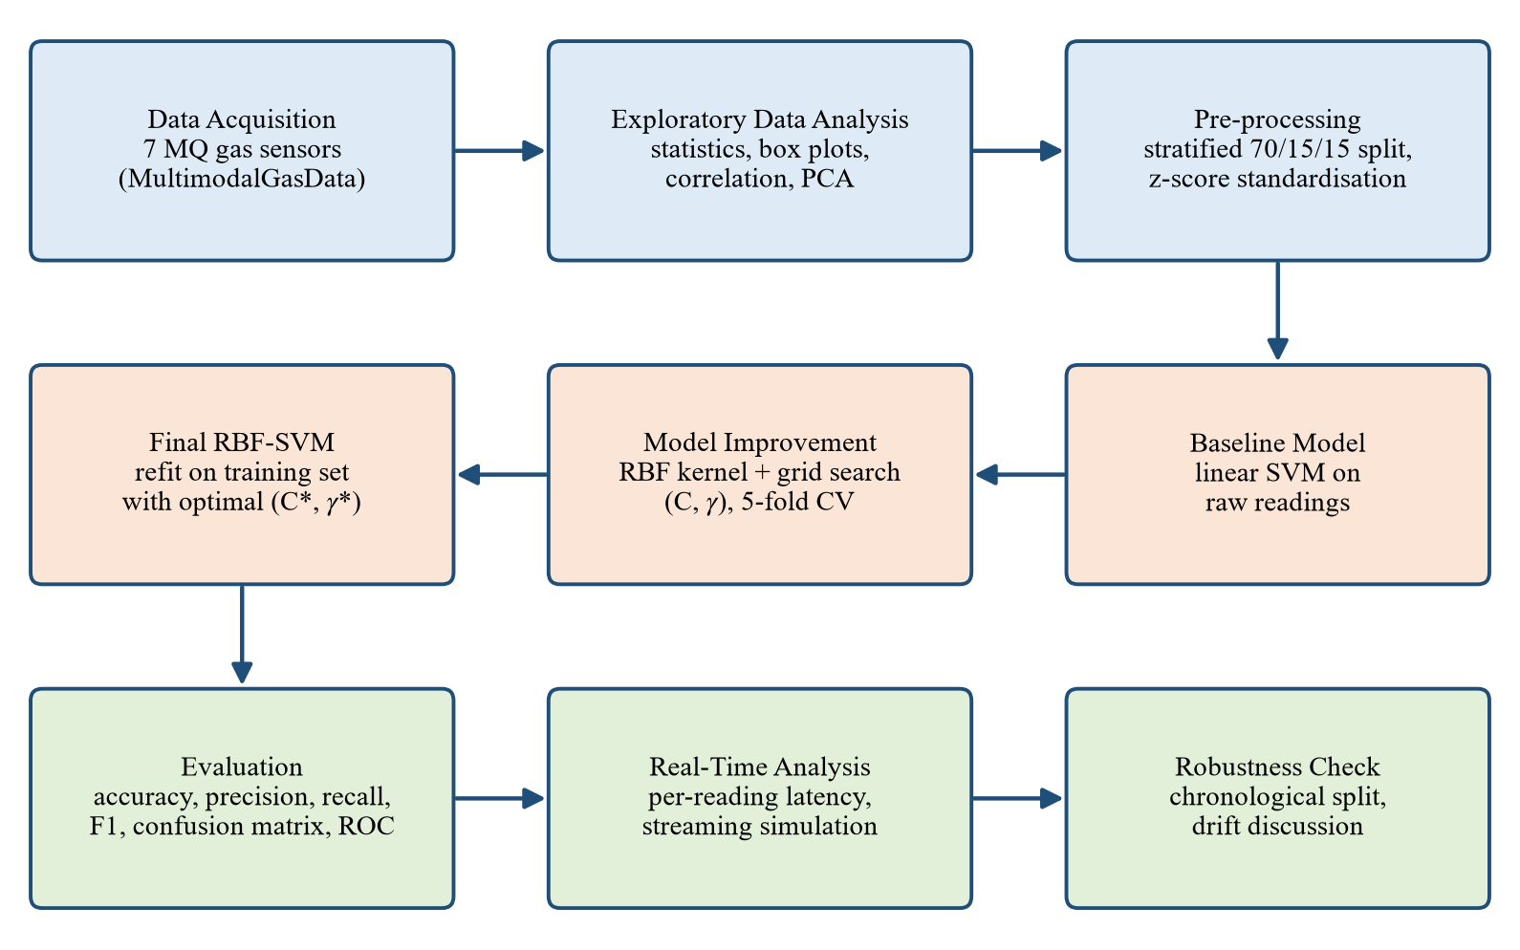
Method: from raw readings to a tuned SVM
1
Prepare
Stratified 70/15/15 split, then z-score scaling fitted on training data only.
2
Baseline
Linear SVM on raw readings, to see how far a straight boundary goes.
3
Improve
RBF kernel; C and γ chosen by 5-fold cross-validated grid search.
4
Stress-test
Test set, latency per reading, time-ordered split, pipeline data.
Notes:
The workflow mirrors the report chapters. Important detail: the scaler is fitted on the training data only, so no information leaks from the test set. The test set is touched once, at the very end.

Slide 6
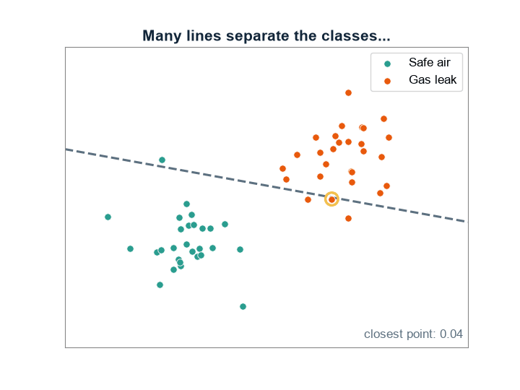
How an SVM separates leak from safe air
Maximise the margin
min ½‖w‖² subject to yᵢ(w·xᵢ + b) ≥ 1
Allow a few mistakes (soft margin)
min ½‖w‖² + C Σ ξᵢ , ξᵢ ≥ 0
Bend the boundary (RBF kernel)
K(x, x′) = exp(−γ ‖x − x′‖²)
Four gases, one decision
6 one-vs-one SVMs vote; the class with most votes wins
Animated: SVM keeps the line with the widest gap; only the circled support vectors decide it
Notes:
Many lines separate two classes; the SVM picks the one with the largest margin 2/||w||, which generalises best. C trades margin width against training errors. The RBF kernel lets the boundary curve without computing new features explicitly (kernel trick). With 4 classes, scikit-learn trains 6 pairwise SVMs and they vote. The full derivation, including the dual and KKT conditions, is in Chapter 3.

Slide 7
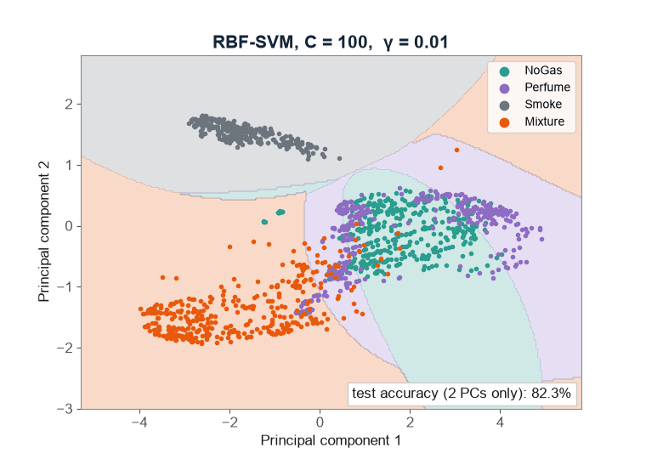
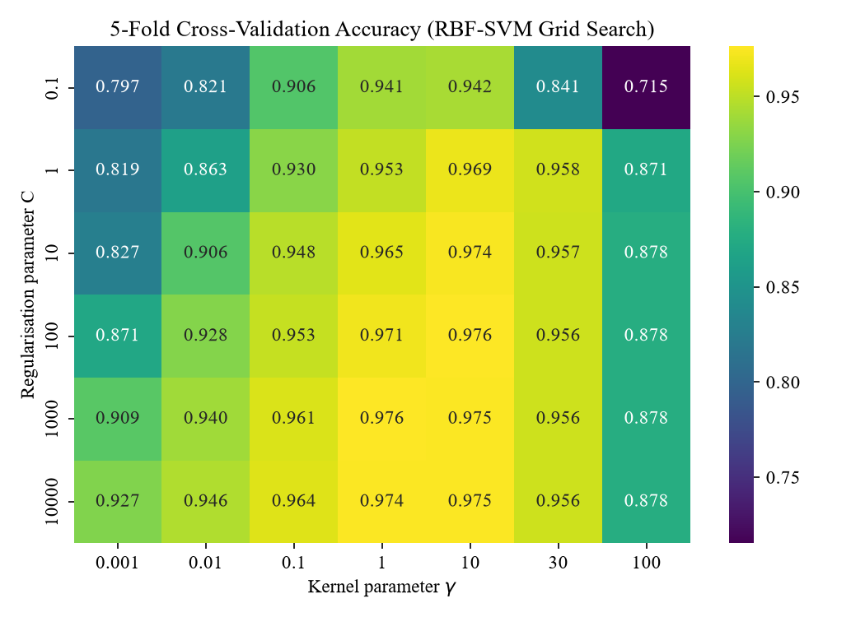
Tuning C and γ with 5-fold cross-validation
Animated: as γ grows, the boundary bends to follow each gas cluster (shown on 2 principal components; the real model uses all 7 sensors)
Best: C = 100, γ = 10 → CV accuracy 97.63% (42 combinations × 5 folds)
Notes:
Two knobs: C (how strongly we punish errors) and gamma (how local the RBF kernel is). We searched 6 values of C times 7 of gamma with 5-fold cross-validation on the training data. Too small gamma underfits, too large (100) overfits. The best pair C=100, gamma=10 is inside the grid, not at its edge, so the search range was wide enough.

Slide 8
Baseline vs improved: +17.9 points on test
Baseline (test)
Improved (test)
true ↓ pred → | NoGas | Perf. | Smoke | Mix.
NoGas | 161 | 79 | 0 | 0
Perf. | 110 | 130 | 0 | 0
Smoke | 0 | 0 | 240 | 0
Mix. | 0 | 0 | 0 | 240
true ↓ pred → | NoGas | Perf. | Smoke | Mix.
NoGas | 230 | 10 | 0 | 0
Perf. | 7 | 233 | 0 | 0
Smoke | 0 | 0 | 240 | 0
Mix. | 0 | 0 | 0 | 240
NoGas ↔ Perfume errors: 189 → 17
Perfume barely moves the sensors, so a straight line cannot split it from clean air. Scaling + a curved RBF boundary fixes this; Smoke and Mixture are now 100% correct.
Notes:
Baseline: 80.31% test accuracy; it confuses NoGas and Perfume 189 times. Improved: 98.23% test accuracy, only 17 such errors, and train/validation/test agree closely, so the model is not just memorising. Only remaining errors are between NoGas and Perfume.

Slide 9
Why the RBF kernel, and is the data enough?
Same tuning for each kernel: the curved RBF boundary wins by 2.7 points over polynomial and 13.4 over linear.
CV accuracy still rises with more data (90.6% → 97.6%): more recordings would help a little more.
Notes:
Kernel ablation: every kernel was tuned by the same grid search; RBF is best on test data. Learning curve: training accuracy stays near 100% while cross-validation accuracy keeps climbing, so the gap is closing as data grows; it has not fully flattened.

Slide 10
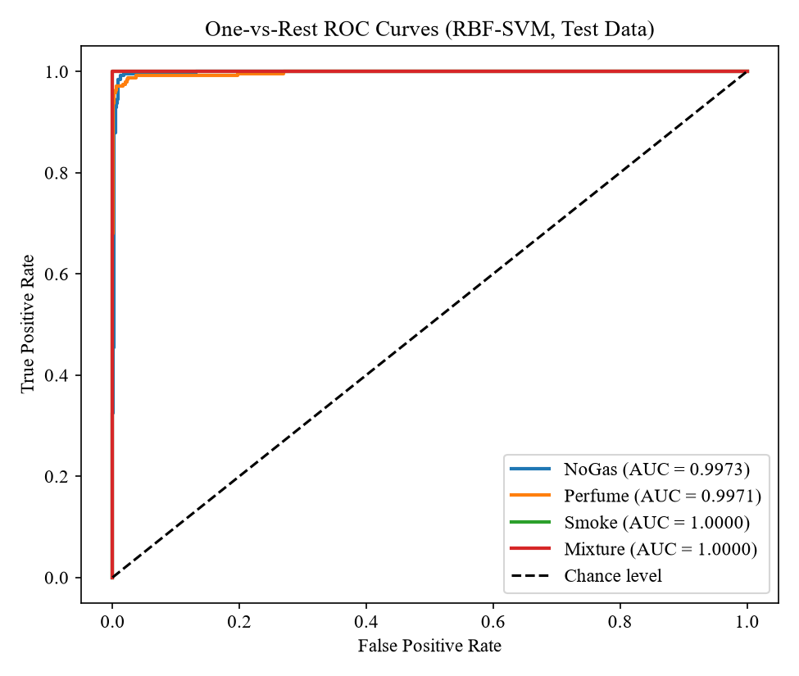
Final model on 960 unseen test readings
98.23%
0.982
test accuracy
macro F1-score
0.9986
99.0%
macro ROC-AUC
gas readings caught (713 / 720)
4.2%
1,304
false alarms on clean air (10 / 240)
support vectors (of 4,480)
Notes:
Headline numbers on the held-out test set. As a leak alarm (any gas vs clean air) it catches 99.0% of gas readings with a 4.2% false-alarm rate. ROC-AUC is 1.0 for Smoke and Mixture and about 0.997 for NoGas and Perfume. 1,304 support vectors means about 29% of training points define the boundary.

Slide 11
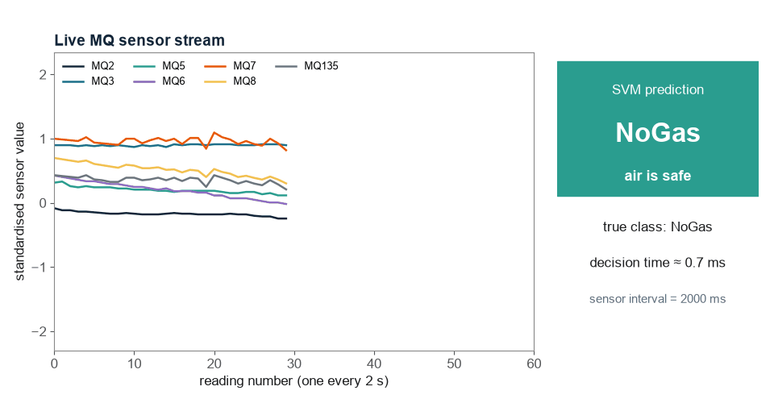
Real time: one decision in about 1 ms
1.10 ms
mean per reading
0.99 ms
median
1.57 ms
95th percentile
0.21 ms
per reading in a batch
≈ 2,000× faster
than the 2 s sensor interval
Animated replay of recorded sensor readings: the trained SVM labels every reading as it arrives
Notes:
Latency was measured one reading at a time, like a live system would see it, over hundreds of predictions on a normal laptop CPU. Even the slowest prediction (2.88 ms) is far below the 2-second sensor interval, so a cheap edge device or gateway can run the model.

Slide 12
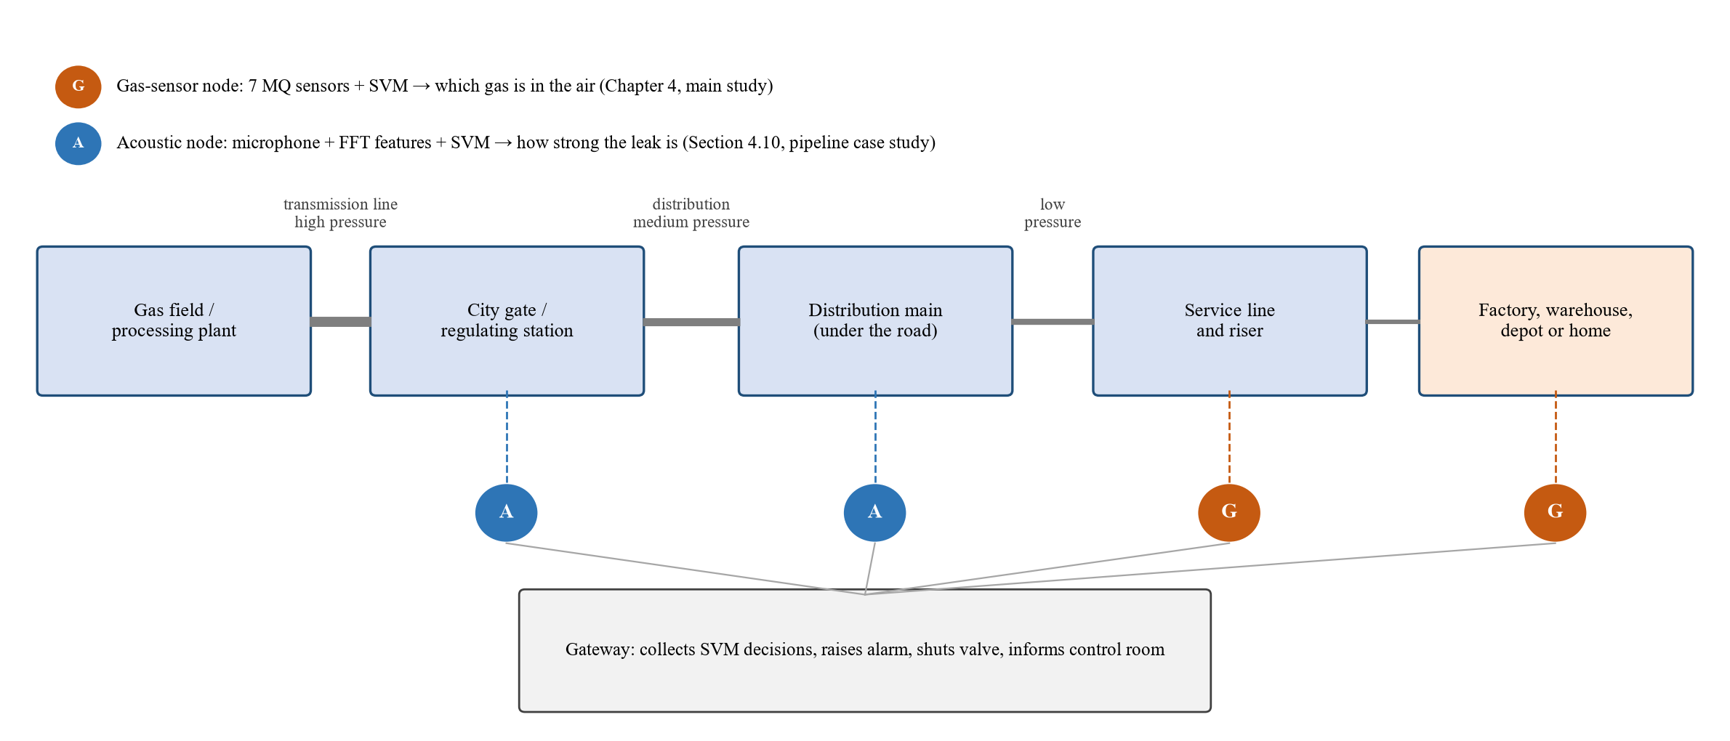
Real-life setting: the SVM along a gas pipeline
Each node runs its own SVM and sends only its decision; the gateway raises the alarm and can shut the valve.
Notes:
This is how the project fits a real network such as Titas: acoustic nodes listen on high and medium pressure mains, gas-sensor nodes sit where people are (service lines, factories, depots). Each node runs its own SVM and sends only the decision to a gateway that raises the alarm and can shut a valve.

Slide 13
Case study: real pipeline leak sounds (GPLA-12)
684 recordings
5 s of sound each, from a real leaking pipe at 3 pressures
39 features
frequency-band energies from the discrete Fourier transform
81.94%
leak pressure when tested on later recordings only
100%
noisy vs quiet background, and which microphone
Notes:
To test the method on a real pipeline, we used GPLA-12: acoustic recordings of a leaking pipe. Raw samples are useless for a linear SVM (53% on 12 classes); turning each 5-second clip into frequency-band energies with the DFT lifts it to 89%. The same math pipeline transfers: features, scaling, RBF-SVM, grid search. Limitation: GPLA-12 has no no-leak class and uses compressed air, so it measures leak strength, not leak vs no leak.

Slide 14

Honest stress test: sensors drift over time
Train on the first 70% of each class, test on the last 30%
Accuracy falls from 98.2% to 54.4%.
430 of 480 later Smoke readings look like Mixture: the MQ sensors' baseline shifts as they age and warm.
Lesson: a deployed node must be recalibrated or retrained regularly, and tested on future data, not shuffled data.
Notes:
This is the most honest slide. A random split mixes early and late readings, so test points have near-twins in training. When we train on early data and test on later data, accuracy drops to 54%, mainly Smoke drifting into Mixture. This is a known property of metal-oxide sensors and it is why we list recalibration and online learning as future work.

Slide 15


Conclusions and future work
What we showed
What comes next
An RBF-SVM on 7 low-cost MQ sensors identifies the gas with 98.23% test accuracy (baseline 80.31%).
It decides in about 1 ms per reading, so it fits real-time use on cheap hardware.
The same SVM method works on real pipeline leak sounds (≈ 89% on 12 classes).
Time-ordered testing shows sensor drift, the main barrier to deployment.
Run the model on an edge device (ESP32 / Raspberry Pi) at a real site.
Periodic recalibration or online learning to handle drift.
Field data from Bangladeshi distribution lines, including a true no-leak class.
Combine gas and acoustic nodes in one alarm gateway.
Notes:
Summarise in one breath: accurate, fast, transferable to pipelines, and honest about drift. Then the future work that follows directly from the drift result.

Slide 16
Thank you. Questions?
98.23%
≈ 1 ms
88.8%
test accuracy
per decision
pipeline, 12 classes
Department of Mathematics, University of Chittagong
Project website (theory, results, Q&A, run-it guides)
fahadjrdev.github.io/GasLeakSVM
Full experiment notebook (Google Colab, about 7 min)
Open the Colab notebook
Notes:
Invite questions. Likely ones: why SVM and not a neural network (small tabular data, convex optimisation, few hyperparameters, fast); why Perfume is the hardest class; how drift would be handled in practice. The website's Q&A pages cover these.

