Slide 1
Introduction to Pandas
Fundamentals of Data Handling with Pandas

Slide 2
What is Pandas?
Pandas is a powerful data analysis and manipulation library for Python.
Used for data cleaning, transformation, and analysis.
Why use Pandas?
Easy to handle structured data (like tables).
Provides data manipulation tools (filtering, grouping, merging).

Slide 3
Installing Pandas
Activate Virtual Environment (Best Practice).
Installation Command:
pip install pandas
The terminal will start the installation.
Once the installation is finished, use the testing code to test the functionality of the library.

Slide 4
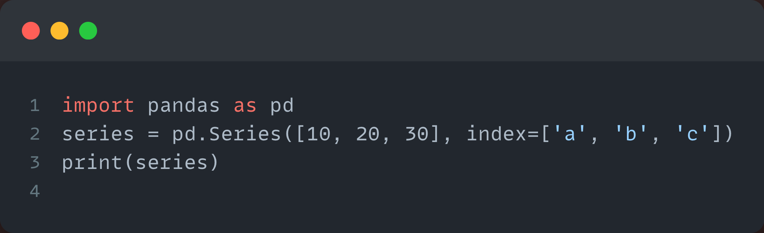
Pandas Data Structures
1. Series
One-dimensional labeled array.
Similar to a list but with labels (index).

Slide 5
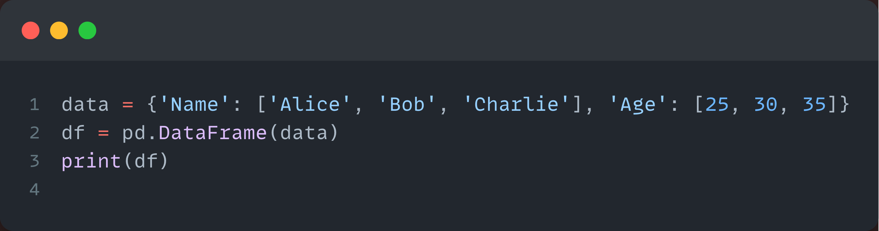
Pandas Data Structures
2. DataFrame
Two-dimensional, like a table with rows and columns.

Slide 6
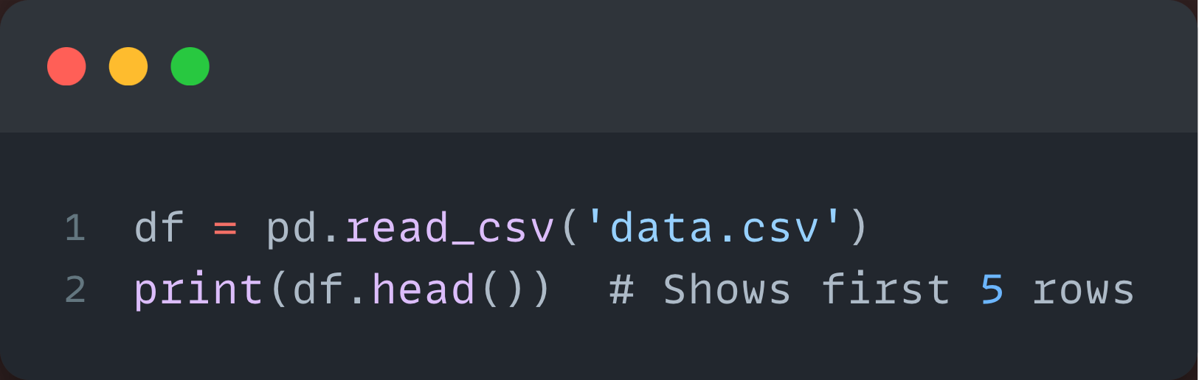
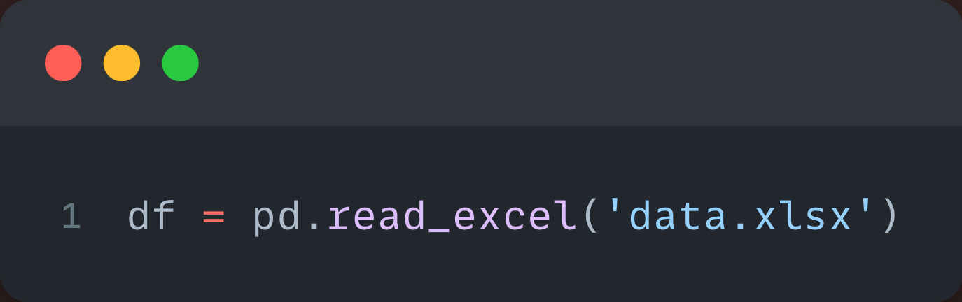
Reading Data
Reading CSV Files
Reading Excel Files

Slide 7
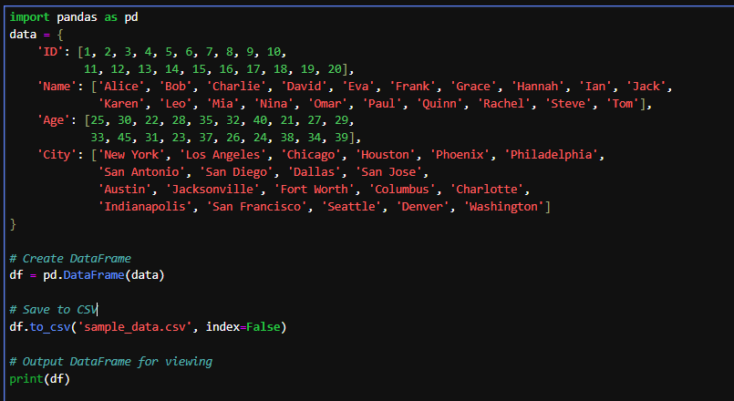

Slide 8
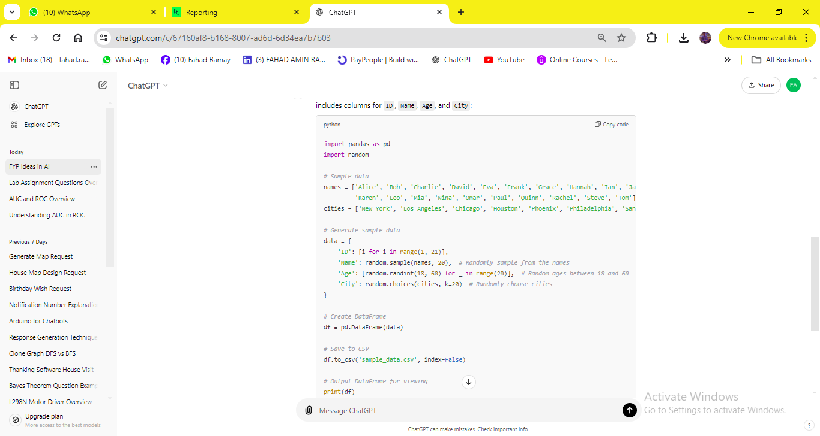

Slide 9
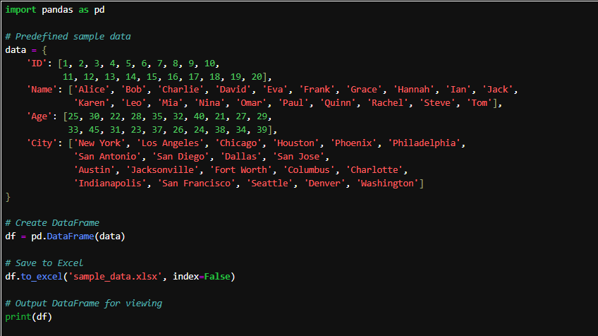

Slide 10
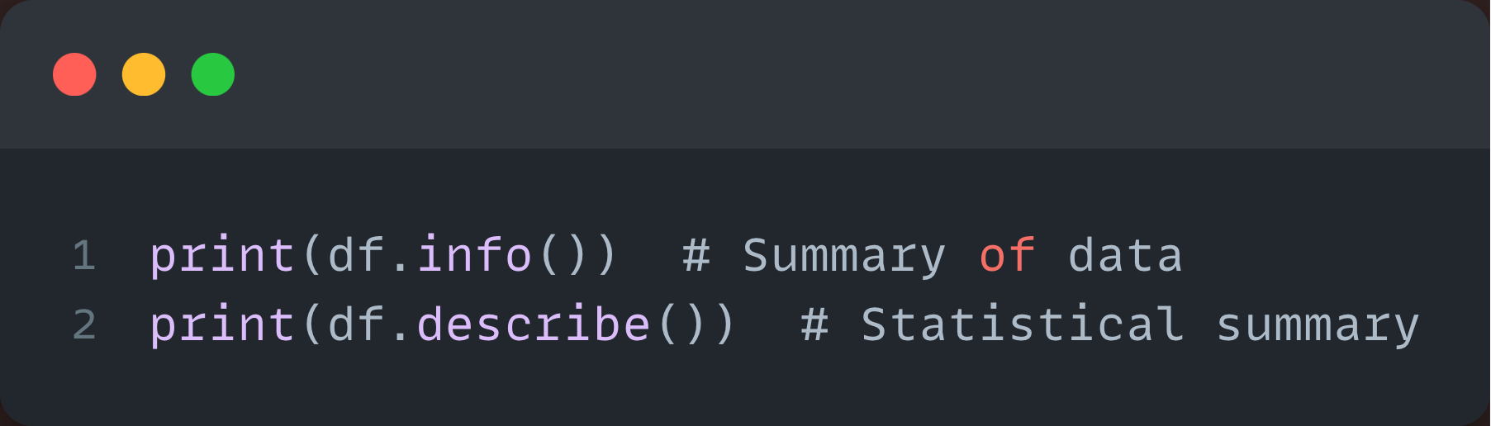
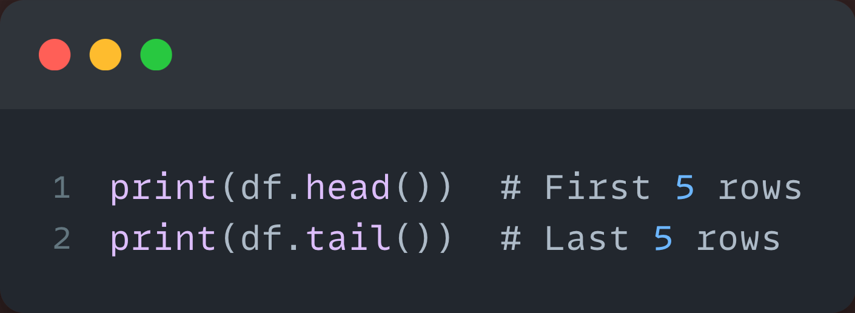
Data Exploration
Basic Info and Summary
Viewing Data

Slide 11
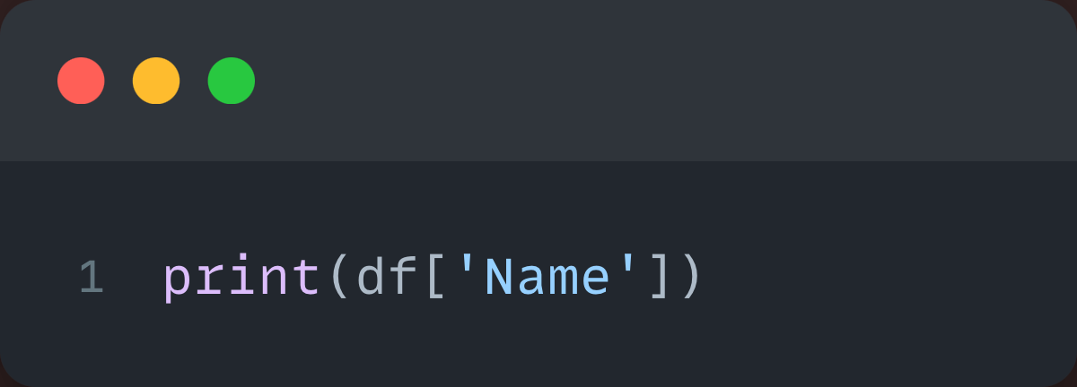
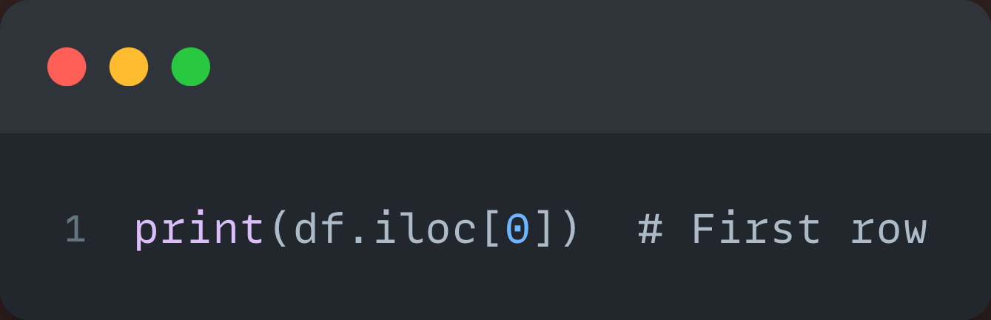
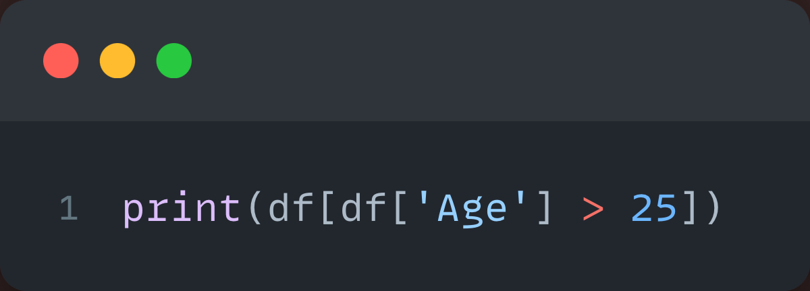
Selecting Data
Selecting Columns
Selecting Rows
Filtering Data

Slide 12
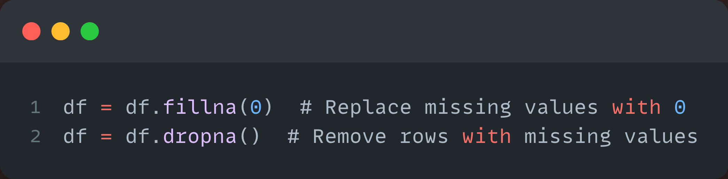
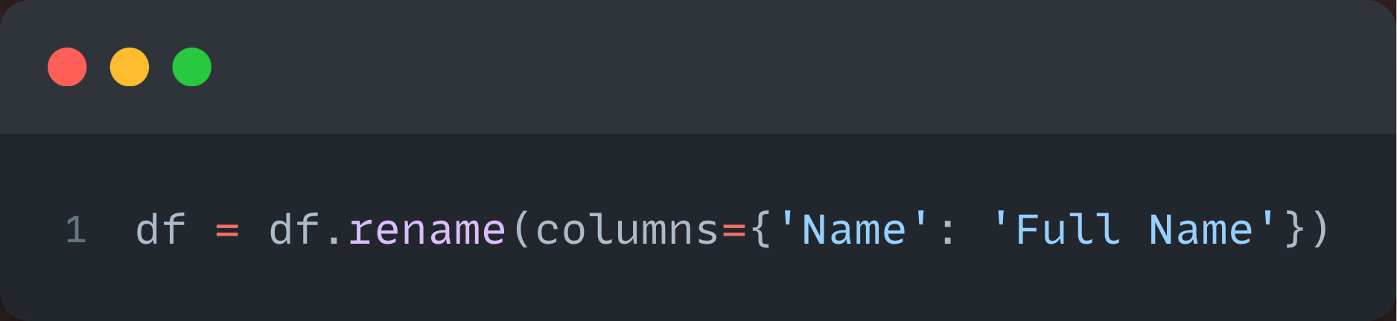
Data Cleaning
Handling Missing Data
Renaming Columns

Slide 13
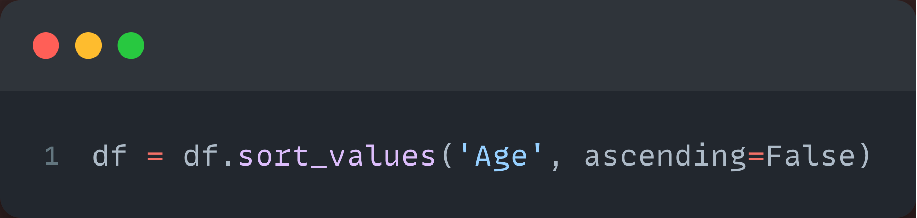
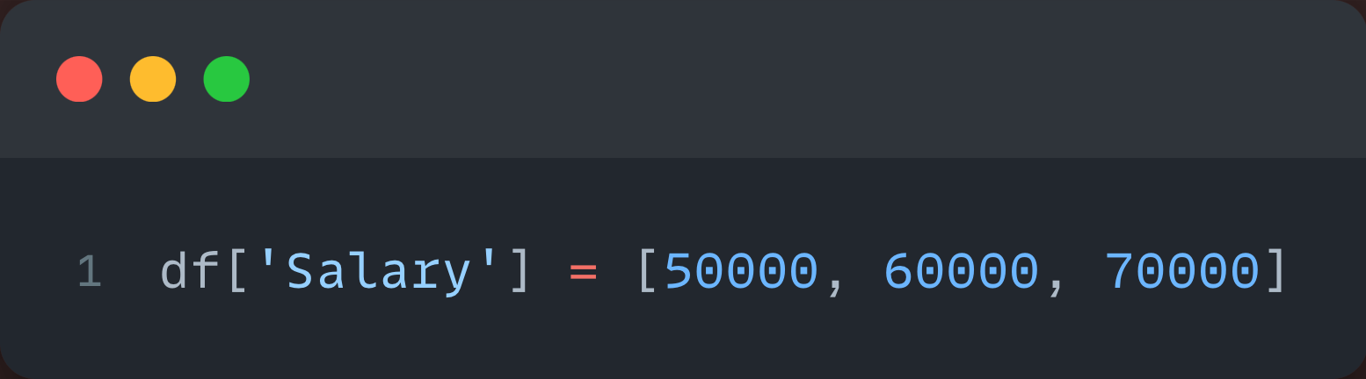
Data Manipulation
Sorting Data
Adding a New Column

Slide 14
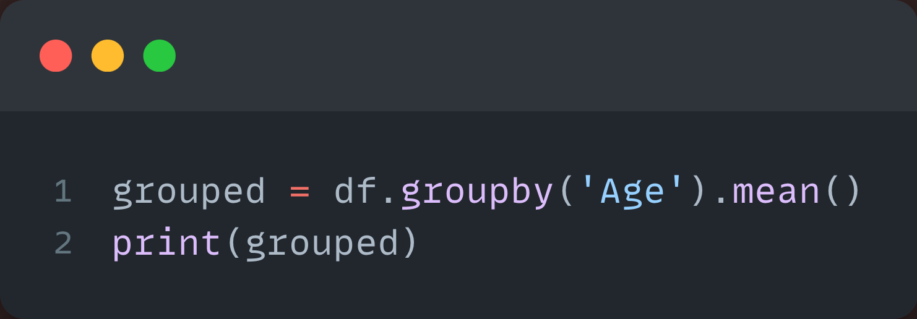
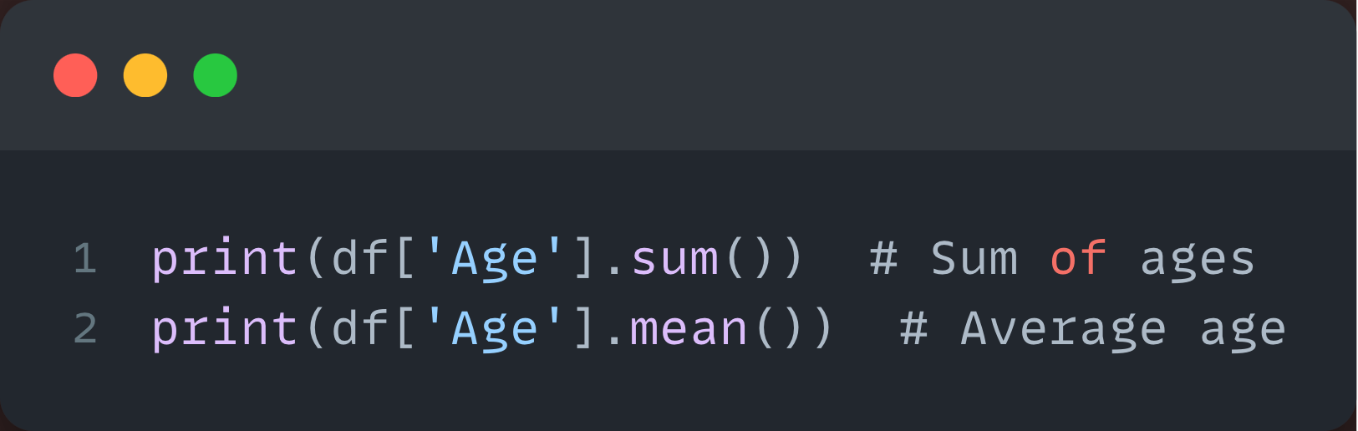
Grouping and Aggregating Data
Grouping by a Column
Aggregating Functions

Slide 15
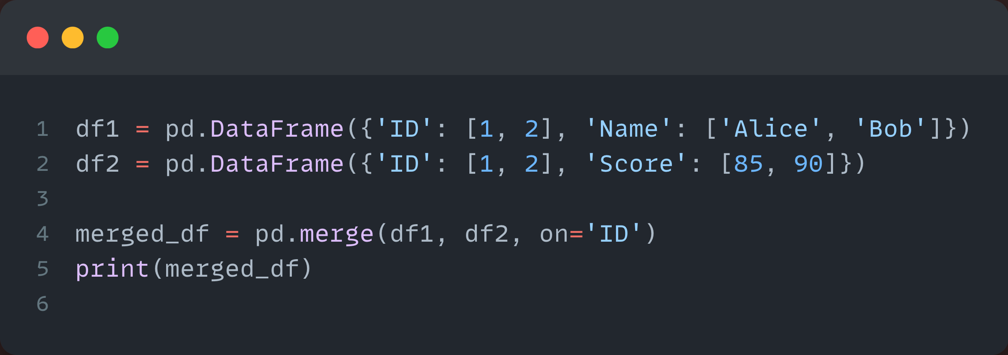
Merging DataFrames
Combining Two DataFrames

Slide 16
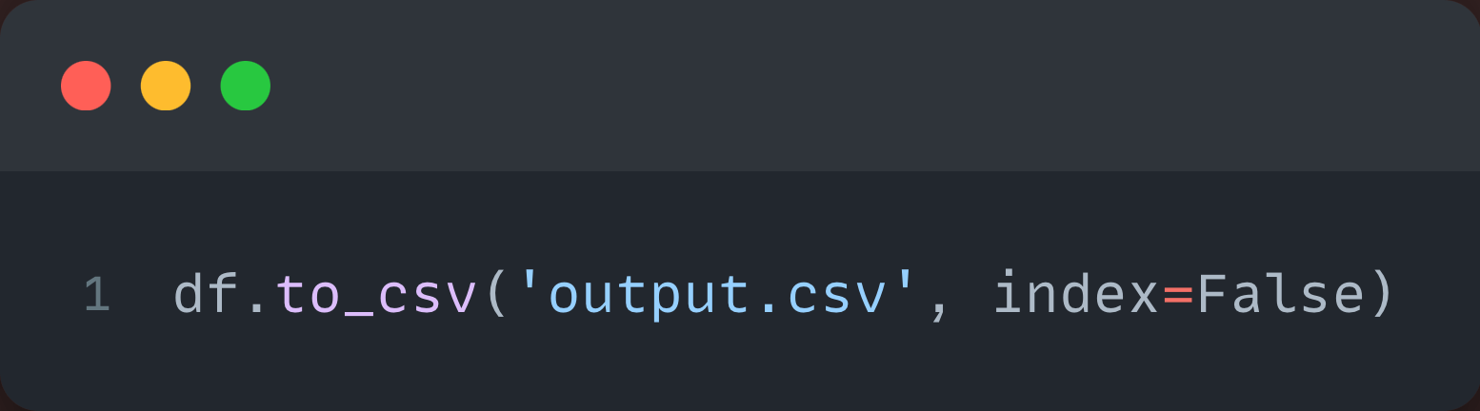
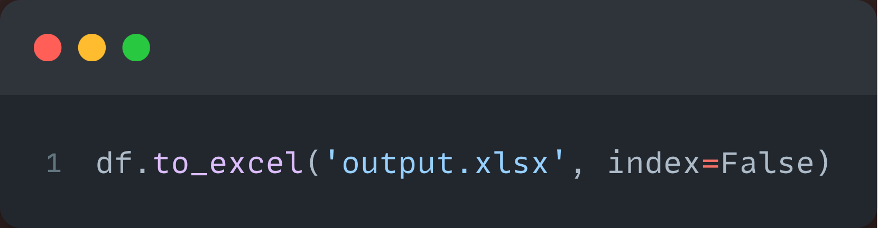
Exporting Data
Saving to CSV
Saving to Excel

Slide 17
Practice Task
Task
Read a CSV file of student data (names, grades).
Filter out students with grades below 50.
Add a new column called Passed (True/False based on grade).
Export the updated data to a new CSV file.

Slide 18
Thank You!
jamil@cuisahiwal.edu.pk

