Slide 1
Verification at the Infineon Design Centre, Bristol
Dr. Tim Blackmore
7th December 2015

Slide 2
Overview
1
Semiconductor Industry
2
Infineon
3
Infineon, Bristol
4
Verification
5
Module and System level Verification
6
Verification Technologies
7
Re-use
8
Summary
Notes:
Lecture is broadly split into 2 parts
First part is mean to set some context. So I’ll take a brief look at the semiconductor industry and the focus pretty quickly on Infineon and the Bristol Design Centre.
In the second part I’ll give an overview of how we execute our verification and start to get a but more technical

Slide 3
Semiconductor Industry

Slide 4
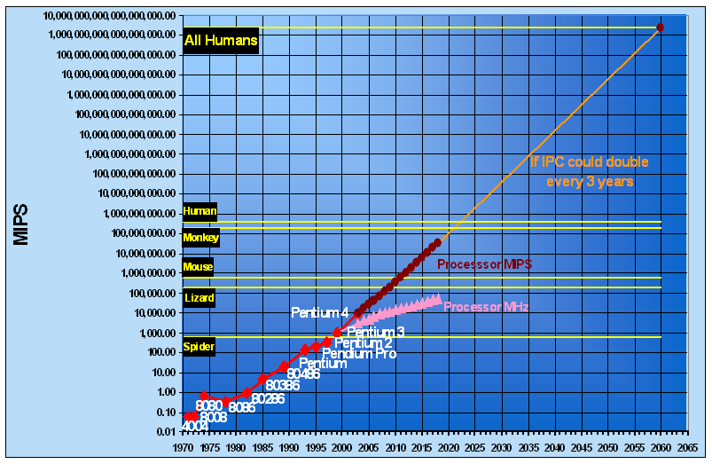
Semiconductor Industry
Moore’s Law
Number of transistors on a semiconductor doubles every two years
Complexity and processing power doubles very two years
Size and price of a semiconductor halves every two years
Semiconductors have become ubiquitous
Computation, communication, power generation, trains, cars, domestic appliances, security, internet of things, …
Notes:
Moore’s law fundamentally it says that the number of transistors can get on the same size of silicon doubles very two years or so.
Implications of this are that you can double the complexity and processing power of a microchip every two years or you can halve the size – and hence price – of a microchip every two years.
In reality we see both of these effects – with our high-end parts doubling in complexity and our low-end parts halving in price.
These dual effects have mean that semiconductors have become ubiquitous. Not only is it possible to do much more with them but they can be so cheap it’s easy to add a level of intelligence to almost anything. To the extent that almost everything you do – even walking down the road – can use a microchip.
The graph here shows that the processing power than can be out on a single chip – no bigger than your fingernail – has just surpassed the processing power of a mouse brain – and is on target to achieve the processing power of all human beings in thew rold by 2065 – although there are some significant technological challenges that will need to be overcome along the way.

Slide 5
Working in the Semiconductor Industry
Fast moving industry – have to cope with exponential growth in complexity
100x-200x increase in complexity in last 15 years
Generation-to-generation improvement in efficiency
Ability to think innovatively
Ability to learn from others - continuous development
New problems with every iteration
Strong problem solving skills
High degrees of automation
Use of EDA tools
Strong programming, scripting and data analysing skills
Re-use as much as possible
Understanding of modular development
Notes:
So what’s it like to work in the semiconductor industry – what skill do you need.
Perhaps the defining characteristic is the need to deal with this doubling of complexity every two years.
According to Moore’s Law there’s been 100x to 200x increase in complexity of microchips over the last 15 years – which is how long I’ve been working in the semiconductor industry. For sure the teams developing those chips are certainly not 100 times as large – in fact they’re probably around the same size as they were 15 years ago. This means we must work much more efficiently – and the main drivers for this are innovation in the way we do things, and the ability to assimilate the improvements being made by others.
Along with the increased complexity comes new problems – so you need strong problem solving skills – and really I spend a significant amount of my day to day to work solving problems – which gives a great sense of satisfaction.
Something that has increased massively over the last 15 years is the amount of automation in my job. The EDA tools we use are far more powerful and a lot of our flow is heavily scripted. The languages we develop test benches in are object and aspect orientated. We are also generating a huge amount of data to analyse and are increasing using databases. So the technical skills needed are probably very similar to those you are learning.
Finally, whilst we’ll improving what we do from generation to generation we certainly don’t want to start again from scratch. So re-use and maintainability are critical. So our scripts and test benches have to be carefully structured.
In short the skills you need to work in the semiconductor industry are exactly the skills that you, as talented computer scientist, have.

Slide 6
Semiconductor Industry in Bristol Area
“Silicon Gorge” - 5th largest conglomeration of high tech companies in Europe (Wikipedia)
Infineon
World #1 in power semiconductors and #2 in automotive and in smart cards
Huawei, Broadcom, Qualcomm
Global leaders in ICT (Information and Communication Technology) solutions based in China/US
Imagination Technologies
A UK based world leader in supplying IP e.g. GPRs
Start-ups and young companies such as XMOS, ...
Notes:
So if you wanted to work in the semiconductor industry could you do it in Bristol? The answer is emphatically ‘yes’.
A lot of semiconductor development in and around Bristol – to the extent it is known as Silicon Gorge after the Avon Gorge.
For a start there a lot of large multinationals in Bristol - companies like Infineon, Huawei, Broadcom and Qualcomm, locate offices in Bristol because it has people with the skill set they require.
There are world leading UK based companies such as Imagination Technologies and smaller companies such as XMOS that started up in Bristol and are trying to make an impact in the world market.

Slide 7
Infineon
Notes:
Let me talk a little about Infineon.

Slide 8

We make life easier, safer and greener – with technology that achieves more, consumes less and is accessible to every­one. Microelectronics from Infineon is the key to a better future.
Part of your life.
Part of tomorrow.
Notes:
These are some standard foils. This one is saying that Infineon isn‘t just about making money – it focusses on technologies that contribute to society – making people‘s lives easier, safer and greener

Slide 9
Top positions in all major product categories
Automotive semiconductors
total market in 2014: $27.5bn
Power semiconductors
total market in 2014: $16.2bn
Smart card Ics
total market in 2014: $2.63bn
Automotive semiconductors incl. semiconductor sensors.
Source: Strategy Analytics, April 2015
Discrete power semiconductors and power modules.
Source: IHS Inc., September 2015
Microcontroller-based smart card ICs.
Source: IHS Inc., July 2015
Notes:
But Infineon is also a commercially successful company – maintaining top positons in its major product categories.
The most interesting from a Bristol point of view is automotive – where Infineon are – for the moment - second to the Japenese company Renesas. The Bristol Design Centre is part of the automotive group which is a good place to be. Last year the largest growth in semiconductors worldwide was in automotive semiconductors – and we’ll look briefly at the drivers for that growth later.

Slide 10




Revenue split by segment
Q3 FY 2015 Revenue: € 1,586m
Automotive
Industrial Power Control
ATV
IPC
Chip Card
& Security
Power
Management & Multimarket
PMM
CCS
OOS+C&E*
*Other Operating Segments; Corporate & Eliminations
Notes:
Automotive also generates the largest division of Infineon – certainly be revenue.

Slide 11




Product range
Automotive (ATV)
Microcontrollers 32-bit for Powertrain, Safety and ADAS
Software development platform DAVETM
Sensors: pressure, magnetic, radar
Power: MOSFETS, IGBTs, smart power ICs: voltage regulators, bridges, driver Ics, CAN / LIN / Flex RayTM transceiver*, DC-DC converters, power system Ics, system-on-chip, embedded power Ics
Hybrid & Electric Vehicle: IGBT HybridPACK™, HybridPACK™ Double Sided Cooling (DSC) modules, gate driver ICs
Industrial Power Control (IPC)
IGBT module solutions incl. IGBT stacks
IGBT modules (high-power, medium-power and low-power)
Discrete IGBTs
Bare die business
Driver ICs
Power Management & Multimarket (PMM)
Discrete high- and low-voltage power transistors
Driver ICs
Control ICs
RF power transistors
Small-signal components
CMOS RF switches for antenna modules
Antenna tuning ICs
MEMS and ASICs for silicon microphones
Customized chips (ASICs)
Chip Card & Security (CCS)
Smart card (contact-less and contact-based) and embedded security ICs
Extensive packaging and service portfolio
Innovative solutions from basic security RFID and memories to high-end security controllers
Leading technologies, e.g. SOLID FLASHTM, Integrity Guard, VHBR, boosted NFC, Coil on Module
*FlexRay is a trademark licensed by FlexRay Consortium GbR
Notes:
Here I’ve highlighted Automotive microcontrollers amongst the product range because this is the products Bristol worked on, in the application areas of engine management, safety and the growing area of advanced driver assistance systems.

Slide 12
Our global R&D network
Leominster
Reigate
Skovlunde
Warstein
Regensburg
Duisburg
Warwick
Dresden
Bristol
Irvine
Linz
Augsburg
El Segundo
Graz
Beijing
Bukarest
Seoul
Villach
San José
Shanghai
Morgan Hill
Pavia
Neubiberg
Torrance
Le Puy Sainte Réparade
Padua
Bangalore
Singapore
Newport
Malacca
Tewksbury
Kulim
Chandler
Notes:
Infineon has a global workforce as well as a global market

Slide 13


Infineon creates a net ecologic benefit
Emission Reduction enabled by our products and solutions
1.4 million tons
more than 14.4 million tons
CO₂ burden¹⁾
Ratio 1:10
CO₂ savings²⁾
Net ecological benefit: round 13 million tons of CO₂ emission reduction
1) This figure considers manufacturing, transportation, function cars, flights, materials, chemicals, waste/waste water, direct emissions, energy consumption, waste, etc. and is based on internally collected data and externally available conversion factors. All data relates to the 2014 fiscal year.
2) This figure is based on internally established criteria, which are explained in the explanatory notes. The figure relates to the calendar year 2013 and considers the following fields of application: automotive; lamp ballast control; PC power supply; renewable energy (wind, photovoltaic); and rives. CO₂ savings are calculated on the basis of potential savings of technologies in which semiconductors are used. The CO₂ savings are allocated on the basis of Infineon's market share, semiconductor content and lifetime of the technologies concerned, based on internal and external experts' estimations. Despite CO₂ footprint calculations are subject to imprecision due to the complex issues involved, the results are nevertheless clear.
The information and data given in this document apply to the Infineon Technologies group, except for International Rectifier companies.
Notes:
And confirmation that Infineon makes the world a greener place – a lot of the CO2 savings are down to the engine mamagement systems we produce – that help to make cars a lot more fuel efficient and a lot less polluting.

Slide 14
Advanced Driver Assistance Systems (ADAS)
ADAS applications include
Adaptive cruise control
Automatic parking
Collision Avoidance Systems
Driver Drowsiness Detection
…
Typically ADAS applications require a car to have increased awareness of its surroundings
Uses RADAR, LIDAR, camera,
In future will use network connectivity
Requires very fast processing of a lot of data at a low cost
Notes:
And now away from the official slides. Wanted a slide on advanced driver assistance systems – an area of massive growth in he automotive semiconductors and one we’re heavily involved in in Bristol.
Adaptive cruise control – cars actively braking when to maintain a good stopping distance from the car in front.
Automatic parking – for example the car parallel parking itself.
Collision avoidance systems – detect imminent collision and either warn the driver or actively take preventative steps – and the least pre-tensioning the seatbelts and warming up the airbags .
Driver drowsiness detection – the car monitoring the driver and giving him or her a jolt or lighting a coffee cup on the dashboard when it detects the driver is tiring. Particularly interesting going forward when the control of the car may be passing between the car itself and the driver and the car will have to ensure the driver is ready to take control before passing it on.
Network connectivity – vehicle to vehicle and infrastructure to vehicle communication.
RADAR, LIDAR and camera technologies produce a lot of data – and this all needs processing very quickly. Doing this at a cost that makes it practical to put this technology in mass produced cars is possible due to Moore’s Law.

Slide 15
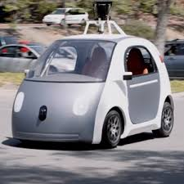

Towards Autonomous Vehicles
ADAS technology could be used for AVs
Main barriers are legal, economic and cultural
https://www.youtube.com/watch?v=0tmCLZOM8kw
Notes:
Legal – Internationally recognised Geneva and Vienna Conventions on Road Traffic state that a driver must be in control of the vehicle
Economic – what will be the impact on the car insurance market
Cultural – how long before people will trust self-driving cars, what about people who enjoy driving
Already there are 150 Google Cars driving around Silicon Valley devloping practical experience – and using radar technology from Infineon.
Video shows new BMW7 series parking itself. Not very spectacular but interesting thing is that the driver is not in the car. However, critically, he is still in control because, although the car is perfectly capable of parking itself, he’s pushing a button – if he takes his finger off the car stops. From a technical point of view its perfectly possible for him to pusn the button and leave the car to park itself – from a legal point of view it’s not.

Slide 16
Infineon, Bristol

Slide 17
Infineon, Bristol
Part of the Automotive Microcontroller Group of Infineon
Working on developing microcontrollers used in application areas such as
Engine Management - increased fuel efficiency, reduced emissions
ADAS
Safety (Airbags, drive-by-wire, ABS, …)
Around 40 permanent engineers working in concept, design and verification
18 permanent verification engineers
Notes:
As I said Infineon Bristol is part of the Automotive Microcontroller group of Infineon.
…

Slide 18
What is an Automotive Microcontroller?
Typical Automotive System
Bus*
Sensor
Actuator
Bus
Microcontroller
Bus
Sensor
Actuator
Bus
Bus
Sensor
*E.g. Ethernet, CAN, Flexray, SPI
Notes:
Typical automotive system consists of sensors, a microcontroller and actuators. The sensors measure and pass this data to the microcontroller. The microcontroller processes the data and decides on the action to be taken which it passes onto the actuators that take the action.

Slide 19
Example Automotive System
Electronic Stability Control System (including ABS)
Brake valve
Gyroscopic Sensor
Brake valve
Microcontroller
Steering Wheel sensor
Brake valve
Wheel Speed Sensors
Brake valve
Notes:
Example automotive system – is a electronic stability control system – aimed at preventing a car from skidding.
The sensors will measure information such as the angle the car is travelling, the angle the car should be traveling at and the speed of each of the wheels.
This information is passed to the microcontroller along busses and the microcontroller will calculate whether everything is as it should be or whether some corrective action needs to be taken. In the case that action needs to be taken it will pass the information on to the actuators – brake valves in this case. For example if one of the wheels is spinning too fast the microcontroller will cause the brake on that wheel to be repeatedly applied and removed until the system stabilises again.

Slide 20
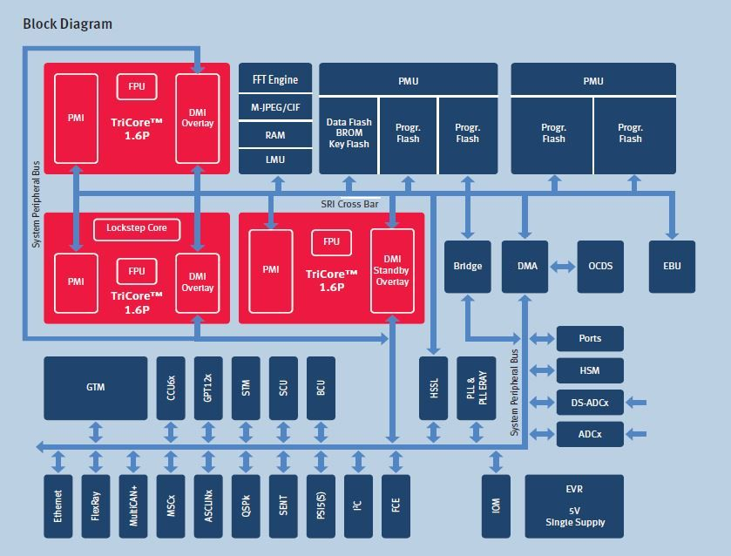
TC279TA Microcontroller
Source: http://www.infineon.com/cms/en/product/microcontroller/32-bit-tricore-tm-microcontroller/
aurix-tm-family/aurix-tm-family-–-tc297ta/channel.html?channel=db3a304342c787030142dbf31c2b151c
Notes:
So what does a microcontroller look like?
Example - previous generation of microcontrollers developed in Infineon.
The red blocks are processors executing code stored in the Flash memories. The code will be executed according to data received from the sensors and this comes in through a number of communication blocks shown along the bottom. Some of the tasks are time-based or repetitive and the timing is controlled by timers like the GTM and STM.
Some of the other blocks are a DMA for moving data around the controller independently of the CPUs. So for example data coming in through the communication modules can be moved to memories closer to the CPU for faster processing.
We have two on-chip busses – including a fast speed interconnect fro moving data around the ‘compute system’.

Slide 21
TC279TA Microcontroller – Bristol
Notes:
The shaded part here is approximately the part that Bristol is responsible for developing.
Which includes the high-speed compute sub-system …

Slide 22
TC279TA Microcontroller - ADAS
Notes:
… and the ADAS sub-system.
In the current generation under development this looks somewhat different.

Slide 23

TriCore Processor
Processor development interesting and challenging
“The most widely distributed processor you’ve probably never heard of”
250 Million sold as of 19 November 2015
On average every second vehicle contains one
Notes:
Just a quick slide on the processor – called TriCore and developed in Bristol. Processors are one of the more interesting and challenging blocks to design and verify – for reasons I’ll touch upon later.
Has been called ‘The .. ’
Recently announced that 250 million have been sold. The poster was produced when 100 million had been sold in 2012 – so 100 million up to 2012 – another 150 million since.
Statistically in every second vehicle produced.

Slide 24
Verification
Notes:
Look at verification – and it’s importance in the context of development of an automotive microcontroller.

Slide 25
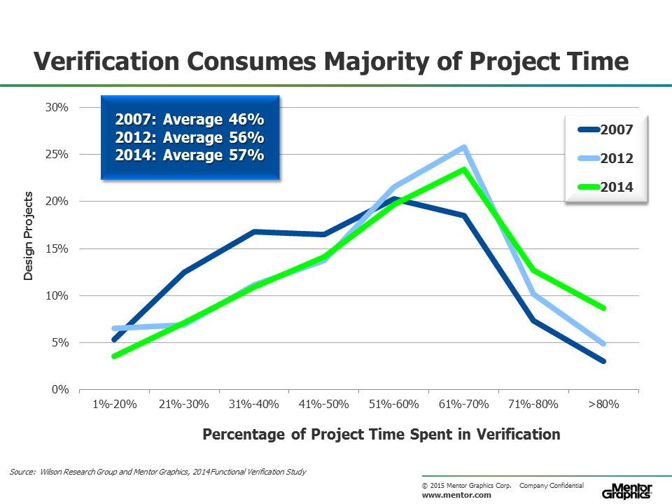
Amount of Verification - Industry
Notes:
Graph from the Wilson research report – a report on trends in verification compiled every few years.
This is just saying across the industry the majority of project time is spent on verification – and increasing over time.
In fact would tend to be higher than average in automotive since bugs can be more critical than in applications such as set-top boxes or mobile phones. Perhaps more around the 70% mark.
When projects can cost 10’s and 100’s of millions this represents a lot of money.
So why spend so much effort and money on verification?

Slide 26
Cost of Not Doing Verification
In 2014 General Motors spent $3.2 billion on recalls and victim compensation and set aside a further $900 million for future costs
Wiped out annual profits
$2.1 billion on recalls
Largest single problem was a faulty ignition switch (caused engine to shut off and prevented airbag from deploying)
Connected with 124 deaths
Recalled >29 million vehicles worldwide
Mechanical problem rather leading to an electronic failures – a bug in the electronics could have had a similar effect
Software problems can also have similar effects – but much cheaper to replace
Notes:
The answer is the cost of not doing verification.
For example.
Before the recalls and compensation GM had made $4.1 billion that year – so the full year profits wiped out
The majority of the $3.2 billion dollars was on recalls rather than compensation($2.1 billion). This despite the faults being connected to deaths.
Faulty ignition switch – shut engine down and prevented airbag deploying – in the event that engine shut down lead to crash the occupants weren’t protected
Until now this has been directly connected to 124 death and lead to the recall of over 29 million vehicles
Mechanical problem leading to a failure of the electronics (the engine management and deployment of airbag being electronic functions) – so a bug in the electronics could easily have had the same effect
A software failure could also have had a similar effect – but would have been much cheaper to put right in the 29 million affected cars, because patching software doesn’t require a physical replacement of parts – and in the future will be done wirelessly over the air so won’t even require physical access to the car.
In truth testing of safety critical software is taken very seriously – but failure doesn’t have the same financial impact as a hardware failure.

Slide 27
Cost of Hardware Bugs – ‘Shift Left’
Cost
£1b
£10m
£1m
£1k
£10
Concept
Phase
RTL Development Phase
Post Silicon
Validation
Software
Development
In the Field
When bug found
Notes:
So let’s look at the cost of hardware bugs.
Here’s the classic curve showing the increasing cost of the same bug over time.
As we’ve seen a bug found in the field can cost £billions to put right.
Verification aims at finding bugs during RTL development – where fixes are typically in the £100’s or less. Although bugs found late in the RTL development phase can require works from several people for several days taking the cost into the £1000’s.
People talk of ‘shifting left’ i.e. finding bugs as early – and hence as cheaply - as possible. Already we’re typically finding many thousands of bugs across the development of a microcontroller.

Slide 28
Summary
Typically > 50% - and often > 70% - of project spent in verification
Economic imperative
Fixing hardware bugs can be very expensive
Litigation can be very expensive
Loss of goodwill can be very expensive
Safety
Incorrect function can lead to loss of life
Since 2011 automotive electronics has it’s own safety standard – ISO26262
Notes:
So …
Economic imperative … can significantly eat in to your profits – or even put you out of business
Correct functioning is vital for safety – incorrect functioning can lead to serious harm or loss of life
With increased amount of electronics in cars, safety of automotive electronic is becoming a huge subject in itself – and is being driven by the ISO26262 standard

Slide 29
Module and System Level Verification
Notes:
Start to look a little more in depth at verification

Slide 30
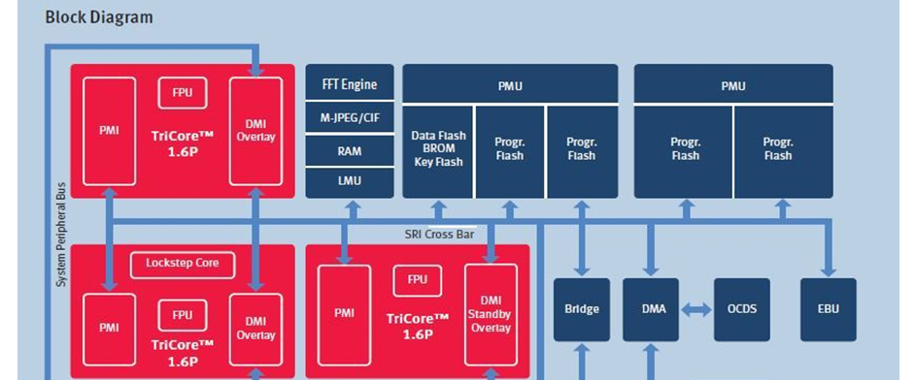
TC279TA Compute and ADAS Sub-system
Bristol responsible for two sub-systems
The sub-system responsible for the ‘compute’
The ADAS sub-system
Includes the development of complex IP – such as TriCore
Notes:
Bristol responsible for the development – including verification – of the compute sub-system and ADAS sub-system.
These sub-systems contain 10’s or 100’s millions of gates.

Slide 31
Challenges
Complexity makes it infeasible for single intellect to fully understand verification requirements of a complete sub-system
Currently ~30 engineers working in verification
Controllability – need complex software to control module inputs at sub-system level
Very difficult to stress interfaces sufficiently to reach all corner cases
Observability – self-checking software not sufficient to observe all failures -> need models and assertions
Run times
Simulation slows down as amount of logic increases
Formal tools can only prove simple properties on large designs
Notes:
The main challenge is again complexity
Then SKIP

Slide 32
Addressing the challenges
Divide and Conquer
Divide systems into sub-systems and sub-systems into modules
Split at standard and simple interfaces
Standard interfaces such as busses
Simple interfaces may just be handshakes
Minimises risks of missing bugs in module interaction
Can end up with large modules – such as processors
Verification is then split
Module level - fully stresses module functionality
Sub-system and system level – checks interactions between modules and sub-systems
Notes:
And the way to deal with complexity is to divide and conquer.
Where do you divide? For verification best to divide along standard interfaces – such as well-defined busses and interconnects – and simple interfaces.
The critical thing here is that these interfaces are well understood so can be modelled accurately in your verification environment – and this minimises the chance of bugs falling through the gaps.
Can end up with some quite large modules – such as a processor – which is why processors and similar modules are a special challenge for verification – they’re large modules which cannot reliably be divided into smaller verification entities.
Verification is split into two distinctive flavours – module-level and sub-system and system level.
But because you have divided at well understood interfaces you have the reduced the complexity that needs to be understood by an individual. They now either just have to understand the detailed behaviour of the modules or the ways the modules interact – but not both.
At module level you can now drive the interfaces directly – so you have good controllability and writing a reference model is a manageable task – so you have good observability.
At sub-system level, because you’re just looking at interactions, you can write relatively simple tests.
And of course everything has to be brought together as a complete microcontroller and the interactions between the sub-systems verified – and for us this is done at Singapore. The main challenge here is getting good cross-site alignment between the sub-systems and the systems to make sure everything is covered somewhere but duplication of effort is minimised.

Slide 33
Module Level Verification
Goals of module level verification
Rigorous verification of complete module
Sufficient stimuli has been applied to achieve
Exacting code coverage goals (e.g. 100% line, branch and toggle coverage)
Functional coverage on
High level requirements
All features in Target Specification
All design corner cases
…
And sufficient checkers are in place to detect any failure conditions
Notes:
So each module is verified stand-alone. This gives much better controllability since can directly drive the module inputs.
The target is to verify the module very thoroughly – in particular it is ensured that all the RTL code has been exercised in a rigorous way; that all high level requirements that relate to the module are verified; that all the functionality described in the target specification is mapped on to functional coverage and all the FC hit; and that any implementation corner cases have been highlighted by the designers and again mapped onto FC which has been hit.
Given the complexity of even a single module it’s not possible to achieve these goals with hand-written tests so the automatic generation of test cases is needed. The most common method for doing this – and the method we use - is constrained-random generation – we use Specman e.
This makes it possible to simulate many thousands of scenarios covering millions of transactions each night. The scenarios that hit coverage of find a big are saved and run on every design release – which in practice means they are re-run most nights.
The full functionality of the design is checked for every transaction passed through it. The proper way to do this is to have transaction-level reference models. These check function only and are not timing accurate. You will need timing checks – that data passes through a design in a reasonable amount of time – and these are checked by assertions. The worst test benches attempt to combine these checks and model the exact timing of the data passing through the design. These are the worst because they are extremely inefficient – a lot of development time is spent getting the model to match the design behaviour and they are very time-consuming to maintain.
Even all this simualtion may not be enough and you may turn to formal verificaition for some of the verification – more later.

Slide 34
Module Level Verification
Goals achieved through
Simulation with test-case automation
Stimuli generated by constrained-random generation (using Specman/e)
Many thousands of scenarios covering many millions of transactions generated every night
Most interesting scenarios saved and re-run across bug fixes
Checking done by
Transaction-level (!) reference models and scoreboards
Assertions to check signal and timing behaviour
Targeted use of formal verification
Notes:
Given the complexity of even a single module it’s not possible to achieve these goals with hand-written tests so the automatic generation of test cases is needed. The most common method for doing this – and the method we use - is constrained-random generation – we use Specman e.
This makes it possible to simulate many thousands of scenarios covering millions of transactions each night. The scenarios that hit coverage of find a big are saved and run on every design release – which in practice means they are re-run most nights.
The full functionality of the design is checked for every transaction passed through it. The proper way to do this is to have transaction-level reference models. These check function only and are not timing accurate. You will need timing checks – that data passes through a design in a reasonable amount of time – and these are checked by assertions. The worst test benches attempt to combine these checks and model the exact timing of the data passing through the design. These are the worst because they are extremely inefficient – a lot of development time is spent getting the model to match the design behaviour and they are very time-consuming to maintain.
Even all this simualtion may not be enough and you may turn to formal verificaition for some of the verification – more later.

Slide 35
System and Sub-system Level Verification
Target: Verify interactions between modules
Typical Goals
Modules are connected together correctly
Functionality requiring interactions between modules
Main metric - toggle coverage on module I/O
Goals typically achieved through
Self-checking C/C++ directed test cases, use-cases and benchmarks
Growing use of
Constrained-random (and graph-based) techniques
Reference models and assertions
Very targeted formal verification
Notes:
With all the modules fully verified all that’s left to check on the sub-systems is that the modules interact correctly together across their standard or simple interfaces.
At the simplest level this means showing that all the modules are connected up correctly – to the interconnects and to each other.
But the division of the modules means that the modules are not totally self-contained – so they will interact across these standard and simple interfaces – and real life applications will use these interactions.
A minimum requirement is that all module I/O has been toggled at sub-system level – but we need to also ensure this has been done in interesting ways.
Traditionally – and still – this level of testing is done with C or C++ test cases enhanced with some BFMs to drive external traffic. Application know-how will be used to write use-cases and benchmarks will be run.
But increasingly module level technologies and methods are being ported up to sub-system and system level verification.
So constrained-random techniques are being used – for instance calling a library of C routines in a random order.#
Checking is being extended by the use of reference models and in particular assertions.
And there is very targeted use of formal verification – for example to check the connectivity.

Slide 36
Verification Technologies
Notes:
Have mentioned simulation and formal verification already, which are the two main technologies used by us. Look a little more in depth and describe how we use them.

Slide 37
Verification Technologies
Simulation | Formal
Run lots of example stimuli through DUV and check result | Exhaustive checking of properties
Complex Test Bench Test case automation Reference models Object and aspect orientated languages | No test bench Only constraints on inputs to avoid false fails Constraints developed alongside properties
Can deal with any size of design Run times will slow down on large designs | Capacity limitations mean only simple properties can be run on large designs
Measure effectiveness of stimuli and checkers using coverage | Measure completeness of properties using coverage
Notes:
Recap of two main verification technologies – there are other such as emulation
Test case automation – automatically generate test cases using constrained random or graph-based techniques
Both simulation and formal property checking have coverage measures but they typically mean different things – exception is measuring the ability to detect injected faults – means same in both and so results can be combined between the two. (Injecting faults is done through mutation.)

Slide 38
When we use formal
Early
Formal Friendly
High Risk Blocks
Simple checks
No up-front test bench development
Take an Agile approach to design
Property-driven approach
Used by designers
Low effort and high return
E.g. maths blocks such as adders and ECC encoders and decoders
High effort but still good RFE
Candidate blocks:
Have many corner cases
Are mission critical
Highly configurable and highly re-used
Properties generated by scripts or
Inbuilt push-button Formal Apps
Usable at (sub-) system level
E.g. Connectivity checks using xml
Notes:
Agile – verify design incrementally as it is developed.

Slide 39
When we use simulation
Most of the time
Work horse verification technology
Expertise more generally available
Scales better
In area (full module, sub-system, system)
In time (e.g. radar data streams)
Notes:
For formal do not always need an expert – but sometimes you do

Slide 40
Re-Use

Slide 41
Different types of re-use
Across Generations
Across Products
Across
Test Benches
Across Technologies
Complexity doubles every generation
Engineering effort remains approx. constant
Cannot start again with each generation
Single generation will have high-end, low-end and application specific products
IP and VIP must be configurable
Integration will need fully verifying for each product
Supported by re-use methodologies (e.g. UVM)
E.g. re-use of VIP for busses across all IP with bus interface
E.g. re-use of checkers across hierarchies
Re-use between formal and simulation
E.g. Re-use of constraints and properties as assertions
Notes:
Across products – mutiple products inside each generation …
Ideally these products are built from same building blocks – the same modules. These modules will need to be configurable to match the requirements of the different products. Ideally verify each of these configurations in one go – not separately for each product.
Re-use across test benches is a big subject and there has been a lot of work put into developing and disemmaniting re-use methodologies such as UVM. This enables re-use across module level test benches e.g. for verification of common functionalities such as bus interfaces and re-use across test benches at different hierarchies such as re-usign assertions from module level at system or sub-system level.
Look at re-use across technologies in a little more detail – most technical part of the lecture.

Slide 42
Example Property
prev(vld) => !vld // Cannot get back-to-back valids
Can be used as a
Formal property – check behaviour of DUV
Formal constraint – constrain how formal tool can ‘drive’ vld into the DUV
Assertion in simulation – check design or test bench behaviour
Supported by move from proprietary to standardised assertion languages (PSL, SVA) over the last ten years
Same property/constraint can be re-used in simulation without re-coding
Why would you want to do this …?
Notes:
We’ll base the discussion around a sample property.
Assertion will check test bench behaviour but not constrain it.
10 years ago it wasn’t possible to re-use a property across formal and simulation because all the formal tools had their own proprietary languages which were not supported by simulators. Now it is possible but why would you want to do this …?

Slide 43
Formal Constraints
Avoiding False Failures
Formal properties can fail due to the tool driving illegal inputs
The DUV is behaving in a bad but unrealistic way
Example
Protocol excludes possibility of back-to-back data
Property fails and the generated counter-example shows vld being driven in consecutive cycles
Detection : debug of counter-example given by failing properties
Solution : add constraint and re-run property
prev(vld) => !vld
Notes:
To explain this we‘ll look at false failures and false passes.
Start by looking at false failures.
These are caused by a formal tool driving illegal inputs – making the DUV behave in a bad but unrealistic way. This bad behaviour would never be seen in a system.
Fasle failures are easy-ish to detect and easy-ish (in this case anyway) to put right.

Slide 44
Incorrectly coded constraints
False Passes
Example: Constraint
prev(vld) => !vld // Cannot get back-to-back valids
Incorrectly coded as
vld == !prev(vld) // Will make vld toggle!!
Over constraint – formal tool is now not fully exercising DUV within protocol
E.g. bug in DUV related to sequence {!vld; !vld; vld} will not be found
A pass may be a false pass
Over-constraints can be due to
Miscoded constraints
Misunderstanding of input behaviour
False passes are the most common reason for missing bugs when using formal property checking
Notes:
False passes on the overhand can be much more difficult to detect and lead to bugs being missed – which as we’ve seen can be very expensive.
Over-constraint – certainly follows the protocol but not fully exercising the DUV within the protocol.
Incorrectly coded restraints causing false passes most common reason for missing bugs – rather than incorrectly coded properties.
In formal property checking don’t normally miss bugs due to incorrectly coded properties – these would normally fail. But do miss bugs due to incorrectly coded constraints.

Slide 45
Detecting False Passes
Passing property gives nothing (or at least very little) to debug
Over-constraints can be detected by
Analysing code coverage achieved by property set
Some formal tools now have code coverage capability built in
Any lines of code not verified by properties? Are these expected?
Checking constraints in simulation
Constraint can be run as an assertion in simulation
Formal: assume vld == !prev(vld) // Will make vld toggle
Simulation: assume vld == !prev(vld) // Will check vld toggles
If the assertion fails then the constraint is incorrect (or there is a problem with the test bench) and needs to be re-worked (and the property set re-run)
Will not detect all over-constraints but will certainly detect this one!
Notes:
Detected false fails by debugging counter-example - passing property has no counter example – it just says PASS. So how to detect a false pass?

Slide 46
Checking Properties at Different Hierarchy Levels
Checking the properties at different hierarchy levels (IP, Subsystem, SoC) can help with checking that the block has been properly integrated
Failing property indicates inputs are driven incorrectly e.g. an IP driving valid data too aggressively
May not be possible to formally check properties at higher levels of hierarchy
Capacity issues for formal tools for large designs
New interfaces to constrain -> new false failures
Can easily check properties as assertions in simulation at different hierarchy levels
Should be sufficient to just check the constraints since have formally proved that if these are satisfied the properties hold

Slide 47
Summary

Slide 48
Summary
Semiconductor industry is fast moving
As a semiconductor company need to be able to handle drive for doubling of complexity every couple of years
Automotive semiconductors among quickest growing segments – driven by ADAS, AVs and electrification
Verification requirements for automotive applications are driven by conflicting requirements
Need to become more efficient
Large cost of getting it wrong – both economic and impact on safety

Slide 49
Summary
Effectively and efficiently deal with complexity by
Divide and conquering
Careful planning
Achieving verification goals at appropriate level of hierarchy
Achieving verification goals with appropriate technology
Very good verification engineers working with leading edge tools and methodologies!
Re-use is a major driver for efficiency
Example of re-use of constraints and properties
across simulation and formal technologies
Across different hierarchy levels

Slide 51
Addressing the challenges
Verification Planning
Example Goal Types | Examples | Example Techniques
Requirements | The DMA shall be able to move data from source to target at 3.2 GB per second | Benchmark @ sub-system level
Features | The DMA has two move engines | FC @ module level
Properties | If a move engine is not in use it must service any new move requests | Assertions or formal property checking @ module level
Corner Cases | Both move engines are requested at the same time | FC @ module level
Connectivity | All module interfaces have been connected properly | Toggle coverage or formal checks @ sub-system level
Metrics | All branches in the RTL have been executed | Combined* Code coverage @ module level
Notes:
SKIP
Decided to verify at multiple levels of hierarchy – now need to plan verification carefully to make sure that everything is covered but duplication of effort is minimised.
Verification Planning, Tracking and Sign-off is again a large subject in its own right – covered here very briefly.
Have to identify all your verification goals upfront – some examples given here. Can be high level requirements, documented lower level features and properties aimed at achieving requirements, implementation requirements like all interfaces must be connected properly, implementation corner cases determined by discussion with designers and generally applied metrics.
Taking the Bristol sub-systems as a whole will have 1000s of verification goals – some of which will incorporate 1000s of related coverage points

