Slide 1
Highlights from the 2016 Wilson Research Group Functional Verification Study
Harry Foster
Notes:
Good morning, my name is Harry Foster, and I’m Mentor Graphics Chief Scientist of Verification. Welcome this web seminar. I am excited to share with you one of my research passions, and that is industry trends in functional verification. In today seminar I will present the findings from our recent 2016 Wilson Research Group Functional Verification Study.

Slide 2
Verification Academy Membership Trend
CAGR: 56.1%
2
H Foster, WRG Functional Verification Study, September 2016
Notes:
But before I get started, I want to share with you some exciting news related to another one of my passions, and that is the Verification Academy. Here you can see that as of May we have over 37000 members signed up for the Verification Academy. If you were to calculate the CAGR (Compound Annual Growth Rate) over the 7 year period between 2009 and 2016, you would find that the Verification Academy is growing at a CAGR of 56.1 Percent.

Slide 3
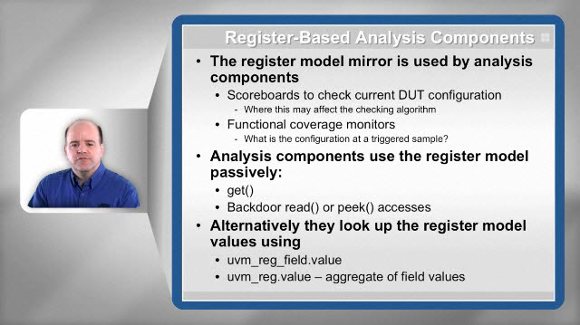
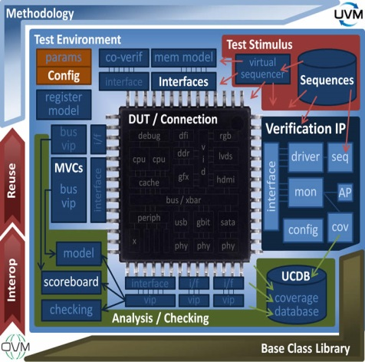
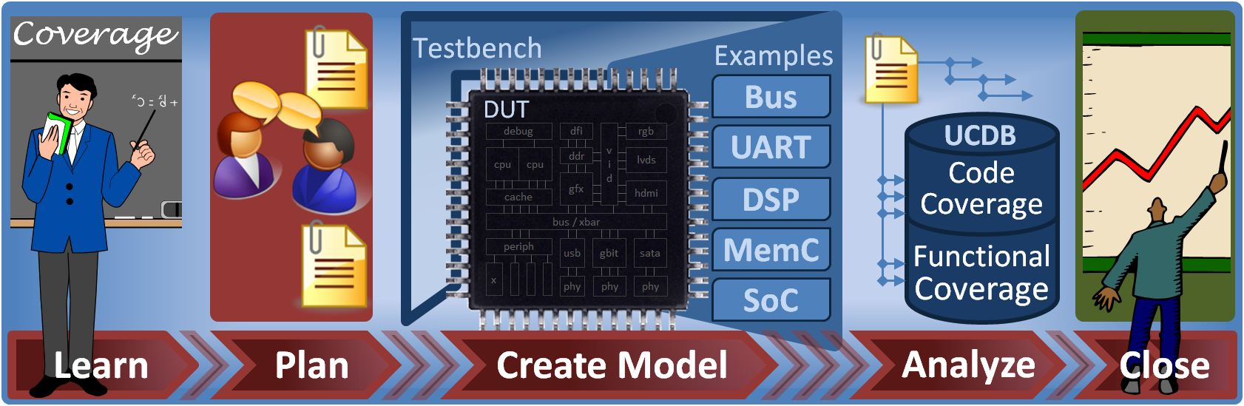
The most comprehensive verification resource around
Online Courses
Verification Cookbooks
Discussion Forums
Patterns Library
Coverage Cookbook
UVM Cookbook
3
H Foster, WRG Functional Verification Study, September 2016
Notes:
Our goal is to be the most comprehensive resource available today in advanced functional verification. And we deliever this content in three forms.
A set of online video courses,Verification Cookbooks, Discussion forums, and a verification patterns library.
-Today, we have 27 online courses, consisting of over 120 video sessions that you can view at your convinience.
-Our UVM cookbook consist 600 pages, and the best resource available on UVM.
- Our discussion forums consist of thousands of discussions from engineers all around the world.
- And our new patterns library provides proven solutions to many recurring verification problems. Check it out!

Slide 4
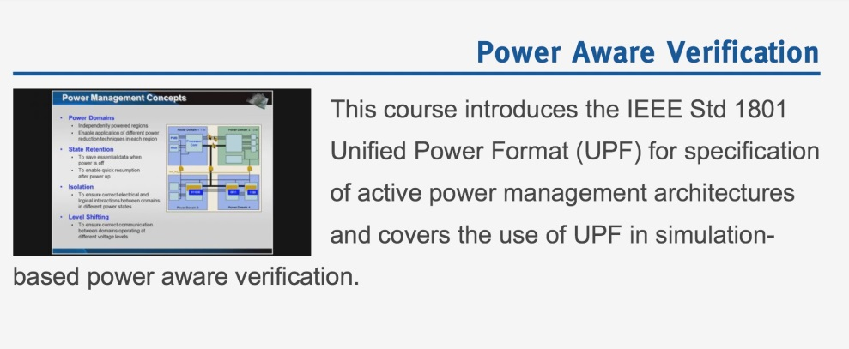
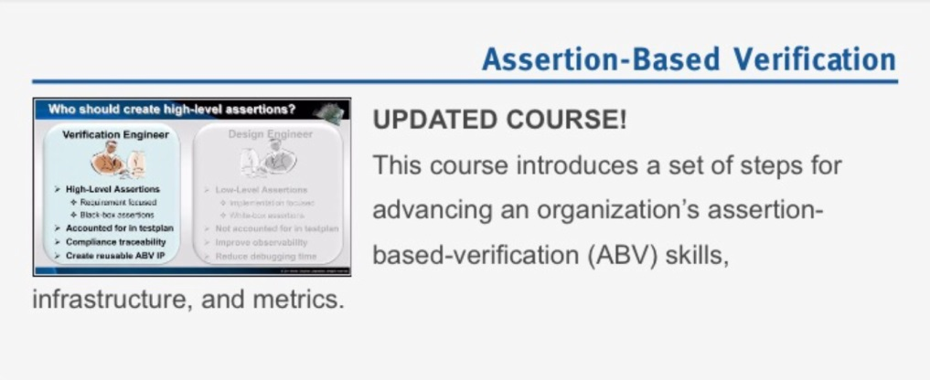
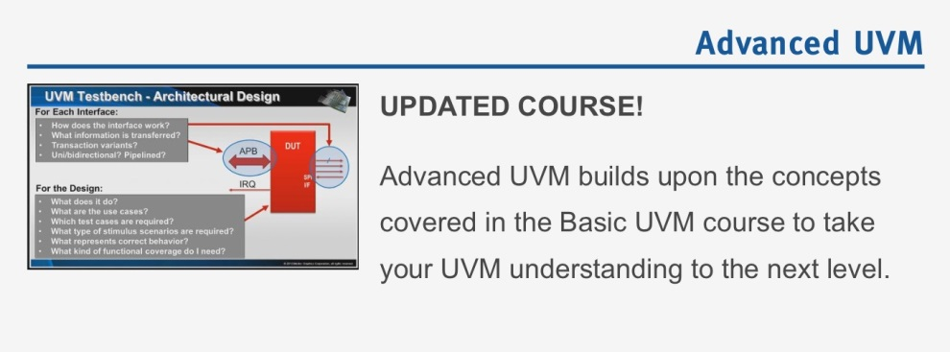
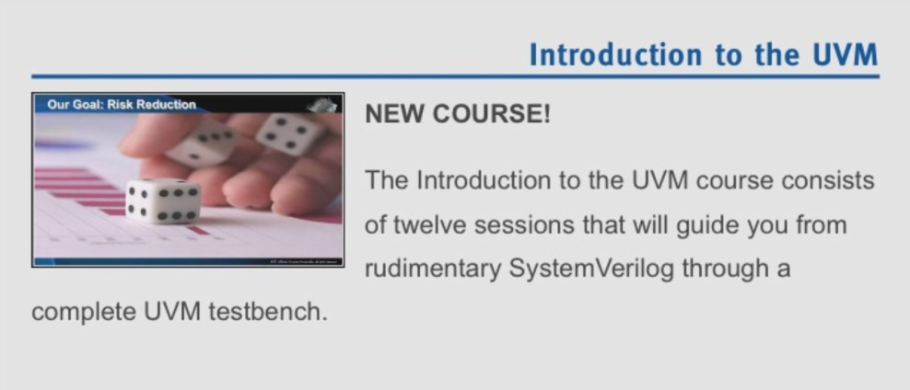
Popular Verification Academy Courses
4
H Foster, WRG Functional Verification Study, September 2016
Notes:
On this slide I am just highlighted a few of our popular online courses.
For example, our Power Aware course. Our ABV course, which provides a lot of process details on how to integrate ABV into your flow. Our Basic and Advanced UVM courses, and a great general Introduction to UVM, ideal for engineers who are not familiar with object-oriented concepts.

Slide 5
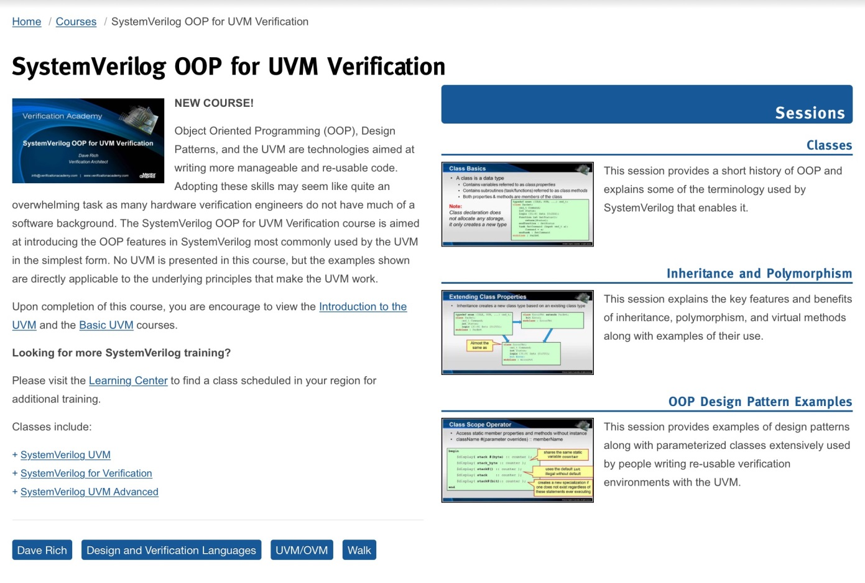
New Verification Academy Course
5
H Foster, WRG Functional Verification Study, September 2016
Notes:
So what new? We just released a new SystemVerilog OOP for UVM Verification course, which I believe is a must view for anyone getting started with learning object-oriented programming concepts, that will benefit you as you mature your UVM skills.

Slide 6
www.verificationacademy.com
Notes:
For more information, please checkout verificationacademy.com

Slide 7
Study Background
Worldwide study
North America, India/China, Japan, Rest of World
Sample frame consisted of 1738 participants
8% smaller than our 2014 study (1886)
3.3x larger than our 2012 study
9.4x larger than the 2004 Ron Collett International study
Confidence interval 95%
±2.36% Margin of Error
7
H Foster, WRG Functional Verification Study, September 2016
Notes:
Ok, let’s get started. First, I want to give you a little background about the 2016 Wilson Research Group Functional Verification Study. This was a worldwide study, conducting in multiple phases or regions of the world: North America, India/China, Japan, Rest of World.
The sample frame of qualified study participants was 1738, which is a little smaller than our 2014. However, this would still rank as one of the largest independent industry studies ever conducted. As a companion, this was 3.3x larger than our previous study, conducted in 2012, and 9.4x larger than the 2004 Collett study.
One key point I want to make about this study is that study pool (or participants) were not drawn for Mentor’s customer list. This would be a biased study. Multiple independent list were used, representing all market segments, and all regions of the world. Mentor commission Wilson Research Group to conduct the study. I analyzed the results—however the analysis was done in a blind fashion, which means I did not know who the participants were.
Using a confidence interval of 95%, the overall margin of error calcluates to be +/- 2.36%.
BTW, the way to interpret confidence intervals is thins. If I were to repeat the steady 100 times on similar popultation, we would expect 95 times to find similar results + or - the margin of error, while 5 times the results would be significantly different.

Slide 8
Design Trends
Notes:
Let’s begin by examining a few industry trends and see how a few design trends are contributing to growing complexity.

Slide 9
Design Sizes
~31% of designs over 80M gates
~20% of designs over 500M gates
Source: Wilson Research Group and Mentor Graphics, 2016 Functional Verification Study
9
H Foster, WRG Functional Verification Study, September 2016
Notes:
Today, thanks to Moore's law, we continue to see larger and larger designs. In fact, over 31% of the Design Projects were working on designs greater than 80M gates. 20% of the participants worked on designs larger than 500M gates. What was somewhat of a surprise in this year’s study was the large increase in projects working on very small designs (less than 100K). It is unclear what is driving this, perhaps a lot of sensor devices associated with IoT designs. At any rate, this is something worth investigating, since the increase in smaller designs can bias the results, since typically projects working on very small designs do not adopt the most advanced verification processes,
Now, certainly, larger designs is one aspect of complexity, but let's look at other trends.

Slide 10
It’s an SoC World
72% of designs contain embedded processors
49% of designs contain 2 or more processors
16% of designs contain 8 or more processors
Source: Wilson Research Group and Mentor Graphics, 2016 Functional Verification Study
10
H Foster, WRG Functional Verification Study, September 2016
Notes:
In 2004, Collett found that 52 percent of designs included one or more embedded processors. Our 2016 study found that the number of designs with embedded processors had increased to 72 percent. Furthermore, 49 percent of all designs today contain two or more embedded processors, while 16 percent of today’s designs include eight or more embedded processors. SoC class designs add a new layer of verification complexity to the verification process that did not exist with traditional non-SoC class designs due to hardware and software interactions, new coherency architectures, and the emergence of complex network-on-a-chip and advanced interconnect.

Slide 11
It’s an SoC World
59% of designs contain embedded processors
32% of designs contain 2 or more processors
Source: Wilson Research Group and Mentor Graphics, 2016 Functional Verification Study
11
H Foster, WRG Functional Verification Study, September 2016
Notes:
Like ASIC/IC designs, FPGAs are becoming more complex. For example, 59% of all FPGAs today contain one or more embedded processors. 32% of all FPGA designs contain two or more embedded processors. Adding embedded processors to FPGA designs increases the verification complexity and introduces new verification challenges that did not exist years ago.

Slide 12
Number of DSP Cores per ASIC/IC Design
Source: Wilson Research Group and Mentor Graphics, 2016 Functional Verification Study
12
H Foster, WRG Functional Verification Study, September 2016
Notes:
This slide shows the number of DSP cores integrated into their designs by various ASIC-IC design projects. We did not see a statistically significant change in this year’s study.

Slide 13
Number of DSP Cores per FPGA Design
Source: Wilson Research Group and Mentor Graphics, 2016 Functional Verification Study
13
H Foster, WRG Functional Verification Study, September 2016
Notes:
Similarly, here is the number of DSP cores integrated into their designs by various FPGA design projects.

Slide 14
More Requirements to Verify
Notes:
Let’s look at a few other attributes that is driving verification complexity.

Slide 15
The Emergence of New Layers of Verification Requirements
Software
Security Domains
Verification Requirements
Power Domains
Clock Domains
Functional
15
H Foster, WRG Functional Verification Study, September 2016
Notes:
One of the main contributing factors to rising verification complexity is due to the emergence of new layers of verification requirements that did not exist years ago.
Beyond the traditional functional domain, we have added clock domains, power domain, security domains, and software.

Slide 16
Projects Working on Designs with Security Features
Source: Wilson Research Group and Mentor Graphics, 2016 Functional Verification Study
16
H Foster, WRG Functional Verification Study, September 2016
Notes:
One thing new that we studied this year was to try and get a sense of the percentage of design projects that are implementing security features into their designs. Again, this represents a new layer of verification that is required that did not exist years ago. Here, we found that 58% of ASIC/IC projects are implementing some type of security feature into their designs, while 46% of FPGA projects are also implementing security features.

Slide 17
Projects Working on Safety Critical Design
DO-254, ISO26262, IEC60601, IEC61508, etc.
Source: Wilson Research Group and Mentor Graphics, 2016 Functional Verification Study
17
H Foster, WRG Functional Verification Study, September 2016
Notes:
Concerning projects that are working under some type of safety critical standard design practice, such as DO-254, ISO26262, IEC60601, IEC61508, etc., we found that 46% ASIC/IC and 44% FPGA projects would be classified as safety critical designs. I actually am skeptical of these numbers, and think they are too high. As I said, this is the first time we asked this question, and I am usually hesitant in sharing the findings from new questions since there could be sampling errors, problems with the wording of a questions, or other issues that need to be worked out. However, I decided to go ahead and share this with you. We will have a clearer understanding of these results when we conduct our next study.

Slide 18
Resource Trends
Notes:
So, what's the verification impact with all this rising design complexity? Let’s look at a few industry trends related to verification effort.

Slide 19
Mean Peak Number of Engineers Increasing
Source: Wilson Research Group and Mentor Graphics, 2016 Functional Verification Study
19
H Foster, WRG Functional Verification Study, September 2016
Notes:
Next. let's look at the mean peak number of engineers working on an ASIC/IC project. You can see that today the mean peak average number of verification engineers is greater than the peak number of design engineers. In other words, there are now more verification engineers working on a project than designers.

Slide 20
More Verification Engineers vs Design Engineers
Source: Wilson Research Group and Mentor Graphics, 2016 Functional Verification Study
20
H Foster, WRG Functional Verification Study, September 2016
Notes:
This is just another way of viewer the data on the previous slide, it illustrates the demand for ASIC/IC verification engineers is greater (on average) compared to design engineers. Although, you can see that this trend is starting to slow down between 2014 and 2016

Slide 21
Mean Peak ASIC/IC Engineers by Design Size
Source: Wilson Research Group and Mentor Graphics, 2016 Functional Verification Study
21
H Foster, WRG Functional Verification Study, September 2016
Notes:
Obviously, the actual peak number of engineers involved on as ASIC/IC project can vary significantly depending on the size of the design, as illustrated in this slide. None the less, the previous slides are useful for understanding the overall industry trends.

Slide 22
About a One-to-One Ration of Design & Verification Engineers
Source: Wilson Research Group and Mentor Graphics, 2016 Functional Verification Study
22
H Foster, WRG Functional Verification Study, September 2016
Notes:
Ok, here we are looking at the mean peak number of FPGA verification and design engineers working on a project. We did not see a statistically significant change between 2014 and 2016. However, we did see a big change between 2012 and 2014. We are pretty close to a one-to-one ratio in terms of FPGA verification and design engineers.

Slide 23
Where ASIC/IC Designers Spend Their Time
Source: Wilson Research Group and Mentor Graphics, 2016 Functional Verification Study
23
H Foster, WRG Functional Verification Study, September 2016
Notes:
Now, ASIC/IC verification engineers are not the only ones involved in the verification process. ASIC/IC design engineers spend a significant amount of their time in verification too. In fact, in 2007, designers spend a little more of their time in design, while in 2012 designers a little more of their time in verification. And since 2012, the industry has reverted back to designers spending a little more of their time in design. None the less, design engineers spend a significant amount of their time in verification activities, such as debugging, sandbox and block level verification, and other verification task.

Slide 24
Where FPGA Designers Spend Their Time
Source: Wilson Research Group and Mentor Graphics, 2016 Functional Verification Study
24
H Foster, WRG Functional Verification Study, September 2016
Notes:
Here you can see where FPGA design engineers spend their time related to actual design and verification task. Not a significant change between 2014 and 2016.

Slide 25
Where ASIC/IC Verification Engineers Spend Their Time
Source: Wilson Research Group and Mentor Graphics, 2016 Functional Verification Study
25
H Foster, WRG Functional Verification Study, September 2016
Notes:
Now let’s look at where ASIC/IC verification engineers spend their time. This slide looks at a few common task, such as test planning, testbench development, creating test (and running simulations), and debugging. You can see that debugging consumes most of their time. If you think about it, when a project has optimized all the other verification task within their flow, you would expect that they spend most of their time in debugging. However, from a management perspective, debugging is insidious since it is unpredictable and the effort can very significantly when identifying and triaging multiple bugs. This makes future project scheduling and planning difficult and inaccurate. Hence, anything that can be done to reduce debugging effort is a big win for a project.

Slide 26
Where FPGA Verification Engineers Spend Their Time
Source: Wilson Research Group and Mentor Graphics, 2016 Functional Verification Study
26
H Foster, WRG Functional Verification Study, September 2016
Notes:
Now let’s look at where FPGA verification engineers spend their time, and you can see that it is similar to ASIC/IC verification engineers. That is, debugging occupies the biggest portion of the FPGA verification engineers time.

Slide 27
Impact of Rising Complexity and Results
Notes:
Ok, now that we have looked at some trends related to rising complexity and effort in terms of resource demands, let’s look at a few trends related to the impact of both complexity and effort.

Slide 28
ASIC/IC Verification Project Time
Source: Wilson Research Group and Mentor Graphics, 2016 Functional Verification Study
28
H Foster, WRG Functional Verification Study, September 2016
Notes:
The first thing let’s look at is the percentage of ASIC/IC project time spent in verification, and as you can see it is all over the map. If you were to calculate the average on the curve, you would find that about 55% percent of an ASIC/IC project’s time is spent in verification. This has been fairly consistent for the past 3 studies. And keep in mind that Moore’s Law has continued during this period—that is designs continued to increase in size and complexity.

Slide 29
FPGA Verification Project Time
Source: Wilson Research Group and Mentor Graphics, 2016 Functional Verification Study
29
H Foster, WRG Functional Verification Study, September 2016
Notes:
Now for FPGA projects, we see that the average percentage of project time spent in verification has risen from the last three studies. The average is still less than the time that an ASIC/IC project spends in verification

Slide 30
ASIC/IC Completion to Original Schedule
Ahead of schedule
Behind Schedule
Source: Wilson Research Group and Mentor Graphics, 2014 Functional Verification Study
30
H Foster, WRG Functional Verification Study, September 2016
Notes:
Now, let’s look at the actual ASIC/IC design completion compared to the project’s original schedule. If has been fairly consistent across multiple studies, with the exception of 2014. It is unclear if there was really something unique going on in 2014, or if this was just a sampling error, like what I talked about when I was discussing confidence intervals. At any rate, the key point is that over 2/3’s of today’s projects are unable to meet their original schedule.

Slide 31
FPGA Completion to Original Schedule
Ahead of schedule
Behind Schedule
Source: Wilson Research Group and Mentor Graphics, 2014 Functional Verification Study
31
H Foster, WRG Functional Verification Study, September 2016
Notes:
For FPGA projects, we rind similar results, where 2014 seems to be an anomaly when compared to 2012 and 2016. Again, about 2/3’s of today’s FPGA projects are unable to meet their original schedule.

Slide 32
Number of Required ASIC/IC Spins Before Production
Source: Wilson Research Group and Mentor Graphics, 2016 Functional Verification Study
32
H Foster, WRG Functional Verification Study, September 2016
Notes:
Another datapoint we should look at related to the impact of rising complexity is the number of required spins before volume manufacturing. You can see that achieving first silicon success has remained relatively constant over the past 9 years. However, we are starting to see a trend where the number of required spins, specifically 2 spins, is starting to decline, and an increase in more spins.
BTW, historically, we have used the number of required spins to get a sense of the effectiveness of a project’s verification process. Unfortunately, we never had a similar metric for FPGA projects. So this year, we tried something new, which I will discuss on the next slide.

Slide 33
Number of FPGA Bug Escapes to Production
Source: Wilson Research Group and Mentor Graphics, 2016 Functional Verification Study
33
H Foster, WRG Functional Verification Study, September 2016
Notes:
Here we asked FPGA projects to tells us the results for their previous project. That is, how many “non-trivial” bugs escaped into actual production (that is, after the product was shipped). It was staggering what we found. Only 22% of FPGA projects had no “non-trivial bug escapes.

Slide 34
Required ASIC/IC Spins for Safety Critical Designs
34% of Safety Critical ASIC/IC
designs require 3 or more spins!
DO-254, ISO26262, IEC60601, IEC61508, etc.
Source: Wilson Research Group and Mentor Graphics, 2016 Functional Verification Study
34
H Foster, WRG Functional Verification Study, September 2016
Notes:
Since this was the first year that we looked at safety critical design, I though it would be fun to partition the number of required spins for ASIC/Ics projects working on safety critical designs. What I found was fascinating. Project’s working on safety critical design actually have a worse track record in terms of number required spins than non-safety critical designs. In other words, the processes put in place to ensure safety do not necessarily reduce bugs.

Slide 35
FPGA Safety Critical Designs with Production Bug Escapes
DO-254, ISO26262, IEC60601, IEC61508, etc.
Source: Wilson Research Group and Mentor Graphics, 2016 Functional Verification Study
35
H Foster, WRG Functional Verification Study, September 2016
Notes:
For FPGA designs, we found that 75% of all safety-critical designs have one or more non-trivial bug that escapes into production.

Slide 36
Flaws Contributing to ASIC/IC Respins
* Multiple answers possible
Source: Wilson Research Group and Mentor Graphics, 2016 Functional Verification Study
36
H Foster, WRG Functional Verification Study, September 2016
Notes:
Ok, next let’s look at flaws that contribute to respins. You can see that it has been fairly consistent for the past three studies, where logical and functional issues are the leading flaws that contribute to respins. You might note that this does not sum up to 100%. The reason for this is that multiple answers are possible. In 2016 we did see a statistically significant spike in power consumption design flaws leading to respins, which is probably something worth investigating.

Slide 37
Root Cause of ASIC/IC Functional Flaws
* Multiple answers possible
Source: Wilson Research Group and Mentor Graphics, 2016 Functional Verification Study
37
H Foster, WRG Functional Verification Study, September 2016
Notes:
If you look at the root cause of logic and functional flaws, we see that design error is the main factor. The other thing to note on this slide are functional flaws that are caused by changes in the spec, as well as incorrect or incomplete specs. Clearly, specification is a problem in our industry.

Slide 38
Flaws Contributing to FPGA Rework
* Multiple answers possible
Source: Wilson Research Group and Mentor Graphics, 2016 Functional Verification Study
38
H Foster, WRG Functional Verification Study, September 2016
Notes:
This shows the flaws contributing to rework after the FPGA has been put into production. Again, logical and functional flaws are the greatest contributor to FPGA rework.

Slide 39
Root Cause of FPGA Functional Flaws
* Multiple answers possible
Source: Wilson Research Group and Mentor Graphics, 2016 Functional Verification Study
39
H Foster, WRG Functional Verification Study, September 2016
Notes:
And finally, if you look at the root cause of logic and functional flaws for FPGA designs, we see similars results that we found for ASIC/Ics. That is, we see that design error is the main factor. The other thing to note on this slide are functional flaws that are caused by changes in the spec, as well as incorrect or incomplete specs. Clearly, specification is a problem in our industry.

Slide 40
Language Adoption Trends
Notes:
Ok, now I want to turn our attention to the adoption trends for various industry standards in terms of languages and libraries.

Slide 41
ASIC/IC Design Language Adoption Trends
* Multiple answers possible
Source: Wilson Research Group and Mentor Graphics, 2016 Functional Verification Study
41
H Foster, WRG Functional Verification Study, September 2016
Notes:
First, let's look at language standards to create RTL designs for ASIC/ICs. Here you can see that Verilog, SystemVerilog and SystemC used to create RTL designs have flattened out, while we are seeing a decline in VHDL and SystemVerilog. Again, it is important to note that this data is for RTL design, and we are not talking about languages used to create testbenches, nor languages used to create higher-level models.
One other comment here is that you might note that if you were to sum the totals for the adoption of the various languages, it is greater than 100%. The reason for this is that many projects are using multiple languages, such as VHDL and Verilog. A lot of this is driven by legacy code as well as design IP adoption.

Slide 42
ASIC/IC Design Language Adoption Trends
* Multiple answers possible
Source: Wilson Research Group and Mentor Graphics, 2016 Functional Verification Study
42
H Foster, WRG Functional Verification Study, September 2016
Notes:
We asked the question to the participants to estimate what languages they plan to use in the next 12 months, and this is the trend we found for ASIC/IC RTL design languages.

Slide 43
FPGA Design Language Adoption Trends
* Multiple answers possible
Source: Wilson Research Group and Mentor Graphics, 2016 Functional Verification Study
43
H Foster, WRG Functional Verification Study, September 2016
Notes:
Now for FPGA designs, this is what we found. Not a surprise here, but VHDL has traditionally dominated as the language of choice for FPGA RTL design, yet we are starting to see a shift.
Now, if you were to look only at specific regions of thw world or market segments, you would see a significant difference. For example, Europe as well as Mil/Aero has a higher adoption of VHDL. None the less, it is important to look at what the oeverall worldwide trend is to better assess where the RTL design echo system is headed.

Slide 44
FPGA Design Language Adoption Trends
* Multiple answers possible
Source: Wilson Research Group and Mentor Graphics, 2016 Functional Verification Study
44
H Foster, WRG Functional Verification Study, September 2016
Notes:
And this is the projected adoption for the next 12 months.
Oh, one other important point about all these language standard adoption trends. The data I am presenting to you is a worldwide average. If you were to only look at a certain region of the world, or specifica market

Slide 45
ASIC/IC Verification Language Adoption Trends
* Multiple answers possible
Source: Wilson Research Group and Mentor Graphics, 2016 Functional Verification Study
45
H Foster, WRG Functional Verification Study, September 2016
Notes:
Now lets look at ASIC/IC adoption of languages used to build testbenches, we find a continue decline in all languages, with the exception of SystemVerilog and C/C++. SystemVerilog adoption is starting to saturate and level off in the upper 70% range.

Slide 46
ASIC/IC Verification Language Adoption Trends
* Multiple answers possible
Source: Wilson Research Group and Mentor Graphics, 2016 Functional Verification Study
46
H Foster, WRG Functional Verification Study, September 2016
Notes:
And this slide agains, illustrates how SystemVerilog has matured and started to level off in its adoption among ASIC/IC projects.

Slide 47
FPGA Verification Language Adoption Trends
* Multiple answers possible
Source: Wilson Research Group and Mentor Graphics, 2016 Functional Verification Study
47
H Foster, WRG Functional Verification Study, September 2016
Notes:
Here we see a similar trend in terms of adopting languages used to create testbences for FPGA designs. For the first time, SystemVerilog has overtaken VHDL as the language of choice for creating testbenches.

Slide 48
FPGA Verification Language Adoption Trends
* Multiple answers possible
Source: Wilson Research Group and Mentor Graphics, 2016 Functional Verification Study
48
H Foster, WRG Functional Verification Study, September 2016
Notes:
And this is the projection for the next 12 months concerning FPGA project adoption of lanaugages used to create testbenches. And again, please keep in mind that this is worldwide averages, and that you would find different results if you were to filter this down to a specific region or market segment.

Slide 49
ASIC/IC Testbench Methodology Adoption Trends
* Multiple answers possible
Source: Wilson Research Group and Mentor Graphics, 2016 Functional Verification Study
49
H Foster, WRG Functional Verification Study, September 2016
Notes:
Now let's look at various methodology standards, built on the previous lanaguages standards that we just discussed. And these methnodologies are used to create testbenches for ASIC/IC designs. You can see worldwide, UVM is the methodlogy of choice.

Slide 50
ASIC/IC Testbench Methodology Adoption Trends
* Multiple answers possible
Source: Wilson Research Group and Mentor Graphics, 2016 Functional Verification Study
50
H Foster, WRG Functional Verification Study, September 2016
Notes:
And here we see continual growth projected over the next 12 months.
BTW, to be fair, we did get a few writin methodologies, such as OSVVM and UVVM that are based on VHDL. I do not list them on this slide since it would be difficult to predict an accurate value since they were not listed as a selection option and were write-in answers. Nonetheless, both the data suggest that the industry momentum and focused has movied to SystemVerilog and UVM.

Slide 51
FPGA Testbench Methodology Adoption Trends
* Multiple answers possible
Source: Wilson Research Group and Mentor Graphics, 2016 Functional Verification Study
51
H Foster, WRG Functional Verification Study, September 2016
Notes:
Now, here are the methodology standards adoption trends for FPGAs.

Slide 52
FPGA Testbench Methodology Adoption Trends
* Multiple answers possible
Source: Wilson Research Group and Mentor Graphics, 2016 Functional Verification Study
52
H Foster, WRG Functional Verification Study, September 2016
Notes:
And this is the projection going forward. Again, we see from a worldwide perspective that UVM is the dominant methodology being adopted by FPGA projects.

Slide 53
ASIC/IC Assertion Language Adoption
* Multiple answers possible
Source: Wilson Research Group and Mentor Graphics, 2016 Functional Verification Study
53
H Foster, WRG Functional Verification Study, September 2016
Notes:
Now, for ASIC/IC assertion language adoption trends, this is what we found.

Slide 54
ASIC/IC Assertion Language Adoption
* Multiple answers possible
Source: Wilson Research Group and Mentor Graphics, 2016 Functional Verification Study
54
H Foster, WRG Functional Verification Study, September 2016
Notes:
And he is the projection going forward. SVA seems to be topping out as it matures.

Slide 55
FPGA Assertion Language Adoption
* Multiple answers possible
Source: Wilson Research Group and Mentor Graphics, 2016 Functional Verification Study
55
H Foster, WRG Functional Verification Study, September 2016
Notes:
And this shows the FPGA assertion language adoption trends.

Slide 56
FPGA Assertion Language Adoption
* Multiple answers possible
Source: Wilson Research Group and Mentor Graphics, 2016 Functional Verification Study
56
H Foster, WRG Functional Verification Study, September 2016
Notes:
And the adoption projection over the next 12 months.

Slide 57
Clocking and Power Trends
Notes:
Alright, the next thing I want to share with you is clocking and power trends.

Slide 58
ASIC/IC Multiple Asynchronous Clock Domain Trends
Source: Wilson Research Group and Mentor Graphics, 2016 Functional Verification Study
58
H Foster, WRG Functional Verification Study, September 2016
Notes:
It’s interesting to note that there really haven’t been any significant changes in terms of the number of independent clock domains over the past few studies. The sweet spot ranges from 2 to 20. Obviously, multiple asynchronous clock domains introduces new verification challenges that require targeted verification solutions, particularly since there is a class of bugs associated with metastability that cannot be found on an RTL model using traditional simulation.

Slide 59
ASIC/IC Number Asynchronous Clock Domains by Size
Source: Wilson Research Group and Mentor Graphics, 2016 Functional Verification Study
59
H Foster, WRG Functional Verification Study, September 2016
Notes:
This slide partitions the design with multiple clock domains by design size. You can see the larger the design, the more clock domains. Intuitatively this makes sense, the larger the design, the more integrated IP. And often each IP has its own clocking and power requirements

Slide 60
FPGA Multiple Asynchronous Clock Domain Trends
Source: Wilson Research Group and Mentor Graphics, 2016 Functional Verification Study
60
H Foster, WRG Functional Verification Study, September 2016
Notes:
This is what we found in terms of number of clock domains for FPGA designs.

Slide 61
More Designs Actively Manage Power
Source: Wilson Research Group and Mentor Graphics, 2016 Functional Verification Study
61
H Foster, WRG Functional Verification Study, September 2016
Notes:
Now for power, we see a shift in the number of designs that actively manage power, from 59% in 2007 to 74% in 2016.

Slide 62
Aspects of Power Management that is Verified
Source: Wilson Research Group and Mentor Graphics, 2016 Functional Verification Study
62
H Foster, WRG Functional Verification Study, September 2016
Notes:
Power domains brings new verification challenges that did not exist years ago. This slides shows various aspects of power managed designs that projects are verifying today. Many of the more advanced power management schemes require software as part of the solution. These aspects of power manage required emulation to verify today, which I’ll talk a little more about in a moment.

Slide 63
Power Intent Standards Trends
* Multiple answers possible
Source: Wilson Research Group and Mentor Graphics, 2016 Functional Verification Study
63
H Foster, WRG Functional Verification Study, September 2016
Notes:
The designs that actively manage power needs some means to describe the power intent of the design. This slide indicates the industry adoption for the two most popular forms of notation: CPF and UPF.

Slide 64
Static and Dynamic Verification Trends
Notes:
Now, I want to look at various technologies and techniques used to verify today's ASIC/IC as well as FPGA designs.

Slide 65
ASIC/IC Formal Technology Adoption Trends
Source: Wilson Research Group and Mentor Graphics, 2016 Functional Verification Study
65
H Foster, WRG Functional Verification Study, September 2016
Notes:
First let's look at formal technology adoption. On this slide I am showing two types of formal technologies. The first is formal property checking (where the user writes some assertions and constraints, and then the tool tries to prove the property using mathmatical technqies). The other formal technology I classify as automatic formal applications (where the user does not need to write any assertions and the tool will autotatically prove some aspect of the design. Examples of this include automatic formal apps to verify security features, IP connectivity check, as well as automatically identify dead locks associated with FSM described in the RTL). Please note that I am not talking about equivancy checking here. We saw a huge growth in adoption of formal property checking in our most recent study.

Slide 66
Formal Technology Adoption
8% CAGR
13% CAGR
Source: Wilson Research Group and Mentor Graphics, 2016 Functional Verification Study
66
H Foster, WRG Functional Verification Study, September 2016
Notes:
You can see that the overall growth in terms of adoption of both technologies has been impressive over the past four years.

Slide 67
ASIC/IC Formal Technology Adoption Trends by Size
Source: Wilson Research Group and Mentor Graphics, 2016 Functional Verification Study
67
H Foster, WRG Functional Verification Study, September 2016
Notes:
The larger the ASIC/IC design, we found the more adoption of formal property checking.

Slide 68
FPGA Formal Technology Adoption Trends
Source: Wilson Research Group and Mentor Graphics, 2016 Functional Verification Study
68
H Foster, WRG Functional Verification Study, September 2016
Notes:
Here we see the FPGA adoption trends for both formal property checking and automatic formal verification.

Slide 69
ASIC/IC Dynamic Verification Adoption Trends
Source: Wilson Research Group and Mentor Graphics, 2016 Functional Verification Study
69
H Foster, WRG Functional Verification Study, September 2016
Notes:
Now let's look at verious simulation advanced verification technololgy and technique adoption trends. For the most part, we see that ASIC/IC design projects have basically matured their verification processes, so we are not seeing much change. It appears that there has been a decline in adoption of a few techniques. However, what is really going on is that we see an increase in projects working on very small designs (less that 100k gates) that is biasing these results. These very small design projects typically don't apply advanced verification techniques.

Slide 70
FPGA Dynamic Verification Adoption Trends
Source: Wilson Research Group and Mentor Graphics, 2016 Functional Verification Study
70
H Foster, WRG Functional Verification Study, September 2016
Notes:
Now, for FPGA projects, we see that they are maturing their verification process farely rapidly, when compared over the last three studies. This is just another indication of the growing complexity of FPGA designs.

Slide 71
FPGA Verification Technique Adoption and Bug Escapes
Source: Wilson Research Group and Mentor Graphics, 2016 Functional Verification Study
71
H Foster, WRG Functional Verification Study, September 2016
Notes:
I thought it would be fun to look at FPGA designs partitioned by designs that had a non-trivial bug escape into production, and those designs that did not, and then look at a few advanced verification techniques. The data suggest that projects that are more mature in their verification processes experience fewer non-trivial bug escapes into production.

Slide 72
ASIC/IC Verification Maturity and First Silicon Success
Source: Wilson Research Group and Mentor Graphics, 2016 Functional Verification Study
Notes:
This is an interesting slide. We looked at FPGA verification technology adoption and compared it to non-trivial bug escapes into production, and what we found was that the data suggest organizations that are less mature in their verification processes experience more bugs.

Slide 73
FPGA Verification Maturity and Bug Escapes
Source: Wilson Research Group and Mentor Graphics, 2016 Functional Verification Study
73
H Foster, Honeywell, Sept 2016
Notes:
This is an interesting slide. We looked at FPGA verification technology adoption and compared it to non-trivial bug escapes into production, and what we found was that the data suggest organizations that are less mature in their verification processes experience more bugs.

Slide 74
Number of Test Created to Verify ASIC/IC Design
2016 Average 200-499
Source: Wilson Research Group and Mentor Graphics, 2016 Functional Verification Study
74
H Foster, WRG Functional Verification Study, September 2016
Notes:
Ok, just a few more slides. This is something I have never released in the past, but is shows the number of test created to verify an ASIC/IC design. Obviously, it is all over the spectrum. The median is 200-499.

Slide 75
Number of Test Created to Verify FPGA Design
2016 Average 1-99
Source: Wilson Research Group and Mentor Graphics, 2016 Functional Verification Study
75
H Foster, WRG Functional Verification Study, September 2016
Notes:
Here is what we found for FPGA designs, where the medium is 1-99 test.

Slide 76
Typical ASIC/IC Regression Time
2016 Average 9-17 hrs
Source: Wilson Research Group and Mentor Graphics, 2016 Functional Verification Study
76
H Foster, WRG Functional Verification Study, September 2016
Notes:
This shows the regression times for ASIC/IC designs, where the medium was 9-17 hours.

Slide 77
Typical FPGA Regression Time
2016 Average 5-9 hrs
Source: Wilson Research Group and Mentor Graphics, 2016 Functional Verification Study
77
H Foster, WRG Functional Verification Study, September 2016
Notes:
And here is the regression times for FPGA designs, where the medium is 5-9 hours.

Slide 78
Longest Regression Time (ASIC/IC vs FPGA)
FPGA Average 9-17 hrs
ASIC/IC Average 1-1.5 days
Source: Wilson Research Group and Mentor Graphics, 2016 Functional Verification Study
78
H Foster, WRG Functional Verification Study, September 2016
Notes:
This show the longest regression time, comparing FPGA designs with ASIC/IC, where the FPGA medium was 9-17 hours, while ASIC/IC medium was 1-1.5 days.

Slide 79
ASIC/IC Signoff Criteria
Source: Wilson Research Group and Mentor Graphics, 2016 Functional Verification Study
79
H Foster, WRG Functional Verification Study, September 2016
Notes:
Now to shift gears a second, we looked that various ASIC/IC signoff criteria. And there has been a trend in the decline of "when all test documented in the verification plan are complete and pass"...and and increase in achieving target coverage as important to the signoff criterial.

Slide 80
FPGA Signoff Criteria
Source: Wilson Research Group and Mentor Graphics, 2016 Functional Verification Study
80
H Foster, WRG Functional Verification Study, September 2016
Notes:
This shows the signoff criterial for FPGA design projects. we did see an increase in importance of coverage for 2016 (shown in red).

Slide 81
Emulation and FPGA Prototyping Trends
Notes:
Ok, the last thing I want to talk about relates to emulation and FPGA prototyping trends.

Slide 82
Why was Emulation Performed?
Source: Wilson Research Group and Mentor Graphics, 2016 Functional Verification Study
82
H Foster, WRG Functional Verification Study, September 2016
Notes:
First this shows various reasons why emulation was adopted on the project.

Slide 83
Why was FPGA Prototyping Performed?
Source: Wilson Research Group and Mentor Graphics, 2016 Functional Verification Study
83
H Foster, WRG Functional Verification Study, September 2016
Notes:
And here we see why FPGA Prototyping was adopted on the project. Actually, the results are very similar.

Slide 84
FPGA Prototyping Challenges
Source: Wilson Research Group and Mentor Graphics, 2016 Functional Verification Study
84
H Foster, WRG Functional Verification Study, September 2016
Notes:
Finally, we asked the question concerning what are some of the FPGA Prototyping challenges they experienced on their project, is this is what we found. There appears to be some improvement in MAPPING ASICS into FPGAs between 2014 and 2016.

Slide 85
Highlights from the 2016 Wilson Research Group Functional Verification Study
Harry Foster
Notes:
And that wraps up the data I plan to present today from our latest study.

Slide 86
FPGA Verification Technique Adoption by Market Segment
Source: Wilson Research Group and Mentor Graphics, 2016 Functional Verification Study
86
H Foster, WRG Functional Verification Study, September 2016
Notes:
BTW, here is the previous slide partitioned down by a couple different market segments. You can see that the Miol/Aero market segment is the most mature of the various segments that I listed.

