Slide 1


Introduction to Design Verification COMS31700
Kerstin Eder
Design Automation and Verification
Department of
COMPUTER SCIENCE

Slide 2
Welcome to COMS31700
Lecturer
Kerstin EDER
Department of Computer Science
Room 3.25 MVB
Kerstin.Eder@bristol.ac.uk
Office hours:
Tu before our lectures but not 10:30-12:00
Alternatively, just come to my office.
Email may not get you a timely response.
Lecture notes, exercises and assignments are/will be online at: http://www.cs.bris.ac.uk/Teaching/Resources/COMS31700/
Comments and feedback are always welcome

Slide 3
COMS31700 Unit Details
Lectures (weeks 1 – 12)
Please check your timetable, at the moment:
Monday (1h) 14:00 – 14:50 in MVB 1.11
except for wk1, wk8, wk12 in QB 1.18
Tuesday (2h) 14:00 – 15:50 in MVB 1.11
except for wk4 PHYS B16/17 ENDERBY and wk8 QB 1.8
Practical Work (weeks 1 – 12)
You are expected to invest 2h per week into practical work.
DV Help Desk on demand
Teaching Assistant: tbc
Assessment Deadlines will soon be on COMS31700 web page!
2 assignments (25% due in week 5/6, 25% due in week 10/11/12)
individual feedback session and assignment review seminars
Option to obtain “feed forward”
1 exam (50% in January)

Slide 4
Literature and Study Resources
Janick Bergeron
Writing Testbenches: Functional Verification of HDL Models.
First Edition, Kluwer, 2000, ISBN: 0-7923-7766-4
Second Edition, Kluwer, 2003, ISBN: 1-4020-7401-8
verificationacademy.com
In addition:
Lecture slides and on-line tutorials on COMS31700 web page
On-line documentation of ModelSim/Questa Simulator and SpecMan Elite
Watch the unit web page for further supplementary literature.
[Credits: Parts of the lecture notes contain material from the book “Comprehensive Functional Verification” by Bruce Wile etal, the book ”Writing Testbenches: Functional Verification of HDL Models” by Janick Bergeron, the book ”The Verilog Hardware Description Language” by Donald Thomas and from lecture slides developed at IBM (by Avi Ziv and Jaron Wolfstal), the University of Pittsburgh, Penn State University, North Carolina State University and Ohio State University. The HDL for the assignments has been developed at IBM.]

Slide 5
What is this unit about?
Aim:
To familiarise you with the state of the art in Design Verification, and to give you the technical background plus some of the practical skills expected from a professional Design Verification Engineer.
Pre-/Co-requisites: programming experience
On successful completion of this unit, you will be able to:
understand the complexities and limits of verification;
carry out functional verification and determine its effectiveness;
set appropriate verification goals, select suitable verification
methods and assess the associated risks;
compile a verification plan that fits into the flow of a design project;
organise a verification team.

Slide 6
Unit Outline
Lecture Topics
Introduction: What is Verification? What is a Testbench?
Verification Flow and Tools including basic Verilog HDL coding
Verification cycle, methodology and plan including coverage
Simulation-based Verification: Stimulus Generation and Checking
Assertion-based Verification (ABV)
Advanced Testbench Design Methodology with SpecMan Elite
(Functional Formal Verification and Property Checking)
Labs
Exercise 1: Evita Verilog interactive tutorial (do @ home asap)
Exercise 2: Introduction to the ModelSim/Questa Simulator
A1, weeks 2-6: Verification of calculator design with ModelSim/Questa
Exercise 3: How to collect Code Coverage with ModelSim/Questa
Exercise 4: Introduction to SpecMan Elite
A2, weeks 7-11: Advanced testbench design with SpecMan Elite
Notes:
Need to sign ModelSim agreement!

Slide 7
What is Design Verification?

Slide 8
What is Design Verification?
“Design Verification is the process used to gain confidence in the correctness of a design w.r.t. the requirements and specification.”
Types of verification:
Functional verification
Timing verification
...
What about performance?
Notes:
The microarchitecture is a good example where functionality such as pipelining, forwarding etc are introduced to increase performance. Maintaining functional correctness is only one aspect of verification. Ensuring non-functional properties such as performance is equally important, e.g. only introducing as few bubbles into the pipelines as are necessary to ensure functional correctness. If more bubbles are introduced than necessary then the result is still functionally correct wrt the architectural state of the design, but the design has a performance bug because the microarchitecture does not function correctly.
Andy Piziali: Verification is the process used to demonstrate that the intent of a design is preserved in its implementation. As a consequence, a bug would be intent that was not preserved.

Slide 9
Verification vs Validation
Verification:
Confirms that a system has a given input / output behaviour, sometimes called the transfer function of a system.
Validation:
Confirms that the system’s transfer functions results in the intended system behaviour when the system is employed in its target environment, e.g. as a component of an embedded system.
Validation is sometimes used when verification is meant.

Slide 10
Why is Verification important?
Verification is the single biggest lever to effect the triple constraints:
Quality
A high quality track record preserves revenue and reputation.
Ideally a team can establish a “right-first-time” track record.
Cost
Fewer revs through the development/fabrication process means lower costs.
Respinning a chip costs hundreds of thousands of £/$/€
+ the associated lost opportunity costs.
Timing/Schedule
Fewer revs through the development/fabrication process means faster time-to-market.
Respinning a chip costs 6-8 weeks at least
+ the associated “lost opportunity” costs.

Slide 11
All about Bugs
Types of bugs
How are bugs introduced?
How can bugs be found?

Slide 12
Why do Designs have Bugs?

Slide 13
Why do Designs have Bugs?
Problem
Solution
Develop a computational solution
Manufacture the HW
Design the HW

Slide 14
Why do Designs have Bugs?
Domain knowledge errors
Problem
Solution
User errors
System failure
Inadequate performance
Specification too vague
Manufacturing errors
Develop a computational solution
Manufacture the HW
Ambigious specification
Specification errors
Algorithmic errors
Coding errors
Design the HW
Timing errors
Mis-interpreation of the specification
Race conditions
Microarchitectural errors
Protocol errors
Interface errors
Integration errors
Copy & paste errors
Deadlocks
Communication errors
Performance errors
Architectural errors

Slide 15
Why do Designs have Bugs?
The human dimension
Domain knowledge errors
Problem
Solution
User errors
System failure
Inadequate performance
Specification too vague
Manufacture the HW
Develop a computational solution
Manufacturing errors
Ambigious specification
Specification errors
Algorithmic errors
Coding errors
Design the HW
Timing errors
Mis-interpreation of the specification
Race conditions
Microarchitectural errors
Protocol errors
Interface errors
Integration errors
Copy & paste errors
Deadlocks
Communication errors
Performance errors
Architectural errors

Slide 16
Cost of Bugs over Time
Loss of Reputation
Lost opportunity cost
Number of
bugs found
Cost of
bugs
Mask costs
Late to market cost
Huge costs are associated with finding a bug in your customer’s environ-ment.
Debug cost
Bug found on system test floor requires respin of the chip.
Bug found at chip level has moderate cost.
Recall cost
Bug found early has little cost.
Time
Initial Design Chip System Customer
The longer a bug goes undetected,
the more expensive it is!
Remember the Intel FDIV bug! ttp://en.wikipedia.org/wiki/Pentium_FDIV_bug
Notes:
Cost of Bugs: Mask cost, Late to market cost, Lost opportunity cost, Recall cost, Credibility, Reputation <Discussion: “Which one is the most important?”>
Some discussion of where do bugs come from and understanding why we have them e.g. Good design versus poor design, Dealing with complexity, DFV, Use of chicken bits by designers? Codebase integrity decay as fixes are applied to fixes – full root cause fix, versus workaround fix, Who is responsible for functional correctness – designer or verification engineer? Both? Role of the verification engineer? Make the designers code work? Find all bugs? Debug the design or pass over to designer when fails?
Who’s to blame when bugs are missed? (dangerous but a real perception of verification in some cases?)
Finding all bugs in impossible. Discuss completeness – and pragmatic approaches to deal with it
I think there could be value in the intro section to discuss Bugs in more depth, since this is the principal purpose of verification. E.g discuss different types of bug – how and why are they introduced? Copy-paste errors? Mis-interpretation of specs or spec ambiguity, human dimension of multiple people making different interpretations? Complex interacting state machines, functionality being spread across code verses encapsulation/localisation? PPA optimisations versus functional integrity?
How are bugs found? Accidentally spotted in RTL code? RTL code reviewing, Verification testing, In field discovery by customers or end users

Slide 17
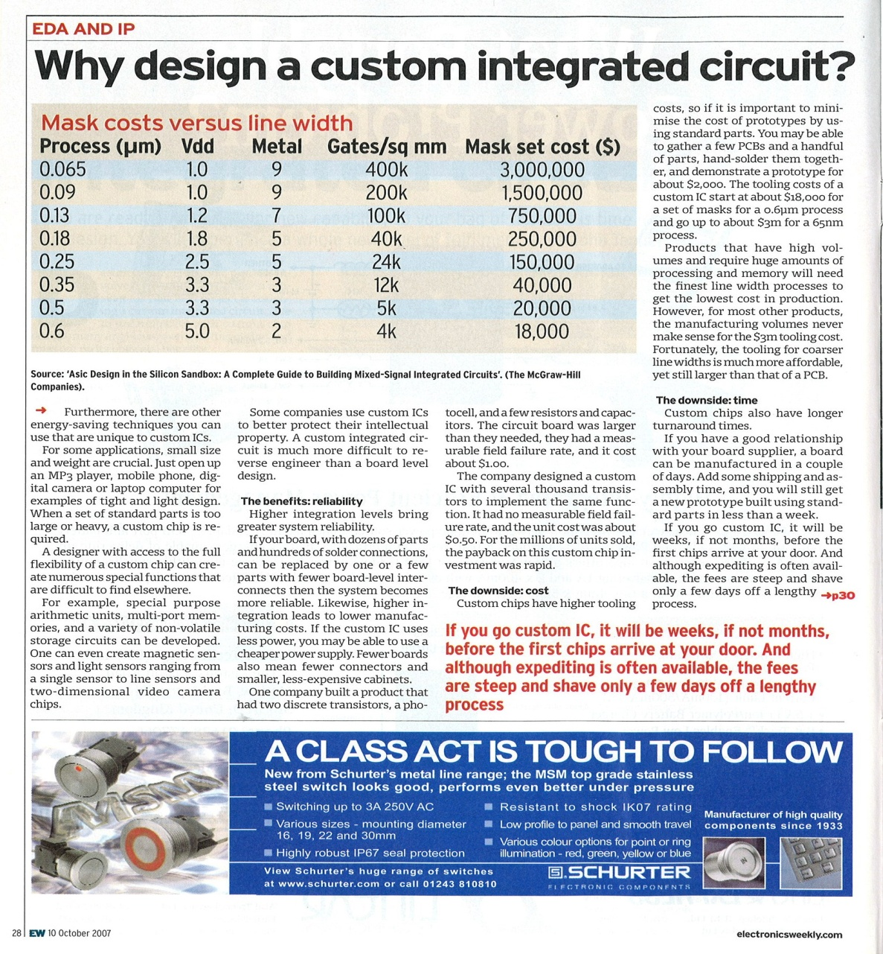
Mask costs (Electronics Weekly, 10 October 2007)

Slide 18
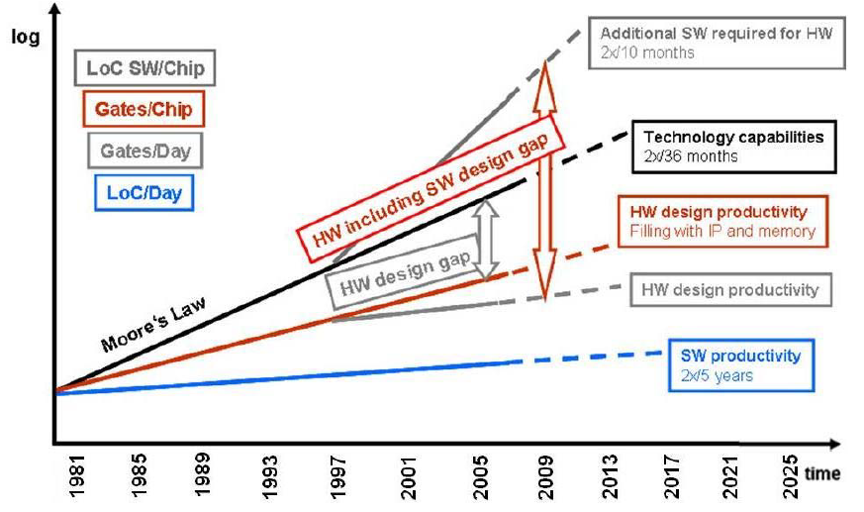
Increasing Design Complexity vs tight TTM Constraints
ITRS Edition 2009, Design Chapter (http://www.itrs.net/)
Hardware and Software Design Gaps versus Time
Getting it right (first time) is more and more difficult:
rapidly increasing design complexity
tight “time-to-market” constraints
Notes:
Got to here, 1st lecture 2014! ☺

Slide 19
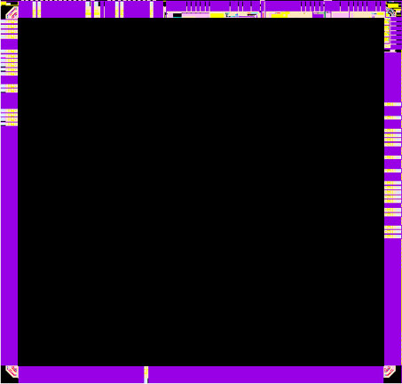
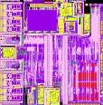
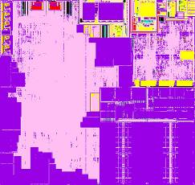

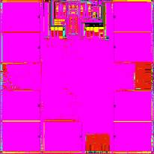
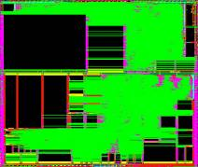

Increasing Design Complexity
5-10K Lines of Control Code
250-500K Lines of F/W
50-100K Lines of Protocol F/W
Video Display
MPEG
Processing
Core
TV Decode
μC
>100K Lines of Appl S/W
Over 2M Lines of Application S/W
20-50K Lines of Protocol F/W
250-300K Lines of DSP F/W
OFDM Modem Processor
Wireless
xDSL
Baseband Signal Processor
5-10K Lines of Microcode
Up to 2M Lines of Network S/W
Multiple Power Domains, Security, Virtualisation
Nearly five million lines of code to enable Media gateway
Notes:
Lot of cores Lots of Domains
Software – more state space needed
What breaks these –
Architectural screw ups (often integration errors) – segue to IP reuse discussion
Logical errors – deadlock state space
Electrical issue lockup in power network leaving domain unisolated undriven etc etc
Dynamic rail crap
Need to do simulations generate SAIF to drive power analyiss
IP integration issues with abstractions of power networks and behavioural models (where are these in beta in Arm)

Slide 20
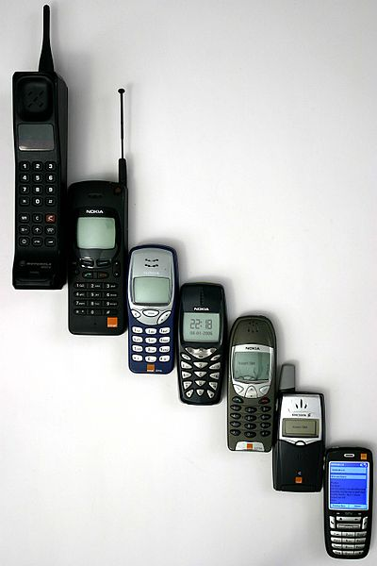
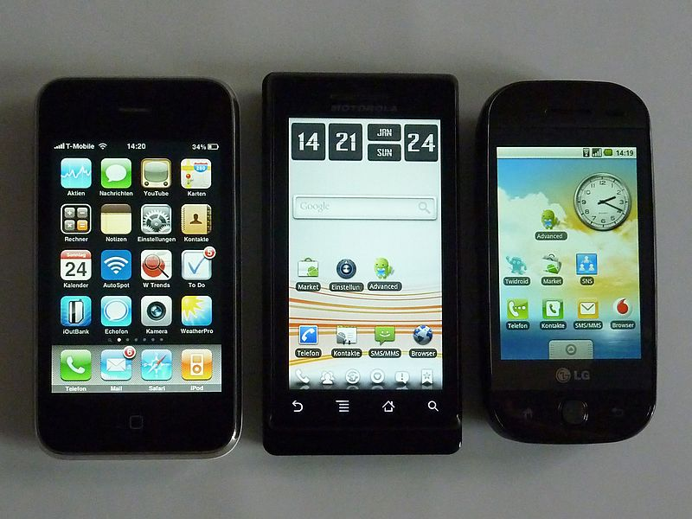
Increasing Design Complexity
From mobile phone to smart phone

Slide 21
Shorter Time-To-Market Windows
Volume
Shipment windows: today
Shipment windows: early 2000s
Design
Shipment windows: 90s
Months
6
12
18
24
95%+
Risks
Quality
Predictability
Productivity
Desired
Actual
Confidence
Time
Time
Scheduled tapeout
Final tapeout
Notes:
In fact, TTM and cost go hand in hand – you need the investment and you need to make sure you can turn that investment into opportunity by getting to market first. So productivity becomes a key component. Given a set time to market window and a set level of investment, your only variable is designer productivity. Clearly the companies that can improve productivity have an advantage over those who can’t.
click
The other key thing that impacts TTM is predictability. What can you count on? Are your schedules realistic? Will your engineering teams meet all design, manufacturability, reliability, and quality objectives while meeting budgets? Very few companies, even the larger ones, can say they have complete predictability in their design schedules.
You often end up missing scheduled tapeouts due to quality, predictability, and productivity issues. Companies need to reduce their quality risks, while increasing predictability and productivity in order to meet TTM windows.

Slide 22
Increasing Verification Productivity
Need to minimise verification time e.g. by using:
Parallelism: Add more resources
Abstraction:
Higher level of abstraction (i.e. C vs Assembly)
This often means a reduction of control!
Automation:
Tools to automate standard processes
Requires standard processes/methodology.
Usually a variety of functions, interfaces, protocols, and transformations must be verified.
Not all (verification) processes can be automated.
Productivity improvements drive early problem discovery!

Slide 23
Increasing Verification Productivity
Productivity improvements drive
early problem discovery
Total
Number
of Bugs
found
Test
Verification
Time

Slide 24
Cost of Bugs to IP companies
IP business model means ARM is not impacted by immediate re-spin costs
BUT.....
The ARM partners are shipping >6B units per year (2011)
The potential impact to business partners and is MASSIVE!
Support burden, debug and maintenance overhead
Cost of lost opportunity for client and for ARM
Potential for loss of credibility and reputation
Credibility impact translates to opportunity impact
Erosion of product integrity due to limitations of metal fixes
Critical bugs may quickly escalate to Exec level between ARM and ARM’s partners
Remember the Intel FDIV bug! http://en.wikipedia.org/wiki/Pentium_FDIV_bug
Bugs are a reality – perfect verification is a myth.
What matters is the ARM response.

Slide 25
Verification in the IC Design Process

Slide 26
The IC Design Process
Architectural
Specification
Gate-Level
Model
Design
Library
Concept
Behavioral
Model
synthesis
Micro Architectural Design
RTL
Model
Transistor-Level
Model
Mask Data
custom
design
Layout
Functional Verification
Equivalence
Checking
Analysis of Timing/Power
Performance Verification
Functional verification aims to demonstrate that the functional intent of a design is preserved in its implementation.

Slide 27
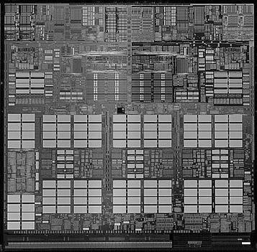
Chip Design Process
Customer
Requirements
General
Specification and
Architecture
High Level
Chip Design
High Level
Verification
HDL Implementation
(Logic Design)
at RTL Level
Functional
Verification
Fixes To HDL
Physical Circuit
Design via Synthesis
Or Custom Layout
Timing Analysis
Result: Description with all details for fabrication (tape-out).
In practice, all ”steps” start (almost) at same time - they run in
parallel!
Design sent
To Fab
Fabricated
Chip

Slide 28
Role of Verification in IC Design
IC design process is complex:
Engineers need to balance conflict of interest:
Tight time-to-market constraints vs. increasing design complexity
Aim: “Right-first-time” design, “correct-by-construction”
More and more time-consuming to obtain acceptable level of confidence in correctness of design!
design time << verification time
Remember: Verification does not create value!
But it preserves revenue and reputation!
Up to 70% of design effort can go into verification.
80% of all written code is in the verification environment.
Properly staffed design teams have dedicated verification engineers.
In some cases verification engineers outnumber designers 2:1.

Slide 29
Chip Design Process
Customer
Requirements
General
Specification and
Architecture
=
High Level
Chip Design
High Level
Verification
=
=
HDL Implementation
(Logic Design)
at RTL Level
Functional
Verification
Fixes To HDL
Physical Circuit
Design via Synthesis
Or Custom Layout
Timing Analysis
=
Result: Description with all details for fabrication (tape-out).
In practice, all ”steps” start (almost) at same time - they run in
parallel!
Design sent
To Fab
Fabricated
Chip

Slide 30
What are you going to verify?

Slide 31
How do Designers know whether a circuit is correct?
Concept
Specification
HDL Design (RTL)
Tape-out
Silicon
VERIFY: What you specified is what you envisioned
VERIFY: What you designed is what you specified
VERIFY: What you taped out is what the RTL describes
TEST: What was manufactured is what you taped out
There is skill, science and methodology behind verification.
Notes:
Important to compare this to MANUFACTURING TEST, i.e. have the transistors been manufactured properly – irrespective of their design functionality?
Testing VS Verification is being handled LATER!

Slide 32
Reconvergence Models [Bergeron]
Conceptual representation of the verification process
Most important question:
What are you verifying?
Purpose of verification is to ensure that the result of some transformation is as intended or as expected.
Transformation
Verification

Slide 33
Verification vs. Test
Often confused!
Purpose of test is to show design was manufactured properly.
Verification is done to ensure that design meets its functional intent prior to manufacture!
HW Design
Fabrication
Specification
Silicon Chip
Verification
Test
Netlist
One test method is scanning: ”Design for Test” methodology
Link all internal registers together into a chain.
Chain accessible from chip pins.
Allows control/observation of internal state.
Impacts area of design, but keeps testing cost down.
Why not ”Design for Verification”? [Hot topic of research!]
@DT, consider: What is design supposed to do? How will it be verified?

Slide 34
Formal: Equivalence Checking
Compares two models to check for equivalence.
Proves mathematically that both are logically equivalent.
Commonly used on lower levels of design process.
Example: RTL to Gates (Post Synthesis)
Synthesis
RTL
Gates
Equivalence Check
Why do equivalence checking when EDA tools exist for synthesis?
See ”HDL Chip Design - A Practical Guide for Designing, Synthesising, and Simulating ASICs and FPGAs using VHDL or Verilog” book by Douglas Smith page 136 and compare MUX spec with what they claim will be synthesised!

Slide 35
Equivalence Checking
F
Inputs
Outputs
xor
G
Conceptually, is there an input vector such that the output of the XOR gate can be “1”?

Slide 36
Cost of Verification
Necessary Evil
Always takes too long and costs too much.
As number of bugs found decreases, cost and time of finding remaining ones increases.
So when is verification done? (Will investigate this later!)
Remember: Verification does not generate revenue!
Yet indispensable
To create revenue, design must be functionally correct and provide benefits to customer.
Proper functional verification demonstrates trustworthiness of the design.
Right-first-time designs demonstrate professionalism and ”increase” reputation of design team.

Slide 37
Verification is similar to statistical hypothesis testing
Hypothesis ”under test” is: The design is functionally correct.
Good Design
(no bugs in design)
Bad Design
(buggy design)
Bugs found
No Bugs found
Notes:
http://en.wikipedia.org/wiki/Sensitivity_and_specificity
Imagine a study evaluating a new test that screens people for a disease. Each person taking the test either has or does not have the disease. The test outcome can be positive (predicting that the person has the disease) or negative (predicting that the person does not have the disease). The test results for each subject may or may not match the subject's actual status. In that setting:
True positive: Sick people correctly diagnosed as sick
False positive: Healthy people incorrectly identified as sick
True negative: Healthy people correctly identified as healthy
False negative: Sick people incorrectly identified as healthy
In general, Positive = identified and negative = rejected. Therefore:
True positive = correctly identified
False positive = incorrectly identified
True negative = correctly rejected
False negative = incorrectly rejected
Terminology:
true positive (TP) eqv. with hit
true negative (TN) eqv. with correct rejection
false positive (FP) eqv. with false alarm, Type I error
false negative (FN) eqv. with miss, Type II error

Slide 38
Verification is similar to statistical hypothesis testing
Hypothesis ”under test” is: The design is functionally correct.
Good Design
(no bugs in design)
Bad Design
(buggy design)
Type I:
False Positive
Bugs found
No Bugs found
Type I mistakes (“convicting the innocent”, a “false alarm”):
Easy to identify - found error where none exists.
Notes:
http://en.wikipedia.org/wiki/Sensitivity_and_specificity
Imagine a study evaluating a new test that screens people for a disease. Each person taking the test either has or does not have the disease. The test outcome can be positive (predicting that the person has the disease) or negative (predicting that the person does not have the disease). The test results for each subject may or may not match the subject's actual status. In that setting:
True positive: Sick people correctly diagnosed as sick, or good design no bugs found. ☺☺
False positive: Healthy people incorrectly identified as sick, or good design but bugs found. ☹
True negative: Healthy people correctly identified as healthy, or bad design and bugs found. ☺
False negative: Sick people incorrectly identified as healthy, or bad design but no bugs found. ☹☹
In general, Positive = identified and negative = rejected. Therefore:
True positive = correctly identified
False positive = incorrectly identified
True negative = correctly rejected
False negative = incorrectly rejected
Terminology:
true positive (TP) eqv. with hit
true negative (TN) eqv. with correct rejection
false positive (FP) eqv. with false alarm, Type I error
false negative (FN) eqv. with miss, Type II error

Slide 39
Verification is similar to statistical hypothesis testing
Hypothesis ”under test” is: The design is functionally correct.
Good Design
(no bugs in design)
Bad Design
(buggy design)
Type I:
False Positive
Bugs found
No Bugs found
Type II:
False Negative
Type I mistakes (“convicting the innocent”, a “false alarm”):
Easy to identify - found error where none exists.
Type II mistakes (“letting the criminal walk free”, a “miss”):
Most serious - verification failed to identify an error!
Can result in a bad design being shipped unknowingly!
Notes:
http://en.wikipedia.org/wiki/Sensitivity_and_specificity
Imagine a study evaluating a new test that screens people for a disease. Each person taking the test either has or does not have the disease. The test outcome can be positive (predicting that the person has the disease) or negative (predicting that the person does not have the disease). The test results for each subject may or may not match the subject's actual status. In that setting:
True positive: Sick people correctly diagnosed as sick, or good design no bugs found. ☺☺
False positive: Healthy people incorrectly identified as sick, or good design but bugs found. ☹
True negative: Healthy people correctly identified as healthy, or bad design and bugs found. ☺
False negative: Sick people incorrectly identified as healthy, or bad design but no bugs found. ☹☹
In general, Positive = identified and negative = rejected. Therefore:
True positive = correctly identified
False positive = incorrectly identified
True negative = correctly rejected
False negative = incorrectly rejected
Terminology:
true positive (TP) eqv. with hit
true negative (TN) eqv. with correct rejection
false positive (FP) eqv. with false alarm, Type I error
false negative (FN) eqv. with miss, Type II error

Slide 40
Summary
What is Design Verification?
Why do we care?
Verification vs validation
Bugs
Sources of bugs
Cost of bugs
Importance of Design Verification
Impact of increasing design complexity
ITRS
Shrinking time to market windows
Increasing Productivity
The chip design process
Where does Verification “fit”?
Reconvergence Models
Help us identify what is being verified

Slide 41
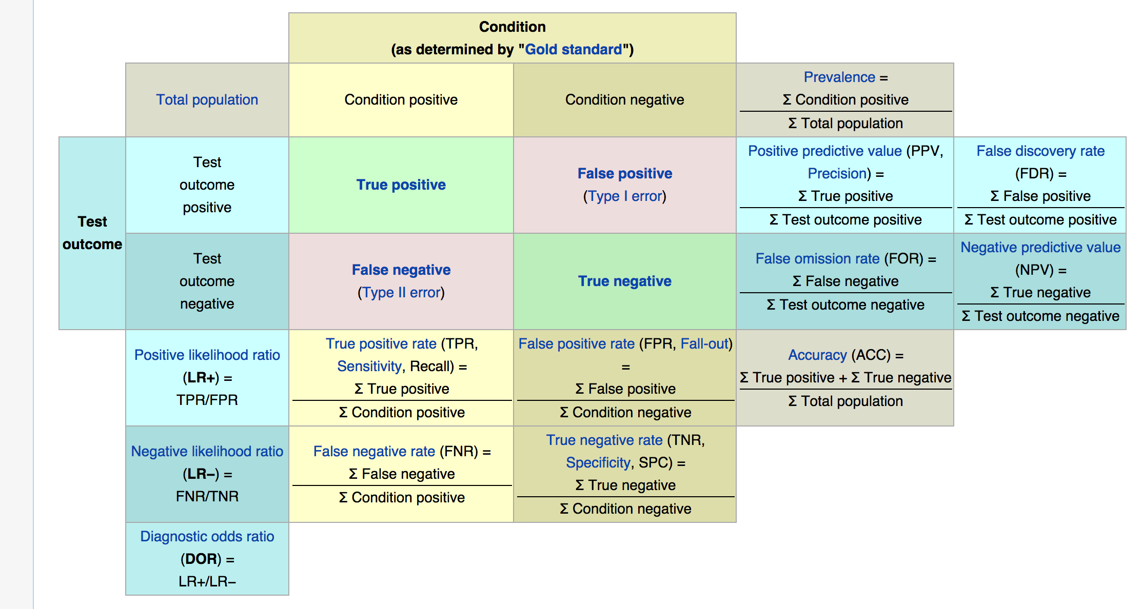
https://en.wikipedia.org/wiki/Sensitivity_and_specificity

