Slide 1
SoC Verification
Mike Benjamin
Associate at TVS
Notes:
Title should ideally be changed to “High Level Testing” – done [KIE]

Slide 2
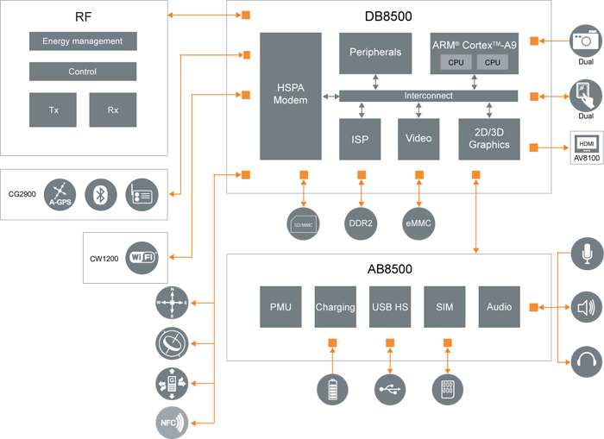
What is SoC level?
Top level Looking at the complete design
System Level Putting the complete design in a wider context …
System architecture
Partner IP
Software
Notes:
Which of these are ‘high level’ and why?

Slide 3
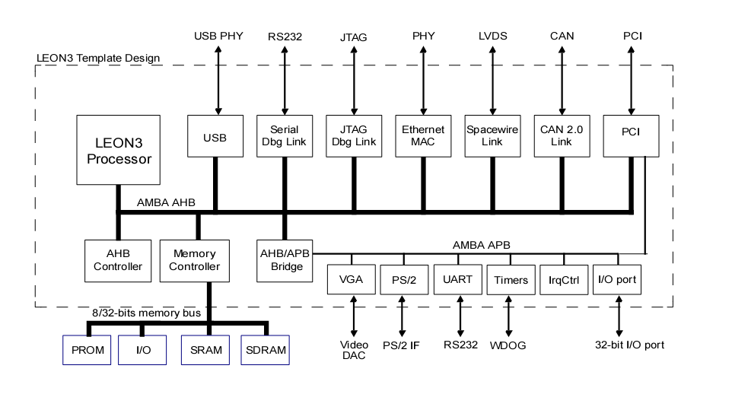
What does a simple SoC look like?
Debug
support
‘Infrastructure’:
IEEE-754 FPU
3-Port Register File
Co-Processor
7-stages
Integer pipeline
Trace Buffer
Clocks
Reset
Interrupts
HW Mul/Div
Debug Support
Debug Support Unit
Interrupt Port
Interrupt Controller
Local I-RAM
I-Cache
D-Cache
Local D-RAM
AHB Master I/F
AMB AHB Master (32 bit)
CPU
Interconnects
IP
Memory → memory map
Peripherals → register map
Notes:
Top level is simply a real SoC

Slide 4
Why write SoC level tests?
Some top level functionality not visible at unit level
Allows verification to focus on actual use model
Missing system level functionality & compliance testing
Imported IP
Register / address mapping
Signal connectivity
Performance verification
Power management
Power on / reset
Coherence?
Clocking strategy
Benchmarking
Testing restricted to real use model
Configurability / parameterized blocks instantiated!
Generate typical/worst case waveforms for power analysis!
Partner IP
Software
System architecture
Notes:
We’ve already done unit level, isn’t that enough?
Some top level functionality not visible at unit level may also mean more easily visible at top level
Clocking strategy: dynamically changing clock ratios, gated clocks …
Remind people of the difference between verification and validation

Slide 5
Why bother doing unit level testing?
Controllability at top level v unit level?
→ REDUCED
Visibility at top level v unit level?
→ REDUCED
Overhead on testing at top level v unit level?
→ INCREASED
Harder to hit corner case and longer run times
Harder to debug fails
Need working top level integration before testing
Need to propagate block level fixes/changes to top level before they can be tested
Need to understand the complete SoC to test and debug a single block
Notes:
Controllability and visibility reduced at top level
Project timescales increased

Slide 6

Barriers to top level testing
Barriers to top level verification?
Solutions?
B1:
Complexity of building the complete top level design
B2:
Late availability of key blocks / functionality
B3:
Difficulty of anyone understanding the complete design
B4:
Size of full top level design
B5:
Limited controllability of the design from outside
B6:
Limited visibility inside design
S1:
Require changes to be co-ordinated between dependent blocks
Regression testing before changes are committed
S2:
A schedule defining milestones for delivering features
S3:
S4:
Ensure major interfaces are stable and well defined
Black box some components
S5:
Replace components with abstract models or BFMs (eg: CPU, memories)
S6:
Notes:
Small changes / errors in one block can break the complete design
Renaming / changes to hierarchy can break verification tools
Aim to have an always working top level (talk about time boxing incremental delivieries)
Verification objectives of stability and well specified interfaces conflicts with design focus on PPA and timing optimization
Architectural tests are not implementation specific

Slide 7
Reuse from unit level?
VIP
BFMs
Monitors and scoreboards
Protocol checkers
Assertions
Functional coverage points
Tests
Integration tests
Connectivity, address mapping
Stress tests
Cross cutting concerns such as interrupts or power management
Shared resources or ‘convergence points’ (eg: memory synchronisation)
Right level of abstraction
Transactions and/or bus accesses
Relative address map
Need to plan for reuse!

Slide 8
What do our top level tests contain?
Tests are typically C programs running on an SoC CPU
Loaded into SoC memory
main(){
report_start();
leon3_test(1, 0x80000200, 0);
irqtest(0x80000200);
gptimer_test(0x80000300, 8);
gpio_test(0x80000700);
report_end();}
int gpio_test(int addr)
{
pio = (int *) addr;
int mask;
int width;
report_device(0x0101a000);
pio[3] = 0; pio[2] = 0; pio[1] = 0;
pio[2] = 0xFFFFFFFF;
/* determine port width and mask */
mask = 0; width = 0;
while( ((pio[2] >> width) & 1) && (width <= 32)) {
mask = mask | (1 << width);
width++;}
pio[2] = mask;
if( (pio[0] & mask) != 0) fail(1);
pio[1] = 0x89ABCDEF;
if( (pio[0] & mask) != (0x89ABCDEF & mask)) fail(2);
pio[2] = 0;
return width;}
Component tests
Register / address map
Result checking
Trace and error reporting
Halt mechanism
Interrupt handling

Slide 9
How to check the test results
Fail causes test to hang
Dump results to memory and compare to reference results from model
mpeg decoder video stream
reference simulator
Explicit checks in the test
Observe and count interrupts
Check data values
Trace comparison
Compare simulation state to a reference model cycle by cycle during the simulation
Use of monitors, scoreboards or assertions
Need error propagated to end of test
Sensitive to accuracy of reference model (especially timing)

Slide 10
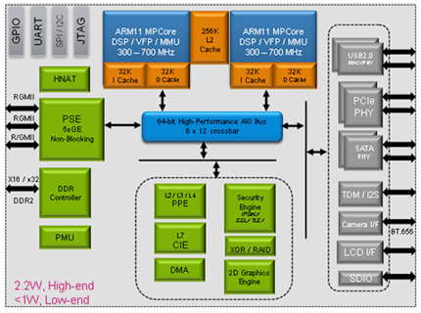
Methodology for top level testing
Pipe cleaning flow with regression tests → to verify basic functionality is not broken
Incremental test set verifying the subsets of functionality → scope grows with successive builds
Architectural and conformance tests
Micro-architectual tests
Soak testing
Performance testing and benchmarking
Notes:
Architectural tests are not implementation specific

Slide 11
Adding Coverage
Tests
Why add coverage?
Conformance testing:
Need complete coverage of cases
Targeting specific scenarios:
Hitting required corner cases
Soak testing
Ensure testing is not becoming repetitive
Coverage Model
Execution
Trace
Parse & Decode
Instruction Set Simulator (ISS)
Coverage Base Classes
(ISA view of resources)
Coverage Grids
Coverage
Database
Notes:
Why have coverage
Complete coverage of cases for conformance testing
Scenario targeting correct space when doing constrained random
Continuing to generate interesting tests rather than becoming repetitive when doing soak testing

Slide 12
How to further increase the ‘stress’
Build multiple configurations (set at build time)
Increase stress by maximising corner cases eg: small memories or FIFOs
Increase stress my maximising ‘synchronisation points’ eg: shared resources or coherent memories
Chicken bits (set at start of test)
Turn features on or off (can be verification specific or used to minimise design risk by disabling potentially risky optimisations)
Hot load (set at start of test)
Can force states of part of the design into conditions that maximise chance of hitting corner conditions early (most often hot load caches but can also leave holes or create dirty entries)
Use of irritators (set during test)
Hardware/DMA data transfers/traffic generators and BFMs (bursts of traffic and corner cases for transaction timing)
Notes:
Transaction timing should include very fast and very slow transactions

Slide 13
The New Verification Challenges of Low Power Design
Energy efficiency
Power dissipation
Why does low power matter?
Battery life eg: mobile devices
Operating temperature and cooling requirements eg: automotive, data centres
How to achieve low power?
Dynamic power = switching flops
Static power = leakage current
Minimize Switching by Design
Clock gating: Inferred (by synthesis) and architectural
Turn off units (eg: run fast then stop)
Multiple power domains and power modes managed by a ‘Power Management Unit’ (PMU)
System level (eg: ARM big.LITTLE architecture)
Some of the new Verification challenges
Ensure correct state retention and restoration when switching a power domain.
Clamping inactive signals at the boundary of a power domain
Ensure the design doesn’t try to use a unit that is (being) switched off!
Can the design get stuck in a power mode?
eg: interacting state machines restored to states that cause deadlock or livelock
Errors in the sequences of save and restore operations performed by the PMU
Interaction of the power modes with chip level power on, off and reset!
Minimise switching
Turn off!

Slide 14
Power Aware Simulation
Need to tell your RTL simulations about low power intent
A common description shared between simulation, synthesis and layout
Two competing standards: UPF and CPF
Both extend the functional description without changing the existing RTL
What they describe…
Power domains, supply rails and switches eg:
create_power_domain pdA –include_scope moduleA
Create_supply_net RETENTION –domain pdA
State retention and isolation
System power states
… the number of state combintions can be large!
For an RTL simulation ‘OFF’ means
All ‘OFF’ registers are corrupted
Any signals driven by logic that is ‘OFF’ are corrupted
No evaluation of logic that is ‘OFF’
Can also describe other features…
Multi-voltage designs and level shifters
Voltage and frequency scaling
Retention registers have separate supplies
Isolation cells have separate supplies

Slide 15
Cost of bugs over time (revisited)
Number of
bugs found
How do you decided when you are done?
Cost of
bugs
How do you find the remaining bugs?
Time
Initial Design Chip System Customer
Notes:
You’ve run out of steam?

Slide 16
Being pro-active to improve verification
Verification Requirements Specification
Achieving the best possible test plan
Methodical analysis of design specifications and extraction of features
Brainstorming and reviewing within the development team
Refinement and maintenance throughout the development process
Tracking and sign-off of verification deliverables against the test plan
Make the design ‘verification friendly’ (design for verification) (High quality products are a combination of robust and extensive verification with good design practices)
Ensure good visibility of architectural and micro-architectural corner cases
Avoid unnecessary functional complexity eg: excessive configurability, irregular structures
Understand the verification impact of design changes (eg: code churn during optimization)
Designers document their intent and assumptions, especially at interface between units
Ensure the architecture, specifications and design are as stable as possible
Communicate! (Verification is not just the responsibility of verification Engineers)
Engage closely with the designers
Be an active participant in reviews
Take every opportunity to get the widest possible input into verification planning

Slide 17
Is block and top level verification sufficient?
Is block level and top level verification sufficient?
Verification of IP in System context
Verifying correct operation with related IP
Verification of complete systems (both HW and SW)
Software conformance testing
Soak testing
Soak testing at system level?
Focus at system level is shared resources
eg: coherent memory system
Running irritator software in parallel on multiple threads or multiple CPUs (minimal OS)
Switching CPUs (eg: swapping big/LITTLE)
Virtualisation

Slide 18
What goes wrong at system level?
Integration bugs
Connecting a big-endian subsystem to a little-endian sub-system
Clocks and power
System hangs following mode change
Concurrency and shared resources
Concurrent memory gets corrupted
Performance
Bus bandwidth and latency is much worse than predicted

Slide 19
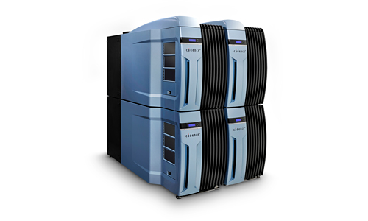
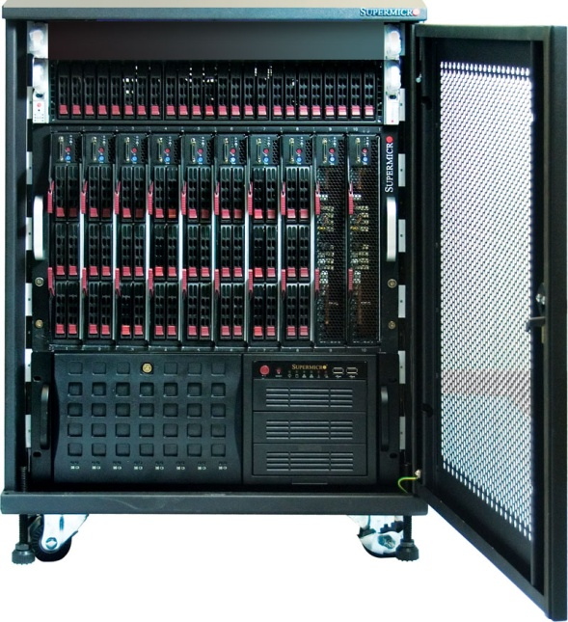
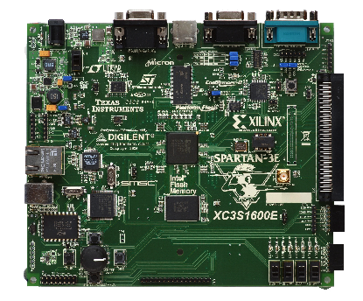
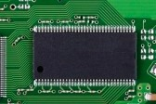
How to go faster! Compute Farm, Emulators, FPGA and test chips

Slide 20
The ‘tradeoffs’ for different platforms
Favours lots of short tests!
… but also need to load tests and dump test results!
 | Compute farm | Emulator | FPGA | Test chip
Speed | 10Hz - 100Hz …per machine | 1MHz | 2MHz – 50MHz | GHz
Observability | Total | Trace window + host debug | Probes + host debug | Host debug
Behavioural testbench? | Yes | Co-emulation (speed penalty) | Co-emulation (speed penalty) | No
Test in ‘real world’ systems | No | Host debug + ICE with speed bridges | Mostly | Yes
Are fails easily reproducible in simulation? | Yes | Yes | No | No
Bring-up time | Minutes | Weeks → hours | Weeks → Days | Months
Partitioning!
Complex timing dependencies
Depends on process maturity
Notes:
Partitioning usually means multiplexing signals between FPGAs hence speed reduction
Even if you have a compute farm it doesn’t speed up debugging a long test fail!
Importance of early pipe cleaning to develop process maturity

Slide 21
Summary
What is SoC level verification? (Top v System)
Looked at structure of a simple SoC
Why do both ‘SoC level’ & ’unit level’ verification?
A methodology for SoC level verification
System level verification
If time permits ….
RIS (Random Instruction Stream) Test Generators
Looked at IP-XACT

Slide 22
Top Level Test Generation
Bias tests to hit interesting corner cases
Scenario interleaving
Target shared resources/’points of convergence’
Non-repetitive useful tests
There should be an efficient workflow
Generation performance
Target diverse platforms
Ease of use
Maintainability
Reuse (of testing knowledge)
Effective result checking:
Propagation of results
Trace comparison
Test
generator
Test
Scenario
Compiler flow
Coverage
Expected
results
Testbench
SoC
CPU
Mem.
Observe results
FABRIC
FABRIC
A
B
C
BFM
BFM

Slide 23
‘Point solutions’ for test generation Memory Coherence
Time sharing a resource (memory)
Coherency
Memory protection
Most interesting cases are overlapping accesses
Colliding access can be: Write||Write, Write||Read, Read|| Read eg: PowerPC: ‘store quadword’ || ‘load quadword’
True sharing: same memory
False sharing: close enough to interfere (eg: same cache line)
MP memory model can have weak ordering (with barriers) (W(a,d1) || W(a,d2)) → M(a) = {d1, d2}
thread 2
CPU B
CPU A thread 1
fabric
Exclusive CPU B
Shared
Unchecked
Exclusive CPU A, thread 1

Slide 24
A general purpose test generator for CPUs
Memory access instruction type
Test generator
Architectural description
Modelling Engineer
Architecture specific knowledge
Load word
Test template
Constraint solver
Reference
Simulator
Source
Target
register
Architecture
independent
knowledge
Base register
Offset
Verification Engineer
Test program
Constraints (relations between attributes)
eg: source.address = base.data+displacement.data
PageCross(source.address)
hard or soft?
Typically several weakly coupled constraints
Randomize all other parameters and events eg: cache event in parallel with load
Huge domains (eg: 2^64 address and data)
Randomly sample solution space
As resources are ‘used up’ it can become harder to solve constraints. Solutions are:
Register reloading
Backtrack and retry
Generating loops is a challenge:
Procedure calls
Recurring interrupts
Self modifying code
→ Prevent random re-entrant code
Notes:
How does test generator know how to construct a valid test?
A: A test is a sequence of instructions

Slide 25
Model Based Test Generation for SoCs?
Ports with properties (eg: address, access size)
Internal state defined by resources (eg: registers, memory, …)
Behaviour defined by constraints between port properties and internal state
XGEN
Test request
Component types
Configuration
Generation Engine
Instantiates components, defines connections, sets static component characteristics eg: address map
Abstract test
Interactions
Refinement
Sequence of transactions possibly involving several components
Testing knowledge
Provides ‘system level’ abstraction
Aids modelling testing knowledge
Test case language
Clear separation between system modelling and test description
eg: different SMP clusters will have same interactions and components and only the configuration will change
Expects a separate checking mechanism
eg: a collision mechanism that biases test cases towards reuse of certain system resources
Test case
Notes:
A framework providing right level of abstractions whilst hiding complex implementation detail
In principle could build such a framework in SystemVerilog…

Slide 26
IP-XACT
IP-XACT is:
A standard XML scheme for describing components and connections.
It describes things like interfaces (<spirit:busInterfaces>) and registers (<spirit:memoryMaps>) rather than function!
Tools can then generate and manipulate the metadata:
Packagers: Generate ‘sound’ meta data for components
Generators: Configure components where IP blocks and the design may both have generic parameters
Assemblers & SoC design tools: Create an IP-XACT description of the design that can be used to automatically stitch together the components
Why is it useful to have a standard for documenting IP?
Provides a common specification that can be shared between: SoC design, verification, software and documentation teams
Vendor neutral: exchange libraries and combine components from multiple sources
Allows automation of SoC and test bench assembly … a manual process is very error prone as number of components increases!

Slide 27
IP-XACT example: IP register description
spirit:value
spirit:bitWidth
spirit:reset
spirit:mask
spirit:bitOffset
spirit:address offset
Address
Ox03
Reset value Ox01
Name
STATUS FLAGS
spirit:size
Width
31
Field offset
1
0
spirit:access
Access
Read/Write or Read Only?
reserved
Field
‘full’
Field
‘empty’
spirit:field
enumeratedValues
Value | Name
0 | NOT_FULL
1 | FULL
Notes:
Register Description
Register Fields

Slide 28
IP-XACT example: Code
<spirit:register>
<spirit:name> STATUS_FLAGS</spirit:name>
<spirit:description> Register contains flags to report if FIFO empty or full </spirit:description>
<spirit:dim>1</spirit:dim>
<spirit:size>32</spirit:size>
<spirit:access>read-write</spirit:access>
<spirit:reset>
<spirit:value>1</spirit:value>
<spirit:mask>3</spirit:mask>
</spirit:reset>
<spirit:field>
<spirit:name>EMPTY</spirit:name>
<spirit:description>FIFO empty flag</spirit:description>
<spirit:bitOffset>0</spirit:bitOffset>
<spirit:bitWidth>1</spirit:bitwidth>
<spirit:access>read-only</spirit:access>
</spirit:field>
<spirit:field>
<spirit:name>FULL</spirit:name>
<spirit:description>FIFO full flag</spirit:description>
<spirit:bitOffset>1</spirit:bitOffset>
<spirit:bitWidth>1</spirit:bitwidth>
<spirit:access>read-only</spirit:access>
</spirit:field>
</spirit:register>

