Slide 1


COMS31700 Design Verification: Verification Tools Directed Testing with Manual Checking
Kerstin Eder
Design Automation and Verification
(Acknowledgement: Avi Ziv from the IBM Research Labs in Haifa has kindly permitted the re-use of some of his slides.)
Department of
COMPUTER SCIENCE
Notes:
Use the spare time at the end to introduce A1.
Explain spec and how to raise questions.
Explain that the TB needs to be modular.
Explain that a plan is required.
Detail the submission: bugreport.txt and structure.pdf
Point out that the TB needs to be generic enough to find bugs in a 2nd version of the design, i.e. if I was to replace the DUV with the one from last year, would your TB still find bugs?

Slide 2
Functional Verification Approaches
Verification
Static
Dynamic
Reviews
Code
Analysis
Formal
Simulation
Prototyping
Dynamic Formal
Silicon
Linters
FPGA
Equivalence
Checking
Property
Checking
Theorem
Proving
Emulation
Notes:
Point out that Equivalence Checking is the most common form of Formal Verification now routinely used in practice.
Point out that it should not be confused with Property Checking.
Point out that Property Checking is also called Model Checking.

Slide 3
Achieving Automation
Task of Verification Engineer:
Ensure product does not contain bugs - as fast and as cost-effective as possible.
(... and of Verification Team Leader):
Select/Provide appropriate tools.
Select a verification team.
Decide when cost of finding next bug violates law of diminishing returns.
Parallelism, Abstraction and Automation can reduce the duration of verification. (Automation is currently the least applicable!)
Automation reduces human factor, improves efficiency and reliability.
Verification TOOLS are used to achieve automation.
Tool providers: Electronic Design Automation (EDA) industry

Slide 4
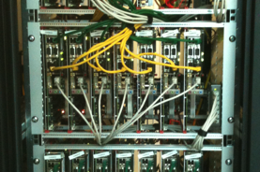
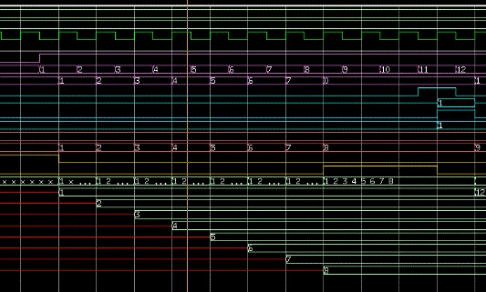
Tools used for Verification
Dynamic Verification:
Hardware Verification Languages (HVL)
Testbench automation
Test generators
Coverage collection and analysis
General purpose HDL Simulators
Event-driven simulation
Cycle-based simulation (improved performance)
Waveform viewers (for debug)
Hardware accelerators/emulators, FPGAs
Static Analysis / Verification Methods (Formal Methods):
Linting Tools
Equivalence checkers
Model checkers
Property Specification Languages (ABV)
Theorem provers
Administration:
Version Control and Issue Tracking
Metrics
Data Management and Data Mining related to Metrics
Third Party Models

Slide 5
Linting Tools
Linters are static checkers.
Assist in finding common coding mistakes
Linters exist for software and also for hardware.
gcc -Wall (When do you use this?)
Only identify certain classes of problems
Many false negatives are reported.
Use a filter program to reduce false negatives.
Careful - don’t filter true negatives though!
Does assist in enforcing coding guidelines!
Rules for coding guidelines can be added to linter.

Slide 6
Simulation-Based Verification
Directed testing with manual checking

Slide 7
Fundamentals of Simulation-based Verification
Verification can be divided into two separate tasks
Driving the design - Controllability
Checking its behavior - Observability
Basic questions a verification engineer must ask
Am I driving all possible input scenarios?
How will I know when a failure has occurred?
Driving and checking are the yin and yang of verification
We cannot find bugs without creating the failing conditions
Drivers
We cannot find bugs without detecting the incorrect behavior
Checkers
How do I know when I’m done?
Checker
Driver

Slide 8
What is a Testbench?
“Code used to create a predetermined input sequence to a design, and to then observe the response.”
Generic term used differently across the industry.
Always refers to a test case/scenario.
Traditionally, a testbench refers to code written in a Hardware Description Language (VHDL, Verilog) at the top level of the design hierarchy.
A testbench is a “completely closed” system:
No inputs or outputs.
Effectively a model of the universe as far as the design is concerned.
Bugs in DUV
Bugs in the TB
Testbench
Driver
DUV
Checker
drive stimulus into the DUV
collect the response and check
Notes:
Do we need reference models and monitors etc here? Probably not for “Directed Testing”.

Slide 9
Simulation-based Design Verification
Simulate the design (not the implementation) before fabrication.
Simulating the design relies on simplifications:
Functional correctness/accuracy can be a problem.
Verification Challenge: ”What input patterns to supply to the Design Under Verification (DUV) ...”
Simulation requires stimulus. It is dynamic, not just static!
Requires to reproduce environment in which design will be used.
Testbench (Remember: Verification vs Testing!)
Verification Challenge: ”... and knowing what is expected at the output for a properly working design.”
Simulation outputs are checked externally against design intent (specification)
Errors cannot be proven not to exist!
“Testing shows the presence, not the absence of bugs.”
[Edsger W. Dijkstra]
Two types of simulators: event-based and cycle-based

Slide 10
General HDL Simulators
Most Popular Simulators in Industry
Mentor Graphics ModelSim/Questa
Cadence NCSim
Synopsys VCS
Support for full language coverage
"EVENT DRIVEN" algorithms
VHDL's execution model is defined in detail in the IEEE LRM (Language Reference Manual)
Verilog's execution model is defined by Cadence's Verilog-XL simulator ("reference implementation")

Slide 11
Simulation based on Compiled Code
To simulate with ModelSim:
Compile HDL source code into a library.
Compiled design can be simulated.
Compile
Simulate
Write HDL code
Compile HDL code
Simulate the design
Correct syntax errors
HDL library
HDL files
Debug the design

Slide 12
Event Flow Example
Block B
Block C
i1
s1
s2
s4
C2
s3
B1
s5
i2
1
s7
3
s9
C1
s6
s8
s10
B2
4
C3
2
s11
i3
D
s12
i4
s13
5
Inputs
Outputs

Slide 13
Event-based Simulators
Event-based simulators are driven based on events. ☺
Outputs are a function of inputs:
The outputs change only when the inputs do.
The event is the input changing.
An event causes the simulator to re-evaluate and calculate new output.
Outputs (of one block) may be used as inputs (of another) ...
Re-evaluation happens until no more changes propagate through the design.
Zero delay cycles are called delta cycles!

Slide 14
Delta Cycles
Event propagation may cause new values being assigned after zero delays.
(Remember, this is only a model of the physical circuit.)
Although simulation time does not advance, the simulation makes progress.
It is possible to write models that unintentionally get stuck in
delta cycles!
event
Delta Time
Simulation Time
NOTE: Simulation progress is first along the zero/delta-time axis and then along the simulation time axis.

Slide 15
Event Driven Principles
The event simulator maintains many lists:
A list of all atomic executable blocks
Fanout lists: A data structure that represents the interconnect of the blocks via signals
A time queue – points in time when events happen
Event queues – one queue pair for each entry in the time queue
Signal update queue
Computation queue
The simulator needs to process all these queues at simulation time.

Slide 16
Core Algorithm of an Event-Driven Simulation Engine
1
Block Code
Block Function Execution
Schedule Signal Updates
Activate next
call
scheduled block
return
More Blocks
Scheduled?
yes
no
2
Perform Signal Updates
Scheduling Data
Block/Signal Interconnect Topology
Event Data
More Blocks
Scheduled?
yes
no
3
Increment
Model Time?
Done

Slide 17
Simulation Speed
What is holding us back?
Speedup strategies

Slide 18
Improving Simulation Speed
The most obvious bottle-neck for functional verification is simulation throughput
There are several ways to improve throughput
Parallelization
Compiler optimization techniques
Changing the level of abstraction
Methodology-based subsets of HDL
Cycle-based simulation
Special simulation machines

Slide 19
Parallelization
Efficient parallel simulation algorithms are hard to develop
Much parallel event-driven simulation research
Has not yielded a breakthrough
Hard to compete against "trivial parallelization"
Simple solution – run independent testcases on separate machines
Workstation "SimFarms"
100s - 1000s of engineer's workstations run simulation in the background

Slide 20
Compiler Optimization Techniques
Treat sequential code constructs like general programming language
All optimizations for language compilers apply:
Data/control-flow analysis
Global optimizations
Local optimizations (loop unrolling, constant propagation)
Register allocation
Pipeline optimizations
etc.
Global optimizations are limited because of model-build turn-around time requirements
Example: modern microprocessor is designed with ~1Million lines of HDL
Imagine the compile time for a C-program with ~1M lines!

Slide 21
Changing the Level of Abstraction
Common theme:
Cut down the number of scheduled events
Create larger sections of un-interrupted sequential code
Use less fine-grained model structure
Smaller number of schedulable blocks
Use higher-level operators
Use zero-delay wherever possible
Data abstractions
Use binary over multi-value bit values
Use word-level operations over bit-level operations

Slide 22
Changing the Level of Abstraction
s(0) <= a(0) xor b(0);
c(0) <= a(0) and b(0);
s(1) <= a(1) xor b(1) xor c(0);
c(1) <= (a(1) and b(1)) or (b(1) and c(0)) or (c(0) and a(1));
sum_out(1 to 0) <= s(1 to 0);
carry_out <= c(1);
s(2 to 0) <= ('0' & a (1 to 0)) + ('0' & b(1 to 0) );
sum_out(1 to 0) <= s(1 to 0);
carry_out <= s(2);
process (a, b)
begin
s(2 to 0) <= ('0' & a (1 to 0)) + ('0' & b(1 to 0) );
sum_out(1 to 0) <= s(1 to 0);
carry_out <= s(2);
end process

Slide 23
Changing the Level of Abstraction
Scheduling the small blocks
{A1, B1, A2, B2, A3, B3, A4, B4}
Each small block is executed once
Scheduling the big blocks
{A, B, A, B, A, B, A, B}
A = A1 and A2 and A3 and A4
Each small block is executed 4 times
A
B
A1
B1
A2
B2
A3
B3
A4
B4

Slide 24
Changing the Level of Abstraction
Performance
Few large blocks:
High re-scheduling overhead
Many tiny blocks:
High scheduling overhead
Model granularity
Number of blocks

Slide 25
Changing the Level of Abstraction
Performance
Decreasing
Model Activity Rate
Few large blocks:
High re-scheduling overhead
Many tiny blocks:
High scheduling overhead
Model granularity
Number of blocks

Slide 26
Synchronous Design Methodology
The design is comprised of
State-holding (storage) elements
Combinational logic for state transition function
Primary inputs
State Transition Function
(Combinational
Logic)
Primary
outputs
State-Holding
Elements
Clock(s)

Slide 27
Cycle Based Model Build Flow
Language compile – synthesis-like process
Simpler because of missing physical constraints
Logic mapped to a non-cyclic network of Boolean functions
Hierarchy is preserved
Flatten hierarchy – crush design hierarchy to increase optimization potential
Optimization – minimize the size of the model to increase simulation performance
Levelize logic
Translate to instructions

Slide 28
Model Build – Levelization
Levelized
Combinational Logic
Logic is ordered into levels so that
order of evaluation is correct.
E.g., A and B are computed before C.
Latches
A
C
B

Slide 29
Translate to Instructions
xor
sum_out(1)
xor
s(1)
=>
1
s(0)
a
xor
3
=>
sum_out(0)
and
c(0)
and
or
1
b
2
and
or
carry_out
=>
and
c(1)
Load temp1, a(0)
Load temp2, b(0)
Xor temp1, temp2, temp3
Store temp3, s(0)
And temp1, temp2, temp3
Store temp3, c(0)
Load temp1, a(1)
Load temp2, b(1)
Xor temp1, temp2, temp3
…
1
We can convert every Boolean function into a minimal set (~4 or better) of instructions
2
3

Slide 30
Parallelism in Generated Code Cycle-Sim
Word-level operations can be easily parallelized
Is translated into
A(0 to 31) <= B(0 to 31) and C(0 to 31) and D(0 to 31)
LoadWord R1, B(0 to 31)
LoadWord R2, C(0 to 31)
AND R1, R1, R2
LoadWord R2, D(0 to 31)
AND R1, R1, R2
StoreWord R1, A(0 to 31)

Slide 31
Synchronous Design Methodology
Clock the design only as fast as the longest possible combinational delay path settles before cycle is over
Cycle time depends on the longest topological path
Hazards/Races do not disturb function
Longest topological path can be analytically calculated w/o using simulation -> stronger result w/o sim patterns
xor
xor
and
or
and
or
clock : dependent on critical path
and

Slide 32
Hardware Acceleration
Programs created for cycle simulation are very simple
Small set of instructions
Simple control – no branches, loops, functions
Operations at the same level can be executed in parallel
Hardware acceleration uses these facts for fast simulation by utilizing
Very large number of small and simple special-purpose processors
Efficient communication and scheduling

Slide 33
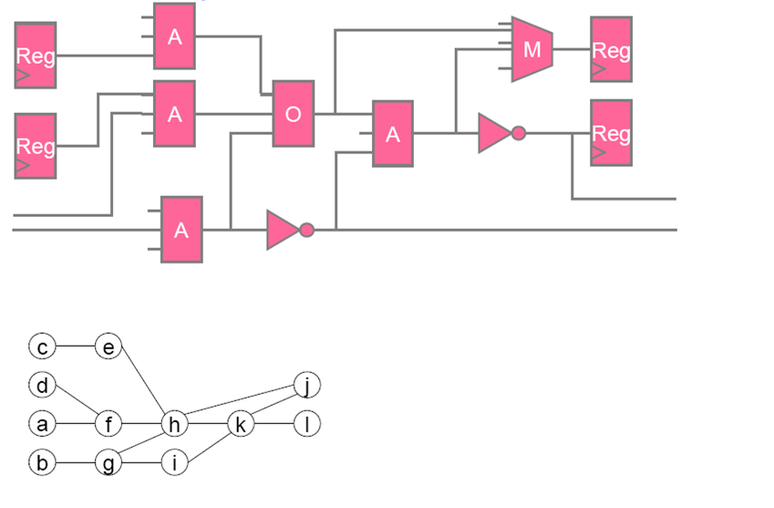
Scheduling Example
e
j
c
f
h
d
k
l
a
g
i
b
EP4 | EP3 | EP2 | EP1
c | d | a | b | Step1
e |  | f | g | Step2
 |  | h | i | Step3
 |  |  | k | Step4
 |  | l | j | Step5
12 steps serial, 5 steps parallel

Slide 34
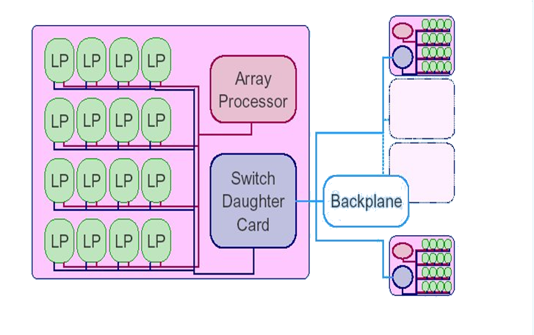
Accelerator Basic Structure
Notes:
Logic Processing units = LPs
These are special purpose processing units, so they are faster than CPUs. ☺

Slide 35
Principle of Operation
Compiler transforms combinational logic into Boolean operations
Compiler schedules interprocessor communications using a fast broadcast technique
Emulation performance dictated by
Number of processors
Number of levels in the design

Slide 36
Simulation Speed Comparison
Event Simulator
1
Cycle Simulator
20
Event driven cycle Simulator
50
Acceleration
1000
Emulation
100000

Slide 37
Verification Languages
Raising the level of abstraction

Slide 38
Verification Languages
Need to be designed to address verification principles.
Deficiencies in RTL languages (HDLs such as Verilog and VHDL):
Verilog was designed with focus on describing low-level hardware structures.
No support for data structures (records, linked lists, etc).
Not object/aspect-oriented.
Useful when several team members develop testbenches.
VHDL was designed for large design teams.
Limitations inhibit efficient implementation of verification strategy.
High-level verification languages are (currently):
System Verilog
IEEE 1800 [2005] Standard for System Verilog- Unified Hardware Design, Specification, and Verification Language
e-language used for Cadence’s Specman Elite [IEEE P1647]
(Synopsys’ Vera, System C)

Slide 39
Features of High-Level Verification Languages
Raising the level of abstraction:
From bits/vectors to high-level data types/structures
lists, structs, scoreboards including ready made functions to access these
Support for building the verification environment
Enable testbench automation
Modularity
Object/aspect oriented languages
Libraries (VIP) to enable re-use
Support for test generation
Constrained random test generation features
Control over randomization to achieve the target values
Advanced: Connection to DUV to generate stimulus depending on DUV state
Support for coverage
Language constructs to implement functional coverage models

Slide 40
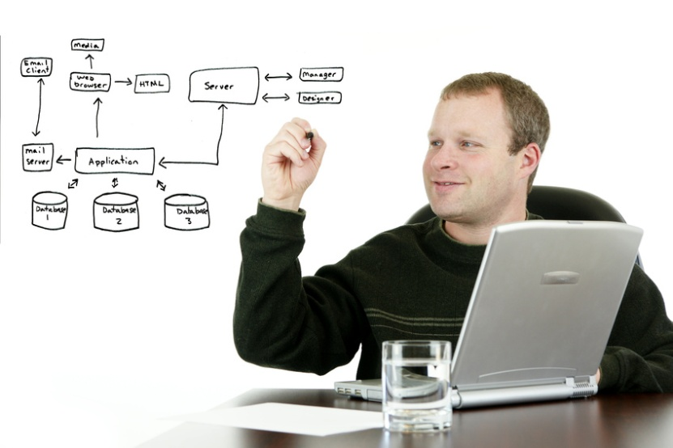
Any other *verification* Languages?
Tommy Kelly, CEO of Verilab:
“Above all else, the Ideal Verification Engineer will know how to construct software.”
Toolkit contains not only Verilog, VHDL, SystemVerilog and e, but also Python, Lisp, mySQL, Java, ... ☺

Slide 41
Directed Testing
Focus on checking

Slide 42
The Importance of Driving and Checking
Activation
Propagation
Detection
Drivers activate the bug.
The observable effects of the bug then need to propagate to a checker.
A checker needs to be in place to detect the incorrect behaviour.
All three are needed to find bugs!

Slide 43
Checking: How to predict expected results
Methods for checking:
Directed testing:
Because we know what will be driven, a checker can be developed for each test case individually.
Sources for checking:
Understanding of the inputs, outputs and the transfer function of the DUV.
Understanding of the design context.
Understanding of the internal structures and algorithms (uarch).
Understanding of the top-level design description (arch).
Understanding of the specification.
Beware:
Often, all outputs of the design must be checked at every clock cycle!
However, if the outputs are not specified clock-cycle for clock-cycle, then verification should not be done clock-cycle for clock cycle!
Response verification should not enforce, expect, nor rely on an output being produced at a specific clock cycle.

Slide 44
Limitations of Using Waveform Viewers as Checkers
Often come as part of a simulator.
Most common verification tools used...
Used to visually inspect design/testbench/verification environment.
Recording waves decreases performance of simulator. (Why?)
Don’t use viewer to determine if DUV passes/fails a test.
Why not?
Can use waveform viewer for debugging.
Consider costs and alternatives.
Benefits of automation.
Need to increase productivity.

Slide 45
Limitations of Directed Testing: Coverage
100%
Directed Approach
Constrained Pseudo-random Coverage Driven Approach
Coverage
Time
Criteria:
Effectiveness
Efficiency
Maintainability
Re-usability
Directed testing has many shortfalls wrt these criteria.
Why would one use Directed Testing?
Need to increase productivity!
Notes:
Typical bug finding curve using only directed tests? (How would it look like?)
What does Coverage mean?
Need to find bugs early
Why use Directed Testing? [to sanity check whether the TB works – before using random generation ;) or for coverage closure]

Slide 46
Impact of Increasing Verification Productivity
Productivity improvements drive
early problem discovery
Total
Number
of Bugs
found
Test
Verification
Need to find bugs early
Time

Slide 47
Verification Tools
Third Party Models
Metrics

Slide 48
Third Party Models
Chip needs to be verified in its target environment.
Board/SoC Verification
Do you develop or purchase behavioural models (specs) for board parts?
Buying them may seem expensive!
Ask yourself:
“If it was not worth designing on your own to begin with, why is writing your own model now justified?”
The model you develop is not as reliable as the one you buy.
The one you buy is used by many others - not just yourself.
Remember: In practice, it is often more expensive to develop your own model to the same degree of confidence than licensing one.

Slide 49

Metrics
Not really verification tools - but managers love metrics and measurements!
Managers often have little time to personally assess progress.
They want something measurable.
Coverage is one metric - will be introduced later.
Others metrics include:
Number of lines of code
Ratio of lines of code
(between design and verifier)
Drop of source code changes
Number of outstanding issues

Slide 50
Summary
We have covered:
Verification Tools & Languages
Basic testbench components
Writing directed tests
The importance of Driving and Checking
Checking when we use directed testing
Limitations of directed testing
Cost of debug using waveforms

