Slide 1


COMS31700 Design Verification: Block-level Case Study with demonstration of (ABV and) Formal Verification
Kerstin Eder
(Acknowledgement: I gratefully acknowledge the support from Cadence who provide the licenses for the Formal Verification Tool demonstration. Special thanks also to Anton Klotz from the Cadence Academic Network.)
Department of
COMPUTER SCIENCE

Slide 2
Case Study
Specification Verification Plan Directed Testing (Code Coverage) Functional Coverage Assertion-based Verification Formal Property Checking

Slide 3
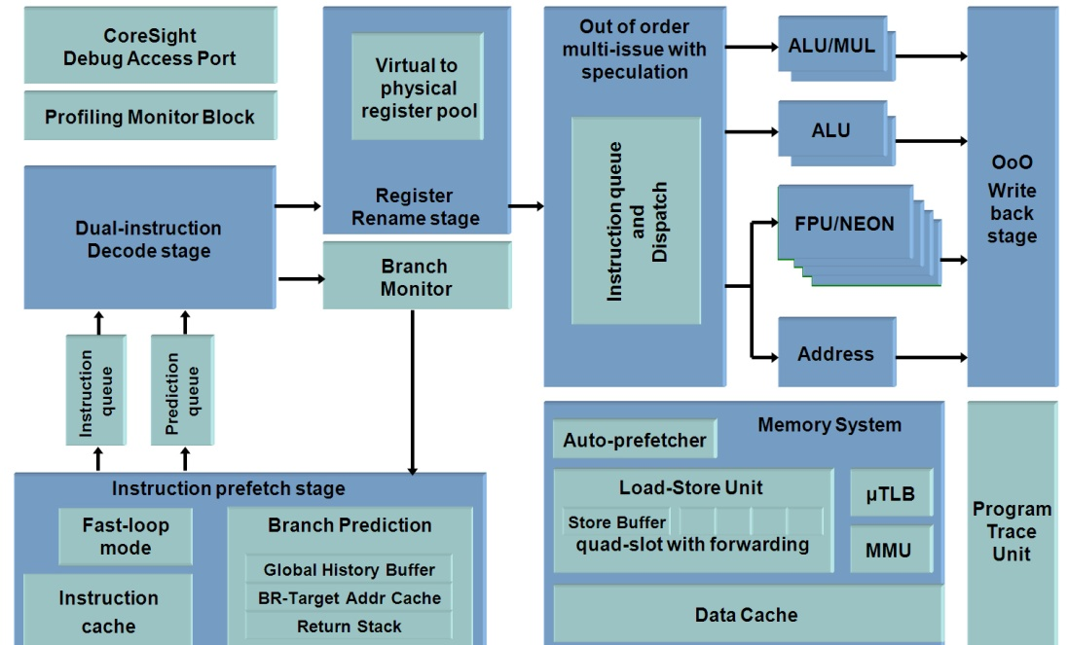
Case Study: FIFO DUV
Remember that the FIFO DUV is part of a larger unit which in turn is part of a larger system.
The demo is focused on the verification of the FIFO at block level only.
data_in [7:0]
data_out_valid
wr
data_out [7:0]
rd
empty
clear
clk
full
FIFO DUV
FIFO DUV
FIFO DUV

Slide 4
Specification

Slide 5
Example DUV Specification - Inputs
data_in [7:0]
data_out [7:0]
wr
data_out_valid
rd
DUV
clear
empty
clk
full
Inputs:
wr indicates valid data is driven on the data_in bus
data_in is the data to be pushed into the DUV
rd pops the next data item from the DUV in the next cycle
clear resets the DUV

Slide 6
Example DUV Specification - Outputs
data_in [7:0]
data_out_valid
wr
data_out [7:0]
rd
DUV
clear
empty
clk
full
Outputs:
data_out_valid indicates that valid data is driven on the data_out bus
data_out is the data item requested from the DUV
empty indicates that the DUV is empty
full indicates that the DUV is full

Slide 7
DUV Specification
High-Level functional specification of DUV
The design is a FIFO.
Reading and writing can be done in the same cycle.
Data becomes valid for reading one cycle after it is written.
No data is returned for a read when the DUV is empty.
Clearing takes one cycle.
During clearing read and write are disabled.
Inputs arriving during a clear are ignored.
The FIFO is 8 entries deep.
Notes:
This SPEC is incomplete. It lacks the statement: Data written to a full DUV will be dropped.

Slide 8
Verification Plan
Those who fail to plan, plan to fail.

Slide 9
The Verification Plan
Functions to be verified:
For each level in the design hierarchy, list all the functions that will be verified at that level.
In particular, identify corner cases for the design.
Methods of verification:
Define which verification methods to use, e.g. simulation (directed or random), formal, etc.
Completion criteria:
Define the measurements/metrics that indicate that verification is complete.
In particular, define coverage models and targets.
Resources required (people) and schedule details:
Integrate the verification plan into the overall design plan and estimate the cost of verification.
Required tools:
List the software and hardware necessary to perform verification.

Slide 10
The Verification Plan
Verification Plans are “live” documents.
They change as our understanding of the DUV increases.
Functions to be verified:
For each level in the design hierarchy, list all the functions that will be verified at that level.
In particular, identify corner cases for the design.
Methods of verification:
Define which verification methods to use, e.g. simulation (directed or random), formal, etc.
Completion criteria:
Define the measurements that indicate that verification is complete.
In particular, define coverage models and targets.
Resources required (people) and schedule details:
Integrate the verification plan into the overall design plan and estimate the cost of verification.
Required tools:
List the software and hardware necessary to perform verification.
The Verification Plan is the Specification
for the Verification Process

Slide 11
Test Scenarios Matrix - Basic
Description | Test #
Check the write functionality | 1.1
Check the read functionality | 1.2
Check the reset functionality | 1.3
Check … | 1.4
Develop a Test Scenarios Matrix for our Case Study DUV.
NOTE: “Check that X” should be read as “Create a scenario that allows checking X”.
These generic tests should be broken to more specific tests
Test case 1.1.1: Check write when empty
Test case 1.1.2: Check write when full
Test case 1.1.3: Check write during reset
…

Slide 12
White Box View DUV Implementation

Slide 13
Example DUV Implementation
Implementation based on a circular buffer
nxt_wr and nxt_rd pointers indicate where the next entry will be written to or read from.
data_counter indicates the number of valid data items in the FIFO.
Complex control logic for pointers and counter.
nxt_wr
data_counter
nxt_rd

Slide 14
Functional Coverage

Slide 15
Cross-Product Functional Coverage
[O Lachish, E Marcus, S Ur and A Ziv. Hole Analysis for Functional Coverage Data. In proceedings of the 2002 Design Automation Conference (DAC), June 10-14, 2002, New Orleans, US.]
A cross-product coverage model is composed of the following parts:
A semantic description of the model (story)
A list of the attributes mentioned in the story
A set of all the possible values for each attribute (the attribute value domains)
A list of restrictions on the legal combinations in the cross-product of attribute values

Slide 16
FIFO Cross Product Coverage Model
From a “White Box” verification perspective:
The FIFO is implemented using a circular buffer.
The circular buffer implementation is based on the following control signals:
nxt_rd, nxt_wr, data_counter
These signals are used to control the data flow and also the empty and full signals.
Verification Plan:
“Interactions of read and write transactions can create complex and unexpected conditions. All combinations need to be verified to gain confidence in the correctness of the FIFO.”
This is the story.

Slide 17
FIFO Cross Product Coverage Model
Attributes relevant to the coverage model:
nxt_rd, nxt_wr, data_counter, empty, full signals
Attribute value domains:
nxt_rd ϵ {0,1,2,3,4,5,6,7}
nxt_wr ϵ {0,1,2,3,4,5,6,7}
data_counter ϵ {0,1,2,3,4,5,6,7,8}
empty ϵ {0,1}
full ϵ {0,1}
Full coverage space:
8*8*9*2*2 = 2304 coverage tasks
Format: (nxt_rd, nxt_wr, data_counter, empty, full)
Find some legal and some illegal examples

Slide 18
FIFO Cross Product Coverage Model
Attributes relevant to the coverage model:
nxt_rd, nxt_wr, data_counter, empty, full signals
Attribute value domains:
nxt_rd ϵ {0,1,2,3,4,5,6,7}
nxt_wr ϵ {0,1,2,3,4,5,6,7}
data_counter ϵ {0,1,2,3,4,5,6,7,8}
empty ϵ {0,1}
full ϵ {0,1}
Full coverage space:
8*8*9*2*2 = 2304 coverage tasks
Format: (nxt_rd, nxt_wr, data_counter, empty, full)
Find some legal and some illegal examples

Slide 19
FIFO Cross Product Coverage Model
Attributes relevant to the coverage model:
nxt_rd, nxt_wr, data_counter, empty, full signals
Attribute value domains:
nxt_rd ϵ {0,1,2,3,4,5,6,7}
nxt_wr ϵ {0,1,2,3,4,5,6,7}
data_counter ϵ {0,1,2,3,4,5,6,7,8}
empty ϵ {0,1}
full ϵ {0,1}
Full coverage space:
8*8*9*2*2 = 2304 coverage tasks
Format: (nxt_rd, nxt_wr, data_counter, empty, full)
Find some legal and some illegal examples
Legal Coverage Tasks:
(0,0,0,1,0)
(2,2,8,0,1)
(3,7,4,0,0)
Illegal Coverage Tasks:
(0,0,0,1,1)
(1,1,4,0,0)
(1,5,0,1,1)

Slide 20
FIFO Cross Product Coverage Model
Restrictions
data_counter is only important when nxt_rd==nxt_wr so that one can tell the difference between empty and full
64 combinations of nxt_rd and nxt_wr
56 cases are for nxt_rd!=nxt_wr, so empty==0 and full==0
8 cases are for nxt_rd==nxt_wr
one set of 8 is for data_counter==0, so empty==1 (and full==0)
one set of 8 is for data_counter==8, so full==1 (and empty==0)
empty and full are not both asserted at the same time
Revised format of coverage model:
(nxt_rd, nxt_wr, empty, full)
total size of coverage space: 8*8*2*2 = 256 coverage tasks
Encode assumptions into properties
Only 56+8+8 = 72 coverage tasks are legal and meaningful.
It is worth noting the close link of the above coverage model to the properties for formal verification.
Defining meaningful functional coverage requires design understanding and engineering skill.

Slide 21
Constraint Pseudo Random Test Generation

Slide 22
Advanced TB Architecture
Constrained such that tests meet scenarios in the verification plan.
Scoreboard & Checkers
Coverage Collector
Monitor
Monitor
A smart data structure that captures what happens in the DUV during simulation. Often combined with checkers.
Stimulus Generator
DUV
Driver
Slave
Captures complete interface protocols by combining several checkers.
Constrained pseudo-random stimulus generation
Self-checking TB
Monitors, Scoreboarding
Coverage Collection and Analysis
Promote a Coverage-Driven Verification Methodology

Slide 23
Test Scenarios Matrix – Advanced
Description | Test # | Topic
Data is not modified | 2.1 | Data checking
 | 2.2
 | 2.3
 | 2.4

Slide 24
Test Scenarios Matrix – Advanced
Basic scoreboard functionality.
Description | Test # | Topic
Data is not modified | 2.1 | Data checking
Data is not lost | 2.2
Data is not duplicated | 2.3
Data order is maintained | 2.4

Slide 25
Test Scenarios Matrix – Advanced
Description | Test # | Topic
Data is not modified | 2.1 | Data checking
Data is not lost | 2.2
Data is not duplicated | 2.3
Data order is maintained | 2.4
Reading and writing at the same time | 2.3 | Corner cases
 | 2.3.1
 | 2.3.2
 | …
 | …
 | …

Slide 26
Test Scenarios Matrix – Advanced
Description | Test # | Topic
Data is not modified | 2.1 | Data checking
Data is not lost | 2.2
Data is not duplicated | 2.3
Data order is maintained | 2.4
Reading and writing at the same time | 2.3 | Corner cases
 | 2.3.1
 | 2.3.2
 | …
 | …
 | …

Slide 27
Test Scenarios Matrix – Advanced
Description | Test # | Topic
Data is not modified | 2.1 | Data checking
Data is not lost | 2.2
Data is not duplicated | 2.3
Data order is maintained | 2.4
Reading and writing at the same time | 2.3 | Corner cases
Reading and writing at the same time when empty | 2.3.1
Reading and writing at the same time when full | 2.3.2
... at the same time as clearing | …
 | …
 | …
These make interesting functional coverage scenarios.
How?
Should we rely on random generation by constraining stimulus to make these rare events happen more often?

Slide 28
Bug Hunting

Slide 29
Given the following bug...
Concurrent reading from and writing to FIFO
Should the data counter change its value?

Slide 30
Given the following bug...
Concurrent reading from and writing to FIFO
ok, the data counter should not change its value
unless reading from and writing to the same data slot
this only happens when the FIFO is
empty: When the FIFO is empty and there is a write at the same time as a read (from empty), then the read should be ignored.
full: When the FIFO is full and there is a read at the same time as a write, then the write (to full) should be ignored.
But the logic that controls the value of the data counter does not distinguish these special cases.
What do we need to do to find these bugs?

Slide 31
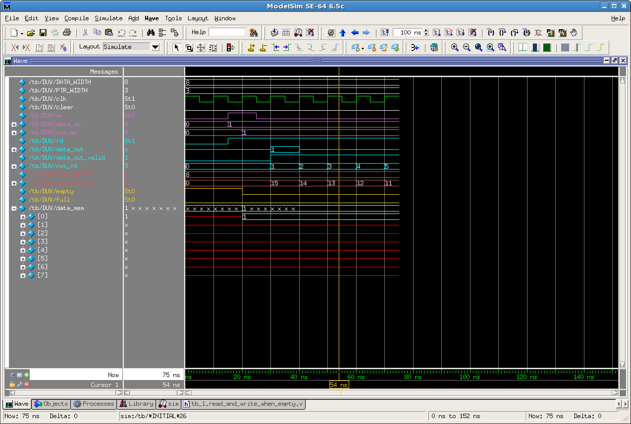
Read/Write when FIFO is empty

Slide 32
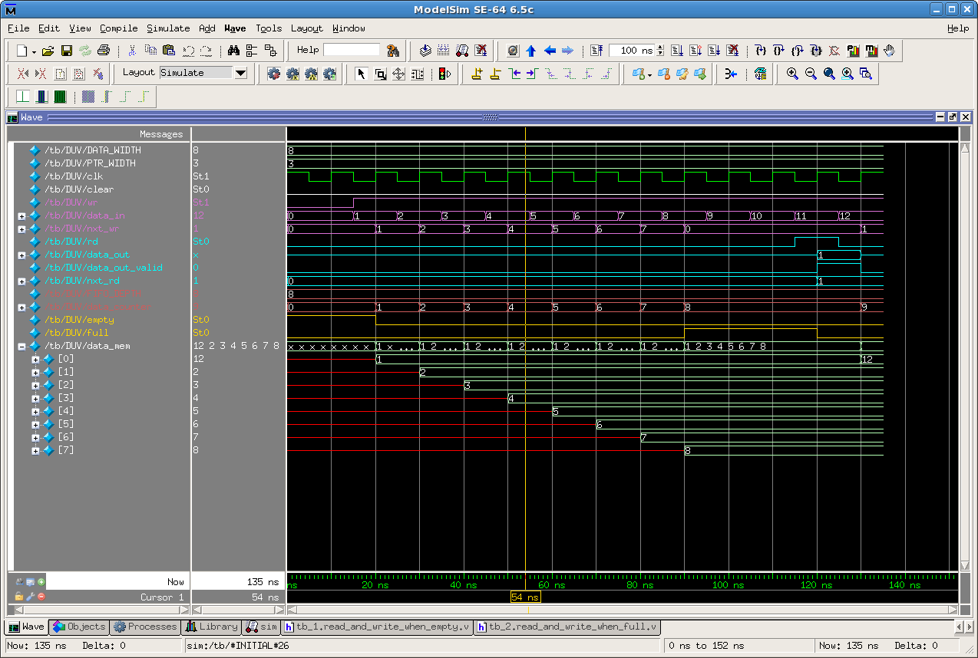
Read and Write when FIFO is full
Long test sequence to expose the bug.

Slide 33
ABV

Slide 34
Properties of the DUV
An invariant property.
Black box view:
Empty and full are never asserted together.
After clear the FIFO is empty.
After writing 8 data items the FIFO is full.
Data items are moving through the FIFO unchanged in terms of data content and in terms of data order.
No data is duplicated.
No data is lost.
data_out_valid only for valid data, i.e. no x’s in data.

Slide 35
Properties of the DUV
White box view:
The value range of the read and write pointers is between 0 and 7.
The data_counter ranges from 0 to 8.
The data in the FIFO is not changed during a clear.
For each valid read the read pointer is incremented.
For each valid write the write pointer is incremented.
Data is written only to the slot indicated by nxt_wr.
Data is read only from the slot indicated by nxt_rd.
When reading and writing the data_counter remains unchanged.
What about a RW from an empty/full FIFO?

Slide 36
Property Formalization

Slide 37
Formalization of key DUV Assertions
System Verilog Assertions (SVA) for:
Empty and full are never asserted together.
property not_empty_and_full;
@(posedge clk) !(empty && full);
endproperty
assert property (not_empty_and_full);
After clear the FIFO is empty.
property empty_after_clear;
@(posedge clk) (clear |=> empty==1);
endproperty
assert property (empty_after_clear);
On empty after one write the FIFO is no longer empty.
property not_empty_after_write_on_empty;
@ (posedge clk) (empty && wr |=> !empty);
endproperty
assert property (not_empty_after_write_on_empty);
Assertions can be monitored during simulation.
Challenge:
There are many more interesting assertions.
Assertions can also be used for formal property checking.

Slide 38
Corner case properties
FIFO empty: When the FIFO is empty and there is a write at the same time as a read (from empty), then the read should be ignored.
property empty_write_ignore_read;
@(posedge clk){empty && wr && rd |=>
data_counter == $past(data_counter)+1};
endproperty
assert property (empty_write_ignore_read);
cover property (empty_write_ignore_read);
FIFO full: When the FIFO is full and there is a read at the same time as a write, then the write (to full) should be ignored.
property full_read_ignore_write
@ (posedge clk) {full && rd && wr |=>
data_counter == $past(data_counter)-1};
endproperty
assert property (full_read_ignore_write);
cover property (full_read_ignore_write);

Slide 39
Formal Property Checking

Slide 40
Functional Verification Approaches
Verification
Static
Hybrid
Dynamic
Reviews
Code
Analysis
Formal
Simulation
Prototyping
Dynamic Formal
Silicon
Linters
FPGA
Equivalence
Checking
Property
Checking
Theorem
Proving
Emulation
Notes:
Point out that Equivalence Checking is the most common form of Formal Verification now routinely used in practice.
Point out that it should not be confused with Property Checking.
Point out that Property Checking is also called Model Checking.

Slide 41
Formal Property Checking
Properties of a design are formally proven or disproved.
Used to check for generic problems or violations of user-defined properties of the behaviour of the design.
Usually employed at higher levels of abstractions.
A reconvergence model is a conceptual representation of the verification process.
It helps us understand what is being verified.
Give a
reconvergence model
for
formal property checking!
Notes:
A reconvergence model is a conceptual representation of the verificaiton process. It helps us understand what is being verified.

Slide 42
Formal Property Checking
Properties of a design are formally proven or disproved.
Used to check for generic problems or violations of user-defined properties of the behaviour of the design.
Usually employed at higher levels of abstractions.
Properties are derived from the specification. (interpretation step)
Properties are expressed as formulae in some (temporal) logic.
under env_constraint if condition then expectation
Interpretation
RTL Coding
Specification
RTL
Property Formalization
Interpretation
Properties (Assertions)

Slide 43
Formal Property Checking
Properties of a design are formally proven or disproved.
Used to check for generic problems or violations of user-defined properties of the behaviour of the design.
Usually employed at higher levels of abstractions.
Properties are derived from the specification. (interpretation step)
Properties are expressed as formulae in some (temporal) logic.
Checking is typically performed on a Finite State Machine model of the design.
This may be the RTL.
Property checking can also be preformed on higher levels of abstraction.
Interpretation
RTL Coding
Specification
RTL
Property Formalization
Interpretation
Property Checking
Properties (Assertions)

Slide 44
Simulation vs Functional Formal Verification
Challenge 1:
Specify properties to cover the entire design.
Challenge 2:
Prove all these properties.
Only selected parts of the design can be covered during simulation.
Naïve interpretation of exhaustive formal verification:
In practice, completeness issues and capacity limits restrict formal verification to selected parts of the design.
Verify ALL properties.
[B. Wile , J.C. Goss and W. Roesner, “Comprehensive Functional Verification – The Complete Industry Cycle”, Morgan Kaufman, 2005]
Notes:
Distinction between reachable and possible states will be demonstrated using Jasper on the FIFO design.
Discuss the meaning of ALL properties: How do we know we have ALL properties?

Slide 45
The Role of Formal Property Checking
Property Checking is the most common form of high-level formal verification used in practice.
Property checking is fully automatic.
Requires the properties to be written.
It performs exhaustive verification of the design wrt the specified properties.
It provides proofs and can demonstrate the absence of bugs.
A counter example is presented for failed properties.
Used for critical well specified parts of the design
Cache coherence protocols, Bus protocols, Interrupt controllers
Formal Methods can suffer from capacity limits
There are tried and trusted techniques to overcome these:
Start with narrow focus on block level, work up towards higher levels in the design hierarchy turning asserts into assumes
Restrict property checking to work over finite small time windows.
Limit environment behaviour by strengthening constraints.
Case splits over a set of properties, partitioning and black boxing.

Slide 46
Outcomes of Formal Property Checking
Formulate Property
Invoke Property Checker
Property proven
Property fails
Vacuity check
Counter example (CE)
Unreach-able
Reach-able
Property is trivially true
Property is non-trivially true
No reach-able other CE exists
Reach-able other CE exists
DUV bug detected
Bug in
Property
DUV satisfies Property
Bug in Property
DUV bug detected

Slide 47
Outcomes of Formal Property Checking
Specify environment constraints for proof.
Formulate Property
Most common mistake, restrict input space so much that property becomes trivially true.
Invoke Property Checker
Under-constrained properties may lead to unreachable counter examples.
Property proven
Property fails
Vacuity check
Counter example (CE)
Unreach-able
Reach-able
Property is trivially true
Property is non-trivially true
Correctness of proof relies on correctness of the environment constraints.
No reach-able other CE exists
Reach-able other CE exists
DUV bug detected
Bug in
Property
DUV satisfies Property
Bug in Property
DUV bug detected

Slide 48

How do you know you’ve encoded the property right?
Keep properties and sequences simple.
Build complex properties from simple, short properties
Peer review properties you write.
If the property fails,
you can investigate the counter example:
Is it reachable or not?
But if the property succeeds, how do you know whether you’ve encoded the property right?

Slide 49
Formal Property Checking
Property checking tools can formally verify assertions.
Basic properties (visualize):
Basic functionality
Range checks
Re-use SV Assertions as properties (check):
Empty and full are never asserted together.
After clear the FIFO is empty.
On empty after one write the FIFO is no longer empty.
Understanding counter examples:
Debug an assumption
Debug a design property
Note:
Closely related to functional coverage.
Link from env_constraints to simulation assertions.

Slide 50
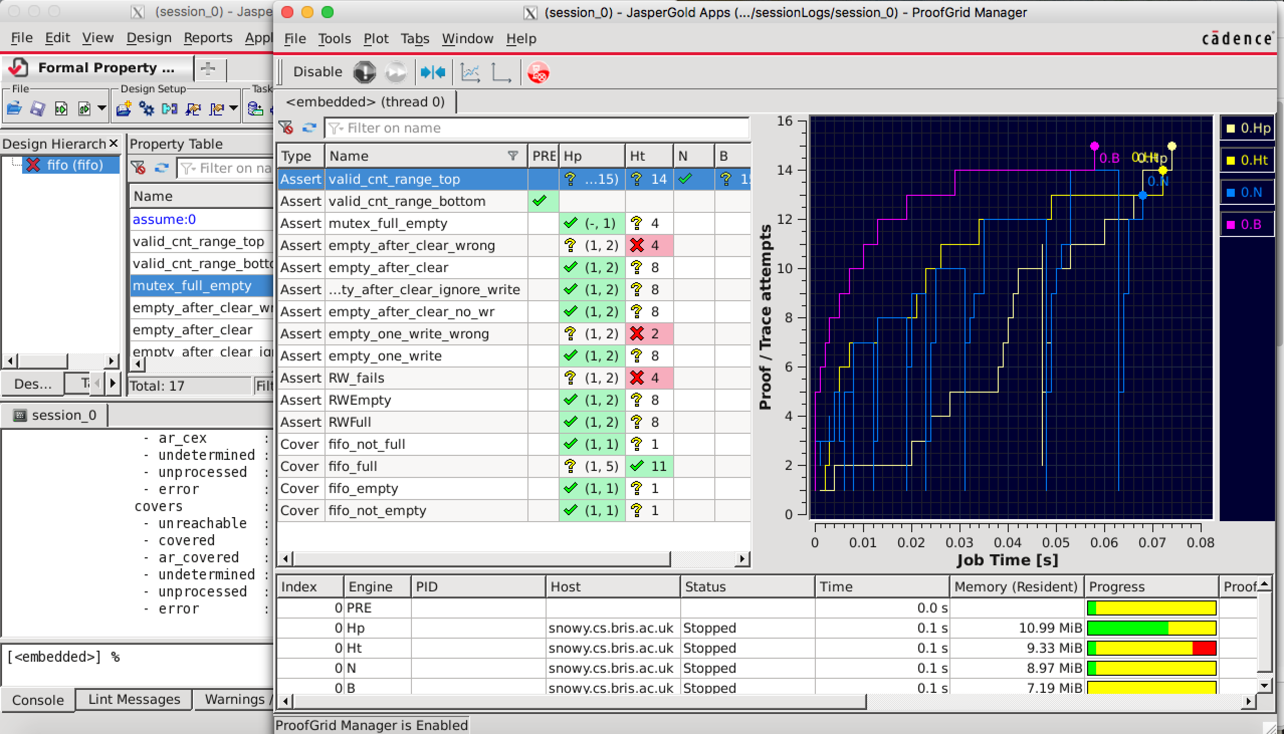
Formal Property Checking
Jasper DEMO
Formal verification of selected FIFO properties from ABV

Slide 51

How big is Exhaustive?
Consider simulating a typical CPU design
500k gates, 20k DFFs, 500 inputs
70 billion sim cycles,
running on 200 linux boxes for a week
How big: 2³⁶ cycles
Consider formally verifying this design
Input sequences: cycles 2^{(inputs+state)} = 2²⁰⁵⁰⁰
What about X’s: 2¹⁵⁰⁰⁰ (5,000 X-assignments + 10,000 non-reset DFFs)
How big: 2²⁰⁵⁰⁰ cycles (2¹⁵⁰⁰⁰ combinations of X is not significant here!)
That’s a big number!
Cycles to simulate the 500k design: 2³⁶ (70 billion)
Cycles to formally verify a 32-bit adder: 2⁶⁴ (18 billion billion)
Number of stars in universe: 2⁷⁰ (10²¹)
Number of atoms in the universe: 2²⁶⁰ (10⁷⁸)
Possible X combinations in 500k design: 2¹⁵⁰⁰⁰ (10⁴⁵¹⁵ x 3)
Cycles to formally verify the 500k design: 2²⁰⁵⁰⁰ (10⁶¹⁷¹)
Simulasaurus

Slide 52
Summary
Block-level Case Study
Specification
Verification Plan
Directed Testing
(Code Coverage)
Functional Coverage
Assertion-based Verification
Formal Property Checking
No single method is adequate to cover a whole design in practice.
Carefully select the verification methods that maximize ROI.
Complement simulation with formal: Integrated approach

