Slide 1


COMS31700 Design Verification: Verification Hierarchy and Fundamentals of Simulation-Based Verification
Kerstin Eder
(Acknowledgement: Avi Ziv from the IBM Research Labs in Haifa has kindly permitted the re-use of some of his slides.)
Department of
COMPUTER SCIENCE

Slide 2
Outline
Observability and Controllability
Verification hierarchy
Levels of verification
Fundamentals of Simulation-based Verification:
Strategy
Driving principles
Checking strategies
Checker
Driver

Slide 3
Observability and Controllability

Slide 4

Observability and Controllability
Observability: Indicates the ease at which the verification engineer can identify when the design acts appropriately versus when it demonstrates incorrect behavior.
Controllability: Indicates the ease at which the verification engineer creates the specific scenarios that are of interest.

Slide 5
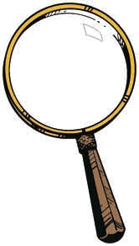
Levels of Observability
Black Box
White Box
Grey Box
Inputs
DUV
Outputs
Inputs
DUV
Outputs
Inputs
DUV
Outputs
Monitor

Slide 6
Black Box Verification
Inputs
DUV
Outputs
The black box has inputs, outputs, and performs some (well documented) function.
To verify a black box, you need to understand the function.
The verification code utilizes only the external interfaces.
The internal signals and state remain in the dark.
Pros:
No knowledge of the actual implementation is required.
Ability to predict functional results based on inputs alone ensures that the reference model remains independent from the DUV implementation.
Verification code is less sensitive to changes inside the DUV.
Cons:
Difficult to locate source of problem, only exposes effects. (If at all! Remember, not all bugs propagate to the outputs.)
Lacks controllability and observability.

Slide 7
White Box Verification
Inputs
DUV
Outputs
(Opposite of black-box approach.)
For white box verification the internal facilities of the DUV are known, visible and utilised for verification.
Pros:
Full visibility and controllability of internal signals.
Can identify and cover corner cases.
Can detect bugs as soon as they occur.
Quickly possible to set up interesting conditions, e.g. counter roll-over.
Cons:
Danger to follow the implementation/design instead of the specification.
Sensitive to changes in the DUV (implementation).
Too many details make it hard to create and maintain.

Slide 8
Grey Box Verification
Inputs
DUV
Outputs
Monitor
For grey box verification a limited number of DUV facilities are utilised in a mostly black-box environment.
Access important and stable features, the rest is kept in the dark.
Combines the pros (if done the right way) or the cons (if done the wrong way) of black and white box.
Progression from black box to grey box should be carefully planned and started only when the DUV is sufficiently stable.
In practice: Most verification environments are grey box.
May need to start with black box with planned evolution into grey box.
Note: Prediction of correct results on an interface is occasionally impossible without viewing an internal signal.
Notes:
Is it worth mentioning FPGAs and HW past simulation such as emulators here?

Slide 9
Levels for Controllability
Black Box
Grey Box
White Box
Watch out for unreachable states!
DUV
Inputs
Outputs
DUV
Inputs
DUV
Outputs
Driver
Watch out for unreachable states!
Inputs
DUV
Outputs

Slide 10
Be careful with White Box Controllability
In theory, the same levels as for observability also exist for controllability:
black, grey and white box
In practice:
We seldom control the internals of the DUV.
This may drive the design into a state that is not reachable under normal circumstances.
It may thus lead to an inconsistent DUV state.
The main exception: Warm Loading
Brings the DUV to a predefined interesting state.
E.g. cache initialization, almost full buffer
Reduces the time needed for reaching this state.

Slide 11
Verification Hierarchy

Slide 12
Verification Hierarchy
Today’s complex chips and systems are divided into logical units
Usually determined during specification / high-level design
Usually follow the architecture of the system
This practice is called hierarchical design
Hierarchical design allows a designer to subdivide a complex problem into more manageable blocks
The design team combines these blocks to form bigger units, and continues to merge/integrate these blocks until the chip or system is complete

Slide 13
Pros and Cons of Hierarchical Design
Pros
Breaks the design into manageable pieces
Allow designers to focus on single function / aspect of the design
Cons
More interfaces to specify / design / verify
Integration issues

Slide 14
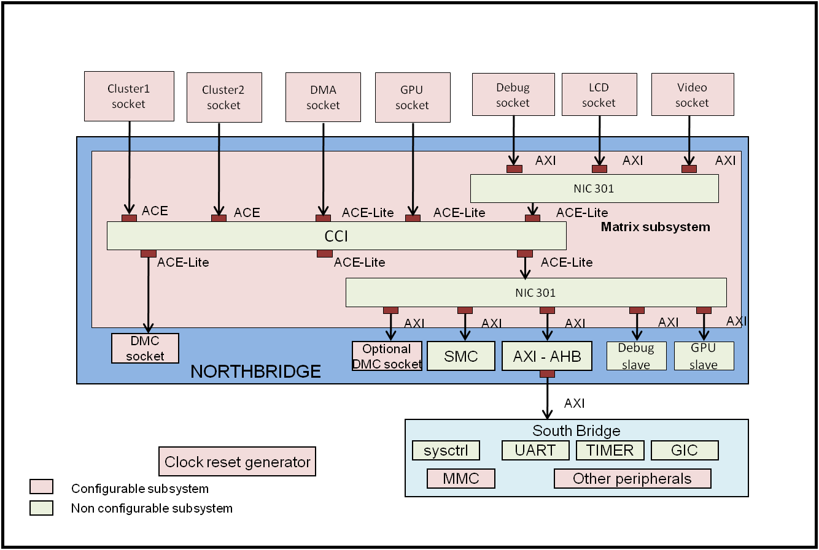
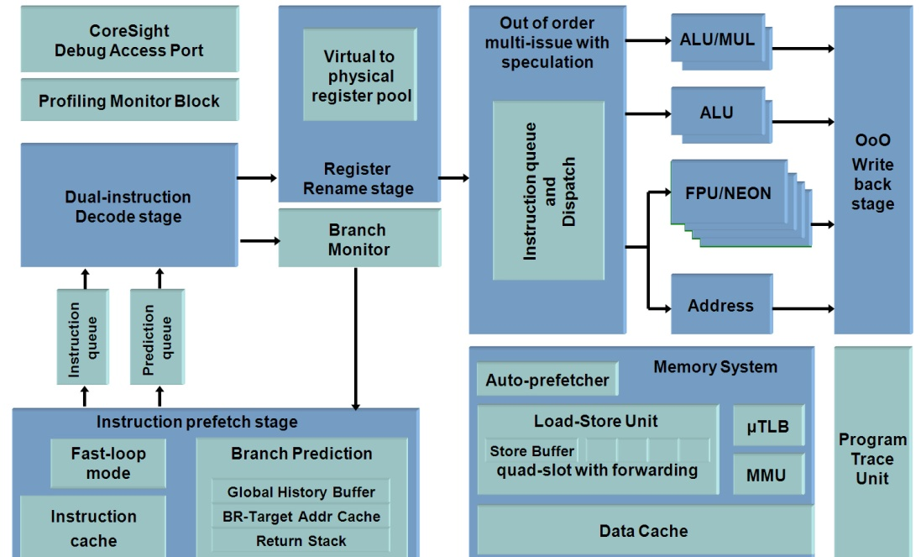
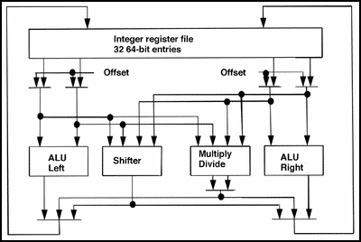
Verification at different Design Levels
system
Volume
of testing
system
top
unit
top
Bugs found
Time
total
Operating System and Application S/W
unit
unit
top
system
Time

Slide 15
Levels of Verification
Verification usually adapts to and takes advantage of the hierarchical design stages and boundaries
Common levels of verification
Designer level (block level)
Unit level
(Core level)
Chip level
System level
Hardware / software co-verification

Slide 16
Designer (Block) Level Verification
Used for verification of single blocks and macros
Usually, done by the designer him/herself
Main goal – Sanity checking and certification for a given block
Ranges from a simple test of basic functionality to complete verification environments
The common level for formal verification

Slide 17
Unit Level Verification
A set of blocks that are designed to handle a specific function or aspect of the system
E.g., memory controller, floating-point unit
Usually have formalized spec
More stable interface and function
The target of first serious verification effort
Verification is based on custom-made verification environment

Slide 18
Core Level Verification
A core is a unit or set of units designed to be used across many designs
Well defined function
Standardized interfaces
Verification need to be thorough and complete
Address all possible uses of the core
The verification team can use “Verification IP” for the standardized interfaces

Slide 19
Chip Level Verification
Verification of a set of units that are packaged together in a physical entity
Main goals of verification
Connection and integration of the various units
Function that could not be verified at unit level
Need verification closure to avoid problems in tape-out

Slide 20
System Level Verification
The purpose of this level of verification is to confirm
Interconnection
Integration
System design
Verification focuses on the interactions between the components of the system rather then the functionality of each individual component

Slide 21
HW / SW Co-Verification
Marries the system level hardware with the code that runs on it
Combines techniques from the hardware verification and software testing domains
This combination creates many issues
Different verification / testing techniques
Different modes of operation
Different speed
Beyond the scope of this course

Slide 22
Which Level To Choose?
Always choose the lowest level that completely contains the targeted function
Each verifiable piece should have its own specification
Function may dictate verification levels
The appropriate level of control and observability drives decisions on which levels to select for verification

Slide 23
Which Level To Choose?
In general, each level that is exposed to the “outside world” is mandatory
For example, chip level, system level
The rest depends on many factors
Complexity
Risk
Schedule
Resources

Slide 24
Fundamentals of Simulation-based Verification
The Strategy of
Driving & Checking

Slide 25
Strategy of Verification
Verification can be divided into two separate tasks
Driving the design - Controllability
Checking its behavior - Observability
The basic questions a verification engineer must ask
Am I driving all possible input scenarios?
How will I know when a failure has occurred?

Slide 26
The Yin-Yang of Verification
Driving and checking are the yin and yang of verification
We cannot find bugs without creating the failing conditions
Drivers
We cannot find bugs without detecting the incorrect behavior
Checkers
Checker
Driver

Slide 27
Comments on Yin and Yang
This perfect harmony does not always exist
Not all failing conditions are equal
Same bug can lead under different failing conditions to different failures (with big difference in consequences)
We cannot (or don’t want to) detect all incorrect behaviors
Some are not important enough
For others we have safety nets
The right balance is a function of the level of verification and specific needs
Example: Block vs Chip level verification – difference in drivers and checkers and in focus of verification.

Slide 28
The Black Box Example
Design Under
Verification
(DUV)
Inputs
Outputs
What does it mean to
Drive all input scenarios
Know when the design fails

Slide 29
Verification of the Black Box
Black box since we don’t look inside it
What does this mean?
The black box may have a complete documentation … or not
To verify a black box the verification engineer must
understand the function and be able to
predict the output based on the inputs.
It is important that the verification team obtain the input, output and functional description of the black box from a source other than the HDL designer
Standard specification
High-level design
Other designer that interfaces with the black box
…

Slide 30
Driving the Black Box
We can start planning the stimuli even before the complete specification of the DUV is given
The definition of the inputs can provide information and hints on
The interface
The functionality
This information can lead to first set of stimuli
More stimuli will be added as we learn more details on the DUV

Slide 31
Driving the Black Box
in_buf_data<0:7> is the data to be placed in the stack
in_buf_valid is on if data is valid
DUV
Inputs
Outputs
clean_stack will invalidate the entire stack
pop_buf<0:1> directs the logic to pop the top 0,
1, or 2 entries from the stack the next cycle
Notes:
Got to here in 1st lecture 2014.

Slide 32
What Can We Learn From This?
We can start understanding the design just from the input descriptions:
What do we know?
What don’t we know?

Slide 33
What can we set up?
Writing to the stack
Back-to-back writes
Long sequences of writes
Reading from the stack
All three possible reads (0, 1, 2 reads)
Back-to-back and long sequences
Corner cases
Reading from an empty stack (and almost empty)
(Writing to a full stack (and almost full))
Combinations and scenarios
Two or three of read, write, clean

Slide 34
Checking Strategies
In microelectronic system design there are five main sources of checkers
The inputs and outputs of the design (specification)
The architecture of the design
The microarchitecture of the design
The implementation of the design
The context of the design (up the hierarchy)
Note that the source of checkers and their implementation are two different issues
Notes:
The _source_ give us inspiration - what can be checked?
The _implementation_ needs to be attached to an existing entity, often found in the DUV implementation, or sourcing implementation signals to establish whether the check passed or failed.

Slide 35
Checking Based On the DUV I/O
DUV Function
DUV
DUV(Input) = Output
Inputs
Outputs
Check the output signals of the DUV based on
The input signals
Understanding of the specification of the DUV

Slide 36
Checking Based On the DUV I/O
The most basic type of checking
relevant for HW and SW alike
Must be present unless we are certain that this type of checking is covered by other types of checking
The checker need not (and should not) imitate the design
Checking is easier than implementing the DUV
Can use higher level of abstraction
Need to verify the outputs instead of generating them
Verification should not enforce, expect nor rely on an output being produced at a specific clock cycle (Why not?)

Slide 37
Checking Based On the Architecture
Example instruction stream:
SUB R7 R1 R2
BRZ R7 L
Architectural (ISA-level) checking is abundant.
The SUB and BRZ instructions are defined in the ISA.
Architecture defines that instructions must complete in order.
Architecture defines that results of SUB must be used by BRZ.
Many checkers have their roots in the Architecture of the design!
Notes:
https://gcsecomputing.org.uk/lmc/
Little Man Computer
Accumulator machine
SUB d x y - Subtract y from x and write result to d.
BRZ x l - If the contents of x are ZERO, set the program counter to address l.

Slide 38
Checking Based On the Microarchitecture
Superscalar Pipeline
The rules on how instructions are grouped depend upon how many pipelines are defined as well as the resources in the design.
Example instruction stream:
SUB R7 R1 R2
BRZ R7 L
Instruction
Grouping
Execution
BRZ R7
Execute
Stall
cycles
SUB R7
No-Stall
The ability or inability of on-the-fly results to feed prior stages of a pipeline will affect instruction grouping.
Put-away results
Fixed
Float
Branch
Store
Note that if the DUV is the Instruction Grouping Unit then this is a design context example as well.
General Purpose Registers R0-R15

Slide 39
Checking Based On the Architecture and Microarchitecture
Check that architectural and microarchitectural mechanisms in the DUV are operating as expected
Buffers: overflow and underflow
Invalid states and transitions in state machines
Pipelines
Reorder buffers
Writeback and forwarding logic
performance enhancing features
…

Slide 40
Checking Based On the Implementation
Check items that are related to specific implementation details
Cyclic buffers for queues
Pipeline buffer stages
…

Slide 41
Checking Based On the Design Context
HDL A
HDL B
X
Y
Y
Z
Higher level of DUV hierarchy
When verifying lower levels of hierarchy such as individual blocks of HDL, the verification engineer derives checkers from an understanding of the function, properties, and context of the larger design.

Slide 42
Output Definition of the Black Box
out_buf_data1<0:8>, out_buf_data2<0:8> are the requested data lines.
Bit 8 of both signals are the valid bits.
DUV
Inputs
buf_full indicates that the buffer is currently full and that any new entries will be dropped
buf_overrun indicates that the last input was not added to the stack due to an overrun

Slide 43
What Can We Learn From This?
The outputs give an insight into the scenarios we need to create.
What more do we know?
Which information is still needed?

Slide 44
Documentation Reveals
The stack is 7 entries deep.
The data items become valid (for reading) one cycle after they have been written.
We can read and write at the same time.
No data is returned for a read if the stack is empty.
Cleaning takes one cycle.
During that time we cannot read or write.
Inputs arriving with a clean command are ignored.
The clean command turns the valid bit off on all 7 entries.
Buffer full is valid one cycle after the buffer is filled.
This is why we need the buf_overrun signal.
The “stack” is a FIFO.

Slide 45
What Can We Learn From This?
The design insight and consultations with architects/designers have provided more understanding of the black box DUV.
What more do we know?
Which information is still needed?

Slide 46
Checking the Black Box
Checker implementation | Checker Source | Checker
A fundamental check on the black box is that the returned data matches the sent data. The verification code must keep an independent copy of all DUV data in order to check the data outputs coming from the design. | Inputs and Outputs, Architecture | The design returns the correct data
The verification code must keep a count of how much data is in the design. This allows prediction and checking of the buf_full and buf_overrun outputs. | Microarchitecture | Buffer overflow
The design description stipulates that the driver may read data from the design the cycle after it sends it. Therefore, the verification team should write a checker to verify that the data is not valid too early/late and that it can be read the following cycle. | Microarchitecture | Data becomes valid at the right time
The out_buf_data wires should never contain valid data unless the driver performed a read and there was data in the design. Similarly, the buf_full and buf_overrun wires should only be active during a full or overrun condition. | Design context | Check all outputs all of the time

Slide 47
HDL Implementation of the Black Box
The actual implementation of the design in the black box example might be:
Logic required to determine if design is full or empty: next_read =/= next_write?
Valid bits need to be implemented
Wrap conditions need to be implemented
data
valid
next_
write
next_
read

Slide 48
And the Checking Counterpart
next_
read
counter
…
Do not imitate the HDL
Use a simple linked list with a head and a tail
Counter is inc/dec as the driver sends/requests data
Much simpler
Can predict behavior exactly
Need high-level verification languages to specify design intent:
Expressive, flexible and declarative
Allow abstraction from implementation detail
next_write

Slide 49
Driving and Checking
You need both or you get nothing!
To find a bug:
Your driver must create the failing scenario, and
Your checker must flag the behaviour mismatch.
Checker
Driver

Slide 50
Bug hunting…(I)
Given this bug in our simple stack:
(Which of course is never “given”... ;)
When clean_stack => 1, the data valid bits should all be cleared.
The next_write pointer and next_read pointer are supposed to be set to the top of the stack.
BUT:
If the in_buf_valid => 1 (with data) is on in the same cycle as the clean_stack, the logic puts the data in the stack but resets the pointers as intended.
This only occurs when the stack has 6 valid entries, because the bug is in the logic that is trying to set the buf_full output.
So, somewhere in the stack, there is a valid bit == 1 that should
not be on.

Slide 51
Bug hunting… (II)
What will it take to create a scenario that uncovers this bug?
1. There must be 6 valid entries.
2. Send a clean and a data entry on the same cycle.
3. Start sending new entries.
Need to send at least 6 new entries in order to move the pointers to the valid entry that shouldn’t be valid.
Driving designs into corner cases can be quite difficult!

Slide 52
Bug hunting… (III)
What do you have to check to find this bug?
This bug could manifest itself in a few ways:
The buf_full comes on because the next write points to a valid entry.
Read returns data when no data should be returned.
buf_overrun comes on too soon, as the write pointer detects that it is pointing to a valid entry when another write comes on.

Slide 53
More on Observability
The chances that the verification engineer would think of such a scenario (without knowing about the bug) are slim.
Part of the problem is the need to flush the erroneous state to the observed output.
The probability of detecting the bug should increase if we could detect it earlier:
Reduce the probability of erasing the erroneous state
Reduce the probability of keeping it hidden
For this we need better observability!
Levels of observability: black box, grey box, white box

Slide 54
Summary
Verification Engineers need to be inquisitive.
Identify interesting driving scenarios.
Find sources for checkers:
I/O, design context, uarch, architecture and implementation.
Familiarize yourself with the specification of the design.
Don’t take understanding for granted. If in doubt - ask!
Work in close collaboration with architects/designers.
Don’t re-implement the design - abstract, ... cheat, ...
Behavioural models are allowed to “cheat”.
Return random data (e.g. memory modelling)
Look ahead in time
Predetermine answers
Select the right level for verification.
Driving and Checking: You need both SKILLS to uncover bugs!

