Slide 1

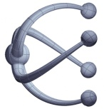
Design Verification COMS30026 WEEKLY STATUS UPDATE – W2
Kerstin Eder
Trustworthy Systems Lab
Department of
COMPUTER SCIENCE

Slide 2
Topics W1
Introduction to DV
Verification Hierarchy
Fundamentals of Simulation-based Verification
Driving & Checking
Lab W1:
get remote access to the EDA software
teach yourself Verilog ☺

Slide 3
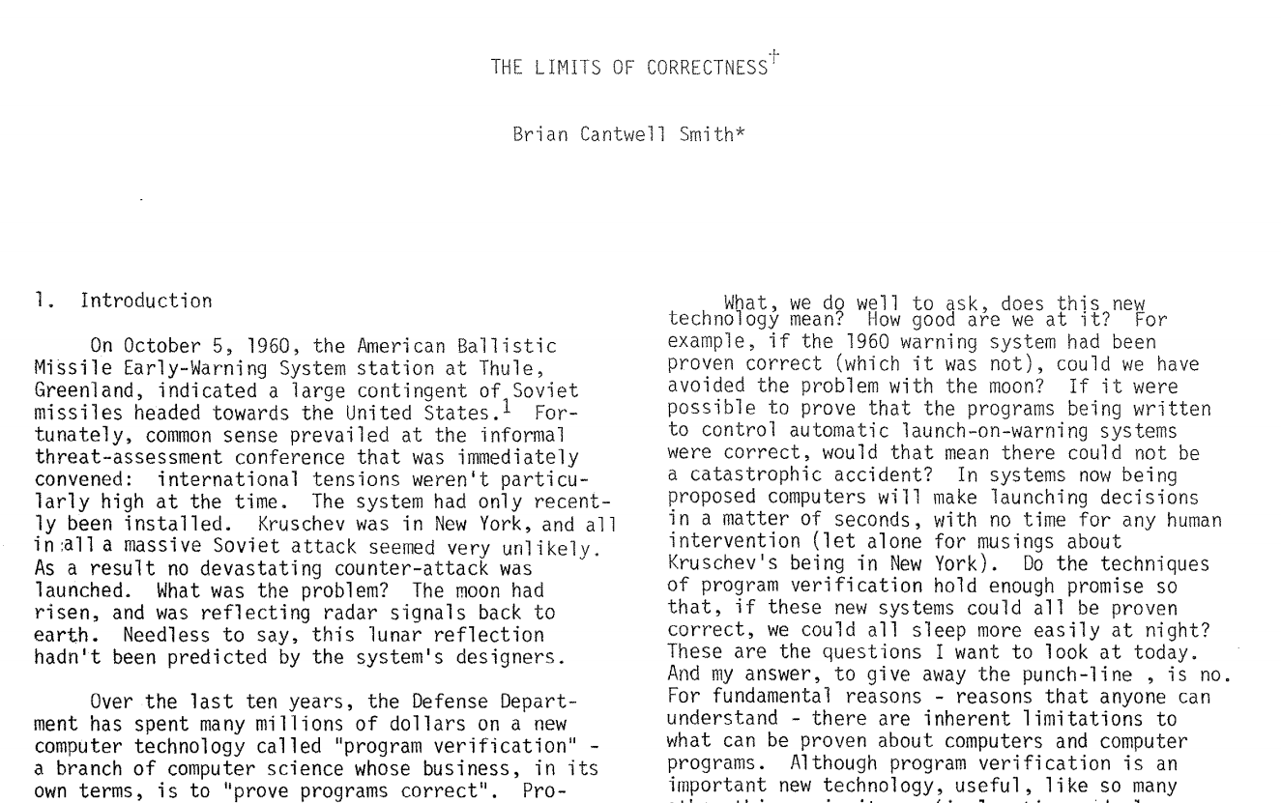
Paper review from W1
Brian Cantwell Smith. 1985. The limits of correctness. SIGCAS Comput. Soc. 14,15, 1,2,3,4 (Jan 1 1985), 18–26.
DOI: https://doi.org/10.1145/379486.379512
Identify the main lines of argument
Why does the author question the notion of “correctness”?
What are the two or three key take-away messages for you?

Slide 4
Topics W2
Verification Tools
Hardware Design Languages (self study)
Verification Cycle, Methodology & Plan
Lab W2:
Introduction to ModelSim/Questa
installed on linux lab machines
Work through mux testbench from Exercise 2
https://uobdv.github.io/Design-Verification/

Slide 5
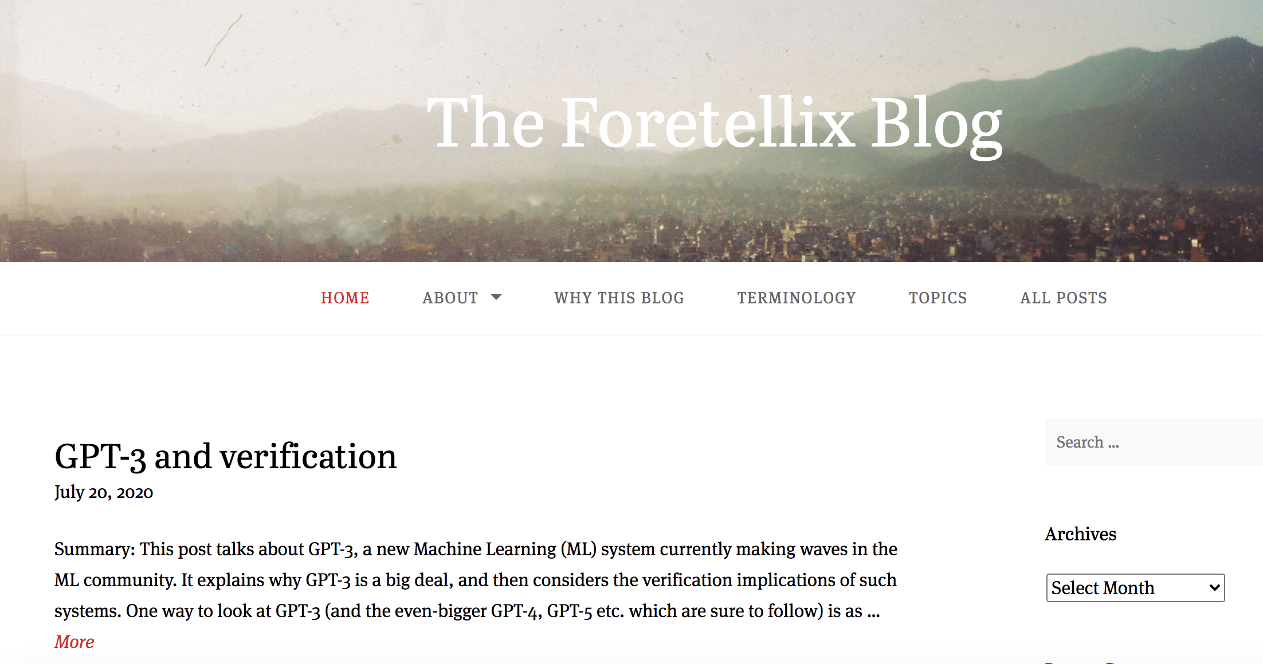
Optional Activities – Week 2
Review the foretellix blog https://blog.foretellix.com/

Slide 6
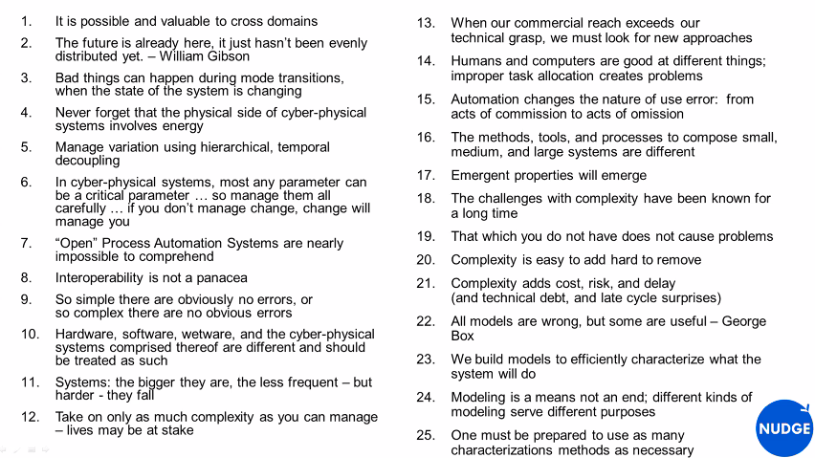
RV2020 Keynote by Lane Desborough on The Physical Side of Cyber-Physical Systems https://youtu.be/QRknQBMK9LA?t=457

Slide 7
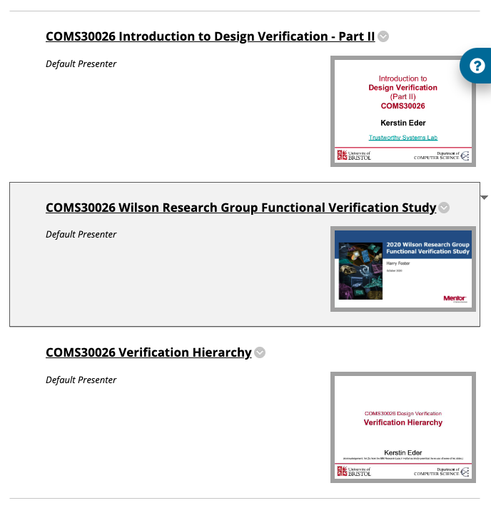
Opportunities – Week 2/3
2020 Wilson Research Group Verification Survey Results
Full recording by Harry Foster on Blackboard

Slide 8
Next
Recordings of lectures for Week 2:
Driving & Checking (from last week)
Verification Tools
Teach yourself Verilog
Verification Cycle, Methodology & Plan
uobdv.github.io/Design-Verification/ shows a weekly schedule of topics to watch BEFORE the next session, ideally
Recordings are available from Blackboard unit page
Tasks for you this week:
Attend the lab session with Xuan to get help with using ModelSim/Questa, then work through the mux testbench from Exercise 2 on https://uobdv.github.io/Design-Verification/

Slide 9

Questions
https://www.bristol.ac.uk/tsl

