Slide 1


Design Verification COMS30026 WEEKLY STATUS UPDATE – W3
Kerstin Eder
Trustworthy Systems Lab
Department of
COMPUTER SCIENCE

Slide 2
Topics W1
Introduction to DV
Verification Hierarchy
Fundamentals of Simulation-based Verification
Driving & Checking
Lab W1:
get remote access to the EDA software
teach yourself Verilog ☺

Slide 3
Topics W2
Verification Tools
Hardware Design Languages
Verification Cycle, Methodology & Plan
Lab W2:
Introduction to ModelSim/Questa
installed on linux lab machines
Work through mux testbench from Exercise 2
https://uobdv.github.io/Design-Verification/

Slide 4
Topics W3
Stimuli Generation Part I: Foundations
Stimuli Generation Part II: Test Automation
Checking
Lab W3:
Introduction to Practical 1 (Weeks 2-4)
Specification review
Debug calculator design using Modelsim/Questa
Example testbench on Blackboard

Slide 5
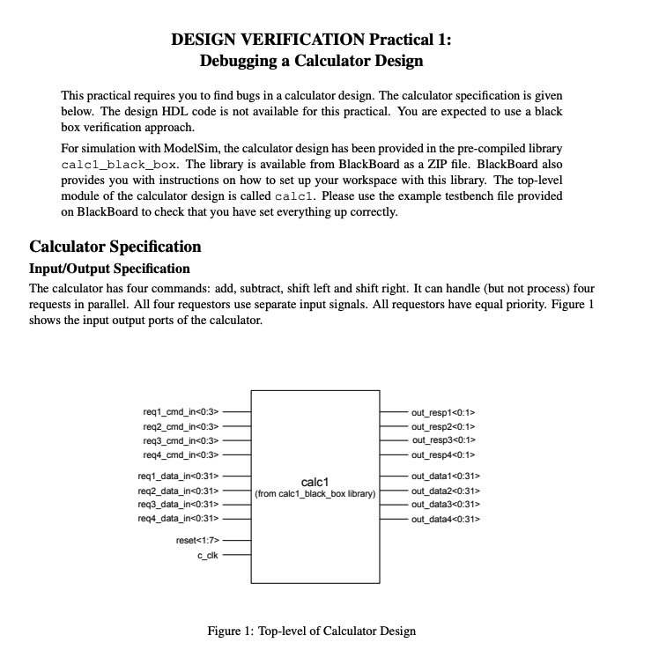

Slide 6
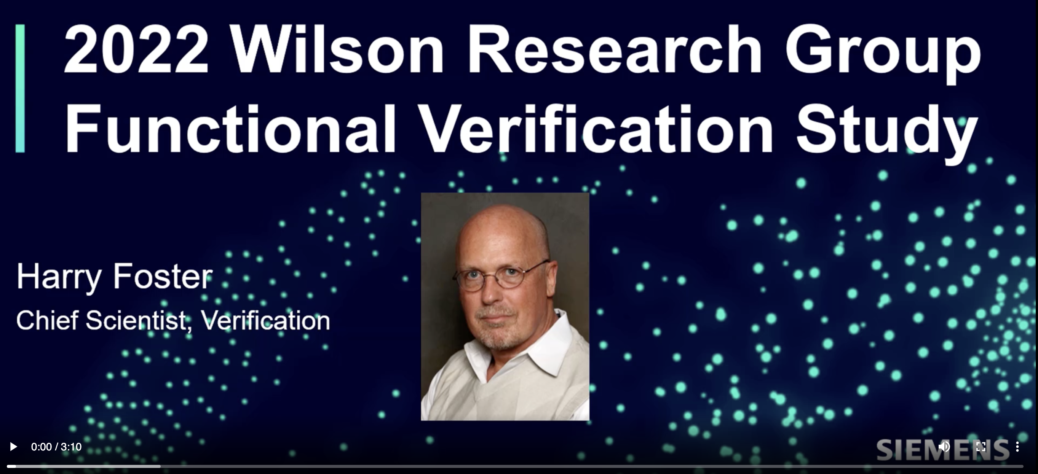
Opportunities – Week 3
2020 Wilson Research Group Verification Survey Results
Full recording by Harry Foster on Blackboard

Slide 7
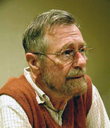
Challenge
Find out about the work of Edsger W. Dijkstra.
In particular, find what he said about testing and its limitations.
Photo from https://en.wikipedia.org/wiki/Edsger_W._Dijkstra

Slide 8
Challenge
Find out about the work of Edsger W. Dijkstra.
In particular, find what he said about testing and its limitations.
“Program testing can be used to show the presence of bugs, but never to show their absence!”
― Edsger W. Dijkstra
Photo from https://en.wikipedia.org/wiki/Edsger_W._Dijkstra

Slide 9
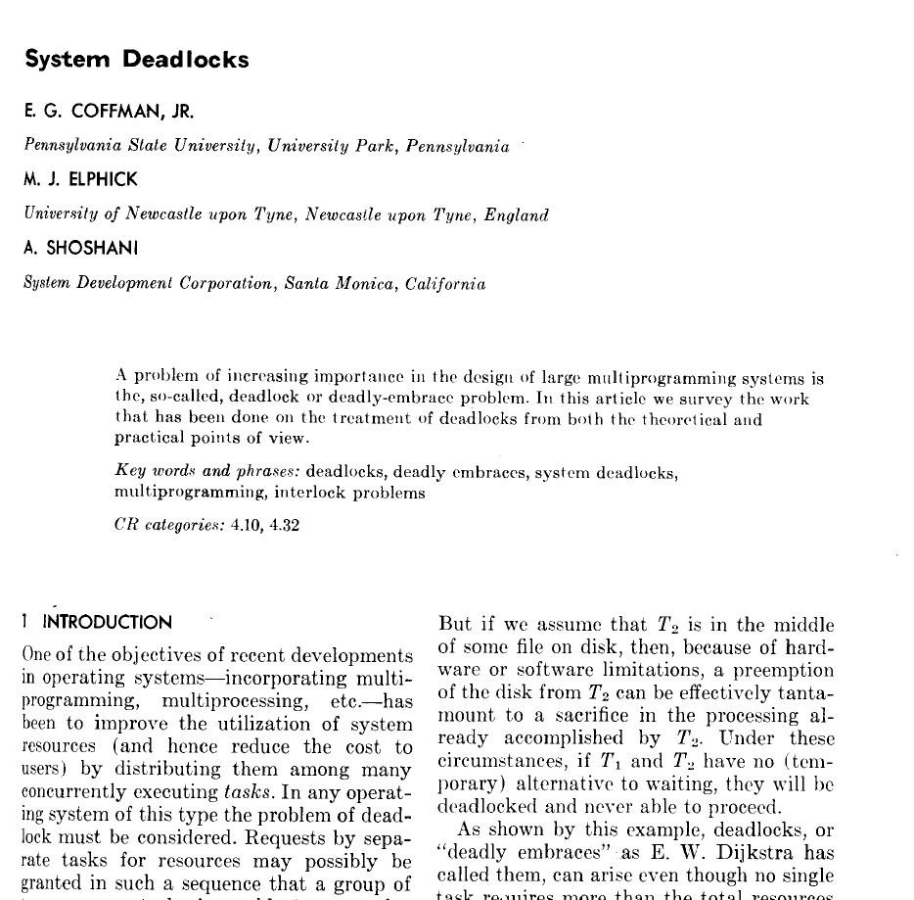
Four necessary and sufficient conditions for deadlock
E. G. Coffman, M. Elphick, and A. Shoshani.
1971. System Deadlocks.
ACM Comput. Surv. 3, 2 (June 1971), 67–78.
DOI: https://doi.org/10.1145/356586.356588
This offers you an opportunity to learn material beyond what has been taught in this unit.

Slide 10
Next
Recordings of lectures for Week 3:
Stimuli Generation Part I: Foundations
Stimuli Generation Part II: Test Automation
Checking
uobdv.github.io/Design-Verification/ shows a weekly schedule of topics to watch BEFORE the next session, ideally
Recordings are available from Blackboard unit page
Tasks for you this week:
Attend the lab session with Xuan to get help with using ModelSim/Questa so you can do Practical 1
Submit issues found during your Specification review to Blackboard Discussion Forum

Slide 11

Questions
https://www.bristol.ac.uk/tsl

