Slide 1
Software Construction & Development
Course Instructor: Dr. Marriam Nawaz
Lecture: 01

Slide 2
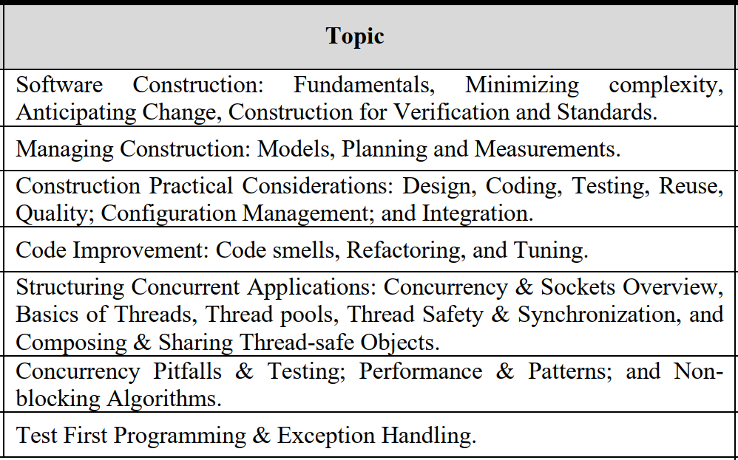
Course Outline

Slide 3
Grading Criteria
25% Mid Term
10% Quiz
15% Assignments
50% Final Exam

Slide 4
Software Processes
A Software Process is
A set of activities (e.g. requirements, analysis, design, coding, testing) combined and sequenced in a particular fashion to produce software
Recent trend: Agile Software Development
Customer needs evolve with time
Satisfying customers at delivery time (rather than at project initiation) is more important than conforming to initial customer requirements

Slide 5
Software Construction
Construction is the work “construction workers” do when they build a house, a school, or a skyscraper.
In common usage, construction refers to the process of building.
The construction process might include some aspects of planning, designing, and checking the work, but mostly construction refers to the hands-on part of creating something.
Software construction is a software engineering discipline.
It is detailed creation of working, meaningful software through a combination of coding, verification, unit testing, integration testing, and debugging

Slide 6
Software Development Phases
Requirements
What needs to be done
Testing
Check that the code does what it is supposed to (functionality, performance, reliability, …)
Analysis
How it should be done
Project Management
Devise a plan, manage resources, costs, time, …
Design
Create a software structure (architecture) around which code will be built
Coding
Fill in the software structure with code
6
Notes:
6

Slide 7
Software Phases Related to Software Construction
Testing
Check that the code does what it is supposed to (functionality, performance, reliability, …)
Design
Create a software structure (architecture) around which code will be built
Coding
Fill in the software structure with code

Slide 8
Software Construction
Important non-construction activities include
Management
Requirements development
Software architecture
User-interface design
System testing
Maintenance

Slide 9
Software Construction
Software construction is a fundamental aspect of software engineering.
It involves the creation of functional software through coding, validation, and testing by programmers.
Contrary to a simple translation of design into software, it delves into complex issues of software engineering.
The process requires a meaningful dialogue between humans and computers, bridging the gap between human intent and computer execution.
Each side contributes unique capabilities: computers offer reliability and speed, while humans bring creativity and problem-solving skills.

Slide 10
Software Construction
Key aspects of Software Construction
Software construction entails a dialogue between humans and computers.
Humans must be logical, precise, and thorough in expressing their intentions.
Computers, despite their limitations, provide reliability and speed in executing tasks.
The symbiotic relationship between humans and computers in software construction results in the creation of meaningful and functional software.
Successful software construction requires a balance between human creativity and computer precision.

Slide 11
Software Construction
Some of the specific tasks involved in construction are:
– Verifying that the groundwork has been laid so that construction can proceed successfully
– Determining how your code will be tested
– Designing and writing classes and routines
– Creating and naming variables and named constants
– Selecting control structures and organizing blocks of statements
– Unit testing, integration testing, and debugging your own code
– Reviewing other team members’ low-level designs and code and having them review yours
– Polishing code by carefully formatting and commenting it
– Integrating software components that were created separately
– Tuning code to make it faster and use fewer resources

Slide 12
Significance of Software Construction
Construction is a large part of software development
Construction is the central activity in software development
With a focus on construction, the individual programmer’s productivity can improve enormously
Construction’s product, the source code, is often the only accurate description of the software
Construction is the only activity that’s guaranteed to be done

Slide 13
SWEBOK Guide (2004 Edition)
SWEBOK stands for Software Engineering Body of Knowledge.
The IEEE Computer Society has developed a Guide to the Software Engineering Body of Knowledge.
The guide represents an extraction of all of the generally accepted principles from the entire body of knowledge.

Slide 14
SWEBOK Guide (2004 Edition)
The Guide to the SWEBOK contains 10 knowledge areas.
Software requirements
Software design
Software construction
Software testing
Software maintenance
Software configuration management
Software engineering management
Software engineering process
Software engineering tools and methods
Software quality

Slide 15
SWEBOK Guide (2004 Edition)
Software construction is a software engineering discipline.
It is the detailed creation of working meaningful software through a combination of coding, verification, unit testing, integration testing, and debugging.
It is linked to all the other software engineering disciplines, most strongly to software design and software testing.

Slide 16
Software Construction’s Links to other Knowledge Areas.
Software Construction and Software Design
Software design and construction are closely intertwined processes in software engineering.
Design analyzes requirements and structures the system, setting the stage for construction.
Construction begins when the design breaks down the problem into manageable parts.
The distinction between design and construction is often blurred, influenced by project scale and complexity.
Both activities require sophisticated problem-solving skills, with design focusing on partitioning and construction on solution implementation.
Automation of well-defined construction tasks allows engineers to tackle more complex challenges effectively.

Slide 17
Software Construction’s Links to other Knowledge Areas.
The Relationship between Tools and Software Construction
In software engineering, tools are hardware or software devices supporting various processes.
An effective tool significantly improves productivity and/or quality.
Software construction tools are software-based tools used primarily within the construction process.
Examples include compilers, version control systems, debuggers, code generators, specialized editors, and testing tools.
These tools bridge the gap between computer efficiency and human creativity, facilitating expression of ideas while enforcing rigor.
They enhance software quality by allowing individuals to avoid repetitive or precise tasks better suited for computers.

Slide 18
Software Construction’s Links to other Knowledge Areas.
Integrated Evaluation in Software Construction
Evaluation of software products is a crucial theme in software engineering, encompassing peer code review, testing, quality assurance, and measures.
Integrated evaluation ensures continuous or periodic internal checks within the development process to maintain correctness.
Product evaluations include design reviews, module compilations, and unit tests, while process-level evaluations involve periodic reassessment of development artifacts.
Integrated evaluation in software engineering is not as advanced as in hardware engineering, where self-test logic and error recovery are built into components.
Historically, software construction has often lacked sufficient evaluation, with developers sometimes omitting necessary checks due to overconfidence.
Automated, semi-automated, and manual evaluation methods are available for software construction, including unit testing, compile-time checks, run-time checks, code reviews, and measurement tools.
Measurement tools are particularly useful during the integration of large software suites, ensuring collected measurements are relevant to the development process goals

Slide 19
Software Construction’s Links to other Knowledge Areas.
Importance of Standards in Software Construction
Successful communication relies on a common language, and standards serve as agreements that facilitate this shared understanding within a community of users.
Standards, whether selected by customers or organizations, integrate concepts and technologies into a broader language for effective communication.
Project managers should consider incorporating additional standards tailored to the project's specific characteristics to enhance efficiency and interoperability.
Software construction is particularly influenced by standard selection, impacting critical aspects such as programming languages, databases, communication methods, platforms, and tools.
While standards are often chosen before construction begins, it's essential for the overall software development process to account for construction needs when selecting standards.

Slide 20
Software Construction’s Links to other Knowledge Areas.
Construction Languages
Definition: Construction languages encompass all forms of communication enabling humans to specify executable problem solutions to computers.
Configuration Languages: Simplest form where developers select from predefined options to create new or custom software installations.
Example: Text-based configuration files in Windows and Unix operating systems.
Toolkit Languages: Utilized for building applications from toolkits, consisting of reusable parts.
Example: Application programming languages (e.g., scripts) or implied by toolkit interfaces.
Programming Languages: Most flexible construction languages requiring extensive training and skill.
Implications: Each type of construction language offers varying levels of complexity and flexibility, impacting development processes differently.

Slide 21
Software Construction’s Links to other Knowledge Areas.
Programming Languages in Software Construction
Software construction aims to communicate intent unambiguously between humans and computers, with programming languages serving as the interface between the two.
Unlike natural languages, programming languages are more literal and lack the contextual understanding of the natural world.
Programming languages enable precise expression of instructions and commands that computers can understand and execute.
Depending on the application domain, specialized, domain-specific languages like PhP, Python, SQL, may be developed or utilized to meet specific requirements

Slide 22
Manual and Automated Construction: The Spectrum of Construction Techniques
Manual Construction:
Manual construction involves solving complex problems using a language that computers can execute.
Practitioners of manual construction require a diverse skill set, including problem decomposition, formal analysis, and forecasting changes over time.
Expert manual constructors leverage advanced logical skills within dynamic environments such as computers or networks.
While coding in a programming language is a component of manual construction, it's not the sole definition.
Effective manual construction results in code that processes data accurately, handles errors effectively, runs efficiently, and is structured for resilience and adaptability.
Inadequate manual construction may lead to code resembling an unprofessional painting, lacking critical details and poorly stitched together.

Slide 23
Manual and Automated Construction: The Spectrum of Construction Techniques
Automated Construction
Automated construction refers to software construction where overall coordination is primarily handled by automated tools or environments.
While complete automation of software construction is not feasible, the control of the construction process can be largely automated, shifting coordination from people to computers.
This automation impacts the complexity of the construction process by breaking human contributions into smaller, more manageable chunks.
Automated construction emphasizes reuse, leveraging existing software solutions effectively by limiting human options.
However, automated construction may not always result in lower costs, as the initial setup costs for the machinery may outweigh the savings from its use.

Slide 24
Moving Towards Automation
Objective: Advance construction processes towards higher levels of automation.
Goal: Simplify software systems to the extent that selecting from a simple set of options is sufficient for operation.
Implications: Enhance accessibility, safety, and reliability by minimizing opportunities for error.
Scope of Automation: Automation goal is evident across all aspects of software development.
Examples:
Application-specific toolkits offer a degree of control beyond basic selections.
Coding techniques and programming practices reflect automation principles.
Defining constants automates value insertion during program modifications.
Class inheritance in object-oriented programming automates method conveyance into new or derived classes.
Benefits: Streamline development processes, foster reliability, and optimize system performance.

Slide 25
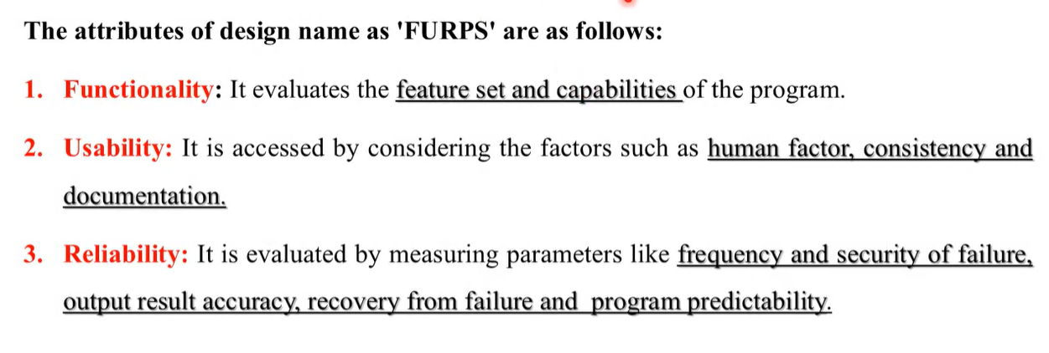
Software Quality Attributes

Slide 26
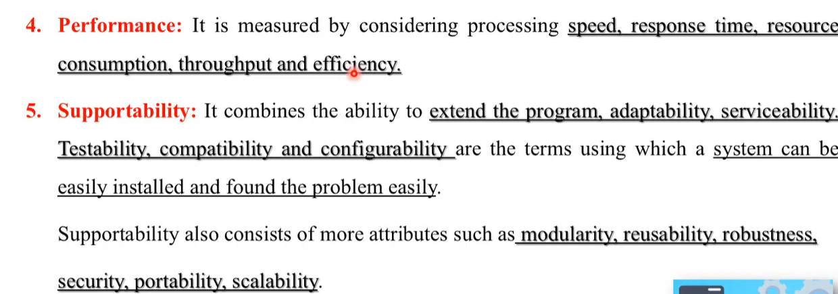
Software Quality Attributes

