Slide 1
Software Construction & Development
Course Instructor: DR. Marriam nawaz
Lecture: 03

Slide 2
Fundamentals of Software Construction
According to the SWEBOK CH#3, the basic fundamentals of Software construction are
Minimizing Complexity
Anticipating Change
Constructing for Verification
Reuse
Standards in Verification

Slide 3
Minimizing Complexity
Humans are severely limited in our ability to hold complex information in our working memories
So minimizing complexity is one of the strongest drivers in software
construction
Need to reduce complexity throughout the lifecycle
As functionality increases, so does complexity
Accomplished through use of standards
Examples:
J2EE for complex, distributed Java applications
UML for modeling all aspects of complex systems
High-order programming languages such as C++ and Java
Source code formatting rules to aid readability

Slide 4
Anticipating Change
Software changes over time
Anticipation of change affects how software is constructed
This can effect
Use of control structures
Handling of errors
Source code organization
Code documentation
Coding standards

Slide 5

Constructing for Validation
Construct software that allows bugs to be easily found and fixed
Examples:
Enforce coding standards
Helps support code reviews
Unit testing
Organizing code to support automated testing
Restricted use of complex or hard-to-understand language structures

Slide 6
Standards in Constructions
Standards which directly affect construction issues include:
Programming languages
E.g. standards for languages like Java and C++
Communication methods
E.g. standards for document formats and contents
Platforms
E.g. programmer interface standards for operating system calls, J2EE
Tools
E.g. diagrammatic standards for notations like the Unified Modeling Language

Slide 7
Reuse
Reuse refers to using existing assets in solving different problems.
In software construction, typical assets that are reused include libraries, modules, components, source code, and commercial off-the-shelf (COTS) assets.
Reuse is best practiced systematically, according to a well-defined, repeatable process.
Systematic reuse can enable significant software productivity, quality, and cost improvements.

Slide 8
Reuse
Reuse has two closely related facets
construction for reuse
construction with reuse
The former means to create reusable software assets, while the latter means to reuse software assets in the construction of a new solution.
Reuse often transcends the boundary of projects, which means reused assets can be constructed in other projects or organizations.

Slide 9
Minimizing Complexity

Slide 10
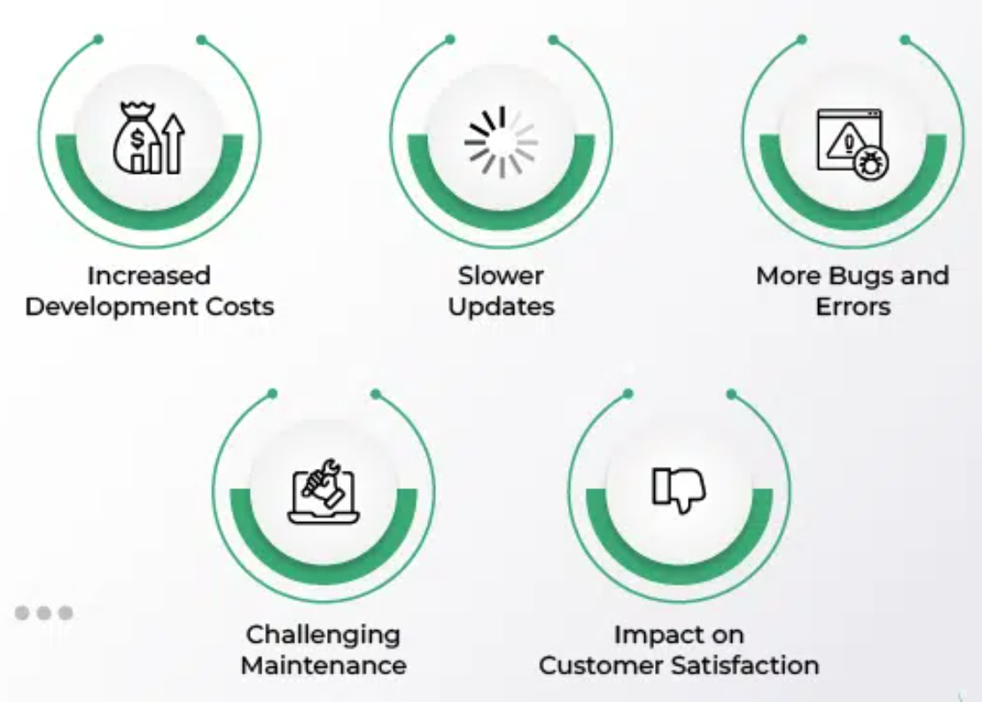
Potential Disadvantages of Complexity

Slide 11
Minimizing Complexity
Potential disadvantages of Software complexity:
Increased Maintenance Effort
Higher Probability of Bugs and Errors
Difficulty in Understanding and Debugging
Longer Development Time
Reduced Performance
Higher Cost of Development and Maintenance
Limited Scalability
Reduced Reusability
Lower Testability
Increased Risk of System Failures

Slide 12
Measuring Complexity
Common metrics for software complexity include:
1. Cyclomatic Complexity:
Measures the complexity of a program's control flow by counting the number of linearly independent paths through the source code.
2. Halstead's Software Science Metrics:
Include measures such as program length, vocabulary size, program volume, program difficulty, and program effort, based on the number of unique operators and operands in the code.
3. McCabe's Complexity:
Similar to cyclomatic complexity, it quantifies the complexity of a program by counting the number of decision points in the code.
4. Lines of Code (LOC):
Measures the size of a program by counting the number of lines in the source code. While not a direct measure of complexity, larger programs tend to be more complex.

Slide 13
Measuring Complexity
Common metrics for software complexity include:
5. Depth of Inheritance Tree (DIT):
Measures the number of levels in the inheritance hierarchy of classes in object-oriented programming. Higher DIT values can indicate increased complexity due to deeper class hierarchies.
6. Coupling and Cohesion Metrics:
Measure the relationships between modules or components in a software system. High coupling and low cohesion can indicate higher complexity and potential maintenance issues.
7. Function Point Analysis (FPA):
Measures the software system’s functionality based on the user's perspective. It considers inputs, outputs, inquiries, internal logical files, and external interface files.
8. Maintainability Index:
An aggregate metric that combines various aspects of software complexity, such as cyclomatic complexity, lines of code, and code blend, to assess the ease of maintaining the software.

Slide 14
Measuring Complexity
Three main approaches to minimize complexity throughout the construction phase:
Removal of Complexity
Principle of parsimony – suggesting that unnecessarily complex theories should be avoided
Automation of Complexity
Reuse of code modules
Localization of Complexity
Localize complexity into small “units” or “modules” that are small enough for a person to understand
Ensuring low coupling and high cohesion

Slide 15
Minimizing Complexity
Complexity can be controlled at two stages:
Software Design Phase
Implementation Phase

Slide 16
Minimizing Complexity
Techniques to minimize complexity in Design Phase:
Modularization
Abstraction
Hierarchical Design
Design Patterns
Prototyping

Slide 17
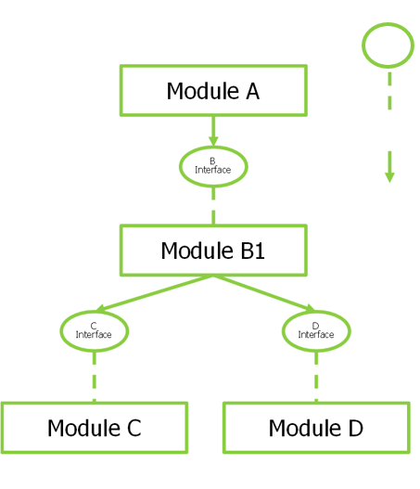
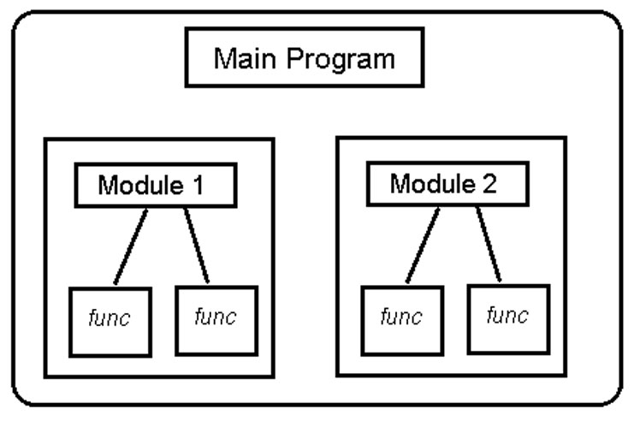
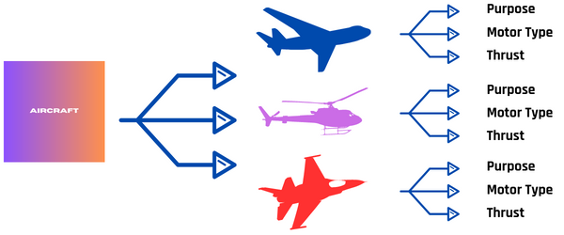
Modularization Hierarchical Design Abstraction

Slide 18
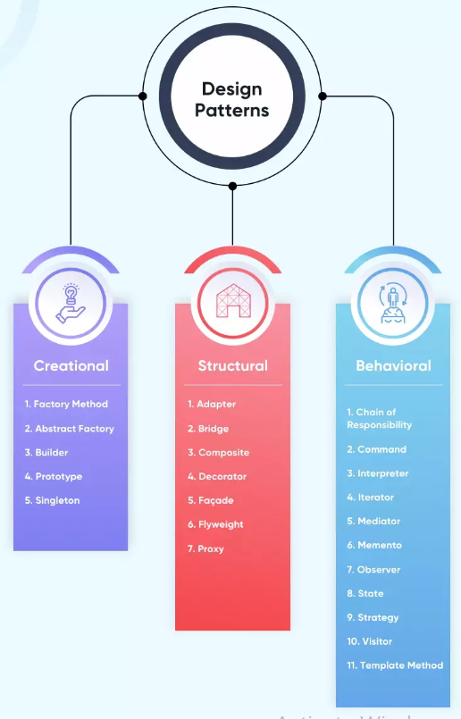
Design Patterns
Providing proven templates to address specific design challenges and promote best practices for building robust, maintainable, and scalable software systems.

Slide 19
Minimizing Complexity
Techniques to minimize complexity in the Implementation Phase:
Functional Decomposition
Modular Programming
Clean Code Practices
Code Refactoring
Test-Driven Development (TDD)

Slide 20
Implementing DevOps and Agile to Reduce Complexity and Cost
Continuous Integration/Continuous Deployment: Streamlines development and deployment processes, ensuring faster and more reliable delivery.
Collaborative Culture: Encourages teamwork between developers and operations, leading to better problem-solving and innovation.
Iterative Development: Allows for regular feedback and quick adaptation to changes, reducing errors and rework.
Resource Optimization: Efficiently uses resources, reducing waste and lowering operational costs.
Rapid Problem Resolution: Quick identification and resolution of issues, improving system stability and user satisfaction.

Slide 21
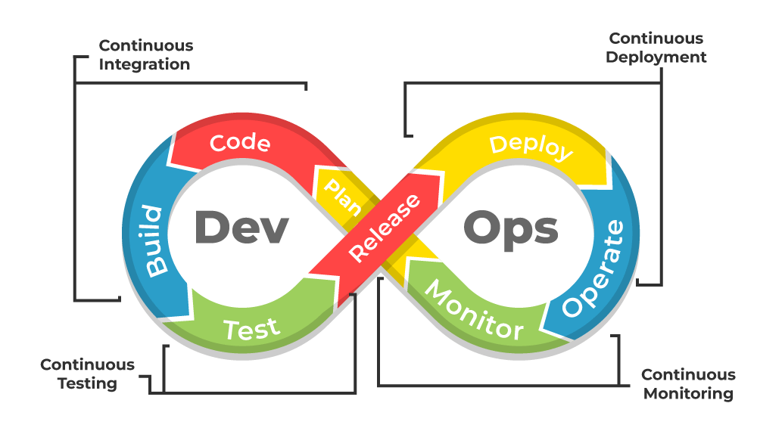
DevOps

Slide 22
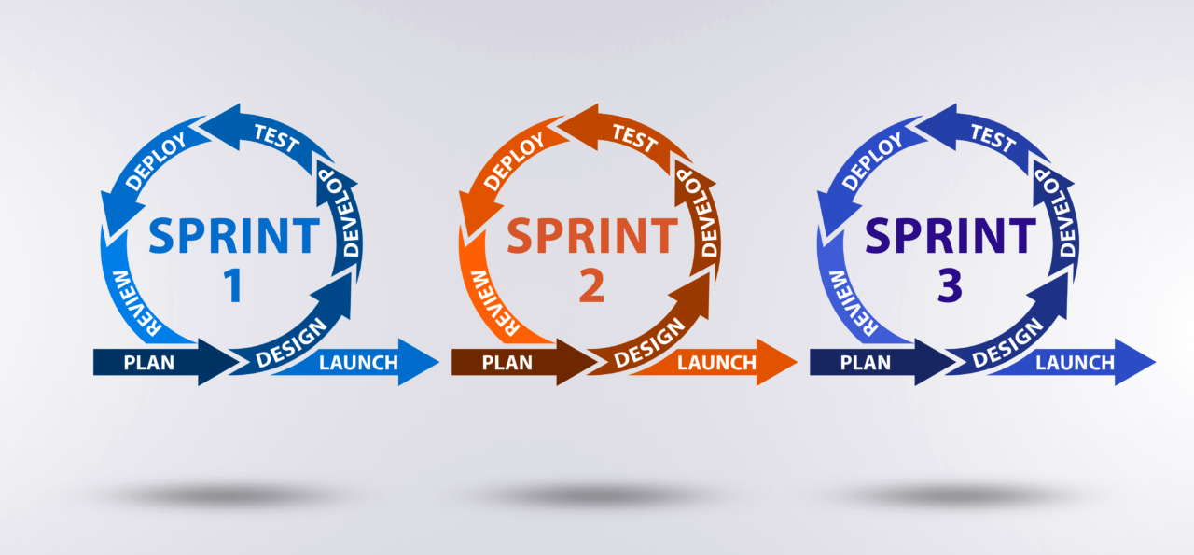
Agile Development Method

Slide 23
Anticipating Change
Techniques and methods that help anticipate diversity include:
Information hiding
Embedded documentation (commenting)
Object-oriented methods
Creation of “glue languages” for linking legacy components
Table-driven software
Configuration files, internationalization
Naming and coding styles
Reuse and repositories

Slide 24
Structuring for Validation
Modular design
Structured programming
Style guides
Test Driven Development TDD
Continuous Integration (CI)

Slide 25
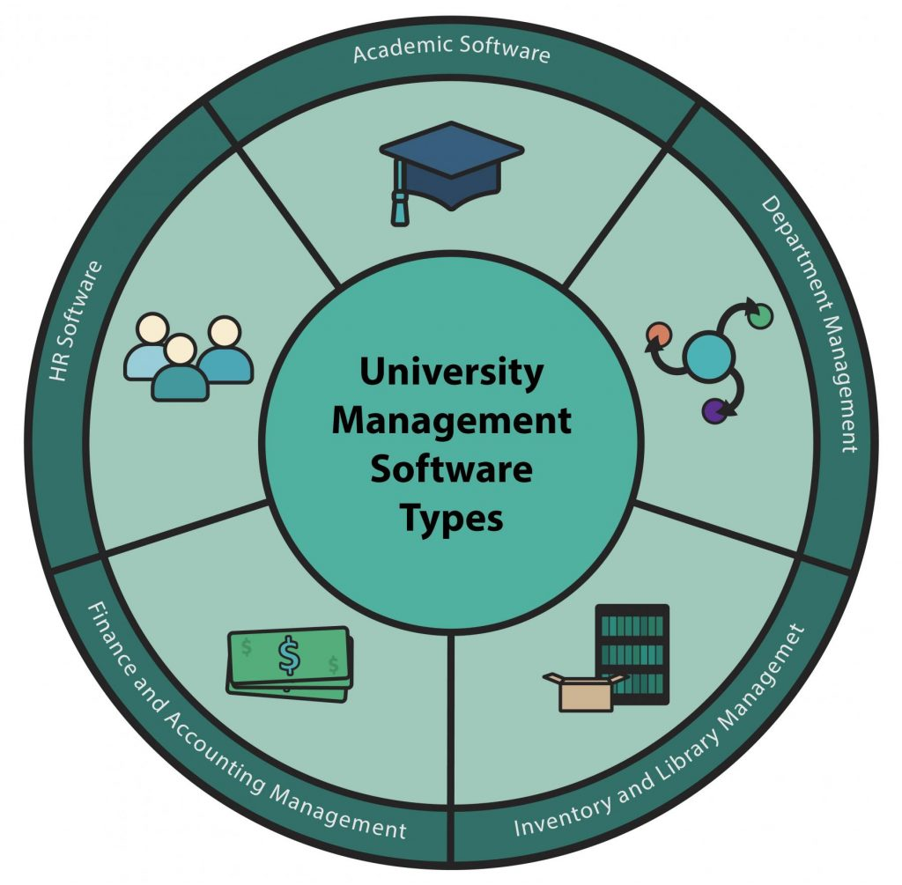
Modular Design

Slide 26
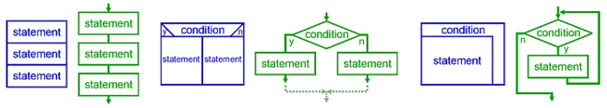
Structured Programming

Slide 27
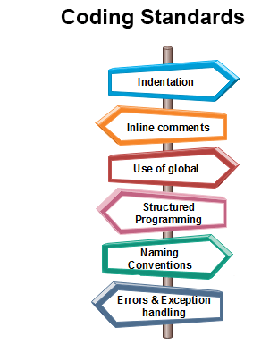
Style Guides

Slide 28
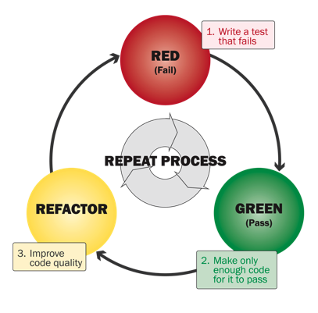
Test Driven Development

Slide 29
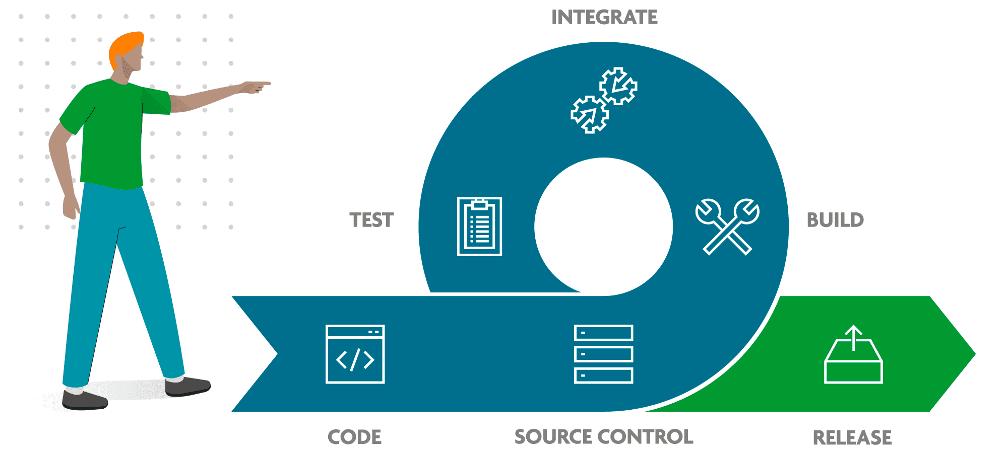
Continuous Integration

Slide 30

Standards in Construction
Standardized Programming Languages:
Ada 95
C++
Java
Standardized Data Description Languages:
XML (eXtensible Markup Language)
SQL (Structured Query Language)
JSON (JavaScript Object Notation)
Standardized Alphabet Representations:
Unicode
ASCII (American Standard Code for Information Interchange)
ISO 8859 (International Organization for Standardization 8859)

Slide 31
Managing Construction
According SWEBOK guide, software construction is managed by following activities
Construction Models
Construction Planning
Construction Management

Slide 32
Construction Models
Numerous models have been created to develop software; some emphasize construction more than others.
Some models are more linear from the construction point of view—such as the waterfall and staged-delivery life cycle models.
These models treat construction as an activity that occurs only after significant prerequisite work has been completed—including detailed requirements work, extensive design work, and detailed planning.
The more linear approaches tend to emphasize the activities that precede construction (requirements and design) and to create more distinct separations between activities.
In these models, the main emphasis of construction may be coding.

Slide 33
Construction Models
Other models are more iterative such as evolutionary, prototyping and agile development.
These approaches tend to treat construction as an activity that occurs concurrently with other software development activities (including requirements, design, and planning).
These approaches tend to mix design, coding, and testing activities, and they often treat the combination of activities as construction.

Slide 34
Construction Planning
The choice of construction method is a key aspect of the construction-planning activity.
The choice of construction method affects the extent to which construction prerequisites are performed, the order in which they are performed, and the degree to which they should be completed before construction work begins.

Slide 35
Construction Planning
Construction planning also defines
the order in which components are created and integrated
the integration strategy
the software quality management processes
the allocation of task assignments to specific software engineers according to the chosen method.

Slide 36
Construction Measurement
Numerous construction activities and artifacts can be measured including code developed, code modified, code reused, code destroyed, code complexity, code inspection statistics, fault-fix and fault-find rates, effort, and scheduling.
These measurements can be useful for purposes of managing construction, ensuring quality during construction, and improving the construction process

Slide 37
THANKS

