Slide 1
Software Construction & Development
Course Instructor: DR. Marriam nawaz
Lecture: 04

Slide 2
Requirements vs. Specifications
Requirements:
statements that describe what a system or product must achieve, but they do not specify how it should achieve it.
typically written from a user or stakeholder perspective and focus on the desired functionality, performance, or characteristics of the system.
They answer questions like “What should the system do?” or “What are the constraints and objectives for the system?”
Specifications:
Specifications, on the other hand, provide detailed information on how a system or product should be designed, implemented, or built to meet the requirements.
Specifications delve into the technical aspects, including materials, dimensions, interfaces, and other engineering details.
They answer questions like “How will the system achieve what the requirements specify?” or “What are the technical parameters and tolerances?”
In summary, requirements define the “what” of a system, while specifications define the “how.” Both are essential in the system development process to ensure that the final product meets the desired goals and functions correctly.

Slide 3
Requirements vs. Specifications
Specifications sit between:
Requirements → (Specification) → Design → Code

Slide 4
Informal Specifications
Informal specifications use natural language (English/Urdu etc.) to describe behavior.
Advantages
✔ Easy to read ✔ Easy to discuss with non-technical stakeholders ✔ Fast to produce
Problems
✖ Ambiguous (“sufficient” means what?) ✖ Incomplete ✖ Hard to verify correctness ✖ Hard to test edge cases

Slide 5
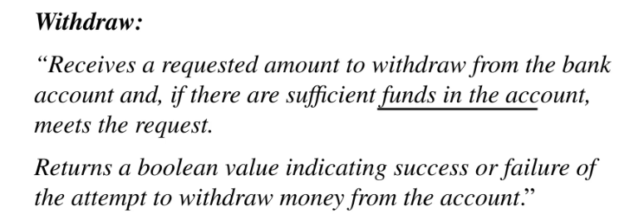
Informal Specifications (Example)

Slide 6
Formal Specifications
Formal specifications describe system behavior using mathematical notation, logic, or formal languages.
Formal specification is the process of defining software systems’ requirements and behavior with rigorous mathematical and logical techniques. Unlike informal specifications, which often rely on natural language descriptions and diagrams, formal specifications use precise formal languages to outline exactly what the system should do. This approach provides a clear and unambiguous description of the system’s intended behavior.
Formal specifications consist of several key components. A formal language is used to express the system’s requirements with precise syntax and semantics. Mathematical models represent the system components and their interactions. Additionally, logical proofs are employed to demonstrate that the system adheres to its specification, thereby ensuring correctness.

Slide 7
Formal Specifications
Goal:
✔ Remove ambiguity ✔ Allow reasoning ✔ Enable verification ✔ Enable static checking / automated proofs

Slide 8
Formal vs. Informal Example
informal ones like:
“Search should be fast.”
Cannot be tested, verified, or proven.
Formal version:
Time(search) ∈ O(log n)
is verifiable.

Slide 9
Formal Specification Techniques
There are 4 major families used in software construction:
Model-Based Formal Specifications
Algebraic Specifications
Axiomatic Specifications (Hoare Logic)
Behavioral Specifications (Automata + Temporal Logic)

Slide 10
Formal Specification Techniques
There are 4 major families used in software construction:
Model-Based Formal Specifications: Represent system state as mathematical objects (sets, functions, relations).
Common frameworks: Z Notation, VDM (Vienna Development Method), Alloy
Algebraic Specifications: Specify system using algebraic equations. Used mainly for abstract data types (ADT) like stacks, sets, lists.
Axiomatic Specifications (Hoare Logic): Use logical assertions to specify behavior.
Behavioral Specifications (Automata + Temporal Logic): Used mainly for concurrency, protocols, real-time systems.

Slide 11
Specification techniques
Algebraic approach
The system is specified in terms of its operations and their relationships
Model-based approach
The system is specified in terms of a state model that is constructed using mathematical constructs such as sets and sequences.
Operations are defined by modifications to the system’s state

Slide 12
Formal specification languages
ASML - Abstract State Machine Language
Yuri. Gurevich, Microsoft Research, 2001

Slide 13
Use of formal specification
Formal specification involves investing more effort in the early phases of software development
This reduces requirements errors as it forces a detailed analysis of the requirements
Incompleteness and inconsistencies can be discovered and resolved !!!
Hence, savings as made as the amount of rework due to requirements problems is reduced

Slide 14
Development costs with formal specification

Slide 15
1. Interface specification
Large systems are decomposed into subsystems with well-defined interfaces between these subsystems
Specification of subsystem interfaces allows independent development of the different subsystems
Interfaces may be defined as abstract data types or object classes
The algebraic approach to formal specification is particularly well-suited to interface specification

Slide 16
Sub-system interfaces

Slide 17
The structure of an algebraic specification
< SPECIFICA
TION NAME > (Gener
ic P
ar
ameter)
sort
< name >
introduction
imports
< LIST
OF SPECIFICA
TION NAMES >
Inf
or
mal descr
iption of the sor
t and its oper
ations
description
Oper
ation signatures setting out the names and the types of
the parameters to the operations defined over the sort
signature
Axioms defining the oper
ations o
v
er the sor
t
axioms

Slide 18
The Structure of an Algebraic Specification
Introduction – Declares the sort (the type name) of the entity being specified, i.e., a set of objects with common characteristics. It also imports other specifications to use.
Description – An informal description of the operations to aid understanding.
Signature – Defines the syntax of the interface to the abstract data type (object), including their names, parameter list and return types.
Axioms – Defines the semantics of the operations by defining axioms characterising the behaviour.

Slide 19
Specification Operations
Constructor operations. Operations which create entities of the type being specified.
Inspection operations. Operations which evaluate entities of the type being specified.
To specify behaviour, define the inspector operations for each constructor operation.

Slide 20
Example: Operations on a List ADT
Let us take an example of a “list” abstract data type.
A list contains a sequence of elements of some type where elements may be added to the end and removed from the front (this is also called a queue, how does this differ from a stack?).
We want operations to Create, Cons (create a new list with an added member), Head (to evaluate the first element), Length and Tail (which creates a list by removing the first (head) element).

Slide 21
Example: Operations on a List ADT
Constructor operations which evaluate to sort List
Create, Cons and Tail.
Inspection operations which take sort list as a parameter and return some other sort
Head and Length.
Tail can be defined using the simpler constructors Create and Cons. No need to define Head and Length with Tail.

Slide 22
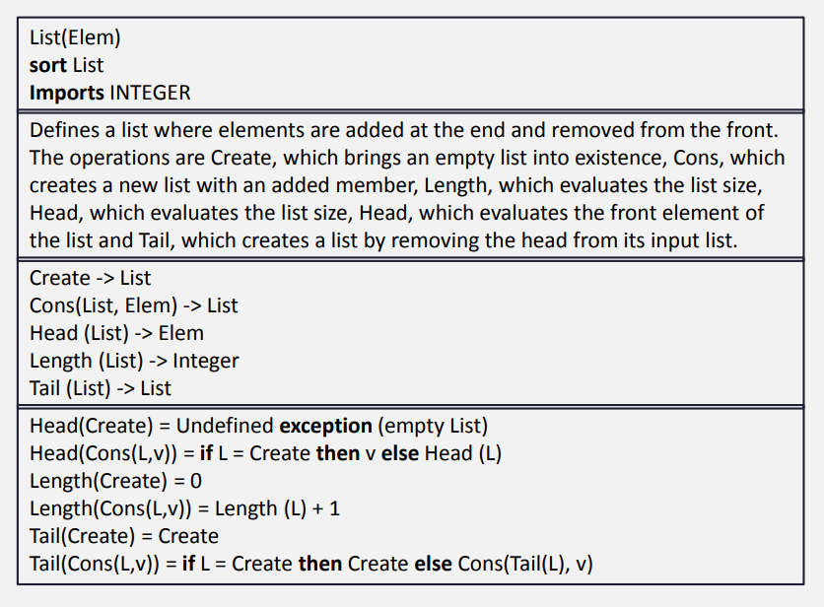
Example: List Specification

Slide 23
Interface Specification in Critical Systems
Let us consider another example: an air traffic control system where aircraft fly through managed sectors of airspace. Each sector may include a number of aircraft but, for safety reasons, these must be separated. In this example, a simple vertical separation of 300m is proposed. The system should warn the controller if aircraft are instructed to move so that the separation rule is breached.

Slide 24
A Sector Object
Critical operations on an object representing a controlled sector are
Enter - Add an aircraft to the controlled airspace;
Leave - Remove an aircraft from the controlled airspace;
Move - Move an aircraft from one height to another;
Lookup - Given an aircraft identifier, return its current height;

Slide 25
Primitive Operations
It is sometimes necessary to introduce additional operations to simplify the specification.
The other operations can then be defined using these more primitive operations.
Primitive operations
Create - Bring an instance of a sector into existence;
Put - Add an aircraft without safety checks;
In-space - Determine if a given aircraft is in the sector;
Occupied - Given a height, determine if there is an aircraft within 300m of that height.

Slide 26
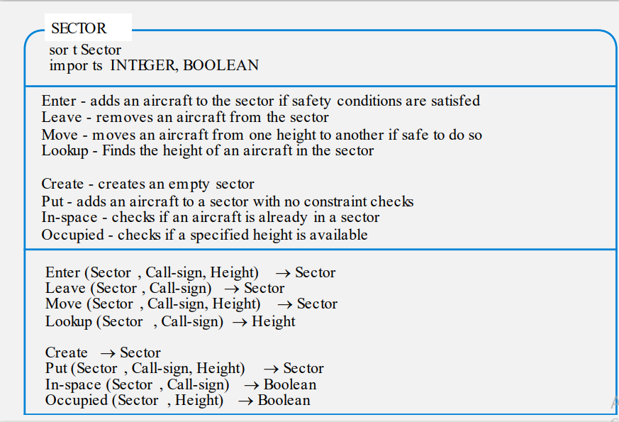
Sector Specification (1)

Slide 27
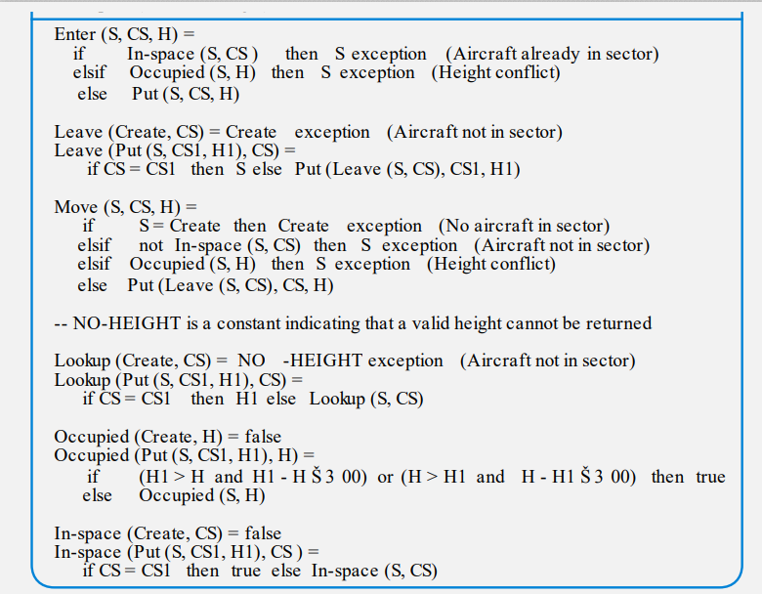
Sector Specification (2)

Slide 28
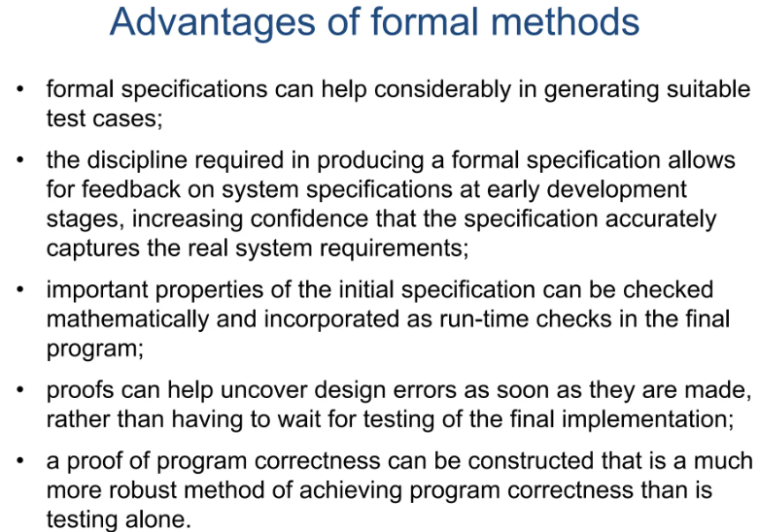
Advantages

Slide 29
Design by contract
Design by contract (DbC), also known as contract programming, programming by contract and design-by-contract programming, is an approach for designing software.
It prescribes that software designers should define formal, precise and verifiable interface specifications for software components, which extend the ordinary definition of abstract data types with preconditions, postconditions and invariants. These specifications are referred to as "contracts", in accordance with a conceptual metaphor with the conditions and obligations of business contracts.

Slide 30
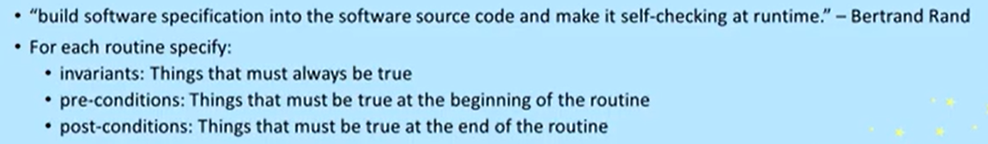
Design by contract

Slide 31
Design by contract
Operation: withdraw(amount)
Client obligations (Preconditions):
amount > 0
balance >= amount
Supplier guarantees (Postconditions):
balance = old(balance) - amount
Class invariants:
balance >= 0

Slide 32
Design by contract (stack example)
Contract for pop():
Client obligations (Pre):
stack is not empty
Supplier guarantees (Post):
size' = size - 1
returned = top element
Invariant:
size ≥ 0

Slide 33
THANKS

