Slide 1
Software Construction
Regular Expressions

Slide 2
Introduction
Every time you enter your email, create a password, or search something on Google, there is a system checking whether your input follows a certain pattern.
How does the computer know what is valid and what is not?
Example
Email format → must contain @
Password → must contain letters +
numbersPhone number → fixed pattern

Slide 3
Introduction
All of these checks are done using something called patterns, and today we’ll learn how to formally define such patterns using Regular Expressions.
So far, we’ve been informally talking about patterns. But computers need a formal way to represent them.
That’s where Regular Expressions (RE) come in—they allow us to mathematically define a set of strings, also called a language

Slide 4
Introduction
Think of a regular expression as a compact formula that represents many possible strings.
Example:Instead of writing: a, aa, aaa, aaaa...We write: a*
“How would you check if a string contains only digits?”
Informal: “only numbers allowed”
Formal: [0-9]+

Slide 5
Basic Building Blocks of Regular Expressions
Regular expressions are constructed using a few simple components (operators + symbols). Think of them as Lego blocks for building patterns.
Alphabet Symbols (Literals)
These are the simplest building blocks. If Σ = {a, b}, then:
a matches string "a“
matches string "b“
👉 Meaning: A single symbol represents itself.

Slide 6
Basic Building Blocks of Regular Expressions
2. Empty String (ε or λ)
Represents a string with no characters
Example: ε matches: "" (nothing)
It’s still a valid string—it just has zero length.”
3. Concatenation (AB)
Putting two expressions together means sequence
Example:ab → matches "ab“ a followed by b
Meaning:First this, then that.

Slide 7
Basic Building Blocks of Regular Expressions
4. Union / OR (+ or |)
Represents choice between options
Example:a + b (or a | b) → matches:"a" OR "b“
Meaning:Either this OR that.
5. Kleene Star (*)
Represents zero or more repetitions
Example:a* → matches:ε, a, aa, aaa, …
Meaning:Repeat as many times as you want (even zero).

Slide 8
Basic Building Blocks of Regular Expressions
6. Kleene Plus (+)
Represents one or more repetitions
Example:a+ → matches:a, aa, aaa, …
Meaning:At least one occurrence.
7. Parentheses ( )
Used for grouping
Example:(ab)* → matches:ε, ab, abab, ababab, …
Meaning:Treat the group as one unit.

Slide 9
Basic Building Blocks of Regular Expressions
Symbol | Meaning | Example | Matches
a | literal | a | "a"
ε | empty string | ε | ""
ab | concatenation | ab | "ab"
a + b | OR | a+b | "a", "b"
a* | zero or more | a* | "", "a", "aa"...
a+ | one or more | a+ | "a", "aa"...
( ) | grouping | (ab)* | "", "ab", "abab"...

Slide 10
Basic Building Blocks of Regular Expressions
“With just these 5–6 building blocks, we can describe any regular language.”
🔹 Nice Mini Example
Build step-by-step:
a → just "a“
a* → many "a“
ab* → "a", "ab", "abb", "abbb"

Slide 11
Regular Expression
As discussed earlier that a* generates Λ, a, aa, aaa, … and a+ generates a, aa, aaa, aaaa, …, so the language
L1= {Λ, a, aa, aaa, …} and L2 = {a, aa, aaa, aaaa, …} can simply be expressed by a* and a+, respectively.
a* and a+ are called the regular expressions (RE) for L1 and L2 respectively.
Note a+, aa* and a*a generate L2.

Slide 12
Examples
Consider the language L={Λ, b, bb, bbb,…} of strings, defined over Σ = {b}.
R.E: b*.
Similarly the language L={b, bb, bbb,…}, defined over Σ = {b},
R.E: b⁺.

Slide 13
Examples
Language L over the alphabet Ʃ = {a,b} where
L = {a ab abb abbb abbbb ... }
L = language (a b*)
L = language (ab*)
Note: (ab*) != (ab)*

Slide 14
Examples
What is the language defined by the expression ab*a???

Slide 15
L is the set of all strings of a's and b's that have at least two letters, that begin and end with a's, and that have nothing but b's inside (if anything at all)
language (ab*a) = {aa aba abba abbba abbbba ........ }
Note: Regular Expression removes ambiguities which are left out while describing language in say statement form.

Slide 16
Write regular Expression for the following:
L2 = {a aaa aaaaa aaaaaaa ……………}

Slide 17
a(aa)*
(aa)*a

Slide 18
Examples
The language of the expression
a*b*
contains all the strings of a's and b's in which all the a's (if any) come before all the b's (if any).
language (a*b*) = {λ a b aa ab bb aaa aab abb bbb aaaa . . . }

Slide 19
Examples
a finite language L that contains all the strings of a‘s and b's of length exactly three.
L = {aaa aab aba abb baa bab bba bbb}
L = language ((a + b)(a + b)(a + b))

Slide 20
Examples
In general, if we want to refer to the set of all possible strings of a's and b's of any length whatsoever we could write,
(a + b)*

Slide 21
Formal Definition of Regular Expression
Recursive definition of Regular Expression(RE)
Rule 1: Every letter of Σ including Λ is a regular expression.
Rule 2: If r1 and r2 are regular expressions then
      (r1 )
      r1r2
      r1 + r2
      r1*
are also regular expressions.
Rule 3: Nothing else is a regular expression.

Slide 22
Examples
Consider the language T defined over the alphabet Ʃ = {a, b, c}
T = {a c ab cb abb cbb abbb cbbb abbbb cbbbb ... }
All the words in T begin with an a or a c and then are followed by some number of b's. Symbolically:
T = language ((a + c)b*)
= language (either a or c then some b's)

Slide 23
Examples
Determine the regular expression (R.E) of the language defined over ∑ = {a b} of all words that begin with the letter a

Slide 24
a(a + b)*

Slide 25
Examples
Now consider another language L, of strings having exactly double a, defined over Σ = {a, b},
R.E : b*aab*.
Why not (a+b)*aa (a+b)*
Language L, of even length, defined over Σ = {a, b},
R.E : ((a+b)(a+b))*.
Language L, of odd length, defined over Σ = {a, b}, ???????

Slide 26
Examples
(a+b)((a+b)(a+b))* or ((a+b)(a+b))*(a+b).

Slide 27
Remark
a language may be expressed by more than one regular expression,
while given a regular expression there exists a unique language generated by that regular expression.

Slide 28
Example
language, defined over Σ = {a , b} of words having at least one a,
R.E: (a+b)*a(a+b)*.
language, defined over Σ ={a, b}, of words starting with double a and ending in double b
R.E : aa(a+b)*bb

Slide 29
Union of languages
We can have union of two or more language defining regular expressions, thus producing an expression that represents another language.
Determine the regular expression of the language defined over Σ= { a b} of words beginning with and ending in same letters

Slide 30
Examples
Language L, defined over Σ ={a, b} of words starting with a and ending in b OR starting with b and ending in a,
R.E: a(a+b)*b + b(a+b)*a
Language L, defined over Σ = {a, b} of words having at least one a and one b,
i) R.E : (a+b)*a(a+b)*b(a+b)*+ (a+b)*b(a+b)*a(a+b)*.
ii) R.E: (a + b)*a(a + b)*b(a + b)* + bb*aa*

Slide 31
Determine the regular expression (R.E) of the language defined over ∑ = {a b} of all words not ending in a

Slide 32
Λ + (a + b)*b

Slide 33
More examples of Regular expressions
Detrmine the R.E for a language of all strings that end in double letter

Slide 34
(a+b)*(aa + bb)

Slide 35
Example… The Language EVEN-EVEN
Language of strings, defined over Σ={a, b} having even number of a’s and even number of b’s. i.e.
EVEN-EVEN = {Λ, aa, bb, aaaa,aabb,abab, abba, baab, baba, bbaa, bbbb,…},
R.E : ((aa+bb)+(ab+ba)(aa+bb)*(ab+ba))*
Note
It is important to be clear about the difference of the following regular expressions
r1 = a*+b*
r2 = (a+b)*
Here r1 does not generate any string of concatenation of a and b, while r2 generates such strings.

Slide 36
Equivalent Regular Expressions
The language of all words that have at least two a's can be described by the
expressions
i) (a + b)*a(a + b)*a(a + b)*
ii) b*ab*a(a + b)*
iii) (a + b) * ab * ab*

Slide 37
Equivalent Regular Expressions
Two regular expressions are said to be equivalent if they generate the same language.
Example
  r1 = (a + b)* (aa + bb)
  r2 = (a + b)*aa + ( a + b)*bb
  both regular expressions define the language of strings ending in aa or bb.

Slide 38
Equivalent Regular Expressions
(a+b)* = (a+b)* + (a+b)*
(a+b)* = (a+b)* (a+b)*
(a+b)* = a(a+b)* + b(a+b)* + λ
(a+b)* = (a+b)* ab(a+b)* + b*a*

Slide 39
Regular Languages
The language generated by any regular expression is called a regular language.
It is to be noted that if r1, r2 are regular expressions, corresponding to the languages L1 and L2
then the languages generated by r1+ r2, r1r2( or r₂r₁) and r1*( or r2*) are also regular languages.

Slide 40
Regular Languages
If L1 and L2 are expressed by r1and r2, respectively then the language expressed by
r1+ r2, is the language L1 + L2 or L1 ∪ L2
r1r2, , is the language L1L2, I.e. the language L1 times L2.
r1*, is the language L1*, of strings obtained by concatenating the strings of L, including the null string.

Slide 41
All finite Languages are Regular
Consider the language L, defined over Σ = {a,b}, of strings of length 2, starting with a, then
L = {aa, ab}, may be expressed by the regular expression aa+ab. Hence L, by definition, is a regular language.
Note
It may be noted that if a language contains even thousand words, its RE may be expressed, placing ‘ + ’ between all the words.
Here the special structure of RE is not important.
Consider the language L = {aaa, aab, aba, abb, baa, bab, bba, bbb}, that may be expressed by a RE
aaa+aab+aba+abb+baa+bab+bba+bbb, which is equivalent to (a+b)(a+b)(a+b).

Slide 42
Reference
Chapter 4, “Regular Expressions”, Introduction to Computer Theory by Daniel I A Cohen

Slide 43

Lec#10

Slide 44
Motivation
How does a compiler understand your code?
How does a system know if input is valid or invalid?
How are programming languages defined?
“All of this is possible because of grammar.”

Slide 45
Real-Life Analogy
Content:
In English:
  “I am going” ✅
  “Going am I” ❌
“Grammar defines what is correct and what is not.”

Slide 46
Why Do We Need It?
To design programming languages
To build compilers and interpreters
To validate input (like regex)
To understand structure of languages
“Grammar helps computers understand structure, not just text.”

Slide 47
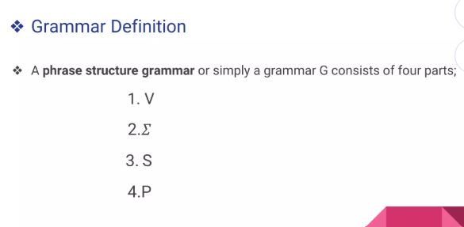
Grammar

Slide 48
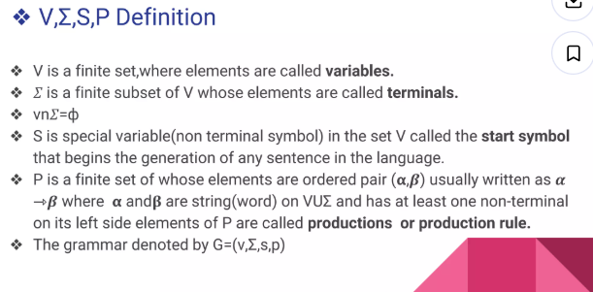
Grammar

Slide 49
Language of grammar
DefinitionLet G=(V,E,S,P) be a grammar then the language L(G)generated by G is the setof all strings of terminals which are derivable from the starting state S. That is> L(G)={w E E*,s *= w}The elements of L(G) are usually called sentences.

Slide 50
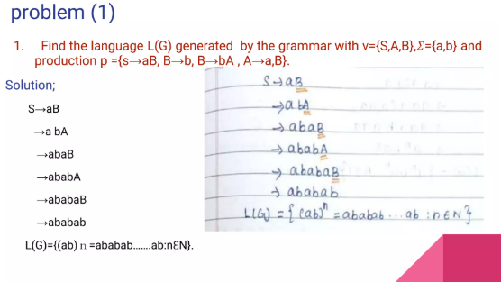
Language of grammar

Slide 51
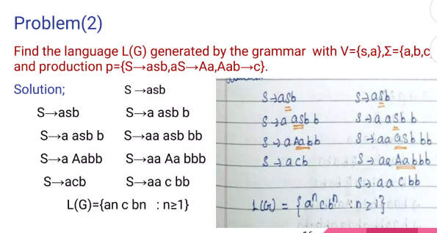
Language of grammar

Slide 52
Parser
“We have learned how to define a language using grammar.
But how does a computer actually use that grammar to
understand input?”
How does a compiler check syntax?
How does it know code is correct?
“This is done using something called a parser.”

Slide 53
What is a Parser?
“A parser checks whether an input string follows a given grammar.”
Input → string/code
Output → valid or error
“Parser = grammar checker for programs”

Slide 54
What is a Parser Generator?
“A parser generator is a tool that automatically creates a parser from a grammar.”
Examples:
ANTLR
YACC
“You give rules, tool gives you working code.”

Slide 55
Why Do We Need Parser Generators?
Writing parser manually is hard
Saves time
Reduces errors
Widely used in compilers
“Parser generators automate syntax checking.”
Grammar → Parser Generator → Parser → Input → Output

Slide 56
ANTLR
One popular parser generator is ANTLR, which we will study next.”
Example
Give very small grammar:S → aS | b
Parser checks strings like:
aab ✅
abb ❌

Slide 57
Real-Life Example
“When you write code in Java, the compiler uses a parser to check syntax.”
Example:
int a = 5; ✅
int = a 5; ❌

Slide 58
ANTLR
“ANTLR (Another Tool for Language Recognition) is a parser generator.”
Takes grammar as input
Generates parser code (Java, Python, etc.) “ANTLR converts grammar into working code.”

Slide 59
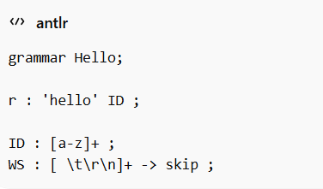
Structure of ANTLR Grammar

Slide 60
Structure of ANTLR Grammar
grammar Hello; → grammar
namer : 'hello' ID ; → rule (parser rule)
ID : [a-z]+ ; → token (lexer rule)
WS : ... -> skip ; → ignore spaces
“Small letters = parser rules, CAPITAL letters = tokens”

Slide 61
How ANTLR Works (Pipeline)
Grammar → ANTLR → Lexer + Parser → Input → Parse Tree
Lexer → breaks input into tokens
Parser → checks structure

Slide 62
Step 1: Write Grammar FileSave as: Hello.g4
🔸 Step 2: Run ANTLR
Example command:antlr4 Hello.g4
🔸 Step 3: Generated Files
ANTLRcreates:
HelloLexer.java
HelloParser.java
HelloListener.java.
🔸 Step 4: Compile & Run
javac *.java
grun Hello r -tree

Slide 63
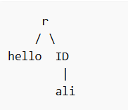
Understand Traversing Parse Tree
What is a Parse Tree?
“A parse tree shows how input is derived using grammar rules.”
Example:Input: hello ali
Tree:

Slide 64
What is Traversing?
“Traversing means visiting each node of the tree.”
going node by node
reading structure

Slide 65
Why Do We Traverse?
“We traverse the parse tree to actually do something with the input.”
Examples:
print values
evaluate expressions
check meaning
build AST

Slide 66
Two Approaches
Listener
Visitor
1. Listener (Easy Way)👉 Think like this:“ANTLR walks the tree automatically, and we just respond.”
2. Visitor (Control Way)👉 Think like this:“YOU walk the tree yourself.”

Slide 67
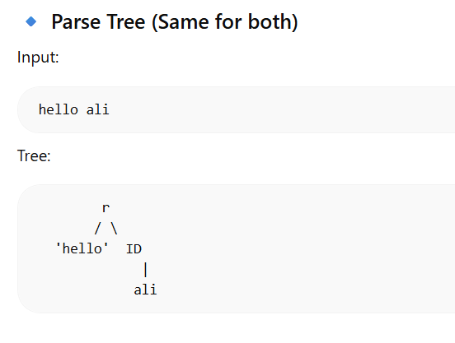
Two Approaches

Slide 68
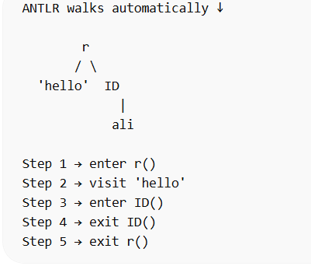
Listener (ANTLR Drives)

Slide 69
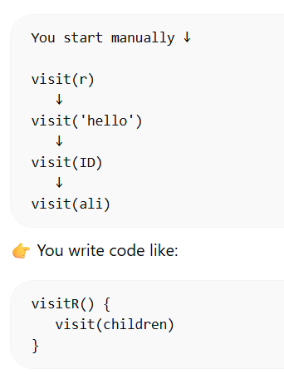
Visitor (YOU Drive)

Slide 70
Constructing an Abstract Syntax Tree (AST)
Parse Tree is:
too detailed
contains unnecessary nodes

Slide 71
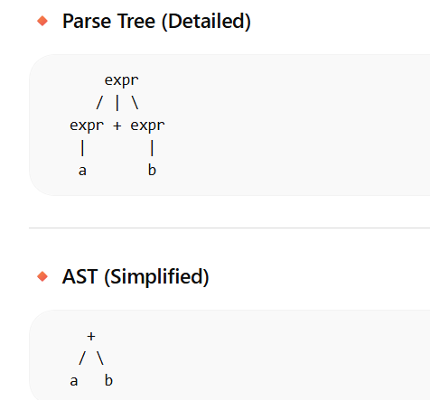
What is AST?
“AST is a simplified version of the parse tree that keeps only meaningful information.”
Expression:a + b

Slide 72
What is AST?
Expression:a + b

Slide 73
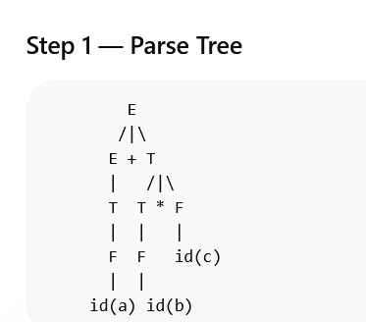
Example
a + b * c

Slide 74
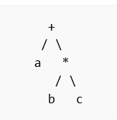
Example
a + b * c
AST TREE

Slide 75
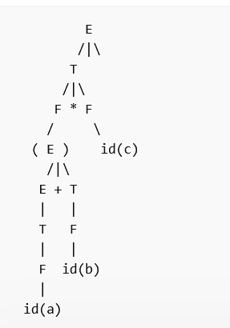
Example
(a + b) * c

Slide 76
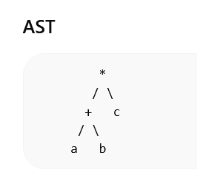
Example
(a + b) * c

Slide 77
What is AST?
“Visitor helps us convert parse tree into a meaningful structure (AST).”

Slide 78
Handling Errors
Step 1: Why Errors?
👉 Input may be wrong:
a + * b
👉 Parser must detect:
syntax error location

