Slide 1
SAR Ship Detection Pipeline
Cosmix The Boogiemen
An Explainable, Defended, Edge-Deployed Radar Target Protocol

Slide 2
The Challenge - Noise & Trust
SAR Imagery is notoriously noisy, saturated with speckle artifacts.
Small target obfuscation: Target ships blend into background ocean clutter.
"Black Box" Models: Operators cannot trust AI targeting blindly.
Network Vulnerability: Standard nets collapse when adversarial noise is injected.

Slide 3
Phase 1 & 2: MVP & GAN Data Engine
YOLOv8-nano detection core dynamically processes massive raw structures.
Programmatic translation of COCO JSON to normalized YOLO labels.
PyTorch Deep Convolutional GAN (DCGAN) synthesizes raw 64x64 footprints.
Seamless injection of synthesized chips perfectly stretches dataset fidelity.

Slide 4
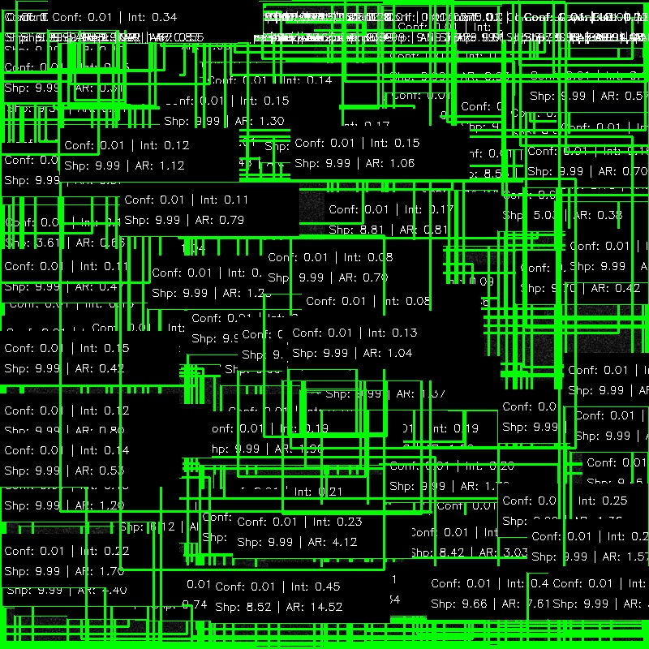
Phase 3: Concept-Based Explainability
Stripped away 'Black Box' nature to extract structural radar metrics (RCS & Laplacian Variance).

Slide 5
Phase 4: Zero-Server WebAssembly
Bypassed entire GPU clouds by flattening the neural architecture.
ONNX Graph: Converted best.pt into an agnostic standalone .onnx graph.
WebAssembly Runtime: onnxruntime-web execution exclusively via client CPU.
Sleek Glassmorphism HTML/JS frontend requiring purely zero backend logic.

Slide 6
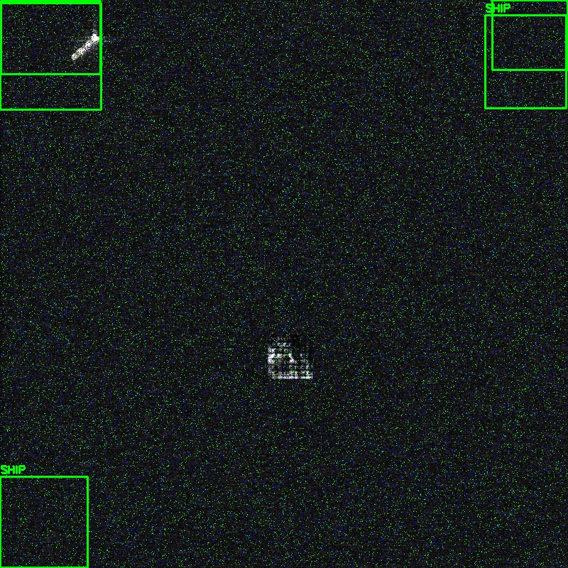
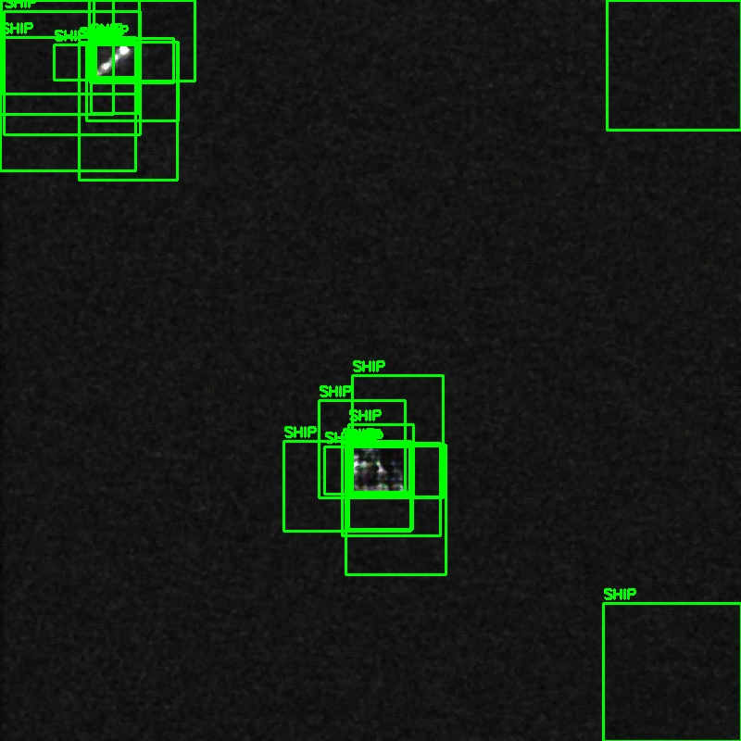
Phase 5: Adversarial Defense
Spatial protective shield restoring network failure via adaptive defense filtering.

Slide 7
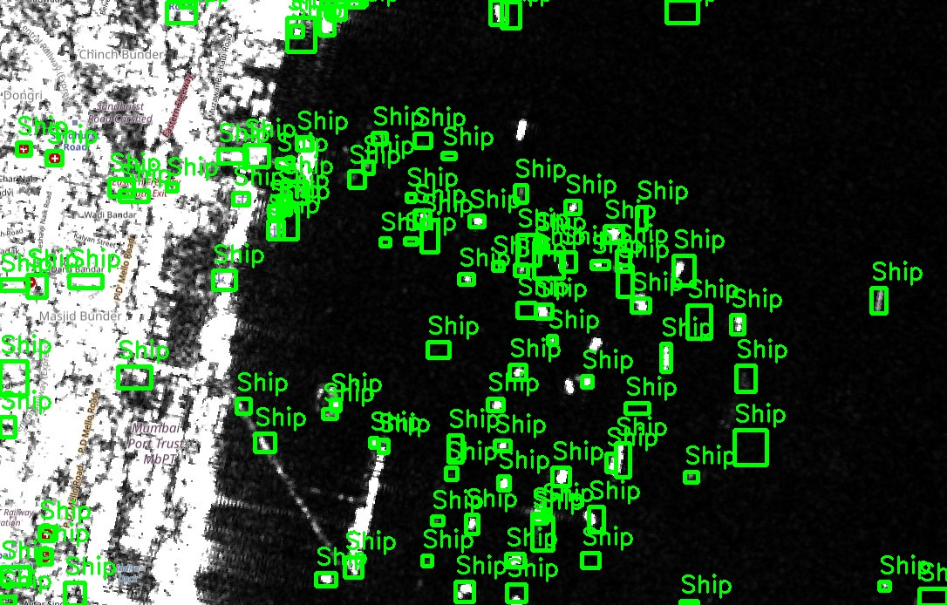
Phase 6: Sentinel Scale Inference
800x800 tiling sliding windows scaling dynamically across multi-gigapixel satellite matrices.

Slide 8
Mission Accomplished 🚀
Pipeline fully mapped, defended, and edge-deployed.
Live interactive interface available on our GitHub Pages Repository.
Thank You!
Cosmix The Boogiemen

