Slide 1

Play Experience Enhancement Using Emotional Feedback
Faham Negini
Thesis Defense – September 2014

Slide 2
Human Emotion and Video Games
Notes:
Emotions, is one of still mysterious aspects of human being. There are still many unanswered questions related to emotions and their properties.
Video games on the other can bring about a virtual world that enables us to experience various feelings.
For a video game, being aware of players emotional state, is a huge achievement. Because it can better accomplish its mission to change the affect state of the player.

Slide 3
Problems
Accessing Player’s Affect State In Real-Time
How to React to Player’s Affective Changes

Slide 4
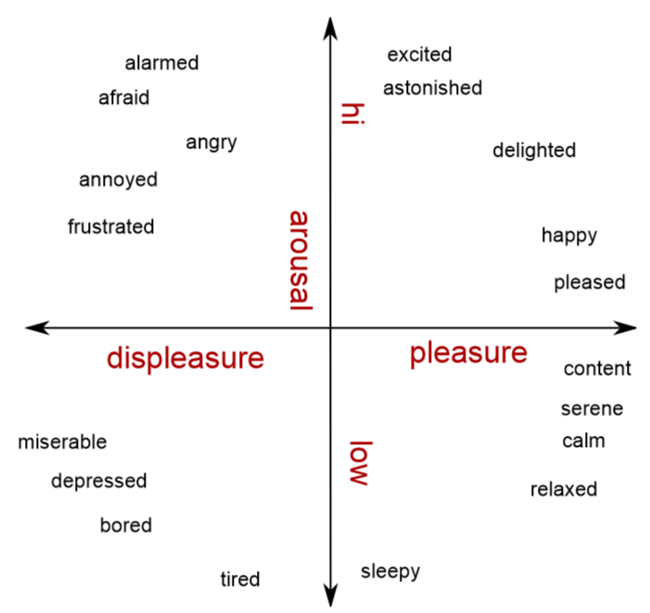
Accessing Player’s Affect State
Basic Emotion Theory (Discrete Categories)
Continuous Dimensions

Slide 5
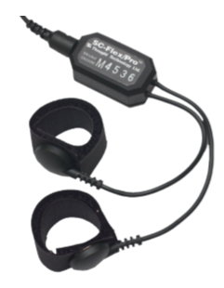
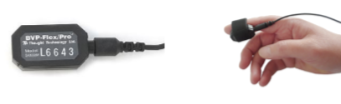

Measuring Affect State
Self-Report
Intrinsic Motivation Inventory
Player Experience of Need Satisfaction
Self-Assessment-Manikin Arousal Scales
Physiological Measures
Galvanic Skin Response
Heart Rate
Facial Electromyography
Notes:
- Self-report has been always subject to doubt for being not accurate specially for low intensity emotions, and also based upon natural differences between individual inferences of same questions. But studies have shown in many cases self-report can correctly reflect changes in emotional state.
- Changes in GSR is even noticeable for low intensity affect state changes.
- Heart rate and HR variability are two other useful measures for real-time uses
- Facial EMG requires pattern matching not very much appropriate for real time uses

Slide 6
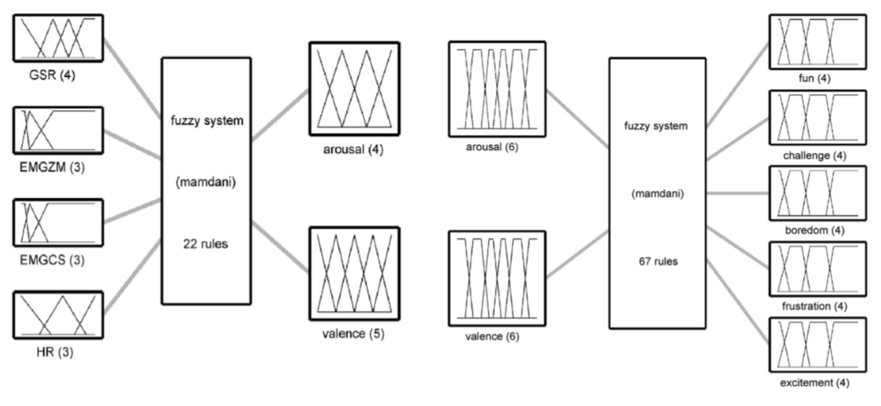
Transforming Physiological Signals into AV Space and then Player-Centric Aﬀective States
Notes:
2 passes of fuzzy transformations using Membership functions made of experimentally developed fuzzy rules.

Slide 7
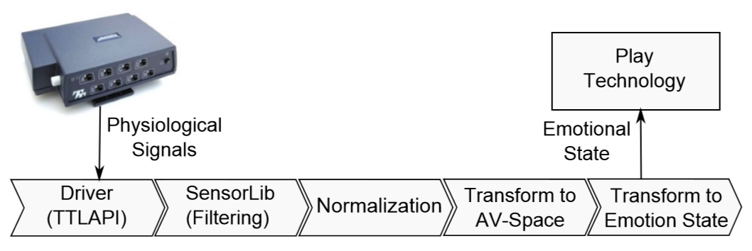
Affect Middleware Engine Modules
Notes:
- Sensor lib developed in hci lab
- Fuzzification phases happens by dot fuzzy library

Slide 8
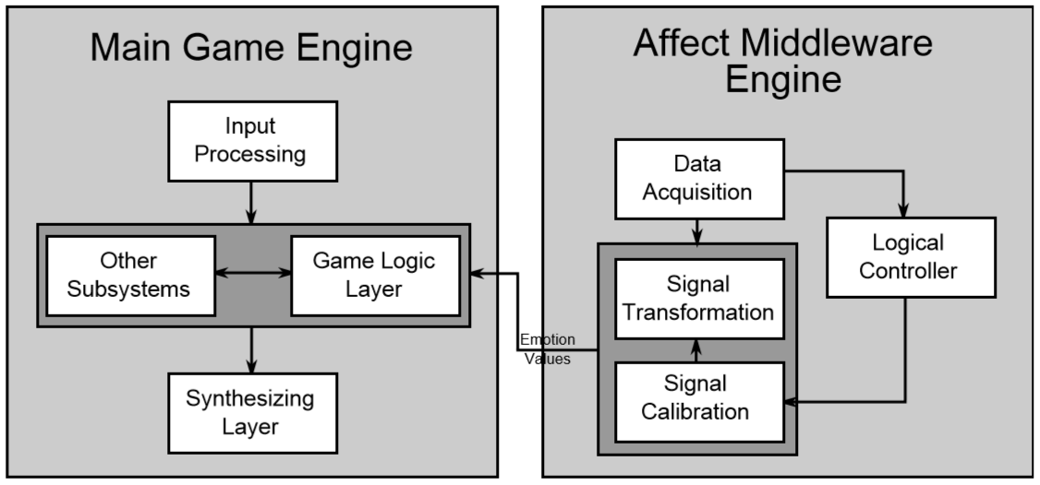
Emotion Adaptive Game System Design
Notes:
This picture actually sums up all which is happening
The right part of our game system design, tries to solve the first problem of accessing affect state of the player
And the left part tries to find an answer to the second problem, which is how to respond to a certain change in player’s affect state

Slide 9
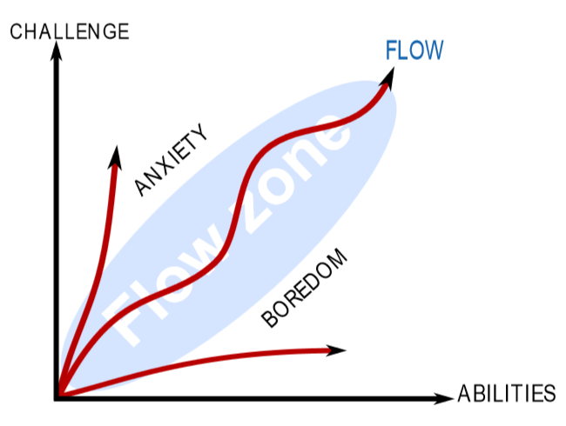
Gameplay, Game Challenges and Flow Zone
Notes:
- In computer games, gameplay is usually considered of key importance. It can be deﬁned as the pattern deﬁned through the game rules. it is usually not a singular entity, and can consist of many diﬀerent elements.
- A good Game Play to create the sense of fun is usually related to challenges.
- Concept of flow coming from psychology identifies challenges and skill as the major factor in feeling flow
- These results from the two different disciplines of psychology and games shows we are on the right track
- So the flow zone theory is totally in compliance with what we need to stay in the fun zone of game play.
- And it leaded us to focus on Arousal more than anything else which is best reflected by the GSR sensor.

Slide 10
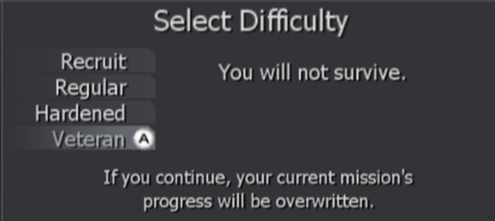
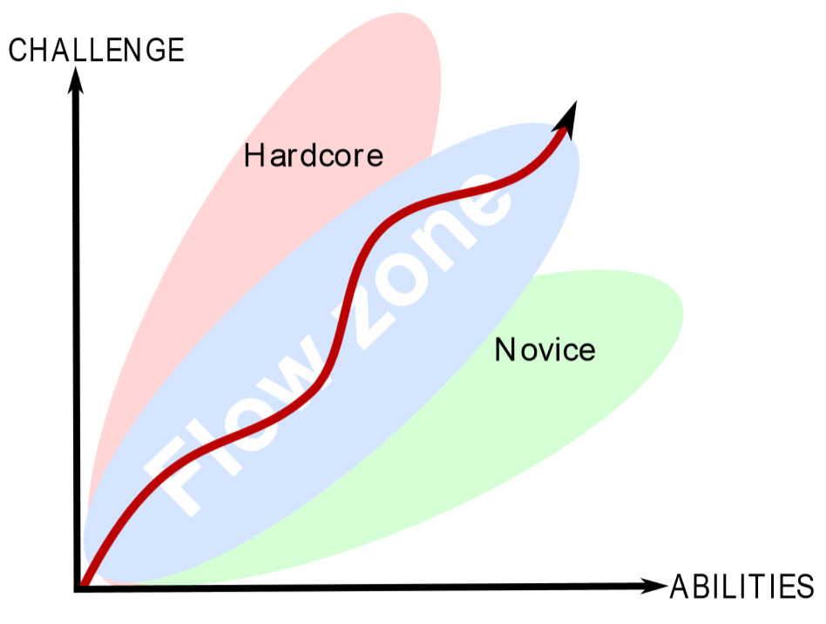
Game Balancing (Dynamic vs. Static)
Notes:
- The process of adjusting various game elements to achieve a better game play is referred to as Game balancing.
In many cases game difficulty referring to challenges level is used synonymous to game balancing.
Static game balancing, lies in manually preset game design elements
Dynamic game balancing, usually happens through in-game performance measures, and more sophisticated AI.
In contrast to the two above we introduce affective game balancing

Slide 11
Design Probe
Components
Affect Sensing
Game Environment
Experience Evaluator
Adaptation Strategies
Player
NPC
Environment
Notes:
- Affect sensing is integrated with Game environment through a logical unit defined in the game engine called The Director
Experience Evaluator consists of recording: physiological signals, major game events like dying or killing a zombie, and finally experience surveys.

Slide 12
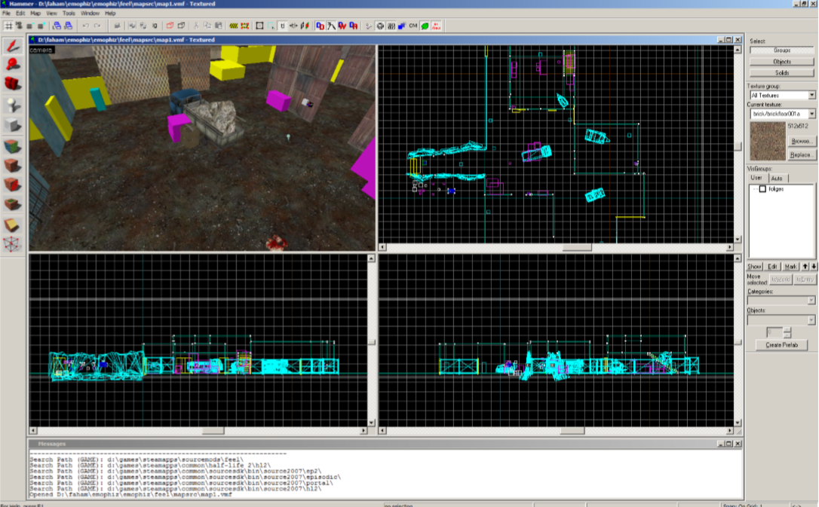
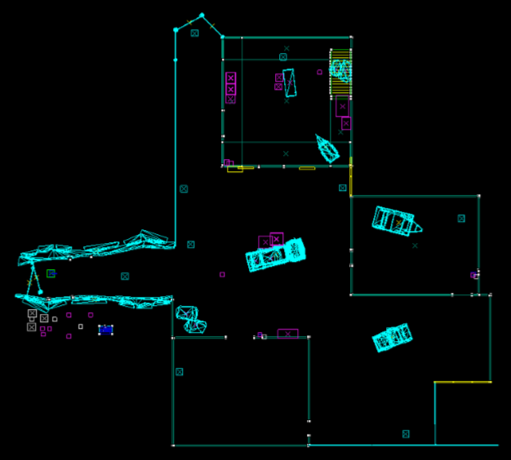
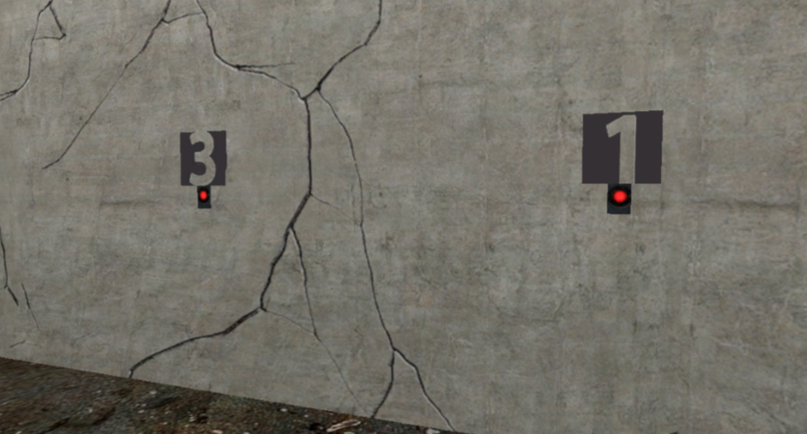



Game Environment
Notes:
- Levels layout from above, developed using the hammer level editor
- Game environment we developed is a zombie survival mode, with infinite ammo. So player need to survive waves of zombies coming as long as they can.
- The game can be played in four conditions: control, Player, NPC and Environment

Slide 13
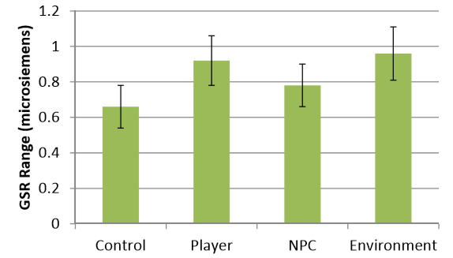
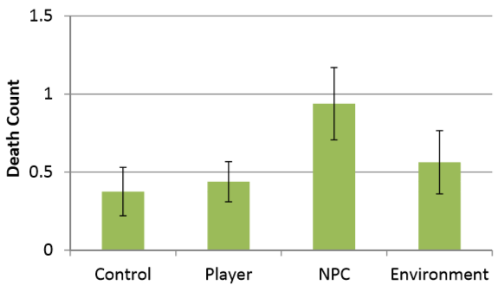
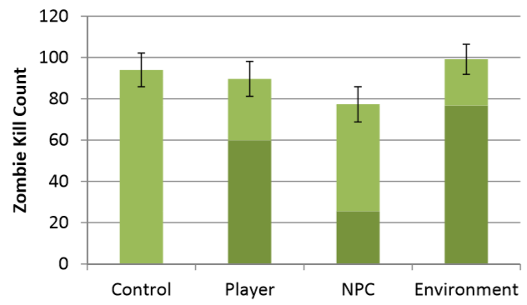
Results
Adaptation
Performance
Experience
Notes:
A Repeated Measure-ANOVA was conducted with condition (Control, Player, NPC, Environment) as a within-subjects factor on all dependent measures
The results showed that GSR Mean (Experience) was higher when I adapted the game.
The Range of GSR (dependent variable) was higher in the Environment and Player conditions. It means player could better stay in the flow zone in contrast to the default condition
Adapting the NPC resulted in fewer kills (particularly during positive adaptation) more deaths, and reduced competence and enjoyment.
Finally, the environmental manipulations were least noticed, whereas adaptations made to the player were most noticed.

Slide 14
Contributions
AME, a software framework to sense player affective state in real-time
Deployment of a reduced version of AME in a custom level of Half-Life 2
Systematically exploring different game adaptation strategies (Player, NPC, and Environment)

Slide 15
Limitations and Future Works
Notes:
The number of participants
I investigated the adaptation in a single game genre (FPS game) with speciﬁc approaches (e.g., manipulating speed and weapons). Investigating whether my results hold in a different genre or with different adaptation choices would help to generalize my ﬁndings
--------
Dynamic Fuzzy Membership Functions Determination
More Advanced Strategies to Calibrate Player’s Signal in Real-Time

Slide 16
Questions

