Slide 1
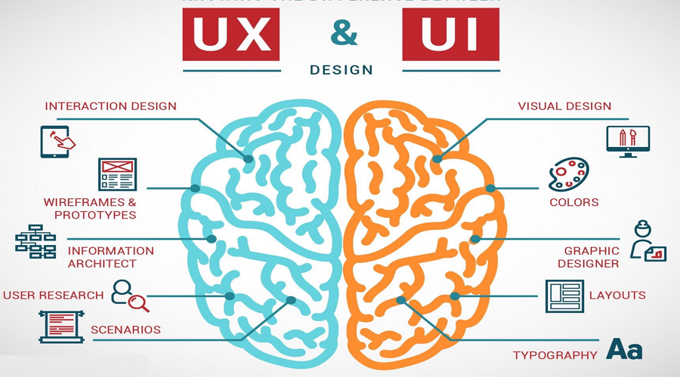
UI/ UX Design Basics

Slide 2
UI AND UX
UX refers to the term User Experience while UI stands for User Interface. But despite their closeness, there are lot more to their execution process and design discipline.

Slide 3
UX design relates to the overall user interaction and experience with an application or a website. It is well known that great user experience results in return customers and great app usage.
Typically, the UX Design process include research, design, prototyping, testing and measurement. Lot of factors influence UX process such as usability, utility, accessibility, design/aesthetics, performance, ergonomics, overall human interaction and marketing.

Slide 4
On the other hand, User Interface (UI) is more about visual design and information design around screens. Though a lot of process go into this graphical element, UI as the name implies, about the things the user will actually see and interact. It delivers tangible results and focuses on how an app or product surface look and functions.

Slide 6


Slide 7
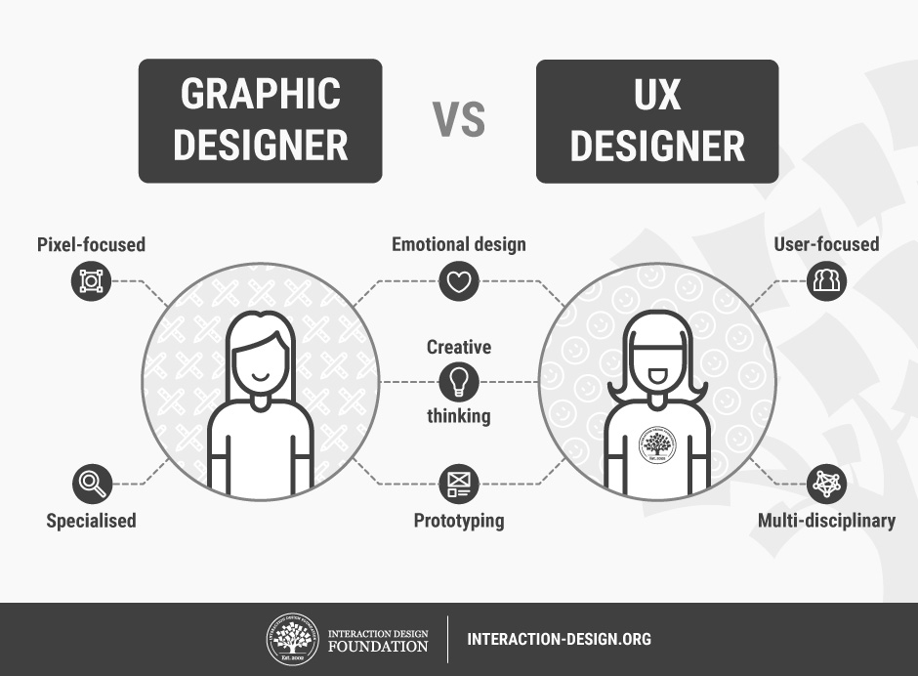

Slide 8
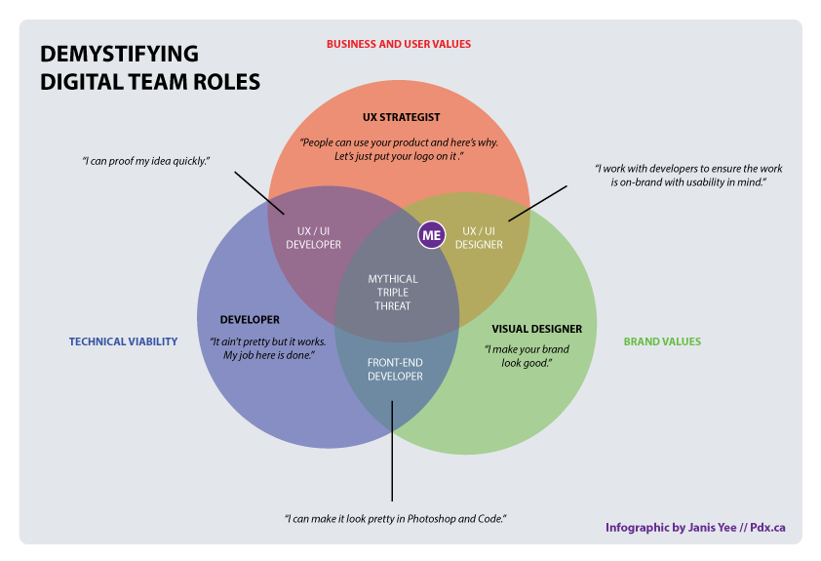

Slide 9
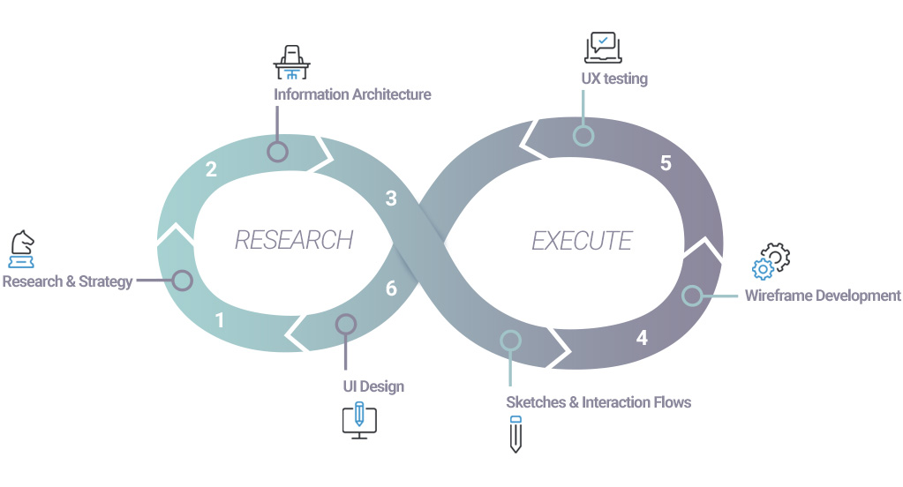

Slide 10
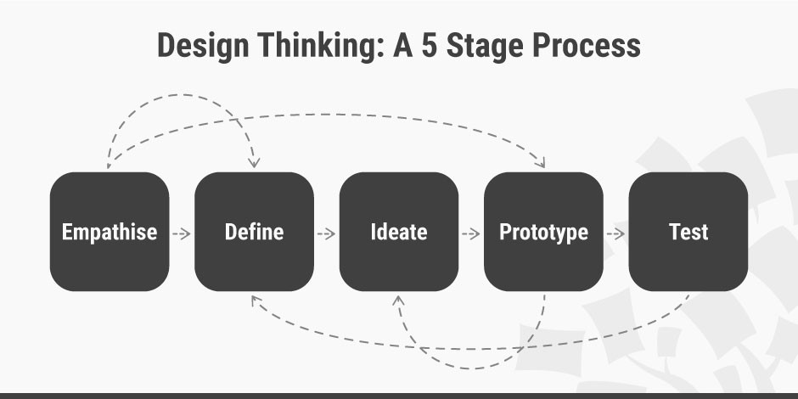

Slide 11
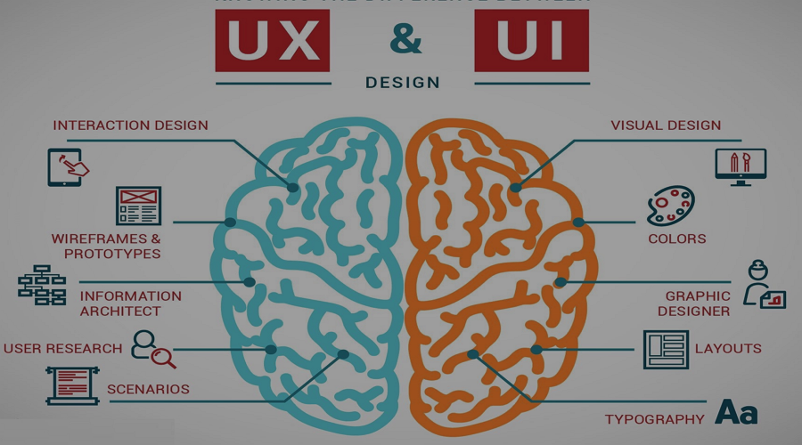
User Interface Design
Part I

Slide 12
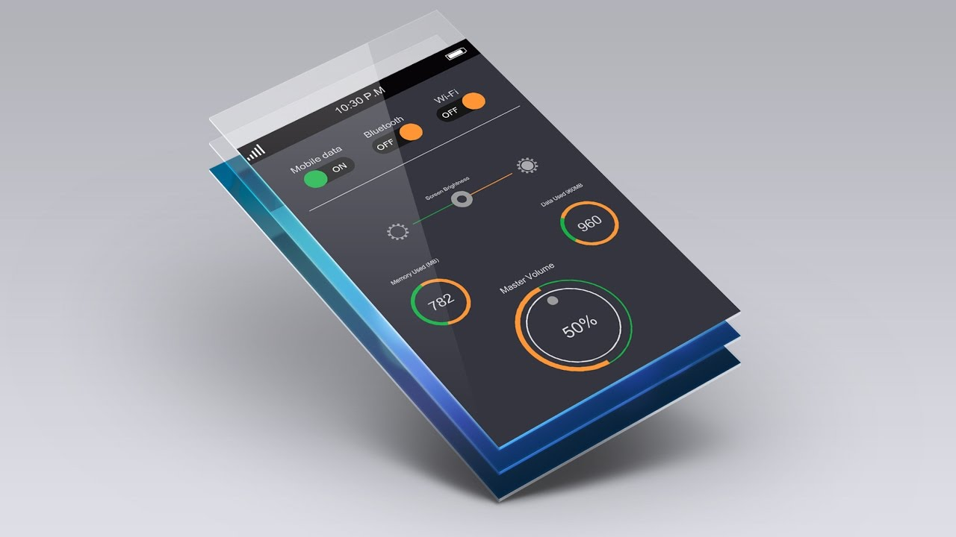
UI Design Basics
Section 1

Slide 13
Introduction
User Interface (UI) Design focuses on:
Anticipating what users might need to do and
Ensuring that the interface has elements that are easy to access, understand, and use to facilitate those actions.
UI brings together concepts from:
Interaction Design
Visual Design and
Information Architecture

Slide 14
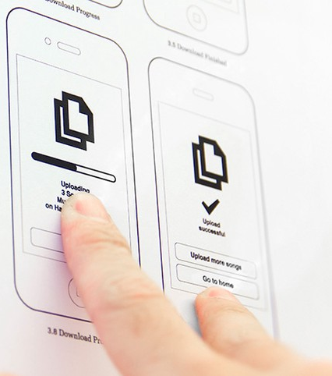
1. Interaction Design
Interaction design is an important component within the giant umbrella of user experience (UX) design.
- Interaction design focuses on creating engaging interfaces with well thought out behaviors.
- Understanding how users and technology communicate with each other is fundamental to this field.
- With this understanding, you can anticipate how someone might interact with the system, fix problems early, as well as invent new ways of doing things.

Slide 15
Best Practices for Designing Interactions
Consider these qualities and associated questions when creating digital products that have an interactive element:
Questions to Consider when Designing for Interaction
  Define How Users Can Interact with the Interface
  Give Users Clues about Behavior before Actions are Taken
  Anticipate and Mitigate Errors
  Consider System Feedback and Response Time
  Strategically Think about Each Elements
  Simplify for Learnability

Slide 16
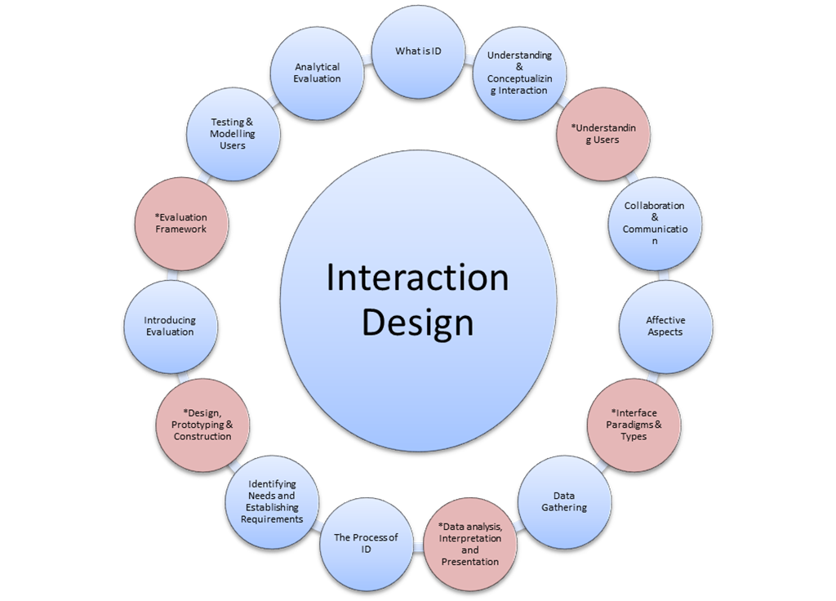

Slide 17
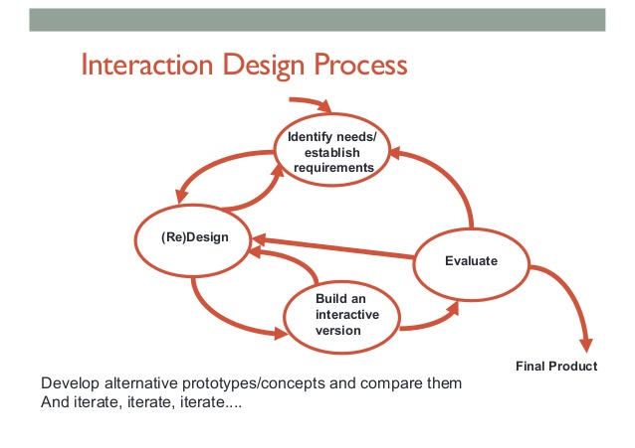

Slide 18
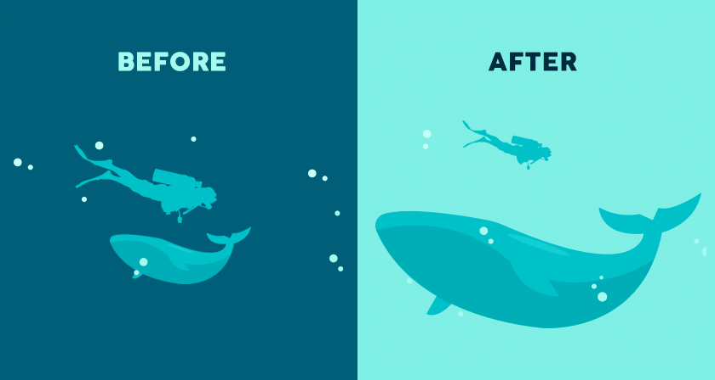
2. Visual Design
Visual design focuses on the aesthetics of a site and its related materials by strategically implementing images, colors, fonts, and other elements.
A successful visual design does not take away from the content on the page or function.
Instead, it enhances it by engaging users and helping to build trust and interest in the brand.

Slide 19
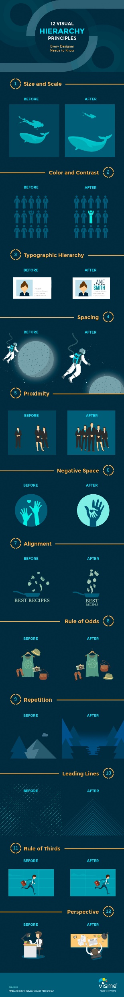
12 Visual Hierarchy Principles

Slide 20
12 Visual Hierarchy Principles…

Slide 21

12 Visual Hierarchy Principles…

Slide 22
12 Visual Hierarchy Principles…

Slide 23
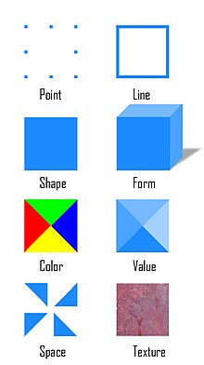
Basic Elements of Visual Design
The basic elements that combine to create visual designs include the following:
Lines
Shapes
Color
Texture
Typography
Form

Slide 24
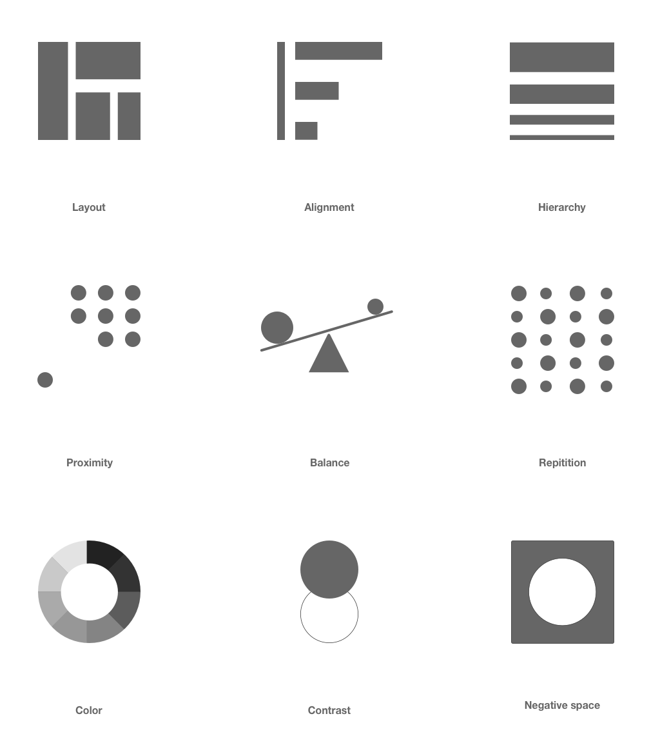
Principles for Creating a Visual Design
A successful visual design applies the following principles to elements noted above and effectively brings them together in a way that makes sense. When trying to figure out how to use the basic elements consider:
  Unity
  Gestalt
  Space
  Hierarchy
  Balance
  Contrast
  Scale
  Dominance
  Similarity

Slide 25
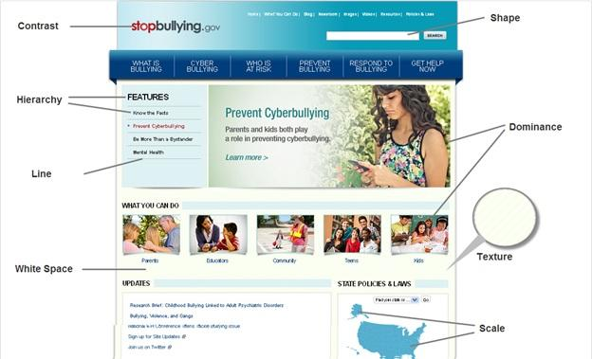
Example of Putting it all together

Slide 26
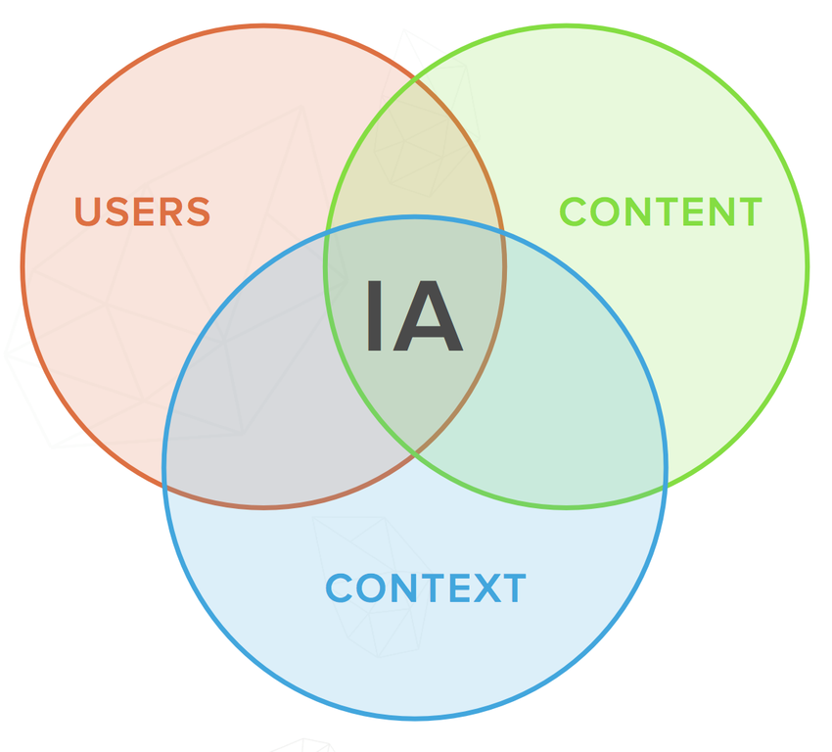
3. Information Architecture
Information architecture (IA) focuses on organizing, structuring, and labeling content in an effective and sustainable way.
The goal is to help users find information and complete tasks.
To do this, you need to understand how the pieces fit together to create the larger picture, how items relate to each other within the system.
Why a Well Thought Out IA Matters
The purpose of your IA is to help users understand where they are, what they’ve found, what’s around, and what to expect.

Slide 27
3. Information Architecture
Why a Well Thought Out IA Matters
The purpose of your IA is to help users understand:
where they are
what they’ve found
what’s around and
what to expect

Slide 28
What You Need to Know
To be successful, you need a diverse understanding of industry standards for creating, storing, accessing and presenting information.
The main components of IA:
Organization Schemes and Structures: How you categorize and structure information
Labeling Systems: How you represent information
Navigation Systems: How users browse or move through information
Search Systems: How users look for information

Slide 29
Interesting, right?
This is just a sneak preview of the full presentation. We hope you like it

