Slide 1


Egyptian Space Agency
EUTS Project - Summer Training
Pilot of Project <<T39>>
Project Name:
Power Subsystem Software & CTE
University Name: Sohag University
Faculty: Engineering
Department: Electronics and Communications

Slide 2
Egyptian Space Agency
EUTS Project - Summer Training
Power Subsystem Software & CTE
By
Team Names
Fahd Badi Abdelhamed
Maha Mohammed Seddik
Ibrahim Abu Elabbas Kenawy
Hussein Khaled Mawas
Ahmed Atef Mohamed
Walaa Salah Saber
Mohamed ElSayed Mohamed
Kerollos Mata Shokry
Under Supervision of
Eng./ Dr.
Shimaa Soltan

Slide 3
Egyptian Space Agency
EUTS Project - Summer Training
Power Subsystem Software & CTE
1- Project Scope
2- Project Requirements
3- Working plane
4- Design
5- Challenges
6- Earned lessons

Slide 4
Egyptian Space Agency
EUTS Project - Summer Training
Power Subsystem Software & CTE
1- Project Scope
Implement a part of power subsystem design.
Teach what is power subsystem function, Learn
Labview, Arduino, serial communication protocol, and
interaction between OBC and Power subsystem.

Slide 5
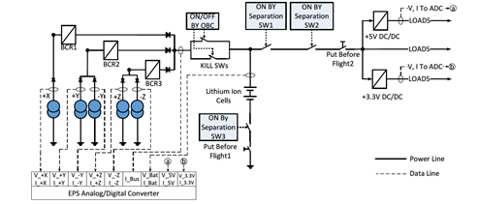
Egyptian Space Agency
EUTS Project - Summer Training
Power Subsystem Software & CTE
Block Diagram of EPS Subsystem

Slide 6
Egyptian Space Agency
EUTS Project - Summer Training
Power Subsystem Software & CTE
2- Project Requirements
Required Knowledge:
-Knowledge in Arduino IDE
-Knowledge in Proteus
-Knowledge in Labview
Required Output :
Implantation of the required interface and response from EPS to the OBC. This is using Arduino board and an embedded code. Implementation of Labview code that simulates interface between EPS and OBC.

Slide 7
Egyptian Space Agency
EUTS Project - Summer Training
Power Subsystem Software & CTE
3- Working plane
Testing each sensor separately.
Building the microcontroller circuit and getting sensor values.
Converting decimal values into hexadecimal.
Packing and unpacking the data frame.
Reading the frame on LabView which converts these values into numbers.
Saving these results in a text file on the PC.

Slide 8
Egyptian Space Agency
EUTS Project - Summer Training
Power Subsystem Software & CTE
4- Design
Block Diagram of EPS subsystem

Slide 9
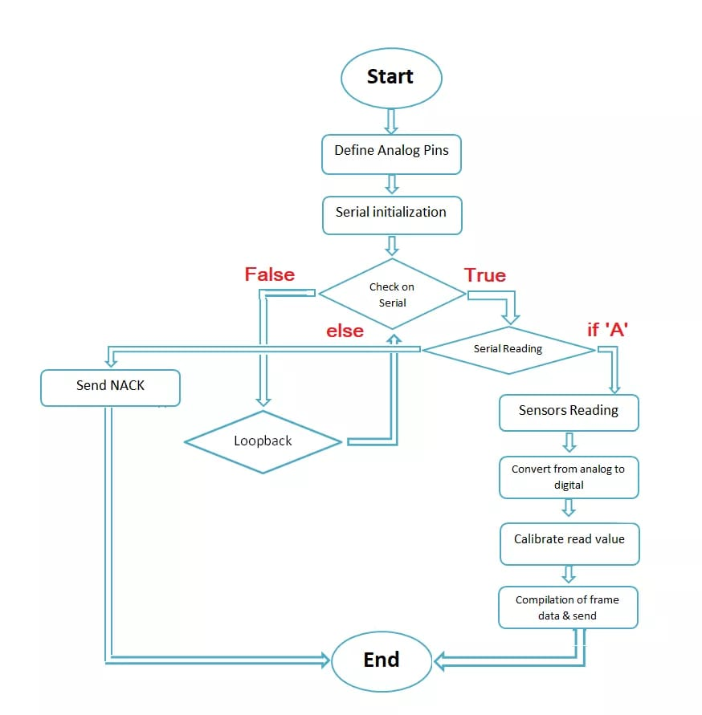
Egyptian Space Agency
EUTS Project - Summer Training
EPS Programming Flowchart
Power Subsystem Software & CTE

Slide 10


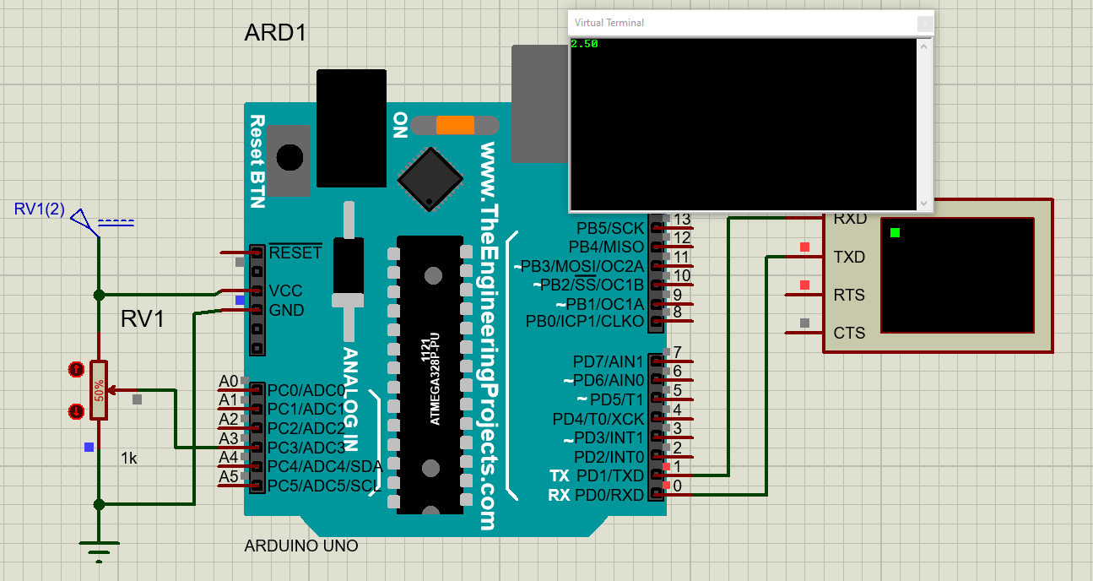
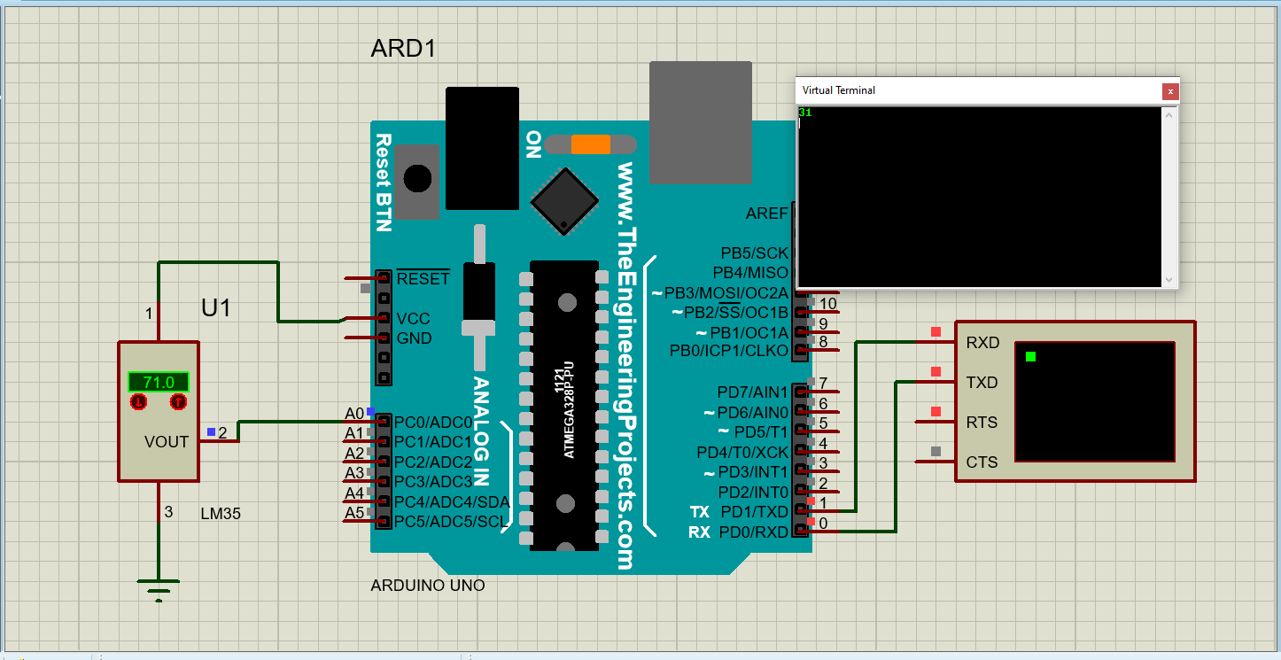
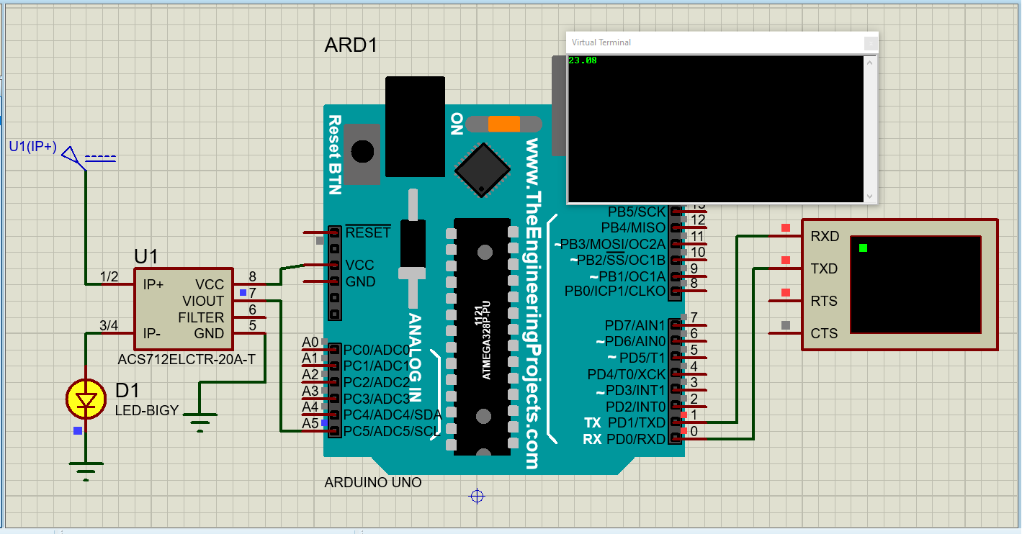
Egyptian Space Agency
EUTS Project - Summer Training
Power Subsystem Software & CTE
Output of each sensor separately on Proteus

Slide 11
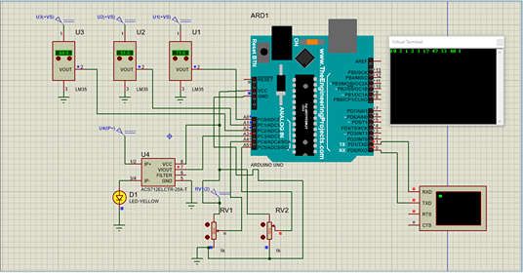
Egyptian Space Agency
EUTS Project - Summer Training
Power Subsystem Software & CTE
Complete circuit configuration and transmission frame
in receiving right command on Proteus

Slide 12

Egyptian Space Agency
EUTS Project - Summer Training
Power Subsystem Software & CTE
Output of the wrong command on Proteus

Slide 13
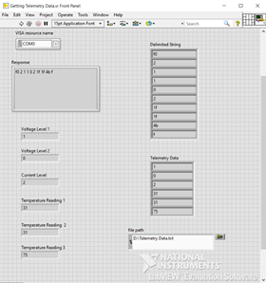
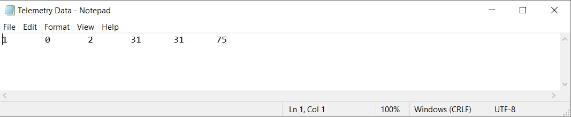
Egyptian Space Agency
EUTS Project - Summer Training
Power Subsystem Software & CTE
Labview GUI

Slide 14
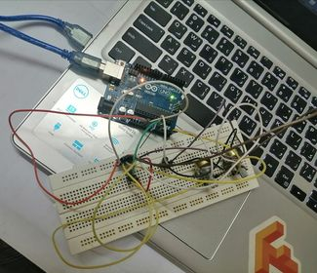
Egyptian Space Agency
EUTS Project - Summer Training
Power Subsystem Software & CTE
5- Challenges
No previous knowledge in Labview
The connection between Labview and Proteus,
so we replace Proteus (software circuit) by Arduino Uno and sensors (hardware circuit) as shown in this figure.

Slide 15
Egyptian Space Agency
EUTS Project - Summer Training
Power Subsystem Software & CTE
6- Earned lessons
We learned how to use Labview for the first time.
Approaching the datasheet on any electric component.
We learned how to receive serial data from Arduino, show and processing them, then save results in a text file in PC.
The experience of documentation and trying to display our work in the best way.

Slide 16
Egyptian Space Agency
EUTS Project - Summer Training
Power Subsystem Software & CTE
Thank You !

