Slide 1


Pro-File viewer
File Metadata Analyzer
SINDH MADARESSATUL ISLAM UNIVERSITY
Supervisor: Mr. ZubairUddin Shaikh

Slide 2
MetaTrackr – File Metadata Analyzer
Fahad Ahmed (BSE-21F-090)
Muhammad Maaz (BSE-21F-094)
Muhammad Siddiqui (BSE-21F-098)

Slide 3


Overview of the Application
It is a Python-based desktop application designed to help users view, analyze, sort, and export metadata of files within a selected folder. The application allows the user:
Sorting by file attributes (size, type, date)
Exporting the data to a CSV file
Visualizing the data using pia chart

Slide 4
Importance of File Management
File management is a key part of working with digital data. It is important for both individuals and organizations because it keeps files organized, saves time, and protects important information.
Why is File Management Important?
📂 Easy to find files
💾 Saves storage space
⏱️ Saves time
🔐 Protects important data
👨‍💻 Improves your work

Slide 5

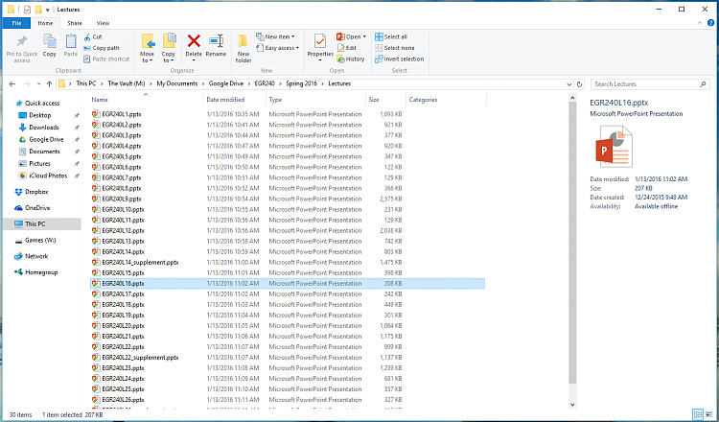
Problem Statement
Many users face difficulty when trying to view or understand the detailed information (metadata) of files stored in a folder. Windows
Explorer and similar file managers provide only basic views with limited control.
There is no built-in or user-friendly tool that allows:
Sorting files by size, type, or date modified
Visualizing file data using charts or graphs
Exporting metadata to formats like CSV for reporting or analysis

Slide 6
objectives
Automate folder metadata extraction
Provide sorting and filtering options
Enable CSV export for reporting
It allows users to see how different file types are using disk space.
Make the tool user-friendly with GUI

Slide 7


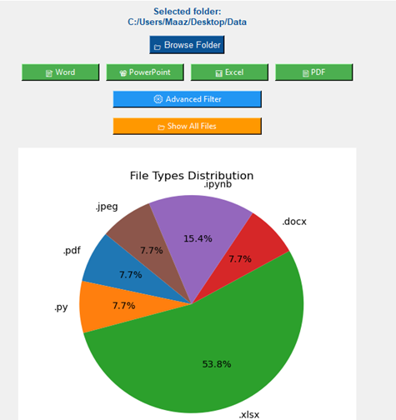




System Architecture
MetaTrackr – File Metadata Analyzer
Selected folder: C:/Users/Maaz/Desktop/Data
Buttons to filter files by type: Word, PowerPoint, Excel, PDF
dvanced Filter" and "Show All Files" options available
Visual summary helps users understand folder contents quickly
Pie chart shows file type distribution in the folder
.xlsx files are the most common (53.8%)

Slide 8
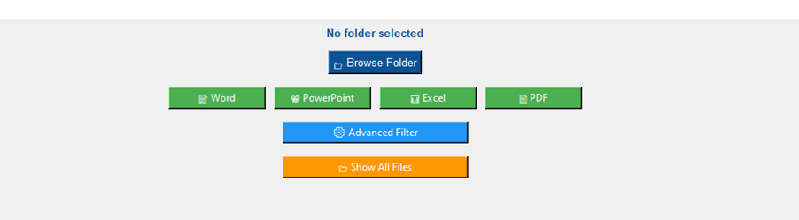
Home Screen
MetaTrackr – File Metadata Analyzer
dvanced Filter" and "Show All Files" options available
word
Powerpoint
Excel
PDF
Advance Filter
Show All Files

Slide 9
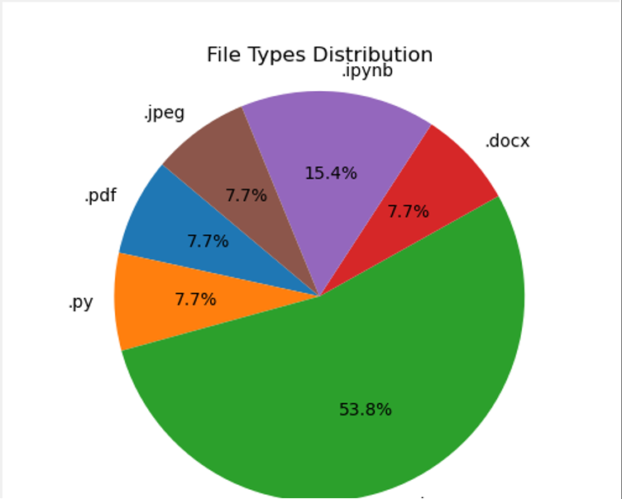
Home Screen
MetaTrackr – File Metadata Analyzer
Pie charts provide a quick overview of data distribution
It allows users to see how different file types are using disk space.
Very user friendly easy to understand, even for non-technical users
Useful for identifying dominant file types

Slide 10
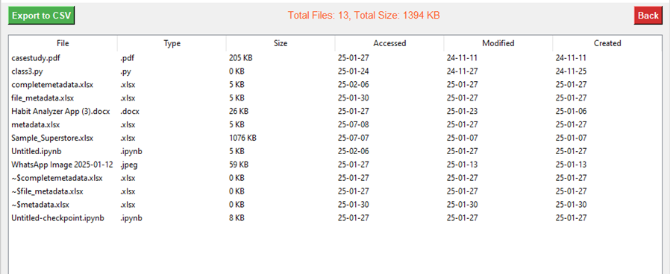
MetaTrackr – File Metadata Analyzer
Show All Files
Advance Filter

Slide 11
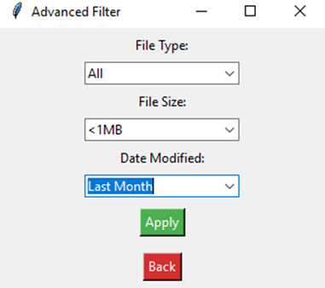
MetaTrackr – File Metadata Analyzer
Advance Filter

Slide 12
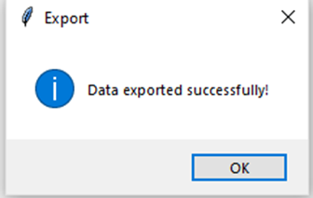
MetaTrackr – File Metadata Analyzer
Export To CSV

Slide 13


Tech Stack
Language: Python
Tkinter – GUI development for the desktop application
os – Folder selection and file metadata extraction
collections.Counter – Counting and grouping file types
matplotlib – Creating and displaying pie charts
datetime – Handling file creation and modification dates
pandas – Exporting data to CSV

Slide 14
Challenges Faced
Handling large folders with many files
Dealing with file permission errors
Maintaining GUI responsiveness during processing

Slide 15
Future Enhancements
Add file preview
Integrate PDF/Docx content summaries
Generate charts/graphs for file stats
Convert to cross-platform app with Electron or PyInstaller

Slide 16
Conclusion:
Successfully created a working tool that:
Saves time
Provides insights
Simplifies folder analysis
Demonstrates real-world utility of Python scripting

Slide 17
THANKYOU
Q/A

