Slide 1
Relational Databases (RDBMS):
MySQL, PostgreSQL, SQL Server
Created by: Fahd Jerbi

Slide 2
MySQL
MySQL is a database system used on the web and runs on a server, The data in a MySQL database are stored in tables. A table is a collection of related data, and it consists of columns and rows.
MySQL is ideal for both small and large applications
MySQL is very fast, reliable, and easy to use
MySQL uses standard SQL
MySQL compiles on a number of platforms
MySQL is free to download and use
MySQL is developed, distributed, and supported by Oracle Corporation

Slide 3
PostgreSQL
PostgreSQL is a powerful, open source object-relational database system that uses and extends the SQL language combined with many features that safely store and scale the most complicated data workloads.
PostgreSQL is highly extensible. For example, you can define your own data types, build out custom functions, even write code from different programming languages without recompiling your database.
It is a highly stable database management system.
PostgreSQL is used as the primary data store or data warehouse for many web, mobile, geospatial, and analytics applications

Slide 4
SQL SERVER
SQL Server is a RDMS developed by Microsoft. As a database server it is a software product with the primary function of storing and retrieving data as requested by other software applications.
Similar to other RDBMS software, SQL Server is built on top of SQL, a standard programming language for interacting with the relational databases.
SQL server is tied to Transact-SQL, or T-SQL, the Microsoft’s implementation of SQL that adds a set of proprietary programming constructs.
SQL Server is ensuring the security of your database.
SQL Server installation and configuration of Microsoft SQL Server are easier

Slide 5
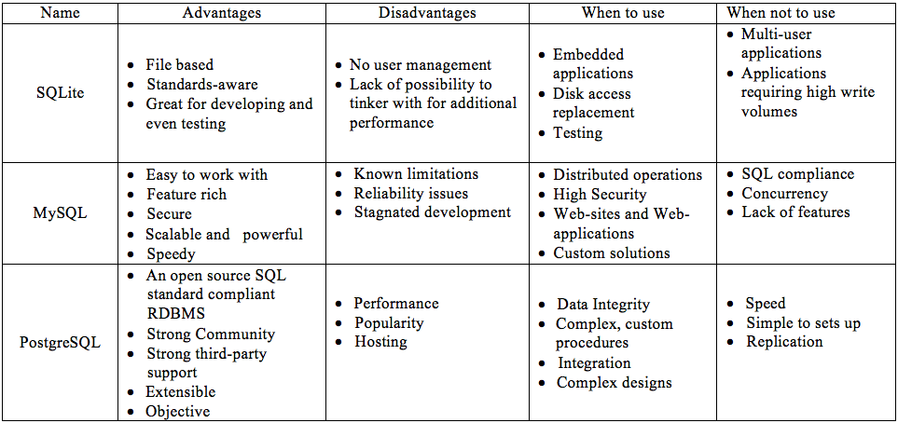
comparison between the three RDBMS

